Slide 1
http://upload.wikimedia.org/wikipedia/commons/c/cc/PWR_nuclear_power_plant_animation.ogv

Slide 2
Nuclear Power
Economics
Safety (“passive”)
Spent Fuel / Waste disposal

Slide 3
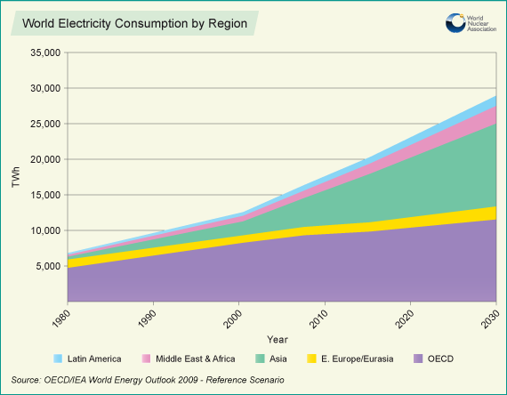

Slide 4
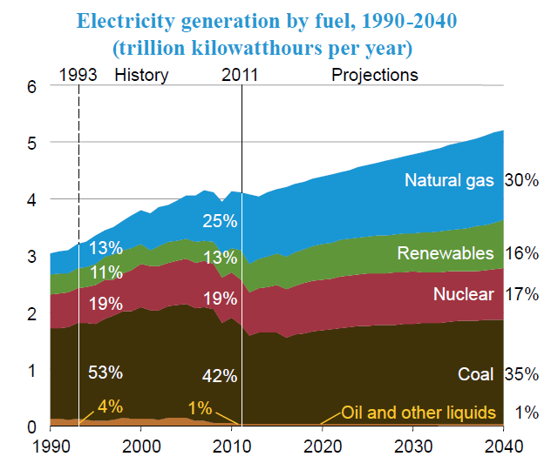

Slide 5
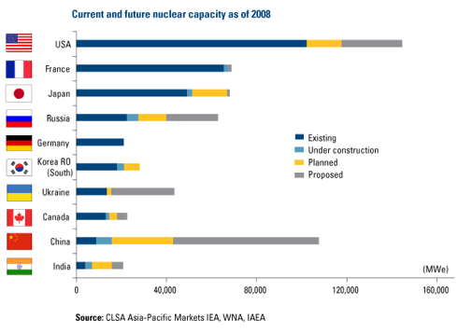

Slide 6
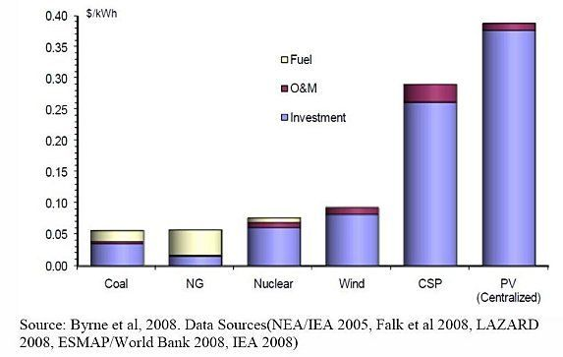

Slide 7
Overnight Capital and Levelized Cost of Electricity Generation from Nuclear
Overnight Capital Cost
EM² built in US | $4500 / kWe
ALWR built in US | $7700 / kWe
EM² built in China | $3000 / kWe
Cost of electricity
2012 dollars per MWh
EM²
EM²
*
* Using Chinese vs. U.S. nuclear power cost ratio from “Projected Costs of Generating Electricity” OECD Rev. June 2010

Slide 8
Nuclear Power
Economics
Safety (“passive”)
Spent Fuel / Waste disposal

Slide 9
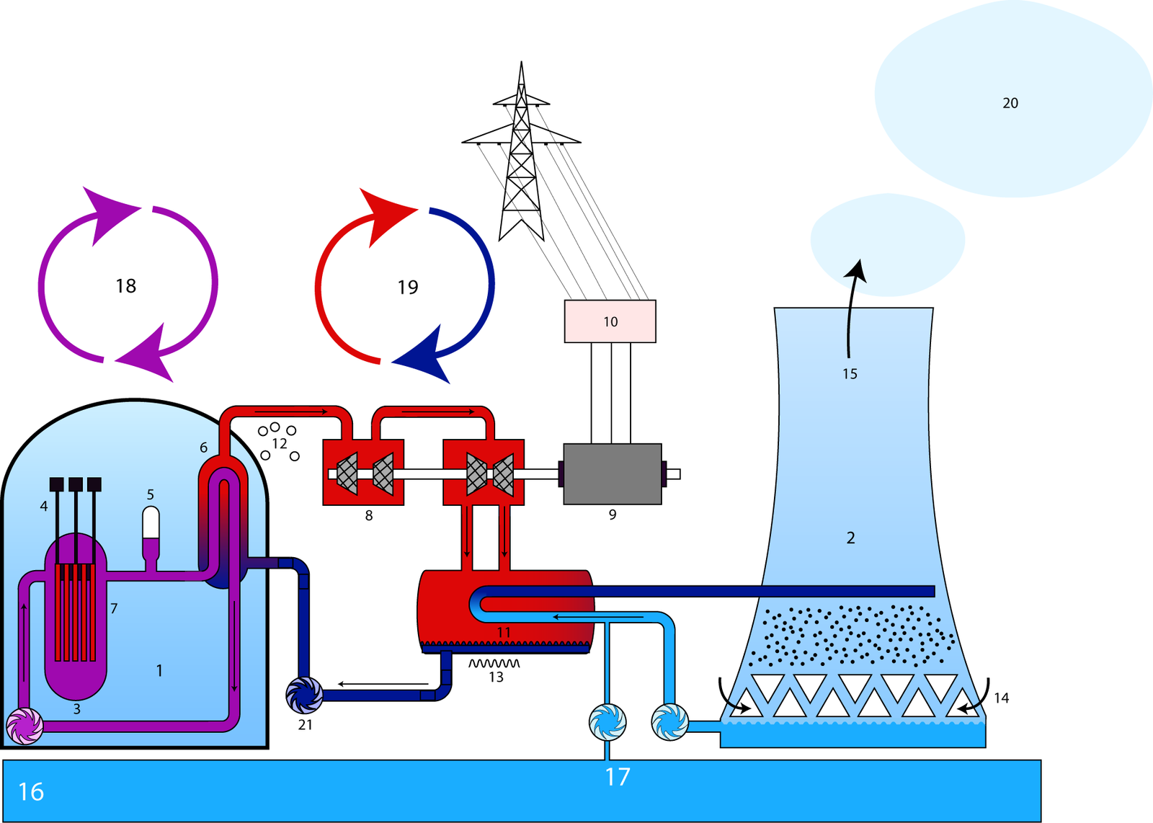

Slide 10
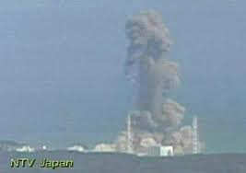
SiC-SiC Composite Cladding has Potential to Significantly Improve Safety of Light Water Reactors
Fukushima
Daiichi
Eliminate hydrogen explosions
Zr + 2H₂O ➔ ZrO₂ + 2H₂
For Zircaloy, destruction by steam reaction occurs at lower temp than fuel melt
SiC + 4H₂O ➔ SiO₂ + CO₂ + 4H₂
For SiC/SiC, structural failure occurs at lower temp than steam reaction
At higher temps (~1400ºC) Zircaloy reaction heat exceeds decay heat

Slide 11
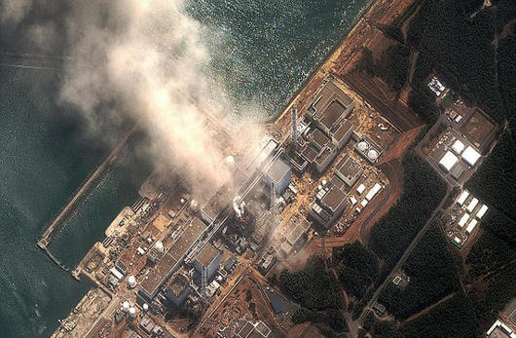
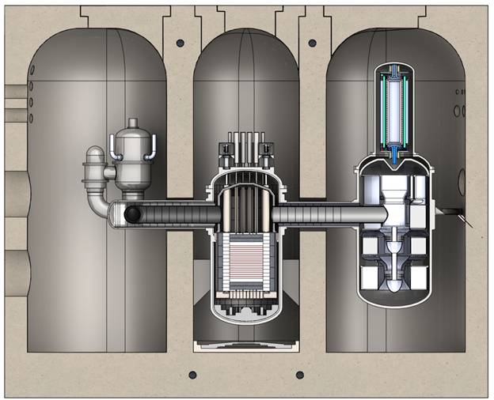
Comparison of EM² vs Fukushima Plant To Earthquake & Tsunami
9.0 magnitude earth quake/tsunami: reactor vessels and containments are intact but all electrical power is severed
Fukushima
air draft heat exchanger
EM²
Grade level
Reactor
Redundant shutdown cooling
Turbine-generator
Leak-tight, below-grade containment
Without power, cooling systems are inoperable
Fuel heats up causing high pressure and hydrogen producing reactions from zircalloy clad
External means of cooling is needed until power to cooling systems is restored
Reactor cooling by natural convection – no power needed
Silicon-carbide clad does not react with helium coolant at high temperature
Walk-away safe – no external intervention needed

Slide 12
Nuclear Power
Economics
Safety (“passive”)
Spent Fuel / Waste disposal

Slide 13
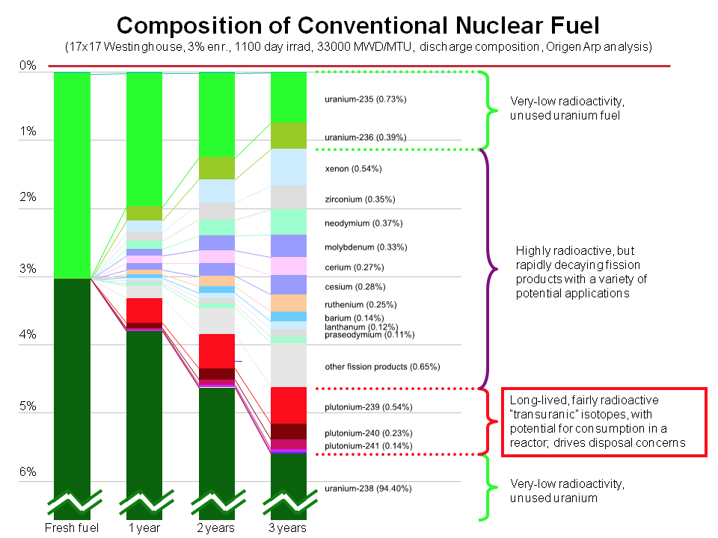

Slide 14
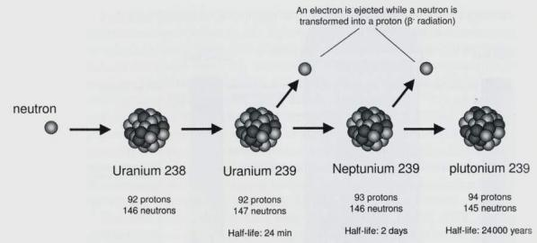
The “Breeder Reaction”

Slide 15
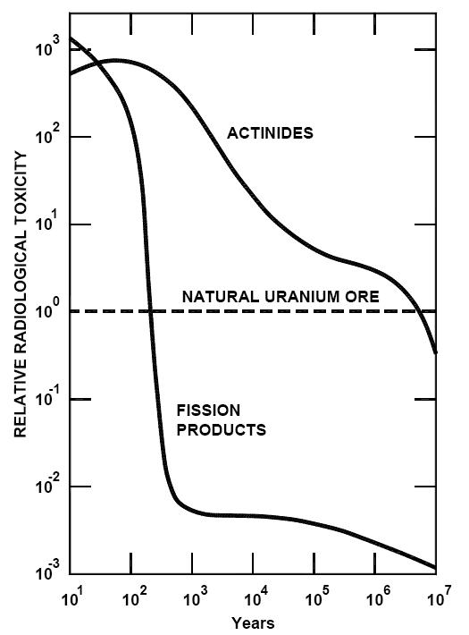

Slide 16
air draft heat exchanger
EM²
Grade level
Reactor
Redundant shutdown cooling
Turbine-generator
Leak-tight, below-grade containment

Slide 17
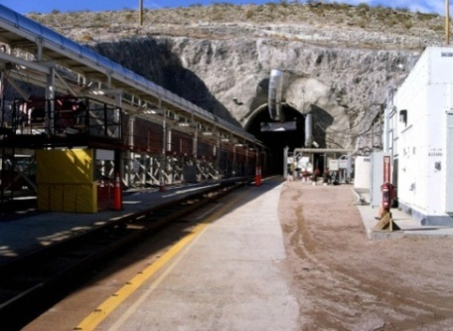
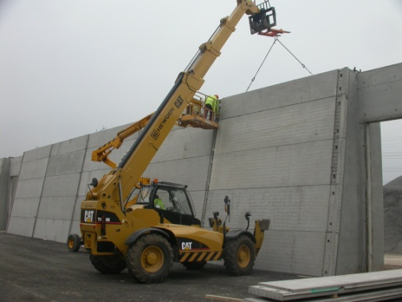
EM² Changes the Game Relative to Nuclear Waste
LWR Waste Disposal
EM² Waste Disposal
Deep geologic repository
Million year life
Large storage capacity
Long term heat
Long term radioactivity
Above ground storage
400 year life
Small storage capacity
Short term heat
Short term radioactivity

Slide 18
BACKUP

Slide 19
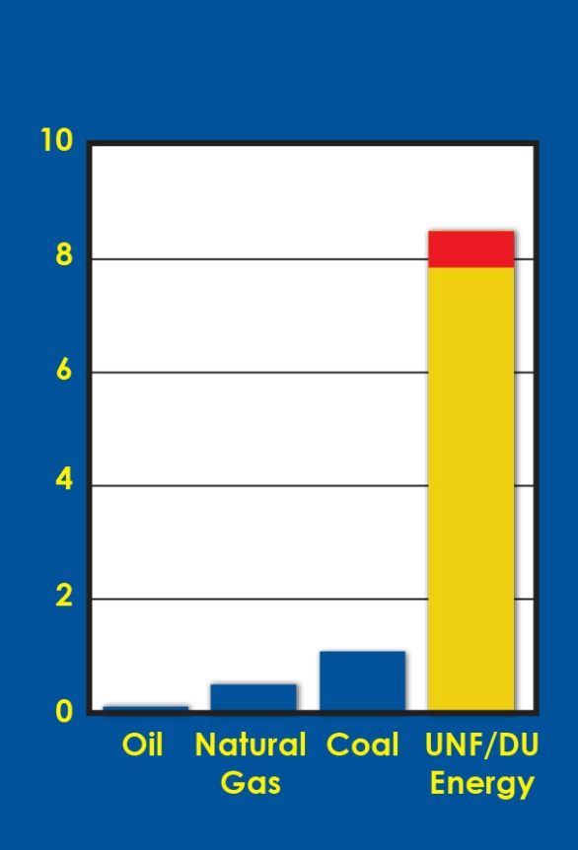


Fuel Resources for Electric Power Generation in the U.S.A.
U.S. Energy Reserves
(Trillion Bbls Oil Energy Equivalent)
Depleted uranium (DU)/
Used nuclear fuel (UNF) inventories
Energy supply
for > 300 years electric power generation
8 TBbl Depleted Uranium
1 TBbl Used Nuclear Fuel

Slide 20
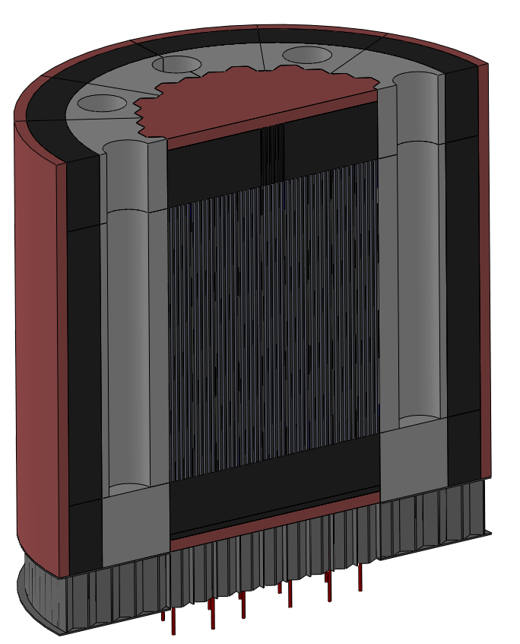
“Convert & Burn” reactor achieves a 30-year fuel life by converting ²³⁸U to ²³⁹Pu and burning in situ
BeO
reflector
Graphite
reflector
Starter | Fertile
LEU: ~ 12% Low- enriched uranium | DU: Depleted uranium
TRU: Transuranics | UNF: Used nuclear fuel
MOX: Mixed U/Pu oxides | NU: Natural uranium
Recycled EM² discharge | 30% ²³²Th 70% ²³⁸U
Conversion
Control drum location
Starter
B₄C neutron Shield
Core support floor 316L

Slide 21
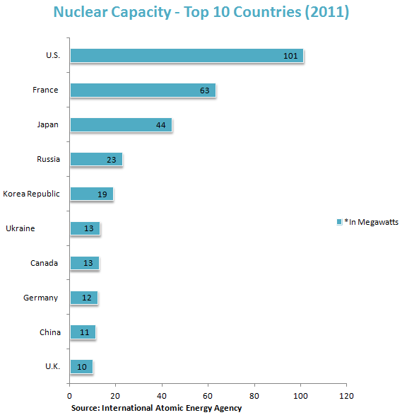

Slide 22
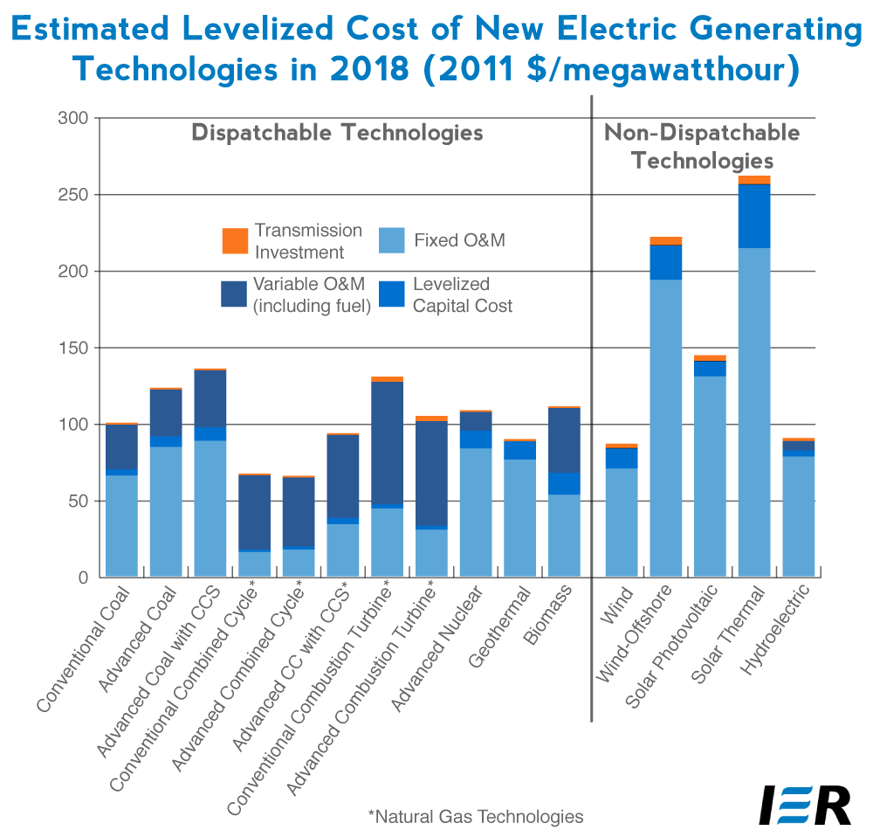

Slide 23
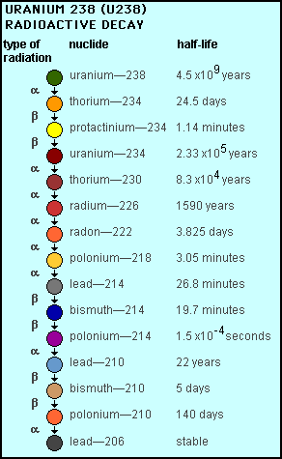

Slide 24
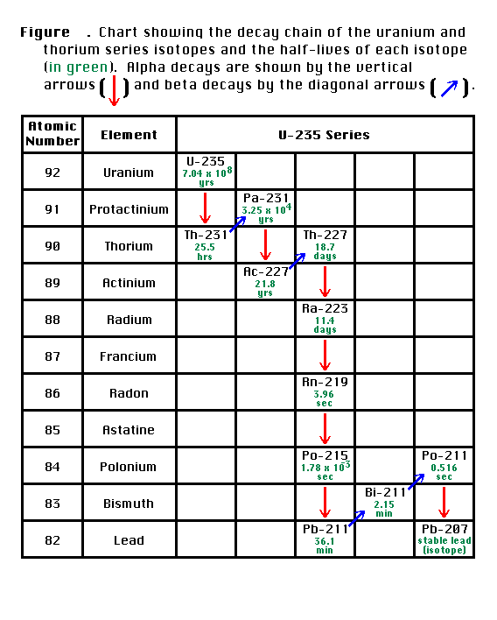

Slide 25
