Slide 1
Dr. Vivek Lall, Chief Executive General Atomics Global Corporation
Engineers Week 2021
Imagining Tomorrow
16th annual Engineers Week event at the Pentagon
Notes:
Dr. Vivek Lall, Chief Executive General Atomics Global Corporation:
Dr. Vivek Lall, Chief Executive of General Atomics Global Corporation based at their headquarters in San Diego, California.
What engineering developments are you most excited to see in the next five years?
Dr. Vivek Lall General Atomics and Affiliated Companies 20 minute Engineers Week 2021 “Imagining Tomorrow” presentation for the 16th annual Engineers Week event at the Pentagon.
Pentagon event is co-sponsored by the Washington Headquarters Services Facilities Services Directorate and the Office of the Under Secretary of Defense for Research and Engineering OUSD(R&E), to be hosted on Wednesday, February 24, 2021, from 1330 to 1500 EST, and will be streamed live from the Pentagon Auditorium.
http://www.ga.com/, https://www.ga-europe.com/en/home__2/, https://www.nspe.org/resources/partners-and-state-societies/engineers-week, https://www.whs.mil/Directorates/Facilities-Services-Directorate-FSD/, https://www.cto.mil/.

Slide 2
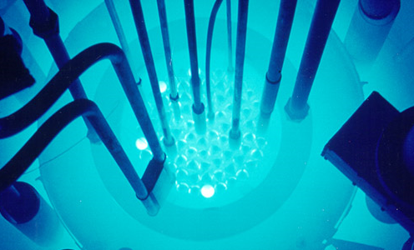
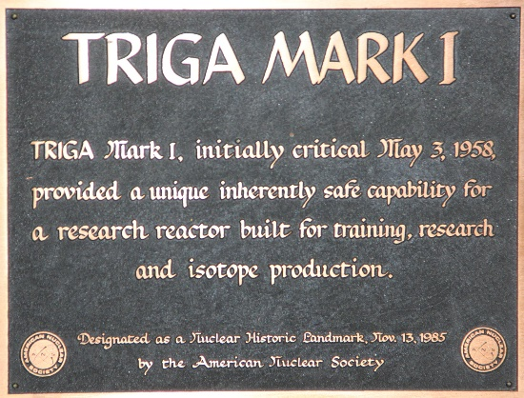
Company History
Founded originally in 1955 as a division of General Dynamics, General Atomics (GA) and its affiliated companies now constitute one of the world’s leading resources for high-technology systems ranging from the nuclear fuel cycle to electromagnetic systems, remotely operated surveillance aircraft, airborne sensors, and advanced electronic, wireless and laser technologies.
General Atomic
(Division of General Dynamics)
Gulf General Atomic
Gulf Royal Dutch Shell GA
GA Technologies Inc.
Chevron USA
Notes:
Global Progress Through Technology:
General Atomics is a defense and diversified technologies company, founded in 1955 as a Division of General Dynamics and acquired by the Blue family in 1986. GA and affiliated companies operate on five continents and include GA Aeronautical Systems, Inc. (GA-ASI).
GA-ASI produces a series of unmanned aircraft and provides electro-optical, radar, signals intelligence, and automated airborne surveillance systems. GA’s Electromagnetic Systems Division produces electro-magnetic aircraft launch and recovery systems for the US Navy, satellite surveillance, electro-magnetic rail gun, high power laser, hypervelocity projectile, and power conversion systems.
GA is the principal private sector participant in thermonuclear fusion research through its internationally recognized DIII-D and inertial confinement programs for the US Department of Energy. GA developed the University of California San Diego [UCSD] Supercomputer Center and has constructed more than 60 Training Research Isotopes General Atomics [TRIGA] nuclear research reactors in 24 countries. GA is a leader in development of next-generation nuclear fission and high-temperature materials technologies.
Other GA affiliates include General Atomics Europe, Heathgate Resources Pty Ltd (South Australia), GA Uranium Resources Group, Diazyme Laboratories Inc., and the GA-Honeywell uranium conversion partnership.
The group occupies 8+ million square feet of engineering, laboratory and manufacturing facilities and comprises over 15,000 employees.
http://www.ga.com, http://www.ga.com/about.

Slide 3
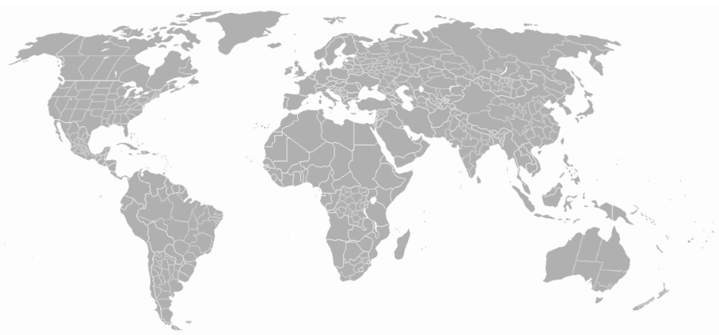
General Atomics and Affiliated Companies Global Locations
General Atomics Aeronautical Systems UK Ltd, London
General Atomics Europe and Subsidiaries, Dresden
Paris
Tokyo
Rabat
General Atomics Headquarters
San Diego, California
Shanghai
Abu
Dhabi
Bangkok
New Delhi
General Atomics Global Corporation Office
Canberra
Adelaide
Notes:
The global network of General Atomics has a presence in multiple countries in addition to operating and deployed locations:
General Atomics Headquarters, San Diego, California, United States of America
Canberra and Adelaide, Australia
London, England [General Atomics Aeronautical Systems UK Ltd (GA-UK)]
Shanghai, China
Paris, France [TRIGA International, a joint venture company with CERCA of France]
Dresden, Germany
New Delhi, India [General Atomics Global Corporation Office]
Tokyo, Japan
Rabat, Morocco
Abu Dhabi, UAE
Bangkok, Thailand
http://www.ga.com/affiliated-companies, http://www.ga.com/about, General Atomics Global Opens New Delhi Office, https://www.ga-europe.com/en/home__2/, http://www.ga.com/general-atomics-aeronautical-systems-uk-ltd.

Slide 4
General Atomics Energy Group Developing Energy for the Future
Notes:
General Atomics Energy Group:
Behind a talented global team of scientists, engineers, and professionals, GA's unique experience and capabilities continue to deliver safe, sustainable, economical, and innovative solutions to meet growing global demands. Our research and development portfolio includes:
Fusion: As a world leader in fusion energy research, GA scientists and engineers are engaged in developing both magnetic and inertial confinement fusion as a safe, clean and virtually unlimited energy source for the future.
Fission: Pioneering energy systems from the world's most widely used test reactor, TRIGA®, to developing next generation advanced reactors for economic sustainable energy.
https://www.ga.com/energy-group/.

Slide 5
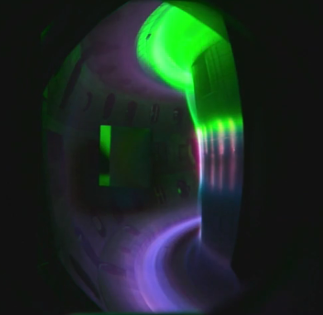
The DIII-D National Fusion Facility Largest Magnetic Fusion Facility in the United States
Investments by the U.S. Department of Energy (DOE) in DIII-D
Major international research program
Synergistic with ITER – the next step in fusion energy development
Notes:
General Atomics Magnetic Fusion:
Perfecting Nuclear Fusion in this lab could mean more carbon-free energy for millions of people. General Atomics (GA) operates a tokamak, a large, donut-shaped device that creates conditions favorable for fusion. In it, particles are heated so hot that they lose their electrons and become electrically charged ions. But the ions have to be squeezed together in a cloud of a particular shape, speed and density for fusion to happen. At these temperatures, no steel or ceramic could hold them.
The solution is to confine the ions with magnetism, in much the same way scattered iron particles can be organized by a magnet. A tokamak is surrounded by powerful magnets to contain and shape the blob of plasma. Lasers are pumped in from four points to help steer the plasma, and microwaves are forced in to heat it. One device spits pellets of fuel into the machine at 200 miles per hour.
To be viable for commercial use, the machine must produce more energy than it takes to operate. When achieved, the payoff will be huge: two pounds of fusion fuel has around the same energy content as 60 railroad cars full of coal, about 18 million pounds. And instead of tens of millions of pounds of carbon dioxide and other pollutants, the only byproduct is helium, an inert gas, enough to fill about 400 party balloons.
General Atomics (GA) has been an international leader in magnetic fusion research since the 1950s. The DIII-D National Fusion Facility, operated by GA for the U.S. Department of Energy (DOE), is the largest magnetic fusion research facility in the US. DIII-D research has delivered multiple innovations and scientific discoveries that have transformed the prospects for fusion energy. DIII-D researchers have won numerous awards, including a record seven instances of the prestigious American Physical Society Excellence in Plasma Physics Prize.
GA's Theory and Computational Science program advances the fundamental theoretical understanding of fusion plasmas through development and application of innovative theoretical approaches to challenging physics issues as well as industry-leading computer simulations. The theory program works with DIII-D to validate models and simulations against robust experimental data.
This research has also delivered the basis for several spinoff technologies that have advanced the state of the art in medical diagnostics, transportation, semiconductors, electronics, and defense applications, including the Electromagnetic Aircraft Launch System (EMALS) being deployed on the next generation of U.S. Navy aircraft carriers.
www.ga.com/magnetic-fusion/, https://www.nei.org/news/2020/perfecting-nuclear-fusion-more-carbon-free-energy.

Slide 6
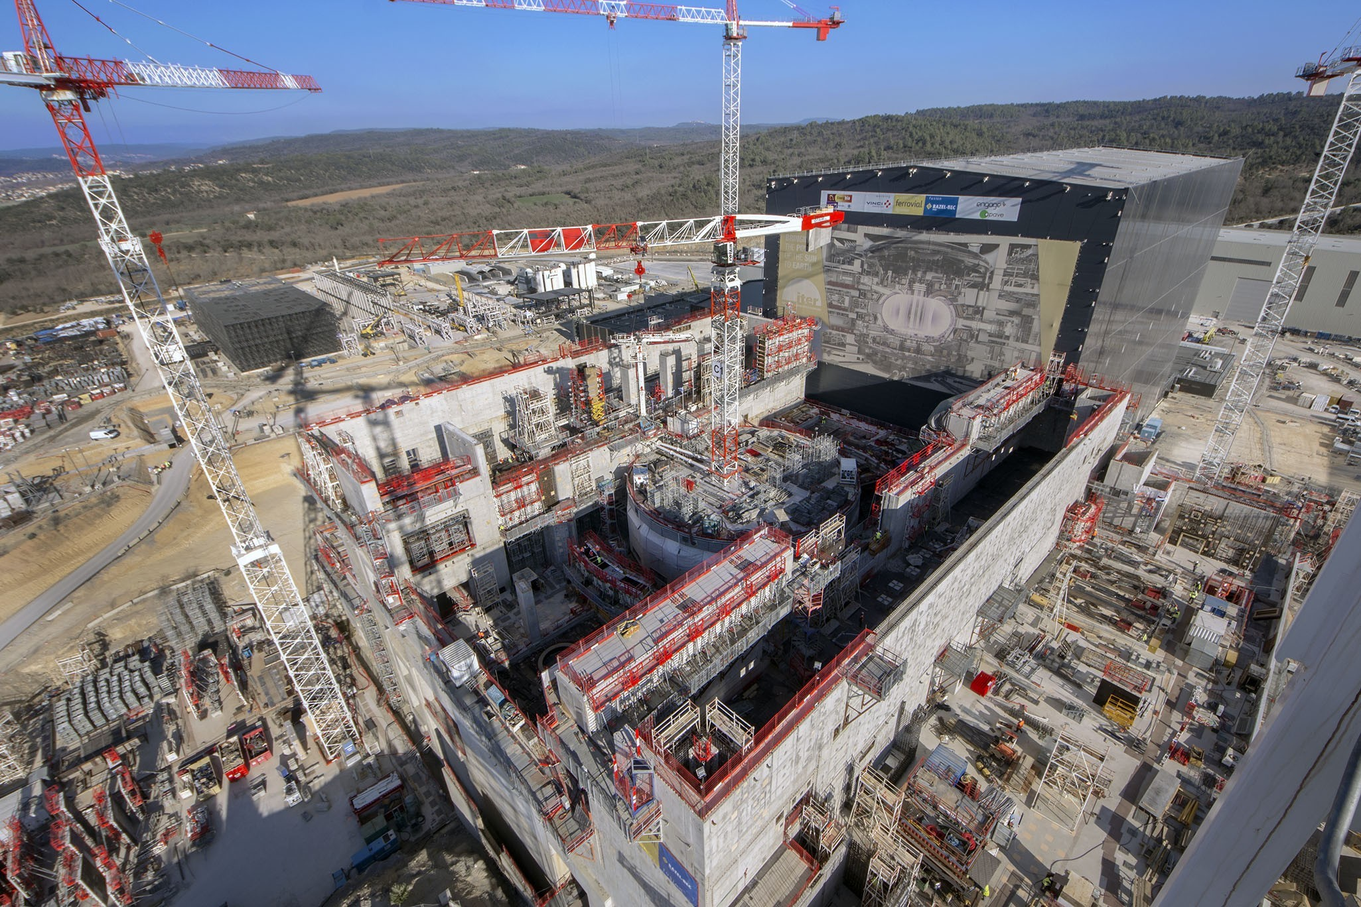
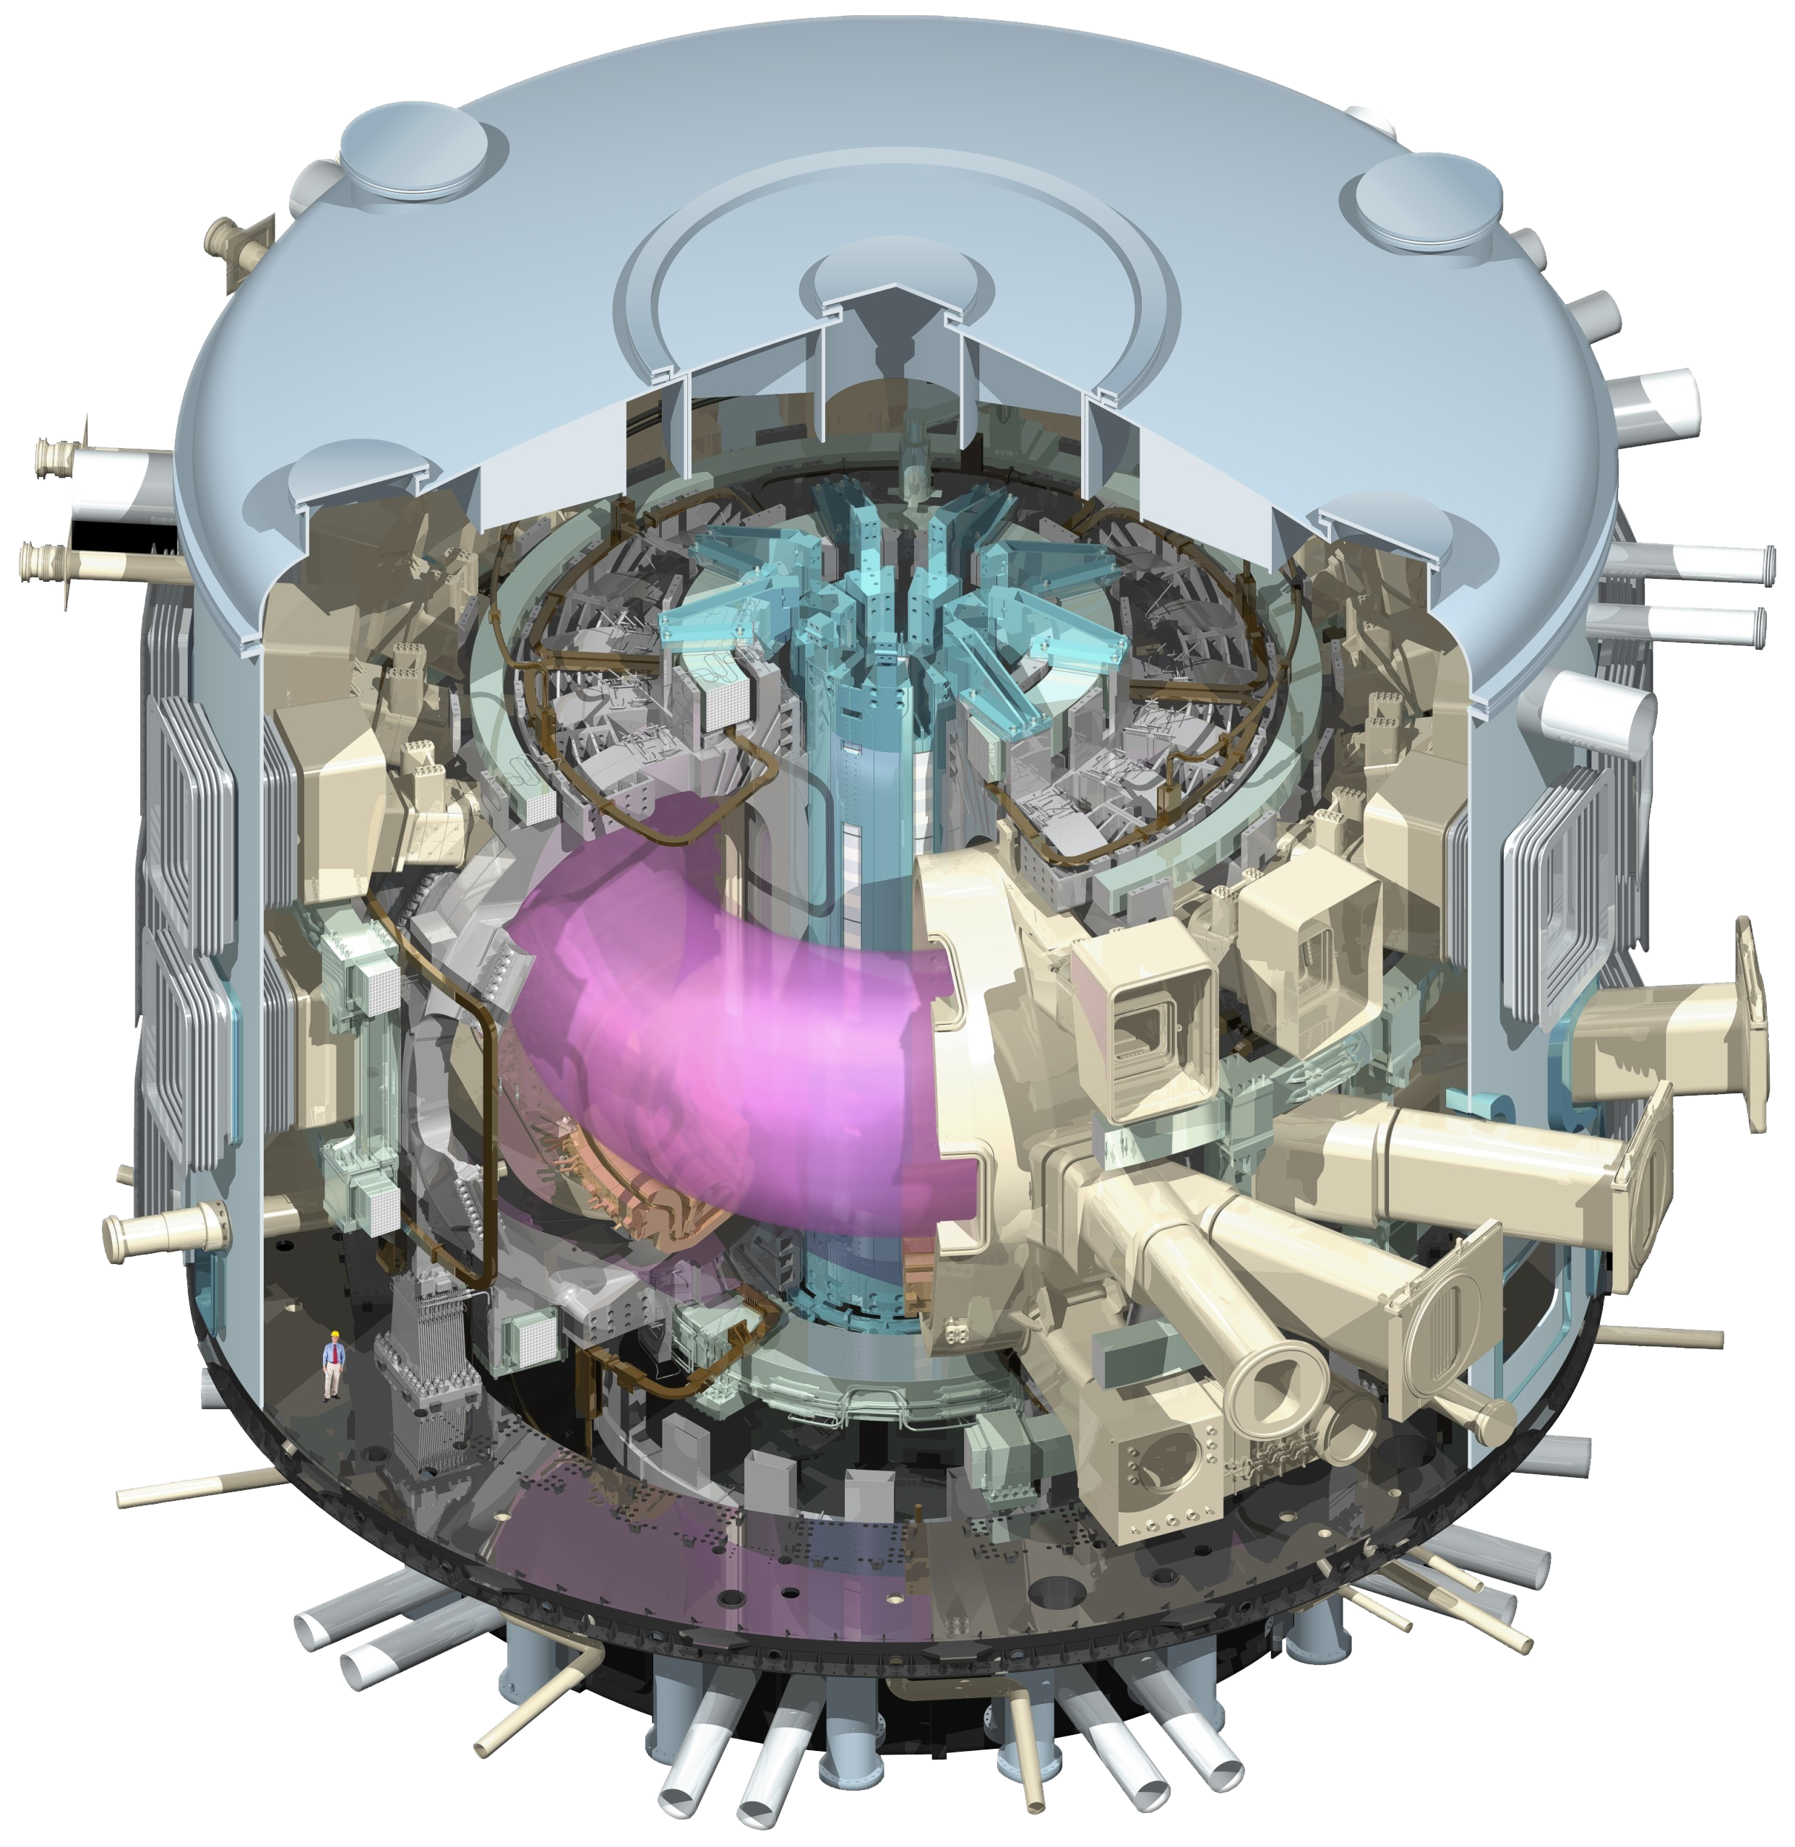
ITER “The Way” to New Energy
The ITER tokamak will be the largest and most powerful fusion device in the world
ITER, Southern France
ITER’s First Plasma is scheduled for December 2025
ITER MISSION
“To demonstrate the scientific and technological
feasibility of fusion energy for peaceful purposes.”
Notes:
ITER ("The Way" in Latin) is one of the most ambitious energy projects in the world today.
GA is a key partner in ITER — one of the largest scientific programs in history — which seeks to demonstrate the scientific and technological feasibility of fusion power, a potentially limitless source of clean energy. The ITER facility is currently being constructed in France by a consortium of 35 nations. GA is manufacturing major components for this worldwide initiative, including the Central Solenoid - the world's largest pulsed superconducting electromagnet – and several key diagnostics systems.
ITER is the world-wide collaboration to build the world's largest tokamak, a magnetic fusion device that has been designed to prove the feasibility of fusion as a large-scale and carbon-free source of energy based on the same principle that powers our Sun and stars.
The experimental campaign that will be carried out at ITER is crucial to advancing fusion science and preparing the way for the fusion power plants of tomorrow.
ITER will be the first fusion device to produce net energy – the point when the total power produced during a fusion plasma pulse surpasses the thermal power injected to heat the plasma. ITER will also be the first fusion device to demonstrate many of the integrated technologies, materials, and physics regimes necessary for the next step, commercial production of fusion-based electricity.
ITER’s First Plasma is scheduled for December 2025.
http://www.ga.com/energy-group, https://www.ga.com/magnetic-fusion/international-iter-project, https://www.iter.org/proj/inafewlines.

Slide 7
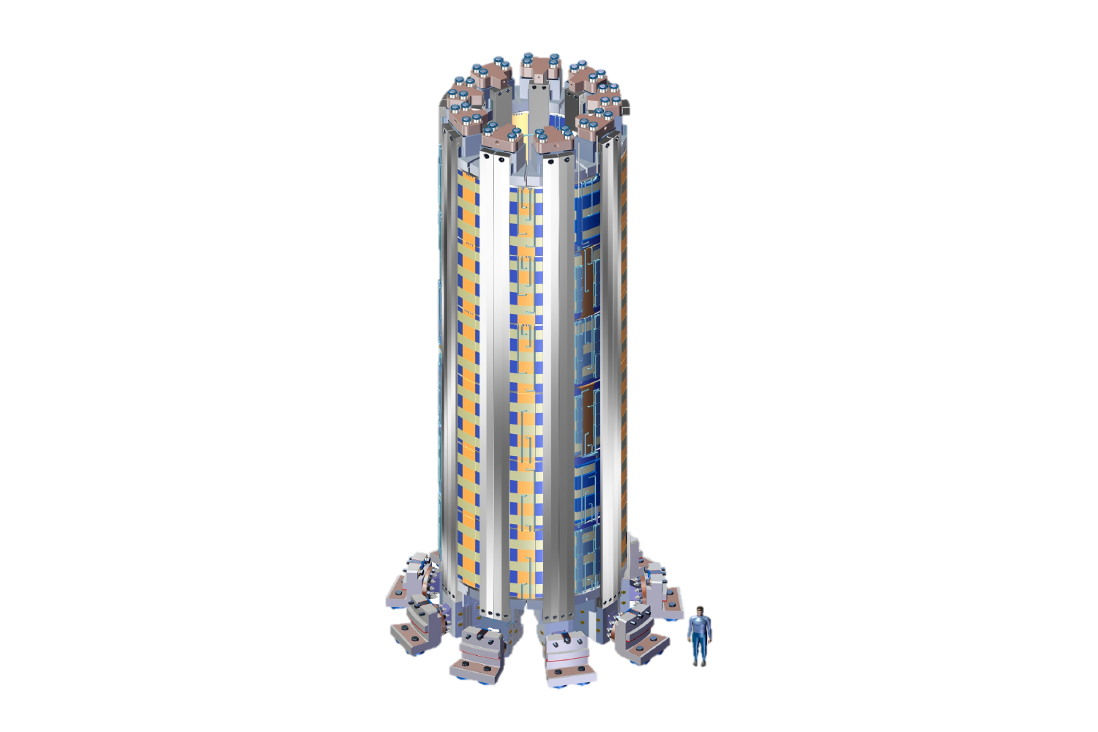
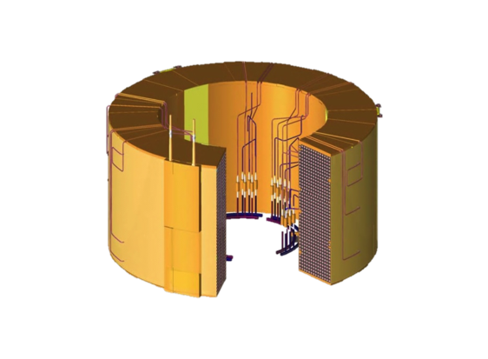
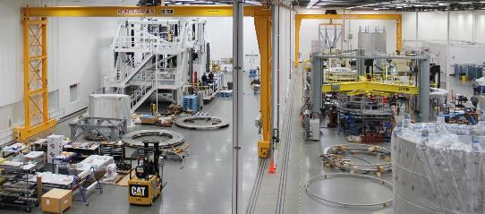
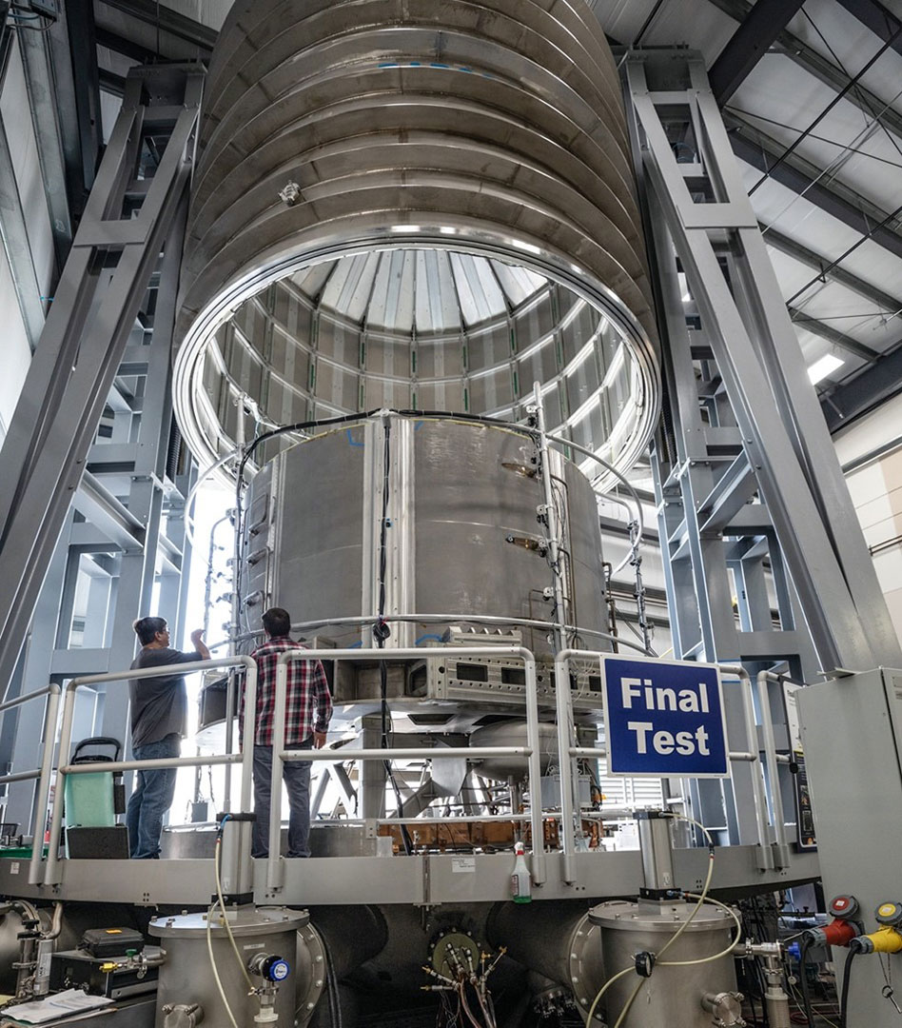
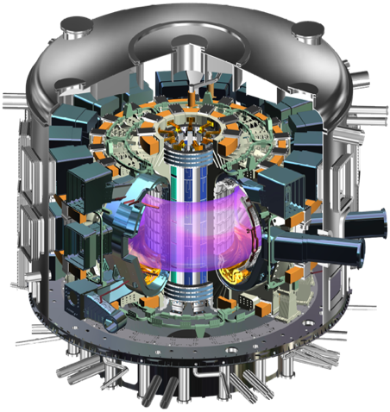
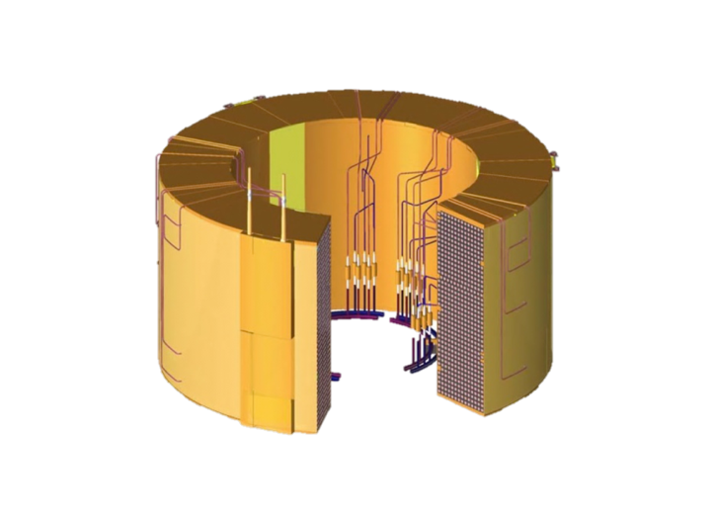
General Atomics Magnet Technologies Center Providing the Heart of ITER
GA is building ITER’s Central Solenoid – the world’s most powerful pulsed superconducting electromagnet
GA Magnet Technologies Center manufactures and tests the
ITER Central Solenoid
6 Magnet
Modules
Make up the
ITER
Central
Solenoid
59 ft
ITER
Magnet
Module
February 2021 GA Completes Fabrication and Testing of First ITER Central Solenoid Module
ITER
Notes:
4 February 2021 General Atomics Completes Fabrication and Testing of First ITER Central Solenoid Module:
After nearly five years of fabrication and a battery of rigorous testing and troubleshooting, General Atomics (GA) has completed the first major milestone in one of the United States’ largest contributions to the ITER fusion project in France. The first module of the ITER Central Solenoid will join others still in fabrication to make up the largest pulsed superconducting magnet in the world. The Central Solenoid will play a critical role in ITER’s mission to establish fusion as a practical, safe and nearly inexhaustible source of clean, abundant and carbon-free electricity.
The first module of the Central Solenoid was built at GA’s Magnet Technologies Center in Poway, Calif., under the direction of the US ITER project, managed by Oak Ridge National Laboratory (ORNL). It will be shipped to France later this year, where ITER construction is more than 70 percent complete. When completed, the 1,000-ton, 59-foot-tall Central Solenoid will sit in the heart of the fusion device, driving 15 million amperes of current through ITER’s plasma to heat and stabilize the fusion reaction. ITER is on schedule to begin first plasma operations in 2025.
Fabrication of the first module began in 2015, preceded by almost four years of collaboration with experts at US ITER to design the process and tools for fabricating the modules. Each 14-foot-diameter, 250,000-pound module requires more than two years of precision fabrication and is composed of more than three miles of niobium-tin superconducting cable.
The module was subjected to a series of demanding tests during and after its production, placing it in extreme conditions similar to what it will experience during ITER operation, including near-complete vacuum and cryogenic temperatures required for the magnet to become superconducting (4.5 Kelvin, about -450 degrees Fahrenheit or -270 degrees Celsius).
The Central Solenoid is one of the most important U.S. contributions to ITER. Like the 34 other nations involved in the project, the U.S. is making much of its initial contribution in the form of components that are manufactured here and shipped to France. This allows member countries to support domestic manufacturing, create high-tech jobs and develop new capabilities in private industry.
The U.S. is contributing about nine percent of the construction costs for ITER, but it will have access to 100 percent of the data and intellectual property from the massive experiment. That data will be critical for the U.S. fusion program, which last month unified behind a strategic plan that calls for capitalizing on ITER’s knowledge to build a fusion pilot plant in the 2040s.
February 2021 https://www.ga.com/general-atomics-completes-fabrication-and-testing-of-first-iter-central-solenoid-module
May 2019 General Atomics Completes Fabrication of First ITER Central Solenoid Module https://www.ga.com/general-atomics-completes-fabrication-of-first-iter-central-solenoid-module
US ITER News Fabrication complete on 1st of 7 central solenoid modules https://usiter.org/news/fabrication-complete-1st-7-central-solenoid-modules
Oak Ridge National Laboratory (ORNL) YouTube channel Building the Heart of ITER https://www.youtube.com/watch?v=sChKik55EmY&t=75s
Recommended video ITER Central Solenoid Fabrication Facility https://vimeo.com/469106753

Slide 8
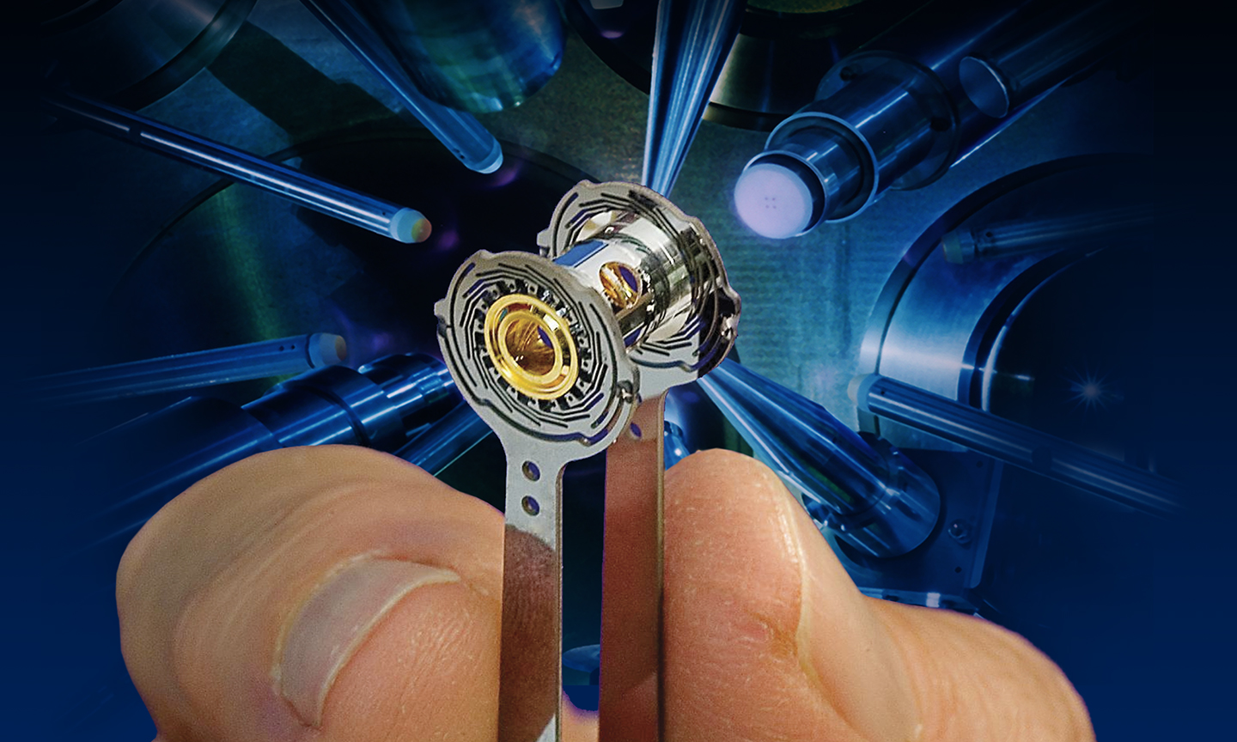
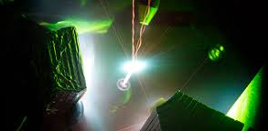
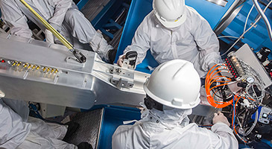
General Atomics Inertial Fusion Technology Division
Fabrication
Microfabrication
National Ignition Facility (NIF)
Ignition Targets
Diagnostics
Notes:
General Atomics Inertial Fusion Technology Division:
The Inertial Fusion Technology (IFT) division supports the DOE National Nuclear Security Administration's research in Inertial Confinement Fusion (ICF) and high-energy-density physics. This initiative is aimed at achieving a safer, more secure, and more effective nuclear deterrent without underground testing by producing thermonuclear burn conditions in the laboratory.
In nuclear fusion, atoms of hydrogen must be heated to temperatures of 100 million degrees Celsius and held at high pressure (or "confined") long enough for a fusion reaction to take place. The sun heats and confines hydrogen with gravity, while magnetic fusion uses strong magnetic fields to confine the hydrogen and heat it with microwaves or other means. ICF uses powerful energy beams, such as lasers, to compress and heat the hydrogen fuel to fusion temperatures, and uses the inertia of the fuel itself to confine it long enough for fusion to occur.
Fabrication:
General Atomics Inertial Fusion Technologies (IFT) has supported the Department of Energy's Inertial Confinement Fusion (ICF) program since 1975. GA researchers pioneered work on the conceptual design of inertial fusion energy power plants, and our early efforts with Lawrence Livermore National Laboratory led to the design of a laser-driven power plant called Cascade, which demonstrated the theoretical possibilities of inertial fusion.
Microfabrication:
General Atomics can supply high-precision micro-machined components on a production or development basis. We can produce millimeter and sub-millimeter-sized components of different shapes in a variety of materials. We have an array of sophisticated and customized automated and robotic assembly stations that can rapidly produce large quantities of high-precision components. We employ machine learning, machine vision, and force-feedback approaches.
For tasks unsuited for robotic assembly, we also have a suite of versatile and accurate manual assembly stations at which our highly skilled and experienced technicians can produce made-to-order components for a variety of applications. Our production processes integrate our industry-leading metrology capabilities to ensure adherence to the most exacting customer requirements.
Diagnostics:
Working with Kentech Instruments, Lawrence Livermore National Laboratory and Sandia National Laboratories, General Atomics has developed a cutting edge line of high-speed imaging diagnostics. These include the DIXI (Dilation X-ray Imager) installed at the National Ignition Facility (NIF) at LLNL. DIXI is a high-speed x-ray framing camera that uses the pulse-dilation technique to achieve a temporal resolution (shutter speed) of less than 10 ps (ps; one trillionth of a second).
The most recent innovation is a single-line-of-sight (SLOS) imager developed with Kentech, LLNL, Sandia, and the Laboratory for Laser Energetics (LLE) at the University of Rochester. SLOS can capture multiple images with a shutter speed of 25 ps, roughly 100 times faster than previous technology.
https://www.ga.com/inertial-fusion/.

Slide 9
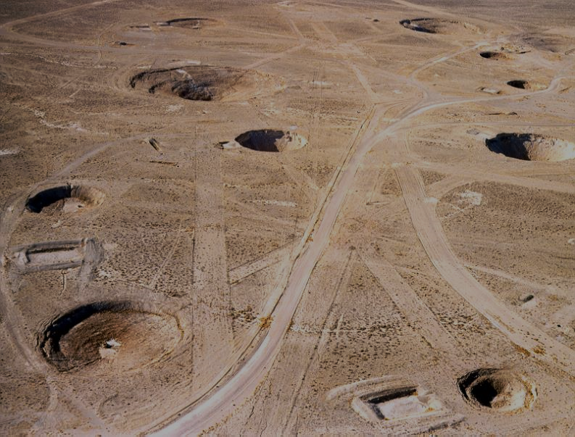
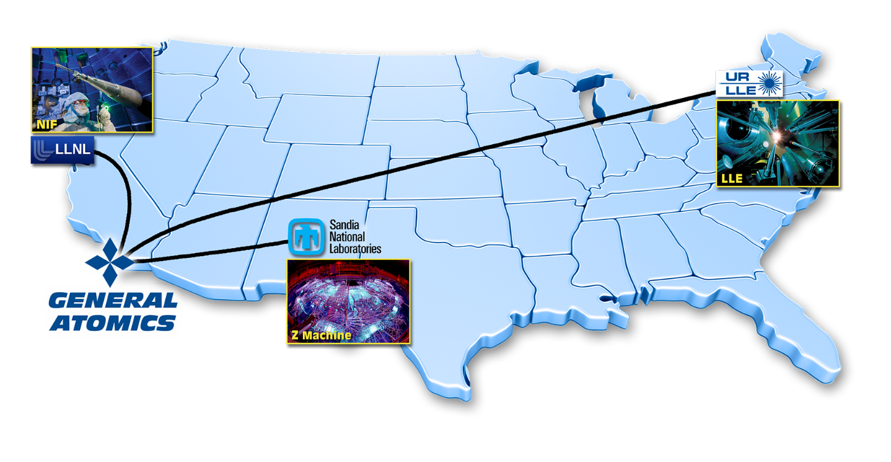
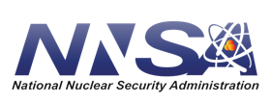
General Atomics Inertial Fusion Technology Division
1992 Moratorium on underground
nuclear weapons testing
Notes:
General Atomics Inertial Fusion Technology Division:
The Inertial Fusion Technology (IFT) division supports the DOE National Nuclear Security Administration's research in Inertial Confinement Fusion (ICF) and high-energy-density physics. This initiative is aimed at achieving a safer, more secure, and more effective nuclear deterrent without underground testing by producing thermonuclear burn conditions in the laboratory.
As the largest industrial participant in the field of inertial fusion, the GA IFT division supplies critical components, world-leading diagnostics, and associated equipment to the ICF laboratories and other clients. The IFT team has been providing innovative, multi-disciplinary materials research and process developments in support of science-based stockpile stewardship for more than 25 years.
GA IFT began supplying the ICF Program with targets, target systems, and target support services in 1990. Today, GA supplies more than 10,000 such components every year for experiments at the five U.S. ICF laboratories.
LLNL Lawrence Livermore National Laboratory https://www.llnl.gov/
NIF National Ignition Facility https://lasers.llnl.gov/
LANL Los Alamos National Lab: National Security Science https://www.lanl.gov/
SNL Sandia National Laboratories – Exceptional Service in the National Interest https://www.sandia.gov/
UR LLE University of Rochester - Laboratory for Laser Energetics https://www.lle.rochester.edu/
NNSA National Nuclear Security Administration | Department of Energy https://www.energy.gov/nnsa/national-nuclear-security-administration
https://www.ga.com/inertial-fusion.

Slide 10
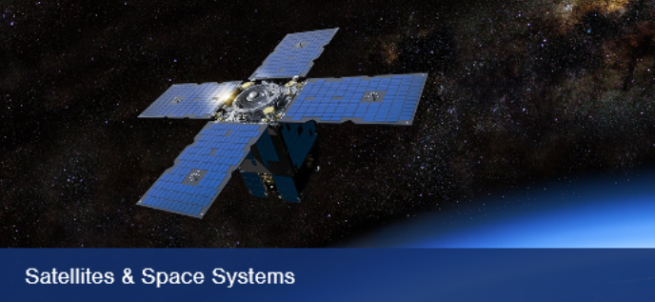
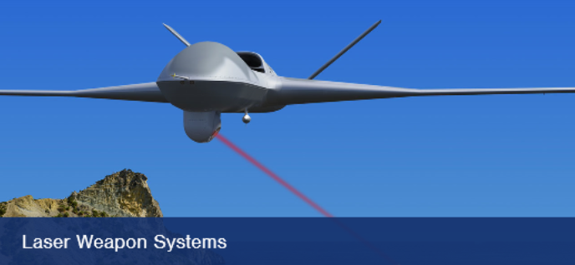
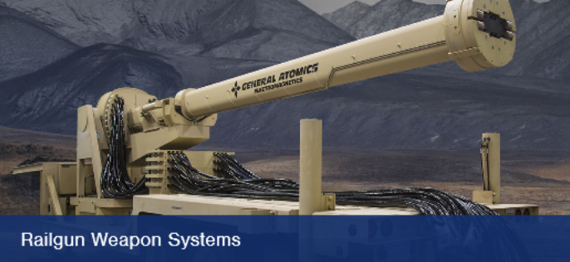
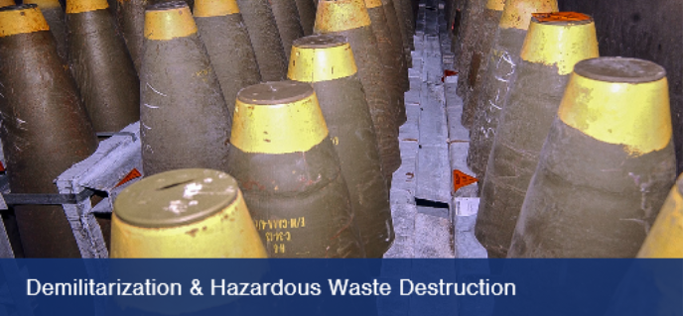
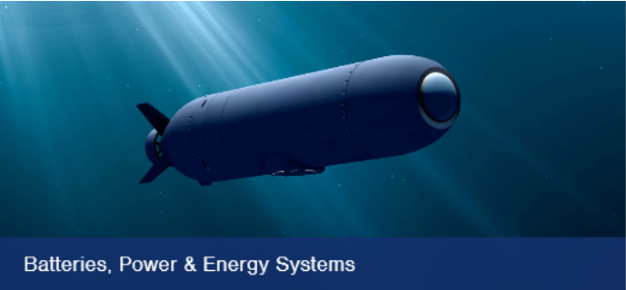
General Atomics Electromagnetic Systems Group
Defense Systems
Notes:
General Atomics Electromagnetic Systems Group [GA-EMS]:
General Atomics Electromagnetic Systems Group (GA-EMS) is applying its rich heritage in research, science, and technology innovation to develop and deliver multi-mission systems and first-of-kind products to help defend our national interests and support critical commercial enterprises worldwide.
Defense Systems:
Aircraft Launch and Recovery Systems GA-EMS’ Electromagnetic Aircraft Launch System (EMALS) and Advanced Arresting Gear (AAG) are revolutionizing naval aviation. EMALS and AAG provide the range of capabilities necessary to launch and recover the full spectrum of carrier-capable aircraft.
EMALS uses electromagnetic technology to launch aircraft from the deck of naval aircraft carriers and offers significant benefits over current launch systems:
•Increased launch operational ability
•Flexible architecture to suit different platforms
•Capable of launching wide range of aircraft weights
•Reduced manning and lifecycle cost
•Reduced thermal signature
•Reduced topside weight and installed volume
AAG is a turbo-electric system designed for controlled and reliable deceleration of aircraft. The AAG system provides significant benefits over current recovery systems:
•Higher availability and safety margins
•Operational capability to recover projected air wing
•Reduced manning and maintenance
•Self-diagnosis and maintenance alerts
Satellites, & Space Systems & Space Technologies:
Whether a specific satellite for a specific mission or a constellation of interconnected spacecraft, GA-EMS is re-defining how customers can access the possibilities of space. GA-EMS offers modular and scalable satellite platforms backed with a history of operational flight experience to support defense, civil, commercial, and academic mission requirements.
GA-EMS' Laser Communication Terminals (LCTs) are enabling faster, higher fidelity communication transmissions. LCTs support vast networking of satellites, the sharing of data and information, and collective on-orbit computing resources in space. GA-EMS' LCTs are facilitating the evolution of modular, space-based communications services, providing a more resilient architecture to ensure 24/7 total connectivity from earth, to space, and beyond by enhancing its laser and sensor capabilities with advanced Adaptive Optics technology for use in space-to-ground laser communication, weapons systems, and Intelligence Surveillance and Reconnaissance (ISR).
Laser Weapons Systems:
The GA-EMS advanced solid state High Energy Laser (HEL) weapon system provides proven laser technologies to enable the detection and defeat of an expanding range of targets, including unmanned vehicles, missile threats, ISR systems, rockets, artillery, and mortars. The system’s modular, scalable design offers significant reductions in size, weight, and power consumption to suit air, land, and sea-based platforms.
Demilitarization and Hazardous Waste Destruction:
GA-EMS’ unique demilitarization - cryofracture systems safely and efficiently dispose of conventional munitions and complex chemical munitions. GA-EMS is the only single source cryofracture system provider that offers a cost effective and environmentally safe alternative to traditional incineration systems and hazardous open pit munitions destruction.
industrial Supercritical Water Oxidation (iSCWO) systems successfully treat a broad range of pumpable hazardous and non-hazardous waste, with 99.99% destruction removal efficiency. GA-EMS’ iSCWO solution replaces other technologies that have high emission rates, post treatment requirements, and substantial installation and operation costs.
GA-EMS’ demilitarization - neutralization process, when used in conjunction with the industrial Supercritical Water Oxidation (iSCWO) system, is an effective solution for the destruction of more complex munitions and chemical weapon stockpiles managed and stored by the U.S. Army.
Batteries, Power and Energy Systems:
GA-EMS is finding more efficient ways to power today’s complex, energy-hungry systems by specializing in creating power and energy systems designed to meet that challenge and support a wide range of land, sea, and air applications.
Lithium-ion Fault Tolerant (LiFT) Battery Systems are modular, high energy density solutions for manned and unmanned submersibles, surface vessels, land vehicles, and airborne platforms. LiFT’s single cell fault tolerance prevents uncontrolled and catastrophic cascading cell failure. This ensures the safety of personnel and equipment, and keeps systems operating through faults to enable mission completion.
Aluminum Power System (ALPS) is designed to provide long endurance capabilities to support underwater vehicles, nodes, and platforms. ALPS utilizes a custom aluminum alloy to provide an energy dense, cost efficient alternative to rechargeable Lithium-ion battery power systems. ALPS’ modular design individually isolates each major component to improve reliability, safety, and ease of refueling.
High Speed Power Generation Systems, Electric Motors & Drives - High Speed Power Generation (HSPG) systems, including permanent magnet motors, generators, and modular drives, to meet the escalating power demand to support ship services and systems.
High Voltage Capacitors - GA-EMS is globally recognized as the leading U.S. developer and manufacturer of advanced high voltage capacitors to meet demanding requirements, specifications, and extreme operating environments.
Railgun Weapon Systems:
GA-EMS is maturing railgun weapon systems to support air and missile defense, counter battery fire, and precision indirect fire. GA-EMS railgun weapon systems feature electromagnetic launchers that use electricity instead of chemical propellants to fire projectiles at high speeds. The high muzzle velocity can be twice that of conventional guns leading to shorter engagement times, extended keep-out, and longer range.
https://www.ga.com/defense, Video linked in the slide & recommended video for production EMALS & AAG: Proven and Mission Ready https://vimeo.com/457921781.

Slide 11
General Atomics Electromagnetic Systems Group Precision Manufacturing
BUILD. TEST. DELIVER.
Manufacturing a new era of weapon systems.
Notes:
GA-EMS Precision Manufacturing:
GA-EMS provides convenient, on-shore manufacturing services for fabricating, assembling, testing, and finishing specialized components for aerospace and defense, industrial, energy, and commercial applications.
We machine, assemble, and test components to meet tight tolerances, and measure each product against the highest quality, compliance, and safety standards in the industry. State-of-the-art manufacturing equipment includes large robotics, a wide range of electrical motor winding equipment, vacuum-pressure resin impregnation tanks, a full range of computer numerical controlled (CNC) machining and milling equipment, and multi-megawatt test capabilities.
GA-EMS offers a depth of design and manufacturing experience to address complex electronics, precision metal components and turnkey assemblies. Our manufacturing portfolio includes expertise in permanent magnet motors and generators, high voltage capacitors, and energy conversion and high voltage power distribution systems. We also design, manufacture and test unique electromagnetic railgun and aircraft launch and recovery systems, electrostatic oil separators, and radiation monitoring systems.
https://www.ga.com/ems-manufacturing.

Slide 12
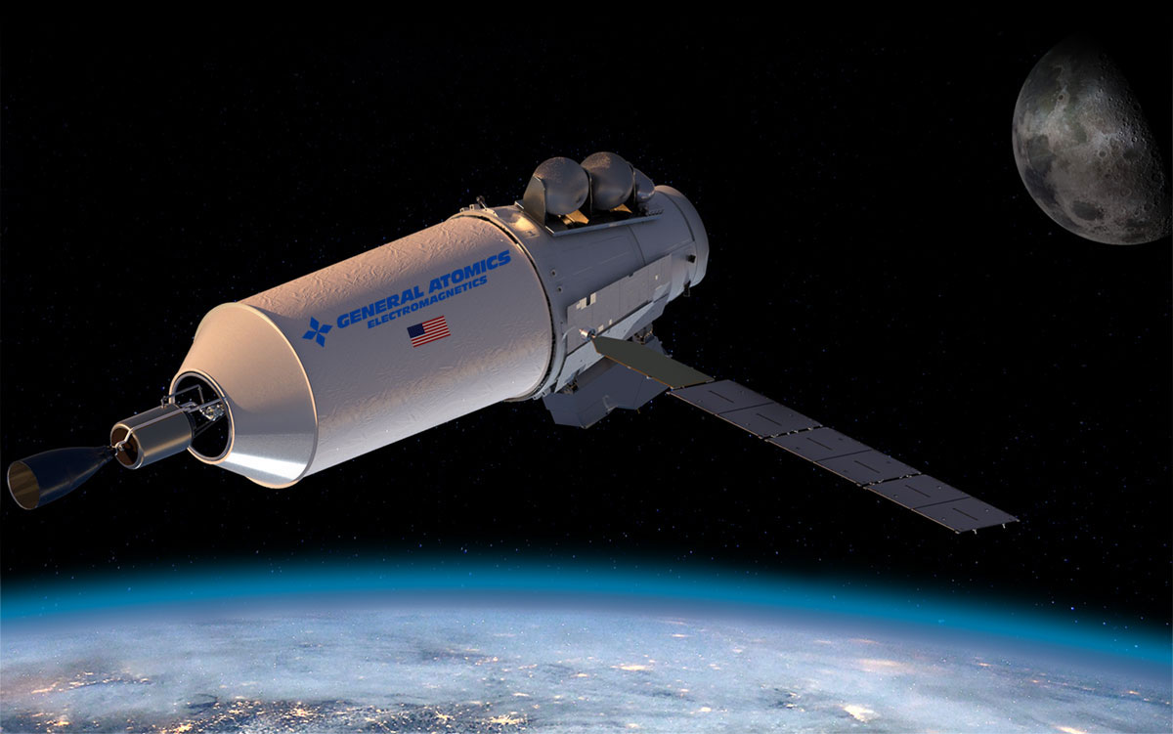
General Atomics Electromagnetic Systems Group Nuclear Thermal Propulsion
Notes:
Space Nuclear:
General Atomics Electromagnetic Systems (GA-EMS) is expanding our space systems expertise by leveraging our 60+ year history of nuclear innovation to demonstrate safe, robust, and scalable space-nuclear energy systems and deliver them on orbit, on time.
Whether its designing safer, more efficient nuclear reactors for use on land, pushing the limits to where we can go in space with nuclear thermal propulsion, or developing future nuclear power for use on the surface of the moon, Mars, and beyond, our goal is the same—Innovation Made Real.
Nuclear Thermal Propulsion:
Since the 1950's, GA-EMS has been unlocking the possibilities of Space Nuclear Thermal Propulsion (NTP). GA-EMS' NTP reactor concept leverages advancements in modern nuclear materials and manufacturing methods with valuable experience from the company's involvement on NASA Atomic Energy Commission (AEC) Project Rover in the 1960s; one of the first programs to demonstrate the feasibility of space-based NTP. GA fabricated approximately 6 metric tons of the nuclear fuel kernels for the project. In 1965, the company was also directly involved in nuclear fuel testing and characterization for the SNAP-10A reactor, the only U.S. nuclear power reactor launched into space.
Now, GA-EMS' NTP design proposes new features that address issues observed in historical designs, such as fuel element corrosion, and achieves a compact core using High-Assay Low-Enriched Uranium (HALEU) instead of High-Enriched Uranium (HEU). GA-EMS' advancements in state-of-the-art nuclear fuel and high temperature ceramic matrix composite materials are key components to the NTP design to create a highly efficient and exceptionally safe propulsion system. Combined with exceptional in-house capabilities to fabricate these components and others, GA-EMS is enabling the future of space exploration.
General Atomics Delivers Nuclear Thermal Propulsion Concept to NASA:
SAN DIEGO, CA, (Sept. 9, 2020) – GA-EMS has delivered a design concept of a Nuclear Thermal Propulsion (NTP) reactor to power future astronaut missions to Mars for a NASA-funded study. The study, managed by Analytical Mechanics Associates (AMA), explored a design space defined by key performance parameters as well as figures of merit. The GA-EMS design exceeded the key performance parameters and optimized the NTP reactor for manufacturability, the highest ranked figure of merit.
https://www.ga.com/space-systems/space-nuclear, https://www.ga.com/general-atomics-delivers-nuclear-thermal-propulsion-concept-to-nasa.

Slide 13
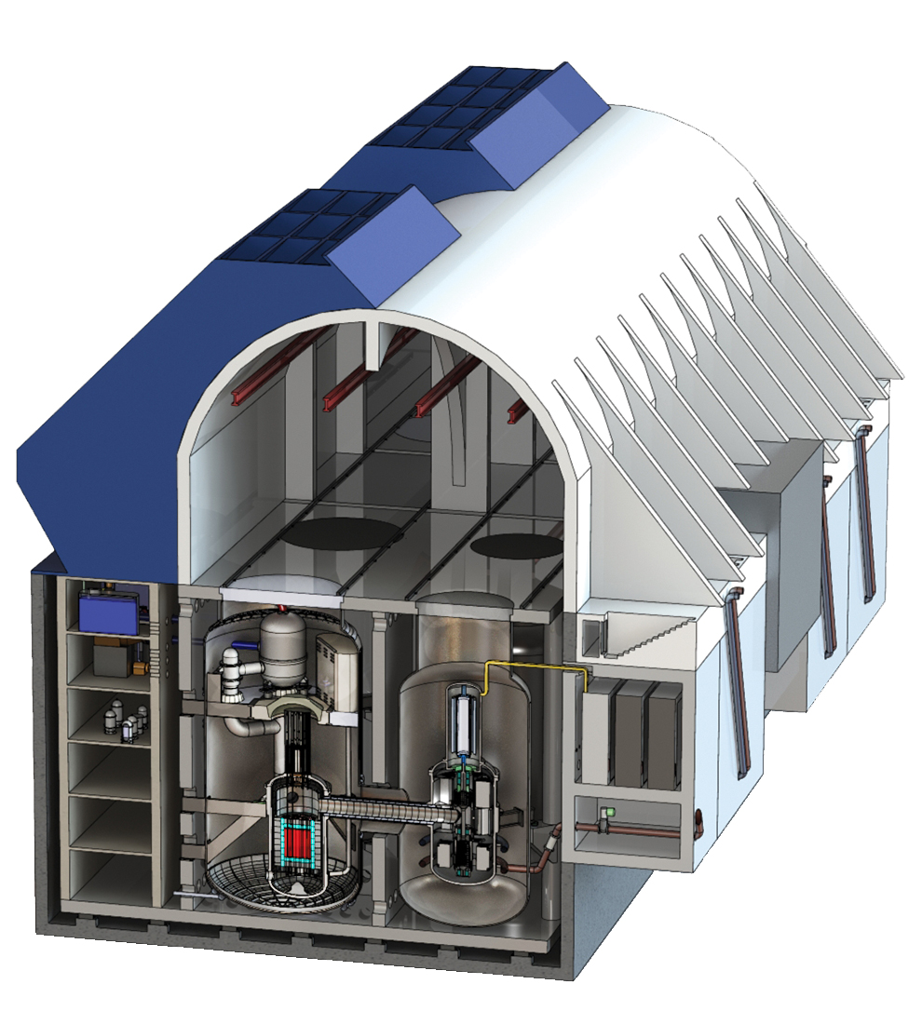
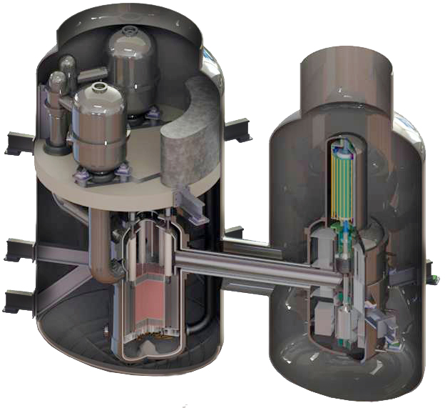
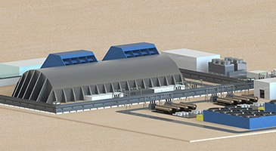
General Atomics Electromagnetic Systems Group Nuclear Technology & Materials Advanced Fission Reactors
Energy Multiplier Module (EM2)
Fast Modular Reactor (FMR) concept
DOE Advanced Reactor Concepts-20 Program
Notes:
GA-EMS Nuclear Technology & Materials (NTM):
The long-term focus of the Nuclear Technologies & Materials (NTM) division is on the innovative Energy Multiplier Module (EM2), an advanced, helium gas-cooled design that addresses the four core challenges facing nuclear energy – safety, waste, cost, and non-proliferation. EM2 can be powered by spent nuclear fuel and operates up to 30 years without refueling.
To support the existing reactor fleet, GA-EMS is also leveraging EM2 research for DOE's Accident Tolerant Fuel (ATF) program, which is developing composite cladding materials that offer a significantly higher safety margin compared to current metal alloys.
GA-EMS is collaborating with Framatome Inc. to develop a new helium-cooled 50-Megawatt electric (MWe) Fast Modular Reactor (FMR) concept that will produce safe, carbon-free electricity and can be factory built and assembled on-site, which will reduce costs and enable incremental capacity additions. The GA-EMS led team will be able to demonstrate the FMR design as early as 2030 and anticipates it being ready for commercial use by the mid-2030s.
GA-EMS has been selected for the Advanced Reactor Concepts-20 (ARC-20) program, one of three programs supported under the U.S. Department of Energy’s (DOE) Advanced Reactor Demonstration (ARD) Funding Opportunity Announcement (FOA). GA-EMS will develop a conceptual design of a new 50-megawatt electric (MWe) Fast Modular Reactor (FMR) that provides safe, carbon free electricity, and has the capability of incremental capacity additions. The FMR will provide rapid load-following capabilities for seamless integration with renewables and other intermittent power sources, on and off the electric grid.
https://www.ga.com/nuclear-fission/, https://www.ga.com/general-atomics-and-framatome-collaborate-to-develop-a-fast-modular-reactor, https://www.ga.com/general-atomics-selected-for-the-department-of-energys-advanced-reactor-concepts-20-program.

Slide 14
General Atomics Aeronautical Systems MQ-9B SkyGuardian® / SeaGuardian®
Delivering unmatched agility and
superior persistent situational awareness over land or sea
12,500 pound Max Takeoff Weight (MTOW)
Remotely Piloted Aircraft (RPA)
Notes:
MQ-9B SkyGuardian® / SeaGuardian®:
Delivering unmatched agility and superior persistent situational awareness over land or sea. Perform over-the-horizon long-endurance, medium-altitude Intelligence, Surveillance and Reconnaissance (ISR) missions.
General Atomics Aeronautical Systems, Inc. (GA-ASI) with nearly 7 million flight hours flown by the Remotely Piloted Aircraft (RPA) fleet, has developed a variant of the Predator® B RPA series that meets NATO standards (STANAG-4671), and in cooperation with the FAA, will subsequently meet airworthiness certification standards domestically and around the world. It leverages both the Predator B RPA and Certifiable Ground Control Station (CGCS) as points-of-departure systems and identifies and incorporates the changes needed to achieve a "Type-Certifiable" system. The Royal Air Force was the very first to capture the SkyGuardian, referred to as PROTECTOR by the British acquisition program, as a replacement for its Reaper fleet.
The MQ-9B is a 12,500 pound maximum takeoff weight remotely piloted aircraft containing both hardware and software upgrades, such as improved structural fatigue and damage tolerance and more robust flight control software, as well as enhancements allowing operations in adverse weather including icing conditions. Additionally, the aircraft will be designed to survive bird and lightning strikes.
A highly modular and is easily configured platform with a variety of payloads to meet mission requirements. The aircraft is capable of carrying multiple mission payloads and includes a state-of-the art Detect and Avoid (DAA) system including space, weight, and power provisions to enable the retrofitting of an airborne Due Regard Radar (DRR) for operation in non-cooperative airspace.
The maritime variant of MQ-9B, SeaGuardian, can be configured with cross-domain capabilities for a vast range of maritime surveillance operations.
https://www.ga-asi.com/remotely-piloted-aircraft/mq-9b.

Slide 15
General Atomics Aeronautical Systems Flies SkyGuardian® as Part of NASA Demonstration
Notes:
GA-ASI Flies SkyGuardian® in SoCal National Airspace System as Part of NASA Demonstration:
Partnership Demonstrates Safety and Utility of Unmanned Aircraft for Commercial Uses.
SAN DIEGO – 06 April 2020 – On April 3rd, GA‑ASI flew its SkyGuardian Remotely Piloted Aircraft (RPA) in the skies above Southern California as part of a joint flight demonstration with NASA. GA-ASI was selected to participate in NASA’s Systems Integration and Operationalization (SIO) activity, which includes multiple flight demonstrations focusing on different types of Unmanned Aircraft Systems (UAS) and their respective flight environments. GA-ASI and NASA have worked collaboratively since 2014 to prove the safety of flying large UAS in the National Airspace System (NAS).
GA-ASI demonstrated ways in which SkyGuardian can be used for a variety of commercial and public services applications, using its onboard sensors. Services featured in the demo included inspections of hundreds of miles of rail, power line, communication and canal infrastructure, agriculture monitoring and topological surveys, as well as wildfire and flood monitoring.
“Our work with NASA is opening the eyes of regulators to the safety and utility of unmanned aircraft systems in the performance of certain tasks for public and commercial good,” said Linden Blue, CEO, GA-ASI. “Our aircraft have already played important roles during crisis management events such as wildfire containment. Our airborne sensors can see through thick smoke, enabling us to inform ground personnel about the locations of fire lines so they can deploy resources efficiently. The SIO demonstration highlighted how the aircraft can be used for many other civilian and commercial missions.”
“NASA’s goal to help accelerate routine UAS operations into the national airspace has moved one step closer with this successful flight demo,” said Mauricio Rivas, UAS integration in the NAS project manager at NASA’s Armstrong Flight Research Center. “Our efforts with General Atomics and our other SIO industry partners will help commercial UAS move closer towards certification.”
Potential SkyGuardian civil missions: Traffic Observation, Accident Awareness, Traffic Re-Routing and Recovery to Normal Flow; News Gathering & Videography; Electrical Power Transmission Line & Infrastructure Monitoring; Oil, Natural Gas, & Hydrogen Pipeline Monitoring; Water Reservoir and Fresh Water Canal, Aqueduct & Pipeline Monitoring; Hydrology & Hydrography; Fire & Natural Disaster Management; Disaster Help – Civil Support; Fire Response & Damage Assessment; Flood Response & Damage Assessment; Storm & Hail Damage Assessment; Earthquake Response & Damage Assessment; Tsunami Warning, Response, Assessment, and Recovery; Airborne Data Acquisition; Pollution Monitoring – Air, Sea, & Land; Seaport Monitoring; Maritime/Coastal Patrol; Exclusive Economic Zone [EEZ] Patrolling, Monitoring & Management…
https://www.ga.com/ga-asi-flies-skyguardian-in-so-cal-nas-as-part-of-nasa-demonstration.

Slide 16
General Atomics Aeronautical Systems MQ-9B SkyGuardian® / SeaGuardian®
Notes:
https://www.ga-asi.com/remotely-piloted-aircraft/mq-9b, embedded video MQ-9B SkyGuardian https://vimeo.com/403835602 recommended for production to use in videotaped presentation.

Slide 17
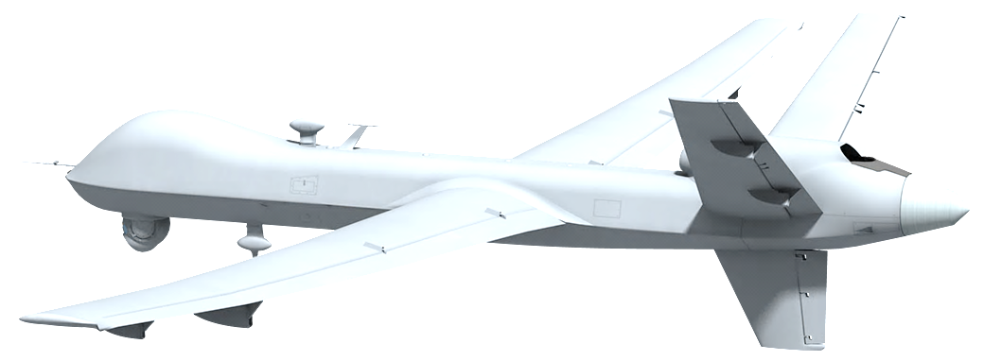
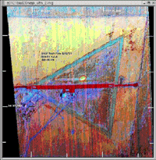
California Air National Guard MQ-9 Disaster Response Wildfire Video Imagery, Landing Zone Mapping, Firefighter Support
2001
First Response Experiment
Labor Day Weekend 2020
400 People Rescued
From the Creek Fire at Mammoth Reservoir
Notes:
Disaster Response, Wildfire Video Imagery, Landing Zone Mapping, and Firefighter Support:
General Atomics Aeronautical Systems started working with NASA to provide life-saving images and maps of wildfires to firefighters in 2001 with the First Response Experiment. Today, fourteen of our fifty States operate the MQ-9 in their Air National Guard Wings and Squadrons beaming disaster video images and information via satellite to operations teams, firefighters, and first responders. In September 2020 the Creek fire in the California's Sierra National Forest cut off the escape of hundreds of campers enjoying the Labor Day weekend at the Mammoth Pool Reservoir. A call came in to the California National Guard at 3:15 p.m. Saturday, September 5th 2020 and the Guard launched a CH-47 Chinook and a UH-60 Blackhawk from about 60 kilometers away in Northern California. A remotely piloted MQ-9 aircraft operated by the California Air National Guard’s 163rd Wing based at March Air Reserve Base maintained watch above the site providing real-time video imagery of conditions and precise location of suitable landing zones. The California Guard MQ-9 pilot, sensor operator, and operations team identified a small clearing alongside a boat launch road that could be used as an emergency landing zone to rescue those trapped by the encircling fire. When the missions were completed on September 8th about 400 people and 27 pets had been rescued with about 21 people taken to hospitals. The Cal Guard CH-47 Chinook and UH-60 Blackhawk aviators were each awarded the Distinguished Flying Cross for the rescues.
As fire ‘engulfed everything’ around campers, an air rescue like no other in the Sierra
- https://www.latimes.com/california/story/2020-09-06/dramatic-night-airlift-rescues-scores-of-victims-trapped-by-creek-fire-at-mammoth-pool
40th Combat Aviation Brigade, Fresno, CA rescues nearly 400 stranded by Creek Fire https://www.dvidshub.net/news/379034/40th-cab-rescues-nearly-400-stranded-creek-fire
California Air National Guard’s 163rd Wing https://www.163atkw.ang.af.mil/
The story behind The Story https://www.dvidshub.net/image/6367823/story-behind-story

Slide 18
Thank You Pentagon Engineers Week
General Atomics and Affiliated Companies
www.ga.com
Notes:
Dr. Vivek Lall General Atomics and Affiliated Companies 20 minute Engineers Week 2021 “Imagining Tomorrow” presentation for the 16th annual Engineers Week event at the Pentagon.
Pentagon event is co-sponsored by the Washington Headquarters Services Facilities Services Directorate and the Office of the Under Secretary of Defense for Research and Engineering OUSD(R&E), to be hosted on Wednesday, February 24, 2021, from 1330 to 1500 EST, and will be streamed live from the Pentagon Auditorium.
http://www.ga.com/, https://www.ga-europe.com/en/home__2/, https://www.nspe.org/resources/partners-and-state-societies/engineers-week, https://www.whs.mil/Directorates/Facilities-Services-Directorate-FSD/, https://www.cto.mil/.

