Slide 1
Solar Powered Aquaponics
Growing Plants and Raising Fish using the Sun!

Slide 2
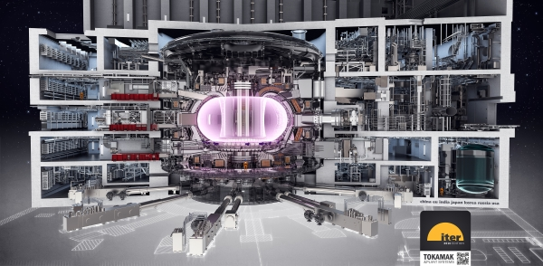
Hello!
Jeff LaBar, Manufacturing Engineer
General Atomics, Electromagnetic Systems
General Atomics is Manufacturing the Central Solenoid for the ITER Plasma Reactor in Europe
Fusion Power = The Sun on Earth = Lotsa Energy!
2040

Slide 3
Overview
Where Does Energy Come From?
Energy Relay Activity
Solar Energy Pros/Cons
Aquaponics Energy Needs
Type of Aquaponics
System Components and Design
Demos

Slide 4
Overview
Where Does Energy Come From?
Energy Relay Activity
Solar Energy Pros/Cons
Aquaponics Energy Needs
Type of Aquaponics
System Components and Design
Demo

Slide 5
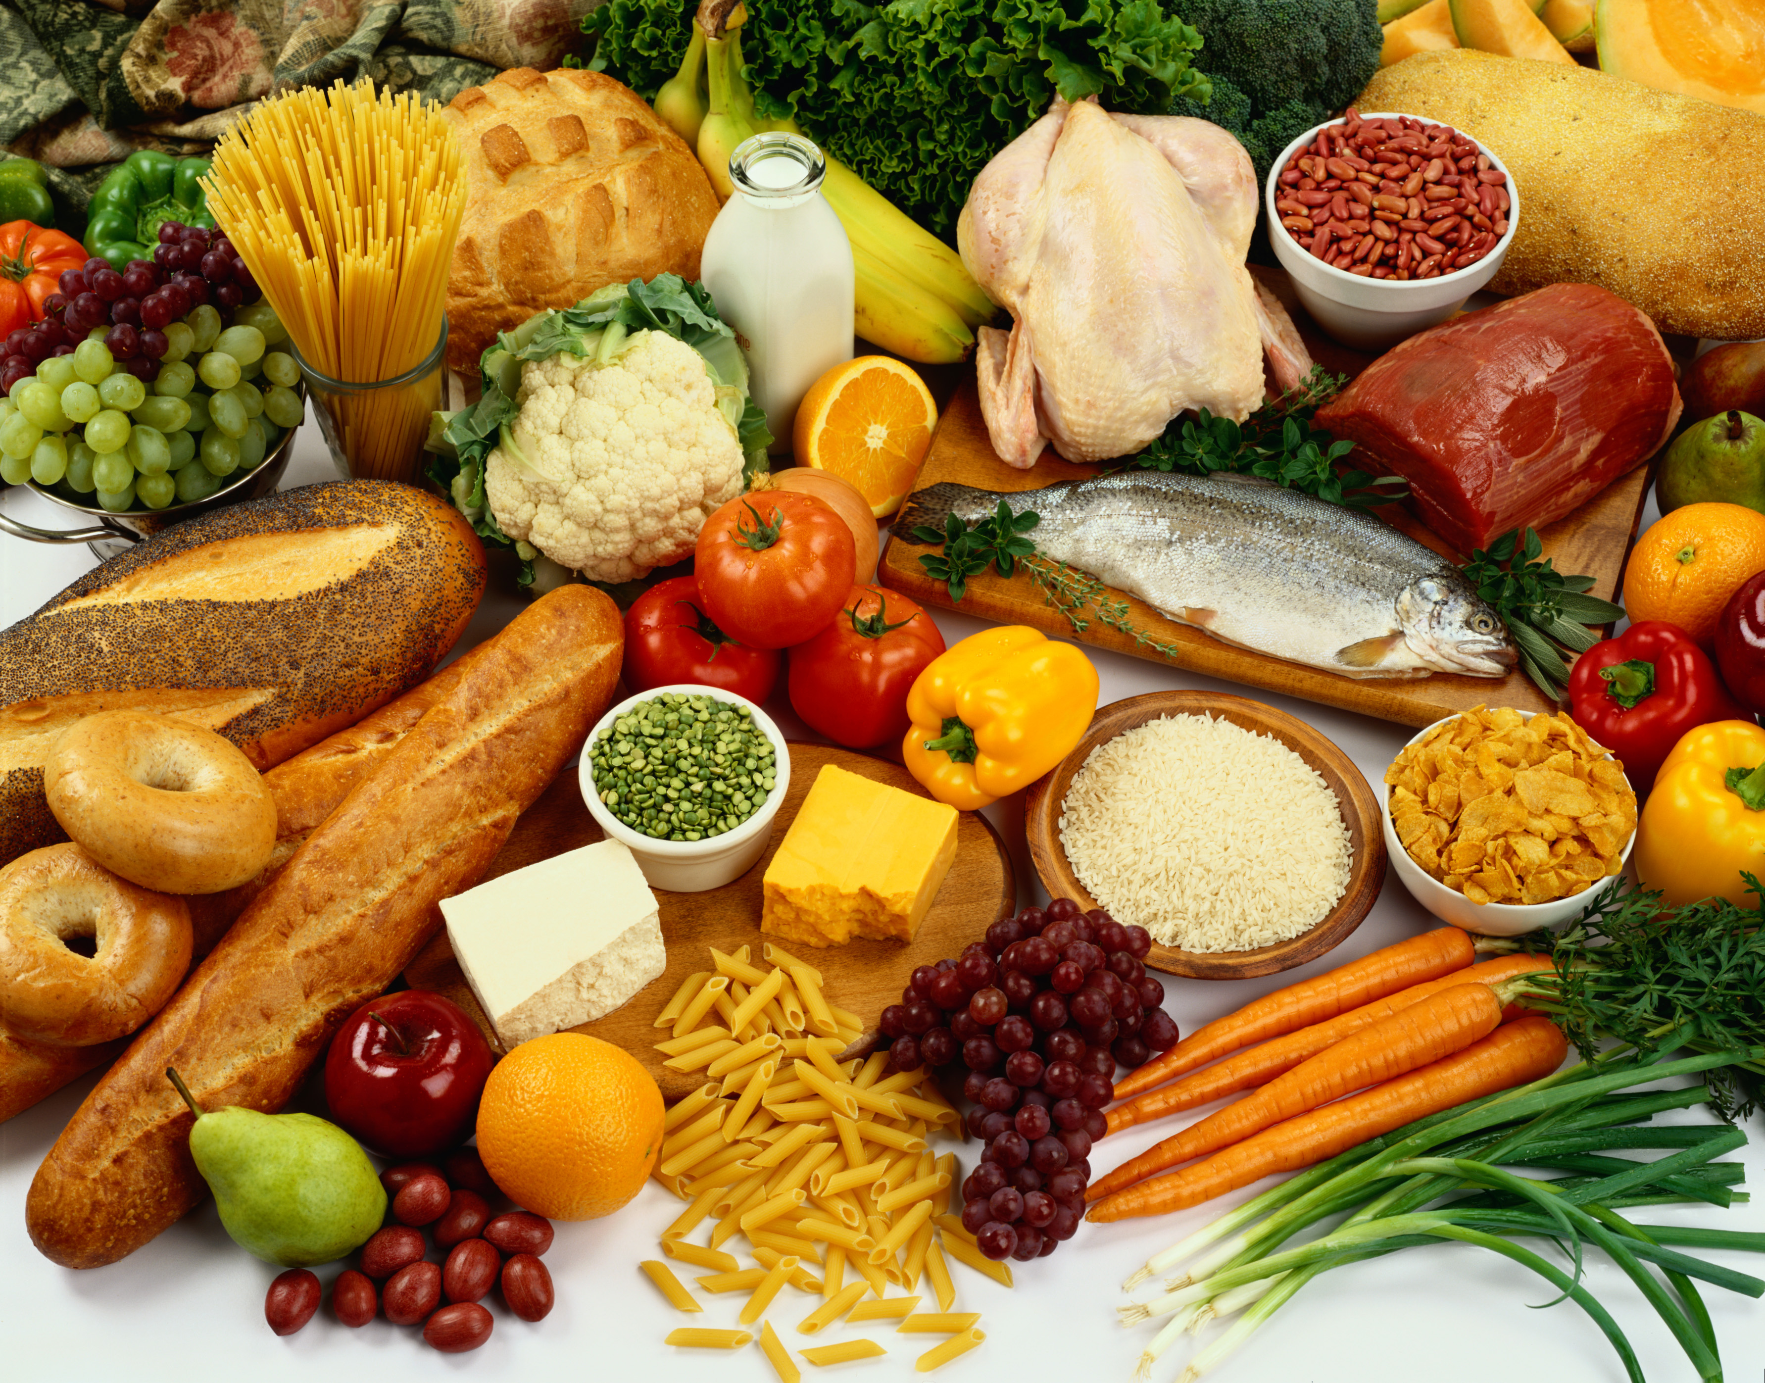
Where Does Energy Come From?
Food

Slide 6
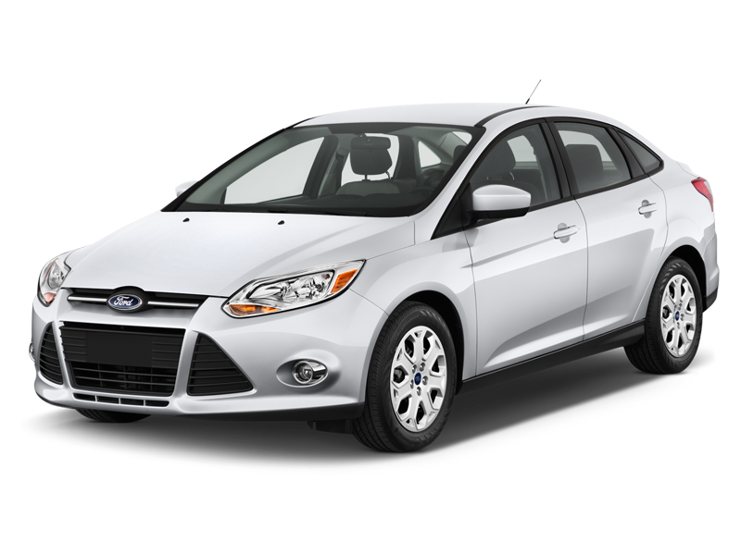
Where Does Energy Come From?
Food
Fuel Pump – Car / Bus

Slide 7
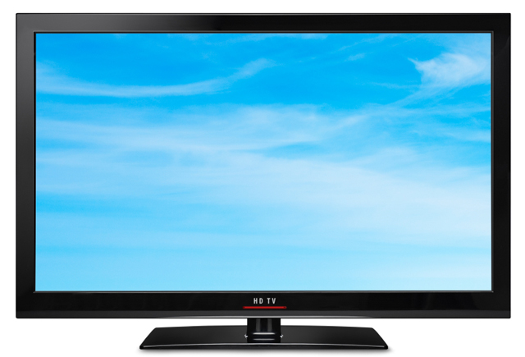
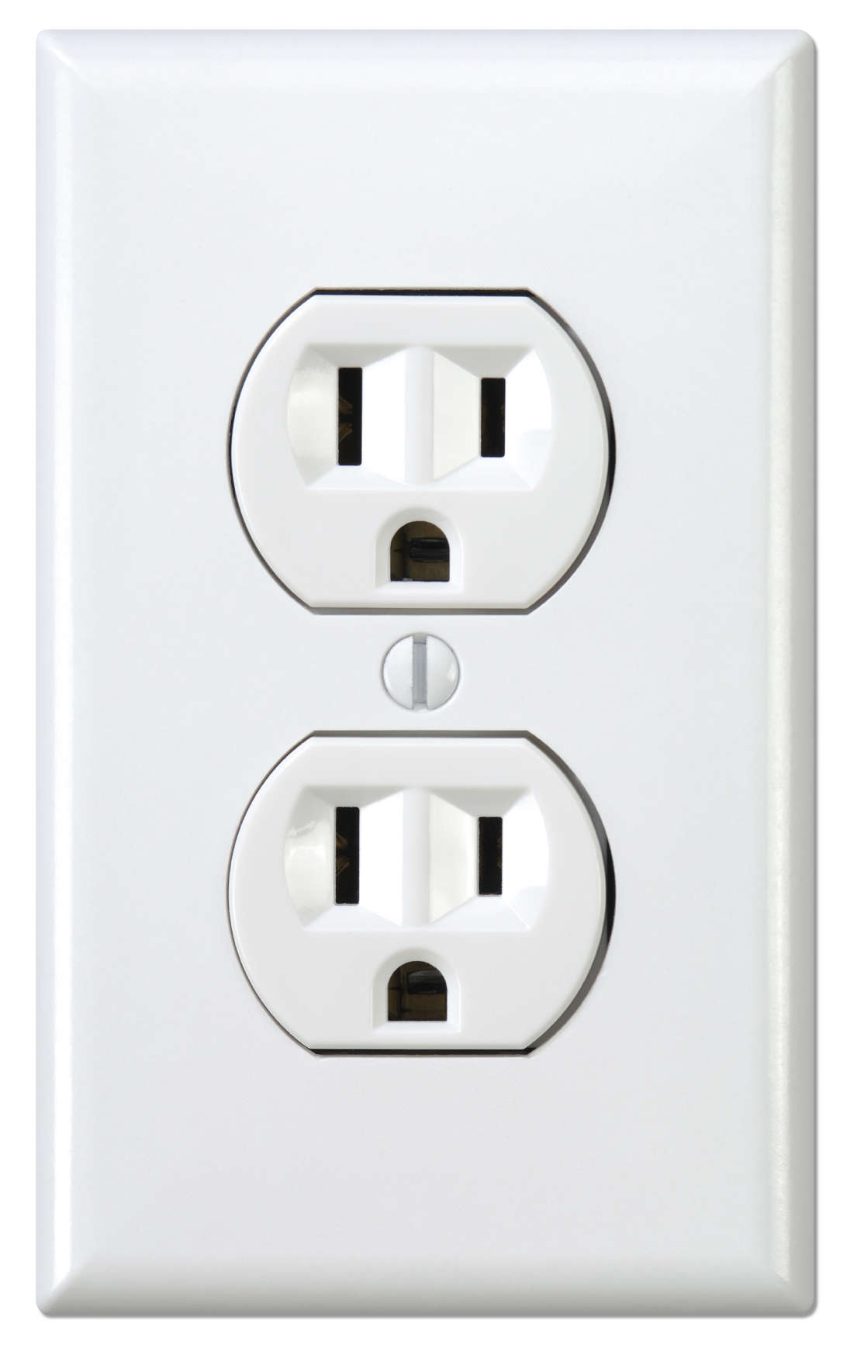
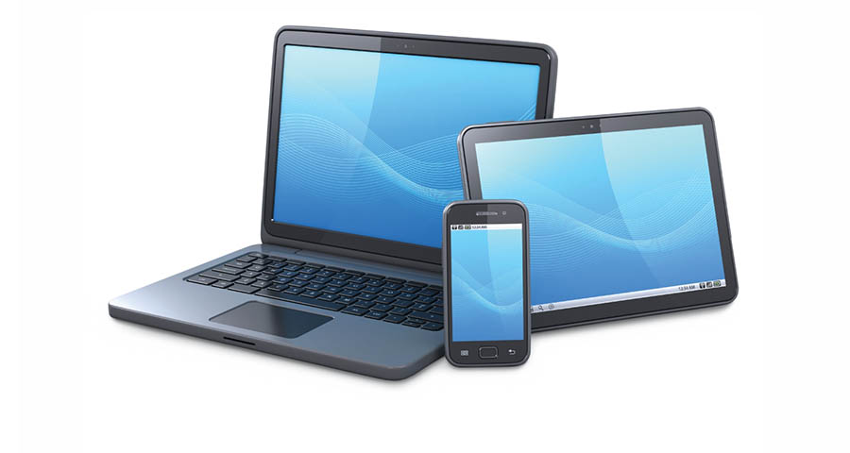
Where Does Energy Come From?
Food
Fuel Pump – Car / Bus
Wall Outlet

Slide 8
Where Does Energy Come From?
Food
Fuel Pump – Car / Bus
Wall Outlet
Where Else?

Slide 9
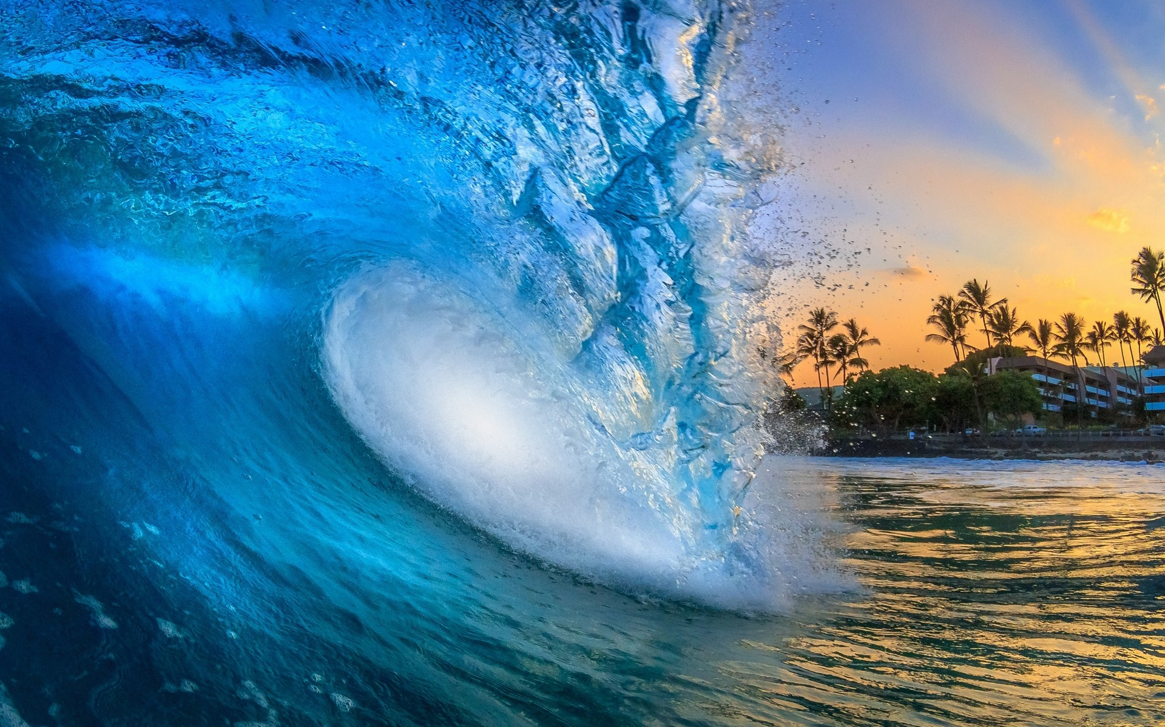
The Sun!
Light
Warmth
Wind
Waves
Plants
Notes:
http://energyquest.ca.gov/story/index.html

Slide 10
The Sun Provides Most of Our Energy

Slide 11
The Sun Provides Most of Our Energy
81% Fossil Fuels – Ancient Sun Energy
89% - Sun Energy!
8% New Sun Energy

Slide 12
How Does Solar Electricity Work?
Notes:
https://www.youtube.com/watch?v=av24fEMhDoU

Slide 13
Overview
Where Does Energy Come From?
Energy Relay Activity
Solar Energy Pros/Cons
Aquaponics Energy Needs
Type of Aquaponics
System Components
Demo

Slide 14
Energy Relay – Wall Outlet – Fuel source
Sun
Plants
Fuel
Mfg Cost
Utility
Wall Outlet
Notes:
Activity

Slide 15
Energy Relay – Solar Panel
Sun
Solar Panel
Battery/Pump
Notes:
Activity

Slide 16
Overview
Where Does Energy Come From?
Energy Relay Activity
Solar Energy Pros/Cons
Aquaponics Energy Needs
Type of Aquaponics
System Components and Design
Demo

Slide 17
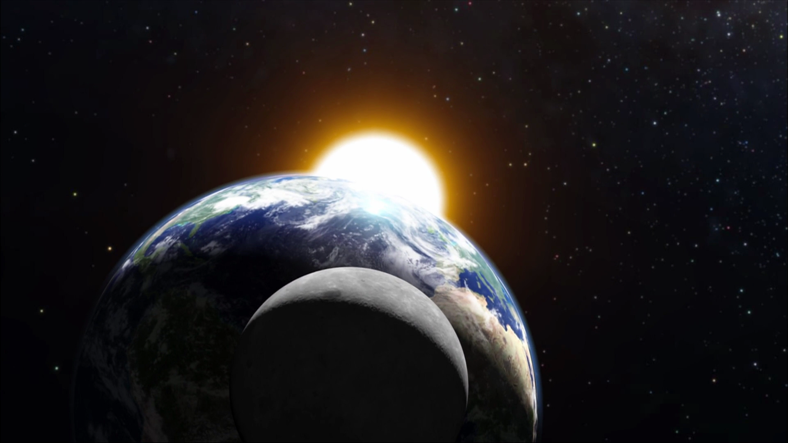
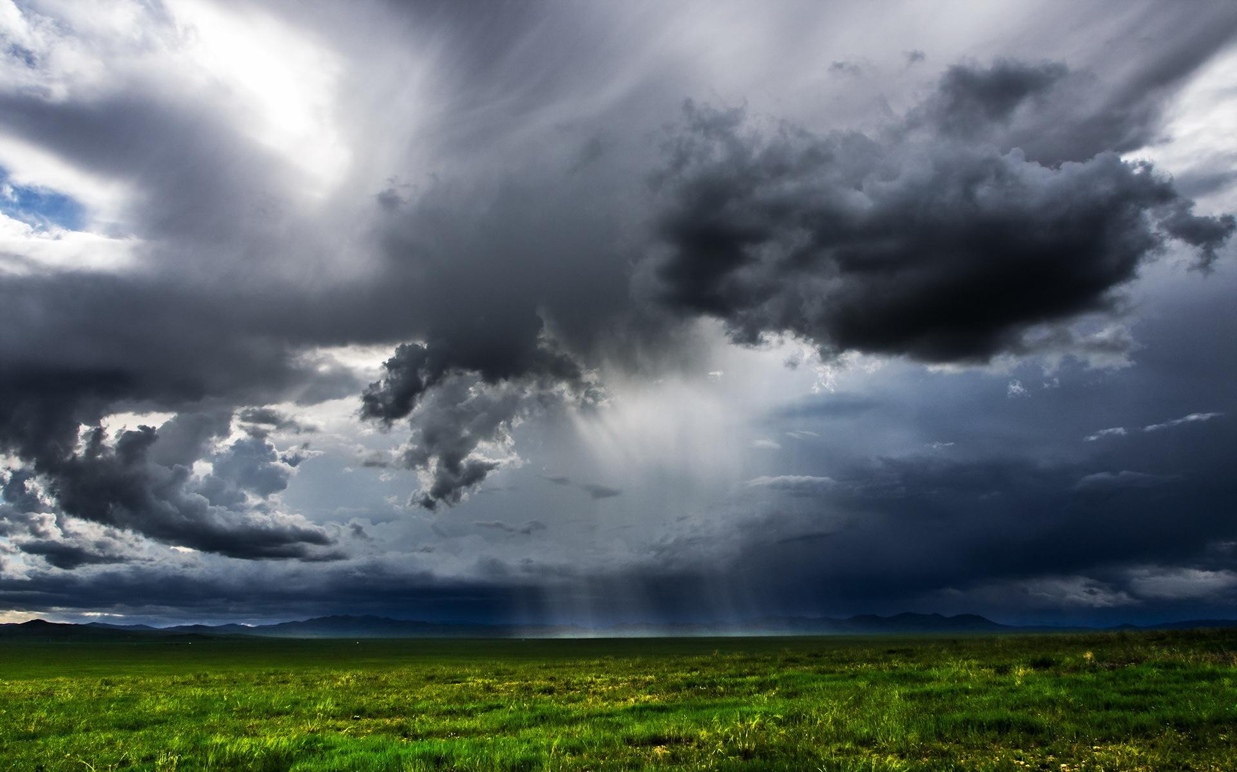
Solar Energy Pros/Cons
Constant or Periodic?

Slide 18
Solar Energy Pros/Cons
Sun
Plants
Fuel
Mfg Cost
Utility
Wall Outlet
Constant or Periodic?
Efficient?
Energy Relay
Sun
Solar Panel
Battery/Pump

Slide 19
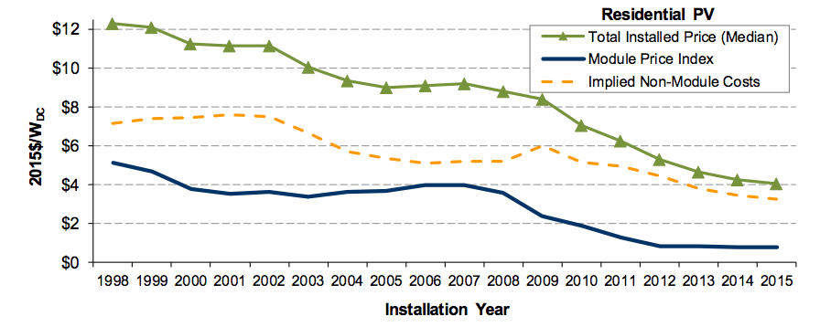
Solar Energy Pros/Cons
Constant or Periodic?
Efficient?
Energy Relay
Cost

Slide 20
Solar Energy Pros/Cons
Constant or Periodic?
Efficient?
Energy Relay
Cost
Some Cons
Great Pros

Slide 21
Overview
Where Does Energy Come From?
Energy Relay Activity
Solar Energy Pros/Cons
Aquaponics Energy Needs
Type of Aquaponics
System Components and Design
Demo

Slide 22
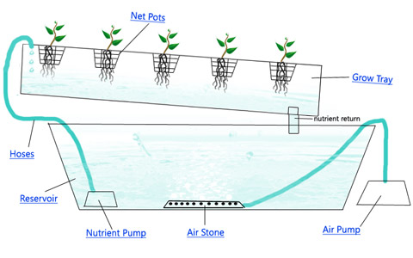
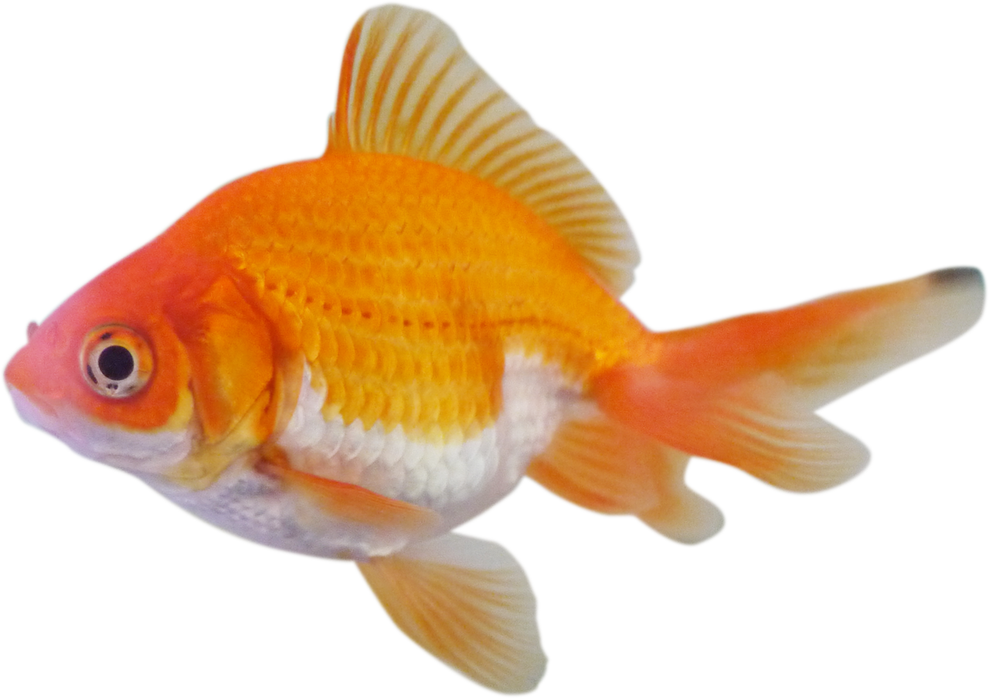
Aquaponics Energy Needs Type of Aquaponics
Nutrient Thin Film (NFT)
Constant Electricity
Good variety of plants
Minimal Media

Slide 23
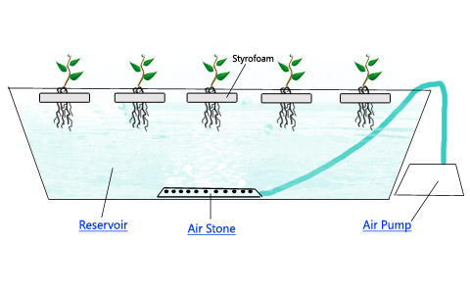
Aquaponics Energy Needs Type of Aquaponics
Floating or Deep Water Cycle (DWC)
Constant Electricity
Good Variety, best for smaller plants
Minimal Media

Slide 24
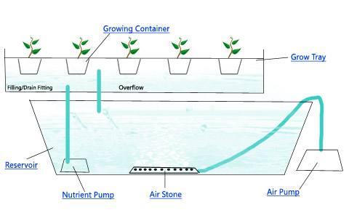
Aquaponics Energy Needs Type of Aquaponics
Flood and Drain
Periodic Electricity
Good variety of plants
Lots of Media
Grow Bed Media

Slide 25
Aquaponics Energy Needs Type of Aquaponics - Comparison
Type | Energy Needs | Solar Friendly
NTF | Constant | No
Floating (DWC) | Constant | No
Flood & Drain | Periodic | Yes

Slide 26
Overview
Where Does Energy Come From?
Energy Relay Activity
Solar Energy Pros/Cons
Aquaponics Energy Needs
Type of Aquaponics
System Components and Design
Demo

Slide 27
Solar System Components
Solar Panel / Solar Controller
Battery
Pump
Level Switch
Timer
Relay or Power Switch

Slide 28
Solar Aquaponics – Key Design Elements Grow Bed Surface Area
L
W
Grow Bed
Grow Bed
Grow Bed
L x W x number of beds
Surface Area

Slide 29
Solar Aquaponics – Key Elements Energy Requirements
Surface
Area
Water Fill
Volume
Amp-Hours
Solar Panel Size in Watts
Amp-Hours
Battery Size in Amp-Hours

Slide 30
Class Assignment – Determine Grow Beds Size and Type
L
W
Grow Bed
Type
NTF
Floating (DWC)
Flood & Drain

Slide 31
In Summary
Where Does Energy Come From?
Energy Relay Activity
Solar Energy Pros/Cons
Aquaponics Energy Needs
Type of Aquaponics
System Components
Demo

Slide 32
Silicon Solar Cells What are they made from? What do they Look Like?
Hands On
Notes:
Show a small amount of sand representing Silicon Dioxide (SiO2)
Show a small piece of Silicon metal – Silicon is made from SiO2
Show a raw Solar Cell – a Solar Cell is Silicon with a very small amount of trace impurities added plus metal lines to conduct electricity

Slide 33
Bell Siphon How does it work?
Hands On
Notes:
Show a small amount of sand representing Silicon Dioxide (SiO2)
Show a small piece of Silicon metal – Silicon is made from SiO2
Show a raw Solar Cell – a Solar Cell is Silicon with a very small amount of trace impurities added plus metal lines to conduct electricity

Slide 34
Questions?

Slide 35
Thank You!

