Slide 1
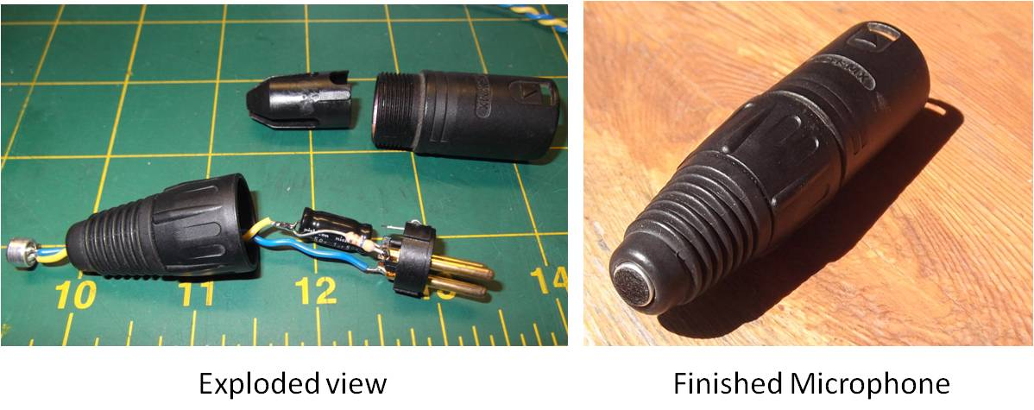
Student DIY Microphone Workshop
A simple, yet effective, student-built, phantom-powered, DIY microphone project for use in school audio/visual labs.
Recommended for Grades 4-12

Slide 2
First, the Ground Rules:
Adult supervision is required.
Soldering irons are HOT! They melt metal and can easily burn skin.
Soldering should only be done by a qualified adult, and in a well-ventilated area away from the main assembly area.
Wear eye protection when cutting and stripping wires.
Assembly is not a race. Take your time to do it right.

Slide 3
Microphone theory of operation
Sound is waves of air pressure moving back and forth.
A microphone has a very small, lightweight surface that vibrates in response to sound waves.
Those vibrations are converted to waves of electricity inside the microphone. The waves of electricity are called the “signal.”
The signal can be amplified through a speaker or recorded electronically.
Amp

Slide 4
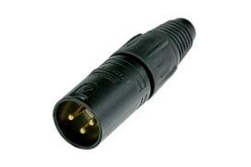

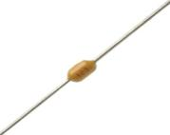
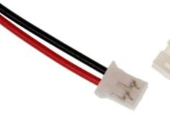
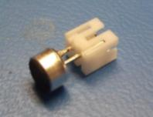
Parts List
XLR connector
47k Resistor
0.1 μF Capacitor
Female micro-mini connector
Microphone capsule with connector

Slide 5
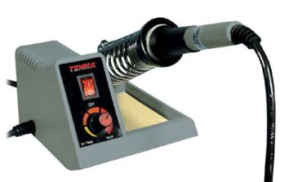
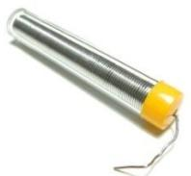
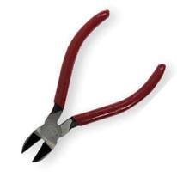

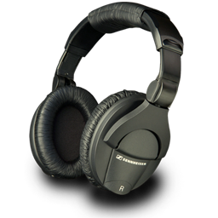
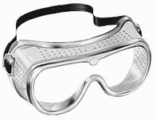
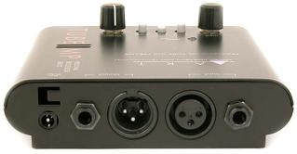
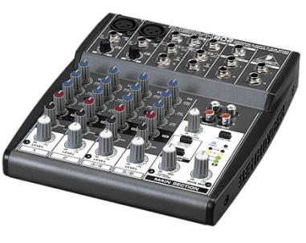

Other items
A soldering iron
Solder
Wire clippers
Wire strippers
Safety Goggles
An audio mixer or microphone preamplifier with an XLR input that supplies 48V Phantom Power. Headphones too!

Slide 6
Assembly Outline
Gather the parts on the list
Twist the capacitor and resistor together and cut the legs
Cut the red & black wires to 2-inches
Cut the black wire to 1-inch on the FEMALE connector
Strip the ends of the wires, and twist the ends
Bring your parts to the soldering table for soldering
Plug-in the capsule and Test the microphone
Assemble the microphone

Slide 7
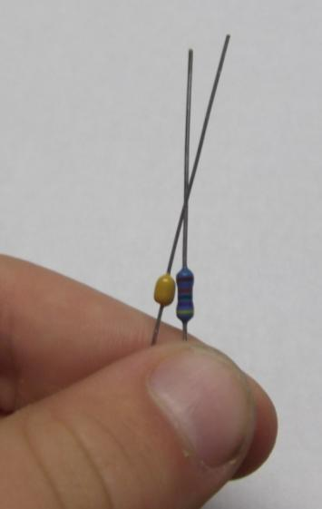
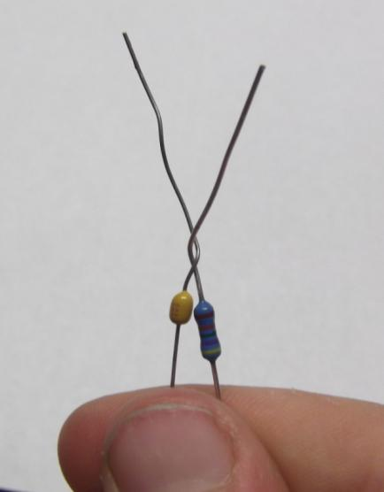
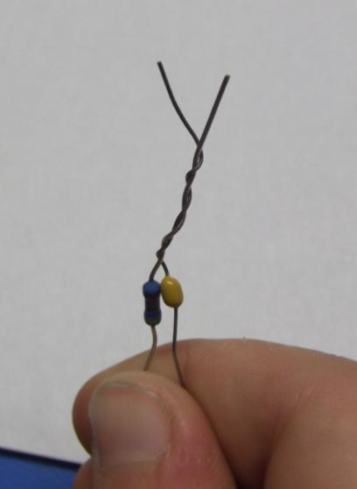
Step 1
Twist the resistor and capacitor together.

Slide 8
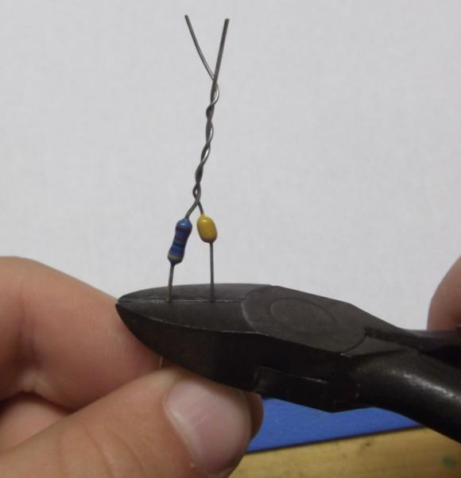
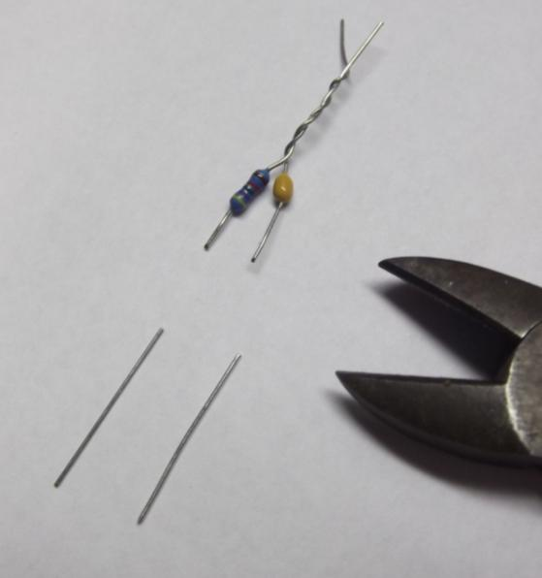
Step 2
Cut the legs of the resistor and Capacitor to ¼ inch (6 mm)

Slide 9
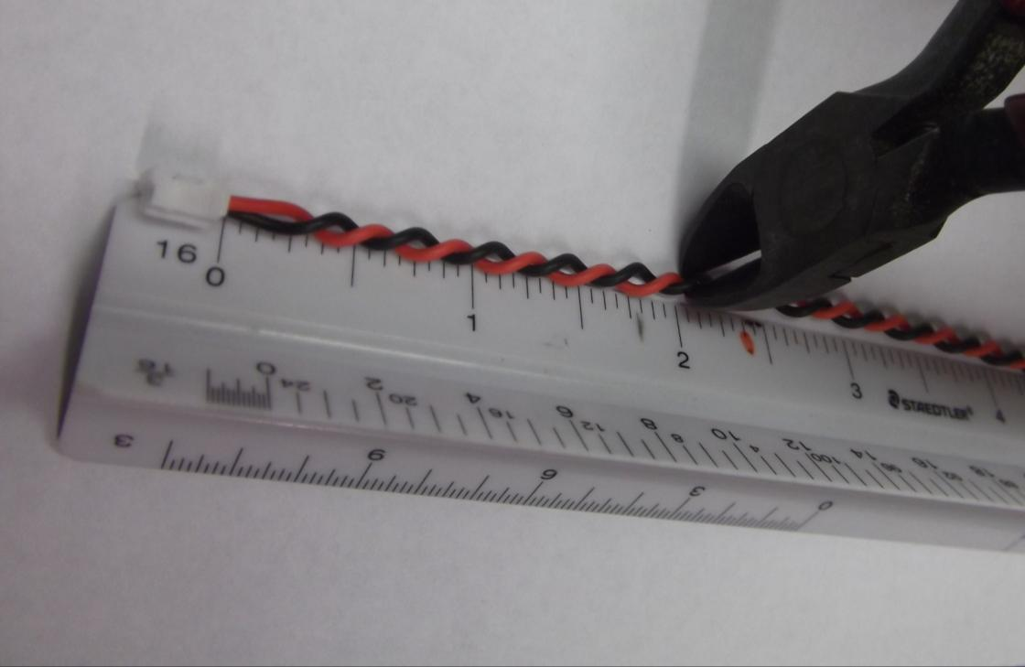
Step 3
Cut the red & black wires to 2-inches (5 cm).

Slide 10
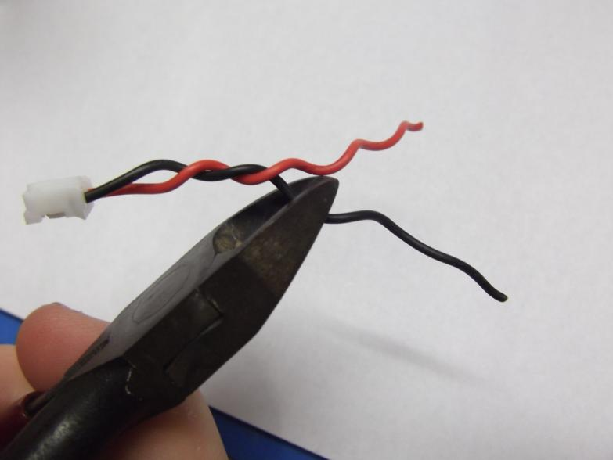
Step 4
Cut the black wire to 1-inch (2.5 cm) on the connector.

Slide 11
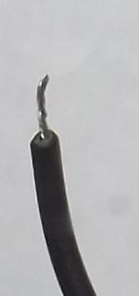
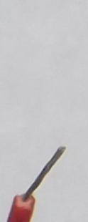

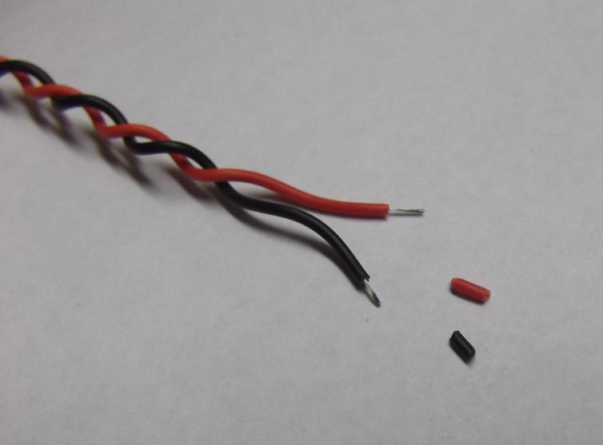
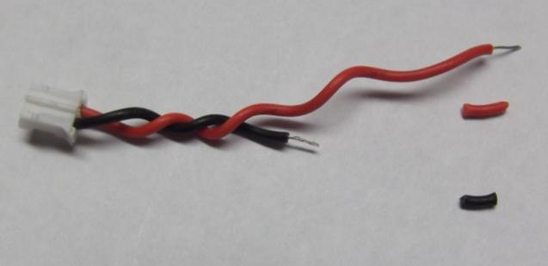
Step 5
Strip the ends of the wires, and prepare for soldering by twisting the ends of each wire.
NOTE: Practice on the extra wire first!!!
Twist each
wire end
Practice on the extra wire first
Finished connector

Slide 12
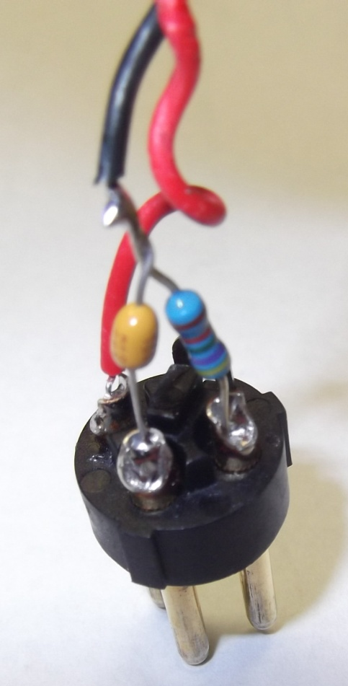
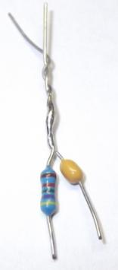
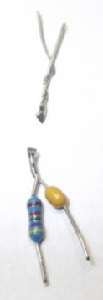
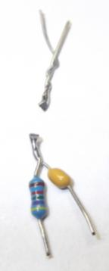

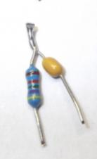
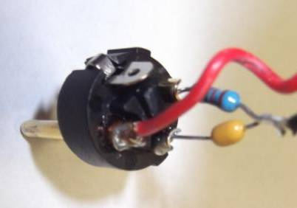
Step 6
Bring your parts to the soldering table for soldering. (Soldering must be done by an adult.)
Solder the resistor and capacitor where they are twisted together.
Cut this soldered connection to ¼ inch (6 mm)
Solder the black wire to this point.
Solder the resistor to Pin 1
Solder the capacitor to Pin 3
Solder the red wire to Pin 2
a
b
c
2
1
d
3
f
3
e
2
1
47k
.1uF

Slide 13
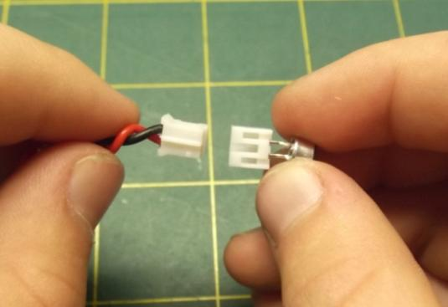

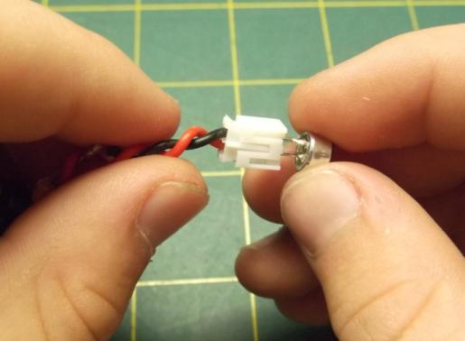
Step 7
Connect the connectors together and test the microphone.
Test the microphone by plugging it into a preamplifier or mixer which delivers 48V phantom power.
Listen through headphones or a speaker output.
“Click!”
If your microphone doesn’t work, try one of these:
Wrap the black wire/cap/resistor connection in tape
Try another capsule
Make sure it is correctly wired to Pins 1, 2, & 3
Verify phantom power is on
Try a different XLR cable
Check the volume of the amplifier

Slide 14
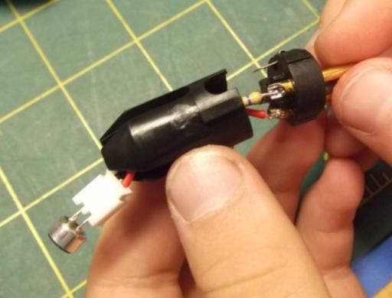
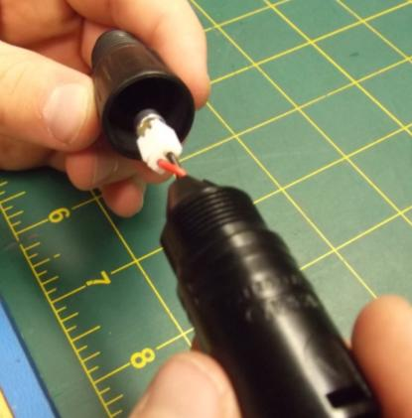
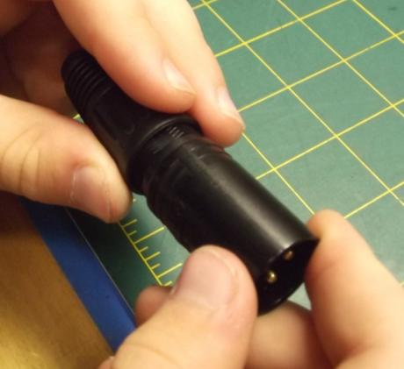
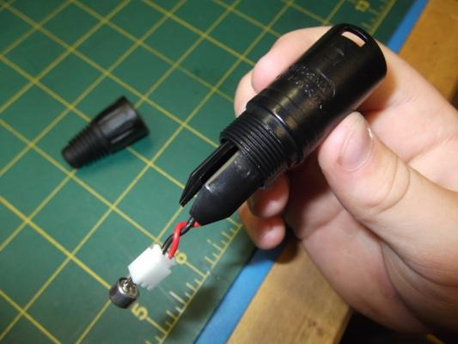
Step 8
Assemble the microphone shell
Keys
The black plastic parts are
“keyed” so that they only fit
one way into the metal shell.
(Figures 1 & 2)
Tighten the front and back together, so that the microphone element presses against the back of the rubber boot. (Figures 3 & 4)
1
3
4
2

Slide 15
Glossary
AC: Alternating Current. Electricity that flows back and forth like waves, alternating in direction. “Signal” is AC in our circuit.
DC: Direct Current. Electricity that only flows one way, direct from one point to another. “Power” is DC in our circuit.
k: kilo, or 1000. A 47k resistor is 47,000 Ohms of resistance.
Ohm: A unit of measure for resistors. More Ohms of resistance equals more restriction of electricity flow.
Phantom Power: 48 volts of DC power supplied on a 3-wire microphone cable.
μF: Microfarads. A unit of measure for capacitors. A 0.1uF capacitor stores 1/10,000,000 of a Farad of electrical charge.
XLR: A specific type of audio connector.

Slide 16
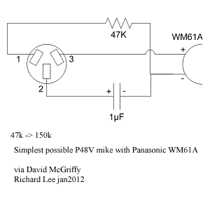
Appendix A: The Schematic
A schematic (“skee-MAT-ick”) diagram is an engineering drawing of an electronic circuit:
<
<
<
<
.
Schematic diagram
3
2
1
47k
.1uF
Assembly diagram
How are they different?
How are they the same?

Slide 17
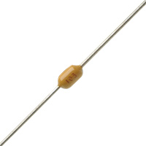
Appendix B: Electronic Components
A resistor resists the flow of electricity.
A capacitor stores DC electricity.
In our circuit, the 47k resistor is used to reduce the voltage to the microphone, from 48v to about 3v
Resistor
Schematic Symbol
In our circuit, a capacitor is used to block the DC voltage used to power the microphone, but allow the AC signal to pass through.
Ceramic
Capacitor
Schematic Symbol

Slide 18
Appendix C: How It Works
The microphone capsule is
powered by DC “phantom power” from the cable.
The microphone uses the
power to capture the
signal, and returns the
unused power to the circuit
through the 47k resistor.
The 47k resistor restricts the flow of unused power, then returns the remaining power to the circuit.
The 0.1uF capacitor blocks the unused DC power from getting to pin 3.
.
The AC signal comes out of the microphone, passes through the capacitor, and into pin 3 of the cable, to the amplifier.

Slide 19
Appendix D: Questions
Does your microphone sound different than someone else’s microphone?
  Why or why not? ___________________________________________________________________
Why do you think it sounds different when you:
  Talk into it from the side? The back? ____________________________________________________
  Hold it in your closed hand? ___________________________________________________________
What happens if you choose a 1uF capacitor (Larger value) or a 10uF Capacitor (even larger value) rather than a 0.1uF capacitor?
  Hint: Larger values reduce high-frequency output, like “hiss” in the letter “S”.
  __________________________________________________________________________________
What do you think will happen if you choose a 4.7k (smaller) resistor, or a 1Meg Ohm (larger) resistor? _________________________________________________
  Hint: The resistor determines how much power gets to the microphone.
What happens if you plug in the capsule backwards (black-to-red?)
  Hint: What happens when you look in a mirror? (Instructor Hint: Phase)
  __________________________________________________________________________________
What happens if you put the resistor or capacitor in backwards? _______________
  Hint: Look for any markings on these components indicating which way they go.
What happens if you don’t plug the microphone into a source that supplies “phantom power?” ___________________________________________________________
  Hint: What happens if you don’t plug-in your TV?

Slide 20
Appendix E: Parts List
Part Description | Suggested Supplier | P/N
WM61A Microphone Element | Digi-Key | P9925-ND
47K Resistor (47.5K) | Digi-Key | 47.5KXBK-ND
0.1μF Axial Ceramic Capacitor 50v | eBay | 0.1μF Axial Ceramic 50v
2-pin connector set * | eBay | Micro Mini JST 2.0 2-pin connector set
XLR Male Barrel Connector | Parts Express | 092-011
Red Wire 24 AWG Stranded | Parts Express | 101-864
Black Wire 24 AWG Stranded | Parts Express | 101-860
Solder 60/40 1.3 oz | Parts Express | 370-052
Soldering station | Parts Express | 374-100
Optional:
Microphone Spring Clip | eBay | 10-pack
15-foot Microphone Cable | eBay | 10-pack
* The red/black wire substitutes for a wired 2-pin Micro Mini connector set.
The WM61A capsule should be prepared ahead of the workshop, by soldering red/black wires, or the male connector directly to the capsule. Pre-preparation saves time during the workshop.

