Slide 1
What skills and knowledge are needed for a diverse set of careers and what’s the basis for these recommendations?
American Physical Society Meeting
Salt Lake City, UT
April 16, 2016
Session C6: Invited Session: Report from Joint Task Force on Undergraduate Physics Program (J-TUPP)
Dr. Lawrence Woolf
General Atomics Aeronautical Systems, Inc.
General Atomics Sciences Education Foundation
San Diego, CA 92127

Slide 2
Goals for this talk
J-TUPP recommendations
Background reports used by J-TUPP
Mapping of J-TUPP recommendations to reports

Slide 3
J-TUPP Charge
What skills and knowledge should the next generation of undergraduate physics degree holders possess to be well prepared for a diverse set of careers?
  Improve the education of a diverse student population.
  Recommendations
    Content
    Pedagogy
    Professional skills
    Student engagement

Slide 4
Caveats
This report is still in a draft stage
The recommendations may change
This presentation was not vetted or approved by other J-TUPP members

Slide 5
Reports
1. A- G; Disciplinary reports (undergraduate chemistry, geoscience, physics, engineering, biology, industrial physics, BYO-CEO focus group)
2. A-C; Learning goals for STEM disciplines (mathematics, chemistry, engineering)
3. A-F; Employee perspective of workplace competencies (6 surveys)
4. A-B; Learning goals form university physics departments (UC Berkeley, Georgetown)
5. A; AIP Career Pathways Project

Slide 6
Reports
6. A_C; AIP Statistical Research Center Reports (knowledge and skills used by physics bachelor’s in private sector 2009/10, 2011/2, PhD physicists in the private sector at PhD +10-15 years)
7. A-B; Meta-analyses of STEM competencies (Jang paper, Miller paper)
8. A-F; J-TUPP interviews with industry leaders who hire undergraduate physics majors (6)
9. A; J-TUPP report on physics majors in the workforce (interviews with 14 with undergraduate degree, 5 hiring managers)

Slide 7
Development of J-TUPP Goals
Experience of J-TUPP members,
  3 (4) Industry
  1 SLAC
  6 (5) University
Iterative development over time and meetings
  Summarize reports/resources
  Mapping of reports/resources to goals to evaluate gaps, strengths: Transparency

Slide 8
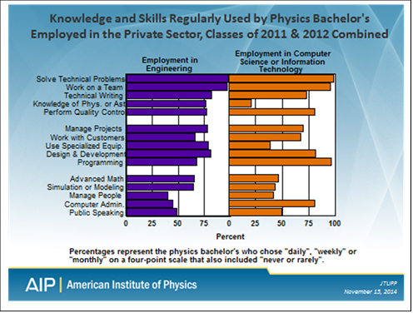
6A. Knowledge and Skills Used by Physics Bachelor’s Employed in the Private Sector, Classes of 2011 & 2012 Combined
https://www.aip.org/statistics

Slide 9
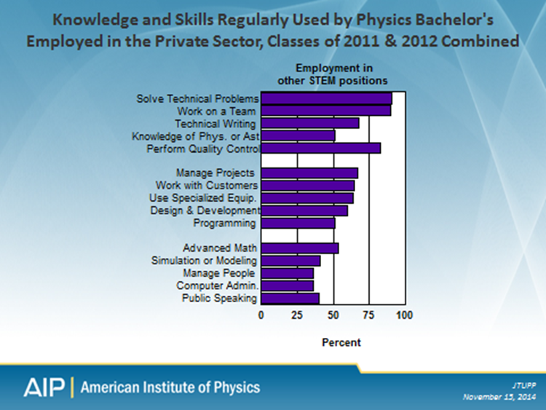
6A. Knowledge and Skills Used by Physics Bachelor’s Employed in the Private Sector, Classes of 2011 & 2012 Combined
https://www.aip.org/statistics

Slide 10
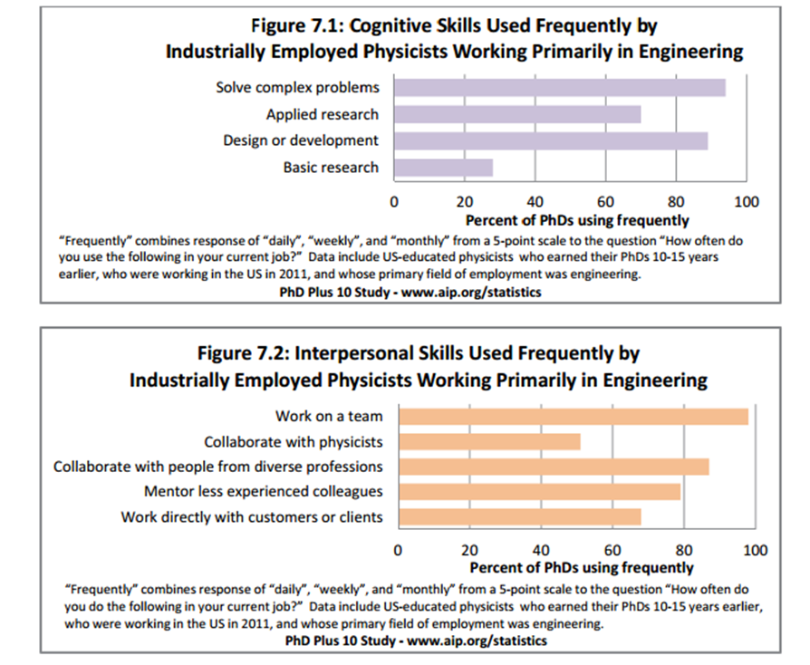
6C. Common Careers of Physicists in the Private Sector
PhDs educated in the U.S. 10-15 years earlier
Similar to undergraduate skills

Slide 11
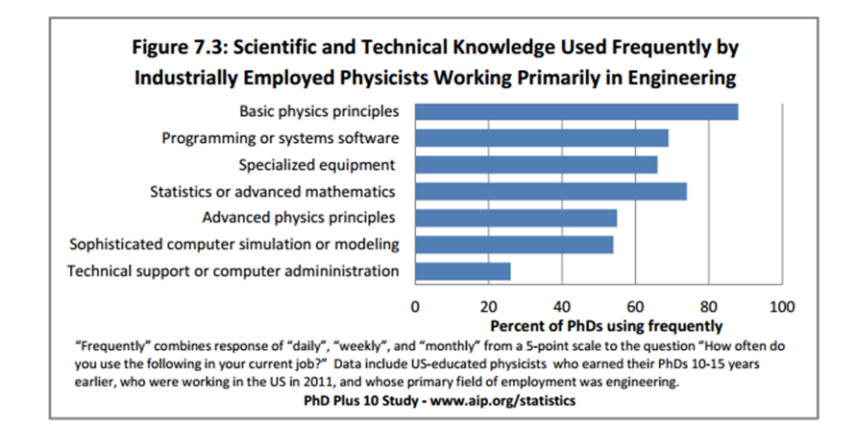
6C. Common Careers of Physicists in the Private Sector
PhDs educated in the U.S. 10-15 years earlier
Similar to undergraduate skills
https://www.aip.org/sites/default/files/statistics/phd-plus-10/PhysPrivSect.pdf

Slide 12
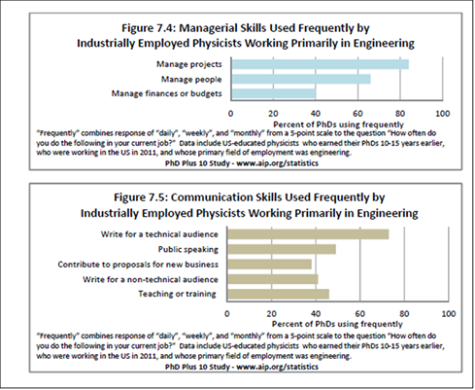
6C. Common Careers of Physicists in the Private Sector
PhDs educated in the U.S. 10-15 years earlier
Similar to undergraduate skills

Slide 13
J-TUPP Recommendations: 4 Categories
  A. Physics-specific knowledge
  B. Scientific and technical skills
  C. Communication skills
  D. Professional/Workplace skills

Slide 14
A. J-TUPP Category
J-TUPP recommendation
  Example 1 of recommendation from background reports with Letter and Number key
  Example 2 of recommendation from background reports with Letter and Number key
Chart summary of categories of background recommendations

Slide 15
A. PHYSICS-SPECIFIC KNOWLEDGE
A.1. Demonstrate understanding of fundamental, crosscutting themes in physics including conservation laws; symmetry; systems, models and their limitations; particulate nature of matter; waves; interactions; and fields
  1E: Integrate facts into larger conceptual framework

Slide 16
A. PHYSICS-SPECIFIC KNOWLEDGE
A.2. Demonstrate competency in understanding and applying basic laws in these areas of physics: classical and quantum mechanics, electricity & magnetism, thermodynamics, statistical mechanics, special relativity, and their applications in areas such as optics, condensed matter physics, and properties of materials
  4A: Mastered a broad set of knowledge concerning the fundamentals in the basic areas of physics (quantum mechanics, classical mechanics, statistical mechanics, thermodynamics, electricity and magnetism, optics, and special relativity).

Slide 17
A. PHYSICS-SPECIFIC KNOWLEDGE
A.3. Demonstrate an ability to represent basic physics concepts mathematically (including making estimations), conceptually, verbally, pictorially, computationally, by simulation, and experimentally
  2A. Use and compare analytical, visual, and numerical perspectives in exploring mathematics

Slide 18
A. PHYSICS-SPECIFIC KNOWLEDGE
A.4. Demonstrate ability to solve problems that involve multiple areas of physics
  2A: promote awareness of connections to subjects both within and beyond the mathematical sciences
  4B. Ability to synthesize knowledge from different areas of physics

Slide 19
A. PHYSICS-SPECIFIC KNOWLEDGE
A.5. Demonstrate ability to solve multi-disciplinary problems that link physics and other disciplines.
  1E: More connections across the disciplines
  1F: Need to work across scientific and engineering disciplines
  2A: Mathematics students should become aware of connections to other areas (both in and out of the mathematical sciences)
  7B: Inter- and multi-disciplinary thinking

Slide 20
A. PHYSICS-SPECIFIC KNOWLEDGE
A.6. Demonstrate knowledge of how basic physics concepts are applied in modern technology, and the ability to apply this knowledge to the solution of applied problems.
  1E: Abstract concepts related to real world examples, use real world context
  2B: The curriculum should expose students to the role of chemistry in contemporary societal and global issues
  3B: An understanding of science and technology and how these subjects are used in real-world settings
  3D: Ability to apply knowledge and skills to real world settings

Slide 21
B. SCIENTIFIC AND TECHNICAL SKILLS
B.1. Demonstrate ability to solve both well-posed and ill-posed questions and problems.
  1B: Engage in complex open and coupled systems thinking; work with uncertainty.
  2A: Pursue open-ended questions; experience tackling ill-posed real-world problems by building and analyzing appropriate deterministic and stochastic mathematical models
  3B: The ability to think clearly about complex problems; The ability to analyze a problem to develop workable solutions
Notes:
Development of J-TUPP is an exmample

Slide 22
B. SCIENTIFIC AND TECHNICAL SKILLS
B.2. Demonstrate basic experimental instrumentation abilities: understand and use manuals and specifications; build, assemble, integrate, operate, trouble-shoot and repair equipment, interface to computers, and calibrate modern laboratory instrumentation and equipment (instrumentation competency )
  4A. An understanding of how to use computers in data acquisition and processing and Use standard laboratory equipment, modern instrumentation, and classical techniques to carry out experiments
  8F: Demonstrate competency in basic experimental technologies including vacuum, electronics, optics, and data acquisition equipment and know limitations of equipment

Slide 23
B. SCIENTIFIC AND TECHNICAL SKILLS
B.3. Demonstrate ability to learn and use industry-standard computational, design, analysis and simulation software and document the results obtained for a computation or design (computational software competency)
  2A. Teach students to use professional-level technological tools such as computer algebra systems, visualization software, and statistical packages
  4B. Understanding of when numerical calculations are indicated and the ability to carry them out
  6C: Knowledge of sophisticated computer simulation or modeling

Slide 24
B. SCIENTIFIC AND TECHNICAL SKILLS
B.4. Demonstrate ability to write and execute a software program using a current software language (coding competency) to explore, simulate or model physical phenomena
  6A,B: Programming
  6C: Knowledge of programming or systems software
  8E: Strong coding skills
  8F: Knowledge of at least 1 programming language
  9. Programming skills

Slide 25
B. SCIENTIFIC AND TECHNICAL SKILLS
B.5. Demonstrate ability to analyze data, including statistical and uncertainty analysis, distinguish between models, and present those results with appropriate tables and charts (data analytics competency)
  2A: a command of data analysis and statistical inference
  4B. Experimental physics: error analysis, curve fitting, data analysis
  6C: Knowledge of statistics or advanced mathematics
  8D: Statistical data analysis

Slide 26
B. SCIENTIFIC AND TECHNICAL SKILLS
B.6. Draft: Demonstrate ability to define problems clearly, design and execute experiments, determine how the results provided answers to the problem, determine follow-on investigations, and understand the context of these results in a larger perspective
  2B: Students should be taught how to define problems clearly, develop testable hypotheses, design and execute experiments, analyze data using appropriate statistical methods
  4A: Be able to think creatively about scientific problems and their solutions, to design experiments; Understand the objective of a physics laboratory experiment

Slide 27
B. SCIENTIFIC AND TECHNICAL SKILLS
B.7. Draft: Demonstrate ability to retrieve information efficiently and effectively by searching the literature, read, analyze, evaluate, interpret, and cite technical articles, and manage scientific and engineering information so that it is actionable
  2B: Essential student skills include the ability to retrieve information efficiently and effectively by searching the chemical literature, evaluate technical articles critically, and manage many types of chemical information; Students' ability to read, analyze, interpret, and cite the chemical literature

Slide 28
C. COMMUNICATION SKILLS
C.1. Demonstrate ability to communicate with many different audiences from many different cultures, understand each audience, and make the communication relevant and have maximum impact for that audience
  2A. communicate mathematical ideas clearly and coherently both verbally and in writing to audiences of varying mathematical sophistication
  5. Building communication skills as part of the undergraduate physics experience

Slide 29
C. COMMUNICATION SKILLS
C.2. Demonstrate the ability to obtain and evaluate information through reading, listening and discussing
  1F: active listening
  3A: written and oral communication skills
  3D: The ability to locate, organize, and evaluate information from multiple sources
  7A: Reading comprehension, active listening

Slide 30
C. COMMUNICATION SKILLS
C.3. Demonstrate the ability to be persuasive in communicating the worth of an idea
  3E: Ability to sell or influence others
  7B: Effective communication including advocacy and persuasion; effective collaboration including leadership, followership, and consensus building
  8D: Must learn to sell project ideas to business managers, clearly articulate your ideas to a variety of people; ability to persuade others to work with you; ability to acquire the big picture or the company perspective to convince others that your idea is good

Slide 31
C. COMMUNICATION SKILLS
C.4. Demonstrate the ability to articulate the state of your understanding of your own and others’ ideas
  1E. Student-centered courses and curricula provide opportunities for students to examine and discuss their understanding of the concepts presented
  4B. Ability to justify and explain specific approaches to solving problems

Slide 32
C. COMMUNICATION SKILLS
C.5. Demonstrate ability to orally communicate physics and technology concepts to a broad range of audiences and stakeholders, including both scientists and non-scientists
  3D: The ability to effectively collaborate orally and in writing
  4A. Communicate the concepts and results of their laboratory experiments through effective writing and oral communication skills.

Slide 33
C. COMMUNICATION SKILLS
C.6. Demonstrate ability to communicate in writing about scientific and technical concepts concisely and completely; demonstrate ability to revise writing to achieve grammatically-correct and logically-constructed arguments
  2B: The chemistry curriculum should include critically evaluated writing and speaking opportunities so students learn to present information in a clear and organized manner, write well-organized and concise reports in a scientifically appropriate style, and use relevant technology in their communications

Slide 34
C. COMMUNICATION SKILLS
C.7. Demonstrate ability to organize and communicate ideas using words, mathematical equations, tables, graphs, pictures, diagrams and other visualization tools
  2A. Use and compare analytical, visual, and numerical perspectives in exploring mathematics

Slide 35
D. PROFESSIONAL/WORKPLACE SKILLS
D.1. Demonstrate ability to work collegially and collaboratively in diverse teams as both leader and member in working toward a common goal
  3A: Collaborating with others; working with a diverse group of people
  7A: Establishing and maintaining interpersonal relationships; developing and building teams
  8F: Work as team and contribute your skills to solve the problem – make an impact

Slide 36
D. PROFESSIONAL/WORKPLACE SKILLS
D.2. Demonstrate the ability to obtain knowledge about existing technology resources relevant for the task at hand

Slide 37
D. PROFESSIONAL/WORKPLACE SKILLS
D.3. Demonstrate the ability to identify independently what you need to learn, and to learn it
  1C: ability to learn new things, self-learning
  2A: A mathematical sciences major should be structured to move students beyond the carefully choreographed mathematical experiences of the classroom
  4B. Tools and encouragement to become life-long learners

Slide 38
D. PROFESSIONAL/WORKPLACE SKILLS
D.4. Demonstrate the ability to generate new ideas.
  7A: Thinking creatively
  7B: Entrepreneurial mindset and associated business acumen; Creativity, curiosity, and design

Slide 39
D. PROFESSIONAL/WORKPLACE SKILLS
D.5. Demonstrate familiarity with basic workplace concepts ; for example: Project Management, Budgets
  1F: Need proficiency in basic business concepts, project management, technology development process that coverts basic research to products
  6A,B: Perform quality control, manage projects, work with customers; manage people

Slide 40
D. PROFESSIONAL/WORKPLACE SKILLS
D.6. Demonstrate awareness of standard practices for effective resumes and job interviews, as well as professional appearance and behavior
  5. Make it easy for a potential employer to see why you are the right person for this job by highlighting your skills and experience most relevant to those listed in the description

Slide 41
D. PROFESSIONAL/WORKPLACE SKILLS
D.7. Demonstrate critical life skills including completing work on time, the ability to work well with others, listening, optimism, realism, time management, responsibility, respect, commitment, perseverance, independence, resourcefulness, integrity, ethical behavior, cultural and social competence.
  7B: Ethical behavior and trustworthiness; self-confidence, positive outlook, accepting responsibility, perseverance, sincerity, respect for others, good judgment; empathy and social responsibility; global awareness and perspective

Slide 42
D. PROFESSIONAL/WORKPLACE SKILLS
D.8. Develop awareness of career opportunities and pathways for physics graduates, both regional and national
  2A: Mathematical sciences major programs should offer their students an orientation to careers in mathematics.
  5. Faculty and staff commitment to physics majors’ success at all levels, regardless of career goals; Mentoring and advising physics majors in accordance with their interests and goals; Connections with alumni; Relationship with the career services office

Slide 43
Conclusions – J-TUPP Recommendations
4 Categories
  Physics-specific knowledge
  Scientific and technical skills
  Communication skills
  Professional/Workplace skills
Robust basis for recommendations
Still in draft form

Slide 44
BACK UP SLIDES

Slide 45
Background reports and resources
1. Disciplinary reports (undergraduate chemistry, geoscience, physics, engineering, biology, industrial physics)
  1A. Undergraduate Chemistry Education: A Workshop Summary (2013)
  1B. Summary Report for Summit on Future of Undergraduate Geoscience Education (2014)
  1C. Adapting to a Changing World--Challenges and Opportunities in Undergraduate Physics Education
  1D. Transforming Undergraduate Education in Engineering Phase I: Synthesizing and Integrating Industry Perspectives
  1E. Vision and Change in Undergraduate Biology Education A Call to Action\
  1F. 2015 Workshop Report on National Issues in Industrial Physics
  1G. The "BYO-CEO" focus group convened in association with the APS April meeting in Denver in 2013

Slide 46
Background reports and resources
2. Learning goals for STEM disciplines (mathematics, chemistry, engineering)
  2A. 2015 Committee on the Undergraduate Program in Mathematics CUPM Curriculum Guide to Majors in the Mathematical Sciences
  2B. Undergraduate Professional Education in Chemistry: ACS Guidelines and Evaluation Procedures for Bachelor’s Degree Programs
  2C. CRITERIA FOR ACCREDITING ENGINEERING PROGRAMS Effective for Reviews During the 2015-2016 Accreditation Cycle

Slide 47
Background reports and resources
3. Employee perspective of workplace competencies (multiple surveys)
  3A. The Role of Higher Education in Career Development: Employer Perceptions December, 2012
  3B. Association of American Colleges and Universities: Top Ten Things Employers Look for in New College Graduates
  3C. Still Searching: Job Vacancies and STEM Skills; Metropolitan Policy Program at Brookings
  3D. How Should Colleges Prepare Students To Succeed In Today's Global Economy? Based On Surveys Among Employers And Recent College Graduates Conducted On Behalf Of: The Association Of American Colleges And Universities
  3E. National Association of Colleges and Employers 2013 Survey
  3F. Daniel Group report on what employers look for in candidates

Slide 48
Background reports and resources
4. Learning goals form university physics departments (UC Berkeley, Georgetown)
  4A. University of California – Berkeley
  4B. Georgetown University
5. AIP Career Pathways Project

Slide 49
Background reports and resources
6. AIP Statistical Research Center Reports (knowledge and skills used by physics bachelor’s in private sector, skills used by PhD physicists in the private sector)
  6A. Knowledge and Skills Used by Physics Bachelor’s Employed in the Private Sector, Classes of 2011 & 2012 Combined
  6B. Knowledge and Skills Used by Physics Bachelor’s Employed in the Private Sector, Classes of 2009 and 2010 Combined
  6C. Common Careers of Physicists in the Private Sector; PhDs educated in the U.S. 10-15 years earlier

Slide 50
Background reports and resources
7. Meta-analyses of STEM competencies (Jang paper, Miller paper)
  7A. Identifying 21st century STEM competencies using workplace data by Hyewon Jang, Journal of Science Education and Technology April 2016, Volume 25, Issue 2, pp 284-301
  7B. Why the Hard Science of Engineering is No Longer Enough to Meet the 21st Century Challenges by Richard K. Miller http://www.olin.edu/sites/default/files/rebalancing_engineering_education_may_15.pdf

Slide 51
Background reports and resources
8. J-TUPP interviews with industry leaders who hire undergraduate physics majors
  8A: Physicist 1
  8B: Physicist 2
  8C: Physicist 3
  8D: Physicist 4
  8E: Physicist 5
  8F: Physicist 6
9. J-TUPP report on physics majors in the workforce

