Slide 1
Engineering, Aerodynamics and Flying
Date
Name
General Atomics
Position
Notes:
Less than 20% of students choose a STEM path ¹
The reason we talking about this today and the reason it is a hot topic within education is because
Sixty percent of the new jobs that will open in the 21st century will require skills possessed by only 20 percent of the current workforce¹
The bottom line is that other countries are producing many more scientists and engineers than the United States ²
DoD faces the additional hiring hurdle of security clearance requirements that often exclude highly talented individuals who are not U.S. citizens ²
Why does that matter?
Ultimately this impacts our workforce and country

Slide 2
What do Engineers Do?
Engineers Come in All Shapes and Sizes
Work in Many Different Environments
  Offices, Outdoors, Space ships and more
Trained in Many Different Fields
  Aerospace, Biomedical, Computer, Civil and more
Engineers Design Many Different Products
  iPhones, Rovers that Explore Mars, and more
Notes:
It is generally important to get the students into the lesson by asking them what they know about you will be talking about (engineering and how airplanes fly). At the end, ask the students what they now think about the issues.
1 National Math and Science Initiative - https://www.nms.org/
2 Department of Defense – STEM Education and Outreach Strategic Plan
3 US Census Bureau – Disparities in STEM Employment By Sex, Race, and Hispanic Origin
4 (http://www.usnews.com/news/blogs/stem-education/2013/01/31/report-many-high-schoolers-giving-up-on-stem)
5 True Child - Do Internalized Feminine Norms Depress Girls’ STEM Attitudes & Participation?
6 The Girl Scout Research Institute. (2012). Generation STEM: What girls say about science, technology, engineering, and math. New York, NY: Girl Scouts of the USA.
7 Weber, K. (2011). Role models and informal STEM-related activities positively impact female interest in STEM. Technology and Engineering Teacher, 71,18-21.
8 Techbridge: SWE Role Models Guide
9 Gerhard Blickle and others, “Mentoring Support and Power: A Three Year Predictive Field Study on Protégé Networking and Career Success,” Journal of Vocational Behavior, Vol. 74, No. 2 (20

Slide 3
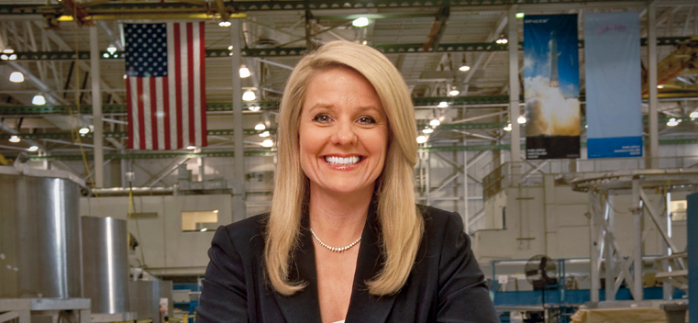
Who is Gwynee Shotwell?
President and CEO of SpaceX
Mechanical Engineer, Rocket Scientist
Notes:
She is an example that Engineers come in all shapes and sizes. She is not your stereotypical engineer. She is a degreed engineer.
She was also a High School Cheerleader, Northwestern Fraternity Sister and the White Rose Queen and is the Mother of Two Teenagers and a Wife
She’s a “whole brain, people engineer”

Slide 4

Why Should I Be an Engineer?
Have Power to make a Difference
Work with Other Talented People
Have Lots of Options
Have Money $$$ and Job Security
Do Cool Stuff!

Slide 5
How do Airplanes Fly?
Aerodynamics
Theory:
  Thrust
  Drag
  Gravity
  Lift
Hands-on
  Build an airplane
  Test and Compete to optimize the design
Notes:
It is generally important to get the students into the lesson by asking them what they know about you will be talking about (engineering and how airplanes fly). At the end, ask the students what they now think about the issues.

Slide 6
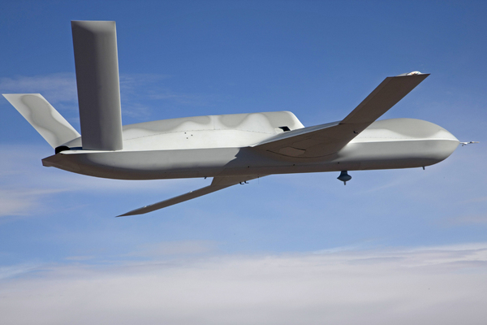
What is Aerodynamics?
The study of how gases interact with a moving body
Engineers use aerodynamics to alter the flow of the gases to make planes fly
Notes:
Aerodynamics is a subset of fluid dynamics, which covers all fluids. All fluids behave, to a certain degree, similarly. Aerodynamics applies not only to aircraft, but also propellers, turbine and compressor blades, etc.

Slide 7
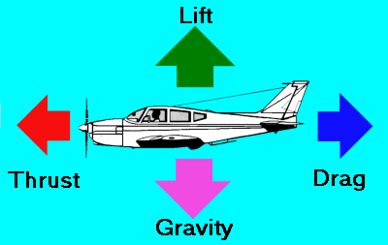
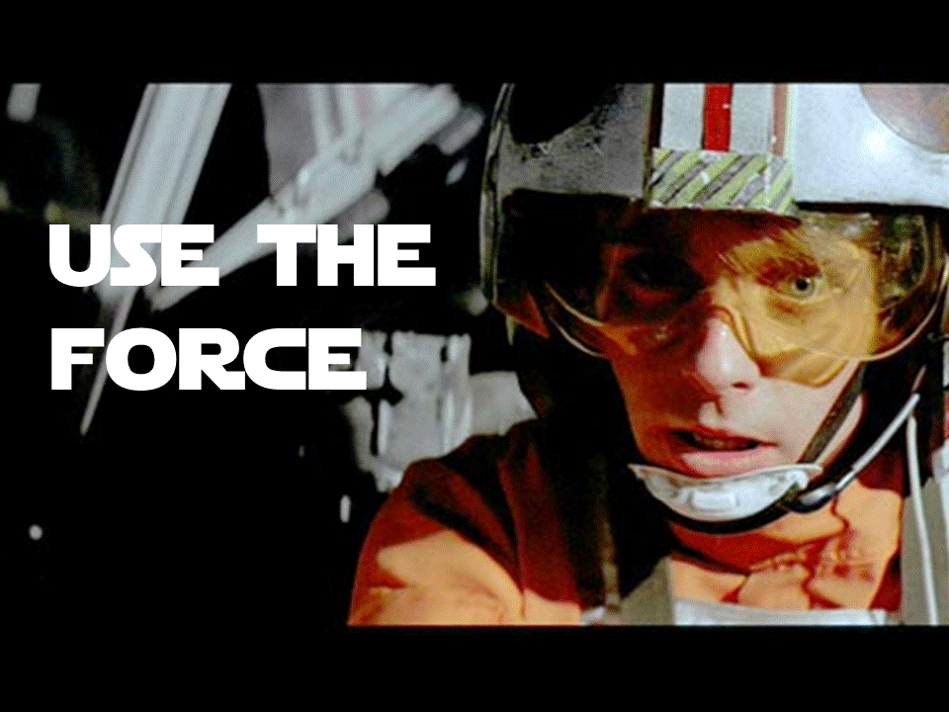
What is a Force?
Force is an interaction that will change the motion of an object
  Intuitive Concepts Push and Pull

Slide 8
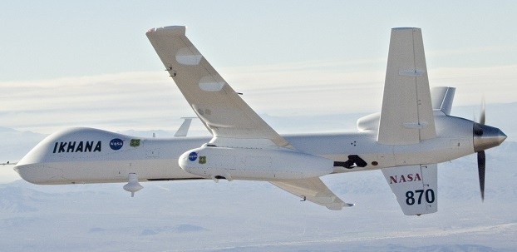
What is Thrust?
Thrust
Drag
The force that pushes an airplane forward

Slide 9
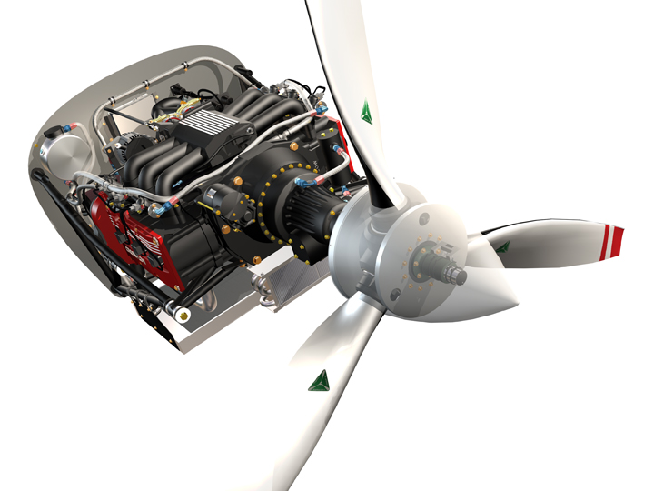
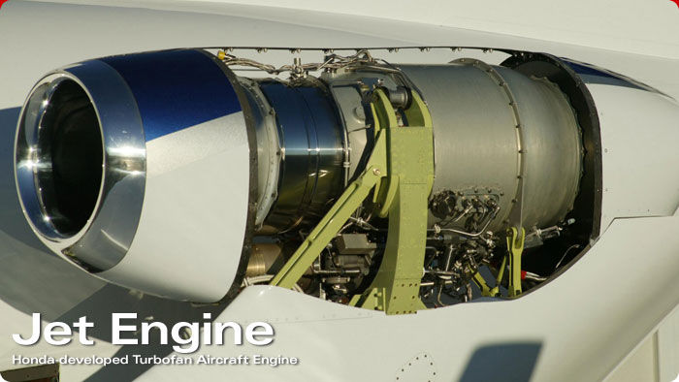
What Provides Thrust?
Airplane Propeller and Jet Engine

Slide 10
What is Drag?
Thrust
Drag
The force that pulls back on an aircraft, slowing its speed
Notes:
Drag: a boring or tiresome person or thing

Slide 11

What does an airplane fly through?
Air
  Temperature (hot air is less dense)
  Wind and Currents (air speed and direction)
  Altitude (higher up air less dense)
  Humidity (moist air, less dense)
Notes:
Temperature:
Hot air is less dense. This affects the output of the engines as well as aerodynamic capabilities. Humidity increases the required runway distance and reduces climb performance. Therefore the amount of passengers and cargo a plane can carry are often restricted when temps are very high. The restrictions depend on the temperature, airport elevation and the length of the available runways. And getting off the ground is only part of it: once airborne, planes have to meet specific, engine-out climb criterion, so nearby obstructions like hills and towers are another complication.
Wind:
Wind, more than rain, directly affects how an aircraft flies because lift is created by the movement of air over the wings. Shifts in air pressure, wind speed or direction can impact how much lift is created with sudden changes being capable of forcing an aircraft to rise or fall suddenly.
Altitude:
At higher altitudes aircraft engines are less efficient due to the decreased density of the air. At higher altitudes lift created over the wings is also lower.
Higher altitudes can also increase the possibility of ice formation either on the wings, which can limit the aircraft’s ability to produce lift, or on sensors which track airspeed and altitude. Higher altitude air is also harder to breathe, which is why aircraft are pressurized.
Humidity:
Humidity affects the way an airplane flies because of the change in pressure that accompanies changes in humidity. As the humidity goes up, the air pressure for a given volume of air goes down. This means the wings have fewer air molecules to affect as they are pushed through the air. Fewer molecules = less lift. The other problem is that jet engines do not like humidity either. Jet engines are built for cold, dry air, and humid air has fewer oxygen molecules to burn per unit volume. Therefore the engine combusts a little bit less and puts out slightly less thrust. Humidity decreases the performance of most aircraft, not only because of it's effect on the wings, but also the effect on the engines.
There are four factors that decrease the performance of a jet airplane - heavy, hot, high, and humid. Notice that three of those factors all have the net effect of lowering the density of the air.

Slide 12
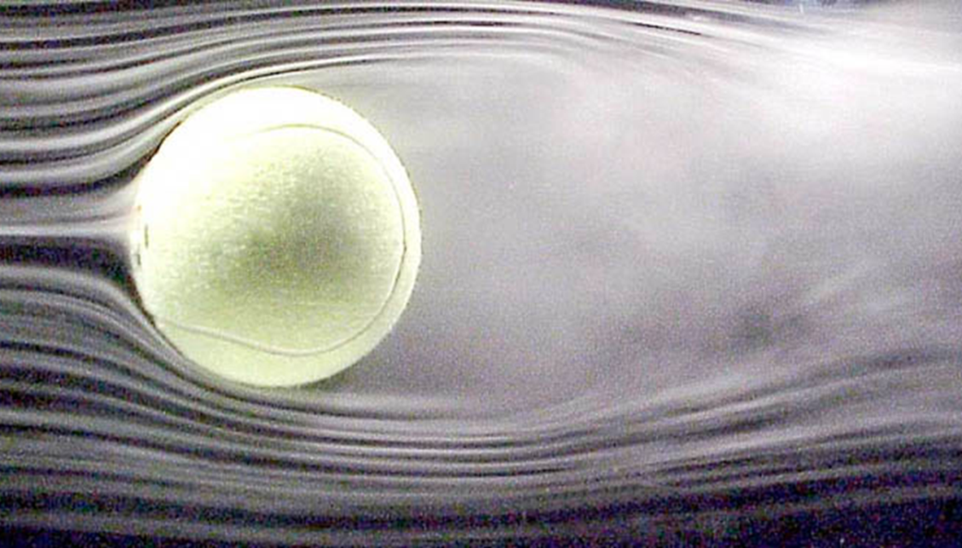
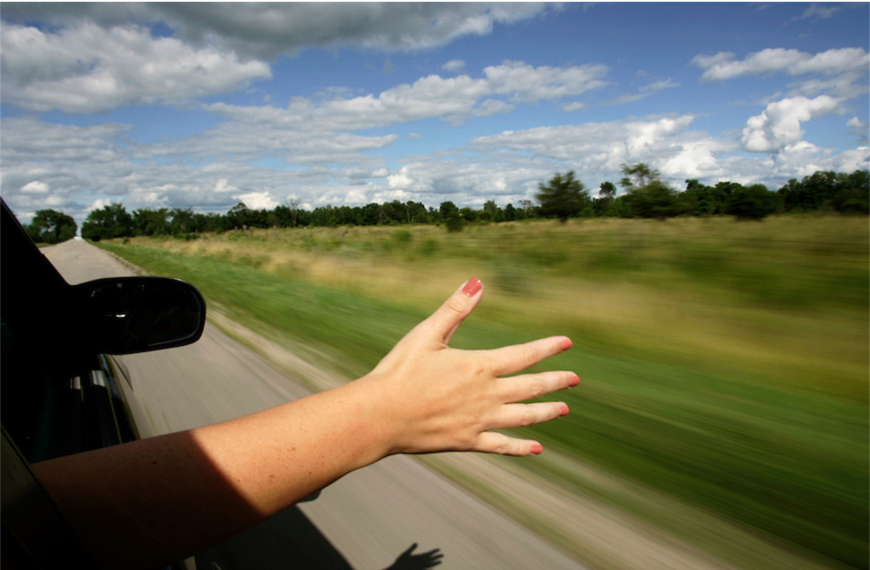
Air pushing against the airplane causes drag
Notes:
Aircraft components with significant contributions to drag:
Wing,
Tail surfaces (e.g., elevator, ruddervator, etc.),
Fuselage, and
Outside payloads.
Not all contributions are advantageous.

Slide 13
Lift
What is Gravity?
Gravity
The force that pulls everything with mass to the ground

Slide 14
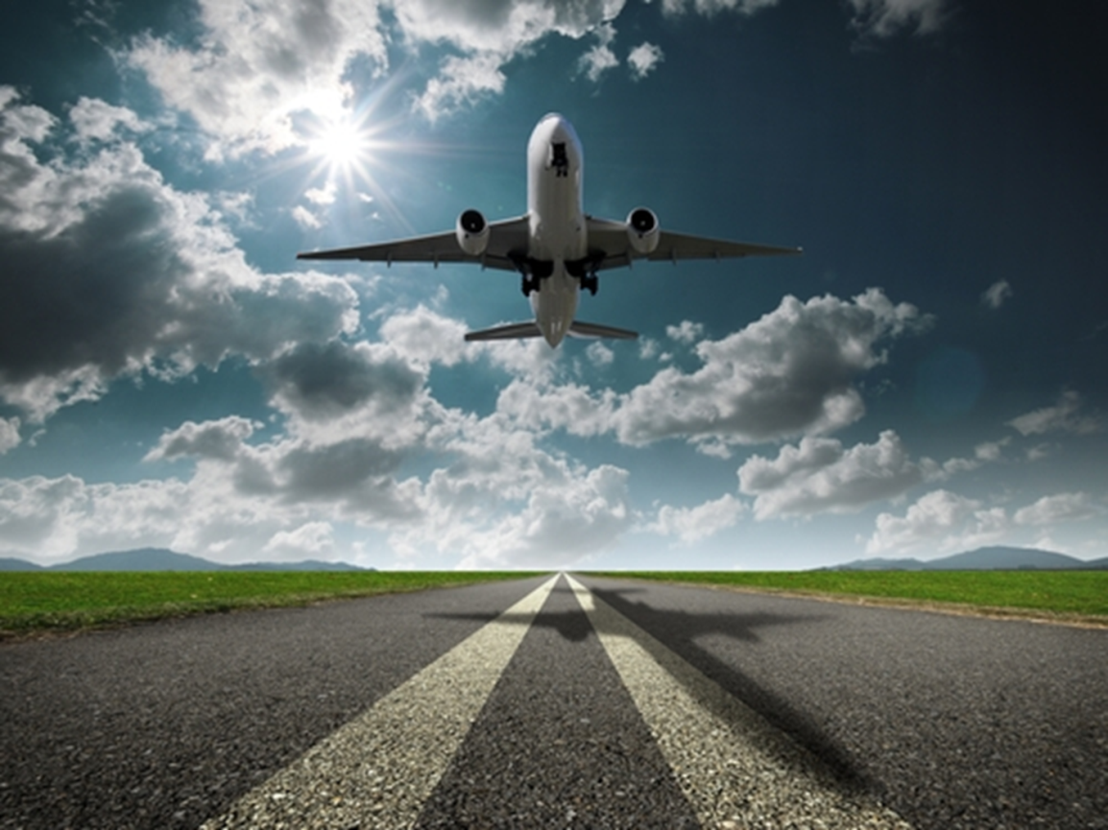
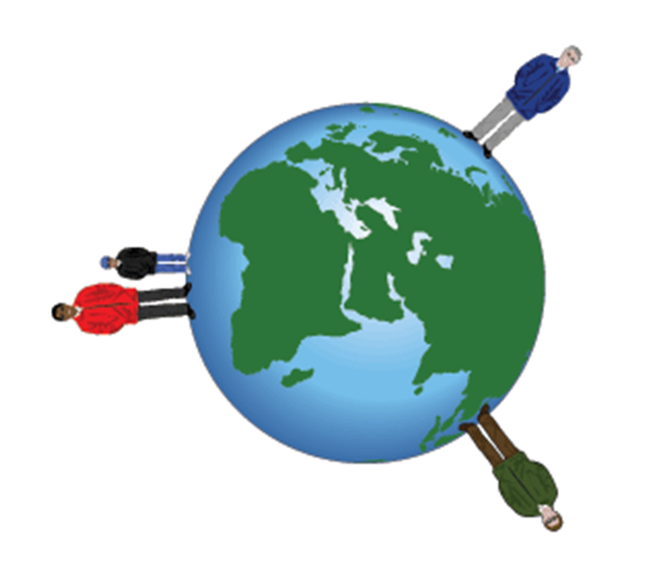
Weight and mass keep you on the ground

Slide 15
Lift
What is Lift?
Gravity
The upward force generated to overcome weight to keep an aircraft flying

Slide 16
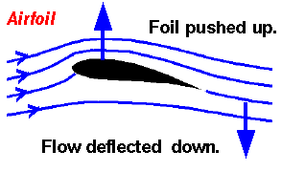
What creates lift?
Bernoulli’s Principle
Tradeoffs in
  Design: Wing airfoil, length, and shape
  Pilot: Flight Speed and Angle
  Environment: Hot, high, and humid
Notes:
http://quest.nasa.gov/aero/planetary/atmospheric/aerodynamiclift.html
The shape of a cross-section for an aerodynamic surface is an airfoil.
When trying to achieve a specific aerodynamic profile, determining shape of the body is typically the first step. For most aircraft, the primary lifting surface is the wing. The shape of the cross-section of a wing is called an airfoil. This airfoil was likely chosen after conducting research and analyses on multiple airfoils. From there, the size and shape of the wing is determined.
Factors that influence lift:
Wing’s Airfoil (cross-section)
Length and Shape of the Wing
Angle of Attack (tilt of the wing)
Density of the Air
Speed of Flight

Slide 17

Bernoulli’s Principle
Dots represent air molecules
Air moves faster over the top of the wing
Lower pressure (more air molecules) under the wing pushes the airplane up
Notes:
Bernoulli's principle: if air speeds up, then the air pressure is lowered. An increase in the speed of the fluid occurs simultaneously with a decrease in pressure or a decrease in the fluid's potential energy.
Air over the top of the wing moves faster
Fast air on top of the wing = low pressure
High pressure under the wing pushes the airplane up
Aircraft components with significant contributions to lift:
Wing,
Tail surfaces (e.g., elevator, ruddervator, etc.), and
Fuselage.
Not all contributions are advantageous

Slide 18
Tradeoffs
Design
  Airfoil thicker, more lift
  Airfoil thinner, reduces drag
  Longer Wings, more lift
  Short swept (angled) wings, reduces drag
Pilot
  Tilt upward deflects more air downward
  Tilt too upward and create turbulence or stall
Environment
  Hot, High, Humid (fewer air molecules) affects wings and engine performance by reducing both drag and lift.

Slide 19
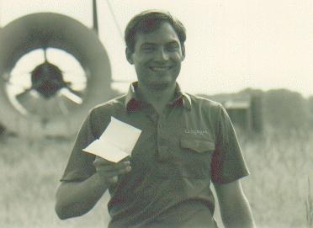
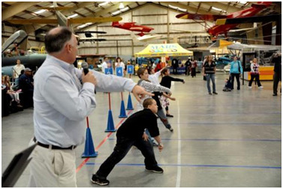
Paper Airplanes
Paper Airplanes can bring science and aerodynamics to life
  Building paper airplanes as a kid inspired Ken Blackburn to set the World Record for longest paper airplane flight and become an aeronautical engineer
Notes:
Picture of young Blackburn with the record holding airplane he designed
Picture of his book
Picture of 2015 Great Paper Airplane Fly-off with Blackburn officiating at Pima Air and Space Museum in Tucson, AZ
Give the introduction below. Then demonstrate how to build two aircraft.
Pointy, fast launch, small wings (DART, STILLETO)
Wide, square wings (ULTRA GLIDE, WORLD RECORD BREAKER)
(From The World Record Paper Airplane Book by Ken Blackburn, p23)
Flight distance is affected by different things.
Hard throws result in fast flight and your best bet for a long flight is a small winged plan (such as a dart) so it fly through the air like a javelin.
Gentle throws results in glides at slow speed and big wings are best.
Fast Launch
Generally produces the longest flights on ground level
Wings produce little lift and should be as small as practical to minimize drag (think Eagle diving, tuck in wings)
Flights up to 200 feet possible, although most flight are no more than 50 feet.
Long pointing planes are best. Length helps to keep them flying straight and small pointy wings minimize drag
Slow Launch
Generally produces the longest flights from an elevation
At slow speeds wings produce a lot of lift. The wings should be as large as practical to minimize drag and there therefore maximize distance.
Square planes are best for long lasting flights.
Wide straight wings produce the least drag at low speeds, which is why birds gliding and sailplanes use them.
Bend back edge of wing up a little bit to enable slow flight
Depending on style of plan, in calm air glide distance will equal between three and six times launch height.

Slide 20
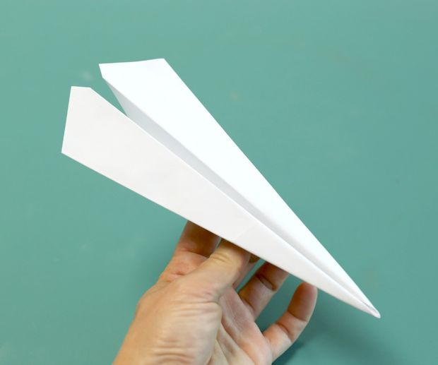
Build Prototypes to Test Different Principles
Weight (gravity)
Shape (lift, drag)
Launch style (thrust)
Notes:
Give the introduction below. Then demonstrate how to build two aircraft.
Pointy, fast launch, small wings (DART, STILLETO)
Wide, square wings (ULTRA GLIDE, WORLD RECORD BREAKER)
(From The World Record Paper Airplane Book by Ken Blackburn, p23)
Flight distance is affected by different things.
Hard throws result in fast flight and your best bet for a long flight is a small winged plan (such as a dart) so it fly through the air like a javelin.
Gentle throws results in glides at slow speed and big wings are best.
Fast Launch
Generally produces the longest flights on ground level
Wings produce little lift and should be as small as practical to minimize drag (think Eagle diving, tuck in wings)
Flights up to 200 feet possible, although most flight are no more than 50 feet.
Long pointing planes are best. Length helps to keep them flying straight and small pointy wings minimize drag
Slow Launch
Generally produces the longest flights from an elevation
At slow speeds wings produce a lot of lift. The wings should be as large as practical to minimize drag and there therefore maximize distance.
Square planes are best for long lasting flights.
Wide straight wings produce the least drag at low speeds, which is why birds gliding and sailplanes use them.
Bend back edge of wing up a little bit to enable slow flight
Depending on style of plan, in calm air glide distance will equal between three and six times launch height.

Slide 21
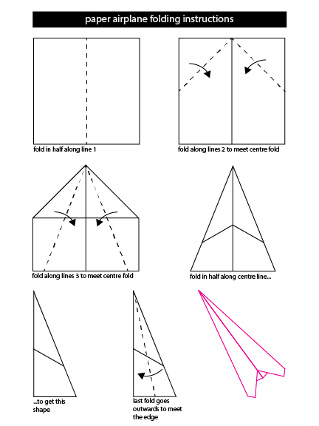
DART
Plane Shape
  Long & Pointy
Wing Shape
  Swept
Notes:
Give the introduction below. Then demonstrate how to build two aircraft.
Pointy, fast launch, small wings (DART, STILLETO)
Wide, square wings (ULTRA GLIDE, WORLD RECORD BREAKER)
(From The World Record Paper Airplane Book by Ken Blackburn, p23)
Flight distance is affected by different things.
Hard throws result in fast flight and your best bet for a long flight is a small winged plan (such as a dart) so it fly through the air like a javelin.
Gentle throws results in glides at slow speed and big wings are best.
Fast Launch
Generally produces the longest flights on ground level
Wings produce little lift and should be as small as practical to minimize drag (think Eagle diving, tuck in wings)
Flights up to 200 feet possible, although most flight are no more than 50 feet.
Long pointing planes are best. Length helps to keep them flying straight and small pointy wings minimize drag
Slow Launch
Generally produces the longest flights from an elevation
At slow speeds wings produce a lot of lift. The wings should be as large as practical to minimize drag and there therefore maximize distance.
Square planes are best for long lasting flights.
Wide straight wings produce the least drag at low speeds, which is why birds gliding and sailplanes use them.
Bend back edge of wing up a little bit to enable slow flight
Depending on style of plan, in calm air glide distance will equal between three and six times launch height.

Slide 22
GLIDER

Slide 23
How to Improve Your Results
Manufacturing Tips
  Fold with care and attention to detail
  Crisp folds, especially on the leading edges, to maximize air flow over the wing
  Make sure the wings are mirror images to prevent spiral flights
Flying Tips
  Hold the plane where the most layers overlap that is closest to the sweet spot, the center of gravity
  Start with an easy level launch
  Record every test flight
Notes:
Want air to pass over wings like smooth butter cream, so make those creases sharp!
Symmetrical wings will keep your flight straight, not a weird downward spiral.

Slide 24
Test to Optimize
Team Roles
  Test Engineer (launch airplane)
  Ground Support Engineer (retrieve airplane)
  Project Engineer (logs flights and present results)
Tests Types
  Thrust: Dominant vs Non-Dominant Throw
  Gravity: Heavy vs Light Paper
  Drag/Lift: Pointy vs Square Wings
Competition for
  Longest Flight
  Longest Distance
Notes:
http://www.paperplane.org/paero.htm
Show the three test plan on the screen and explain to students step by step what they are supposed to do.
Test Engineer flies the aircraft and provides the thrust, wait for the Project Engineer (PE) to say “go” before each launch (launch from the same spot each time, stay put)
Ground support engineer retrieves the aircraft (don’t move the plane until the PE says ok) and brings it back (not flies it back) to the Test Engineer
PE needs a pencil and a watch/phone to record the time aloft and distance in the flight log. PE reports the results to the class.
Go outside to do the tests.
Do Gravity/Thrust/Drag-Lift test while others watch.
If time is short, conduct the tests in parallel.
Get everyone back inside the classroom (if the classroom is near or you can re-order this for the end and go straight to design and competition) for briefing of test results, discussion of what the results mean, review, and design new/modified aircraft for competition

Slide 25
Lessons Learned
Team Project Engineers present their results
  Theory
  Actual Results
Giveaways
  Prizes for Longest Flight and Longest Distance
  Review what we learned
    Engineering
    Aerodynamics
Notes:
Inside after discussion of test results and review, the students have 5 mins to design and build or modify a competition aircraft.
Extra paper (heavy and light) available to make new planes if they don’t want to use the ones they already have
Okay to add other materials like tape and paper clips
If they are done early, they can go outside to test their thrust and designs
Call everyone outside and line up for the big finale.
There will be prizes for first and second place
Make sure everyone has written their names on their planes
Number students 1-2-1-2, and so on to identify them in groups 1 and 2
Group 2 sets back and Group 1 flies their aircraft
No one retrieves their aircraft yet
Group 1 steps back and Group 2 flies their aircraft
No one retrieves their aircraft yet
Teacher finds the one (and second) that flew the furthest and declares the winners
Planes that fly on the roof or otherwise cannot be found are DQ
Winners can pick from World Record Paper Airplane books (distance or duration)
Optional celebration as class ends – GA giveaways, raffle, and food treats

Slide 26
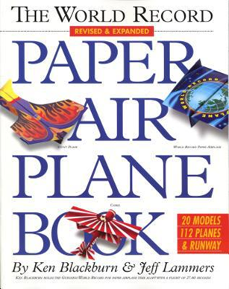
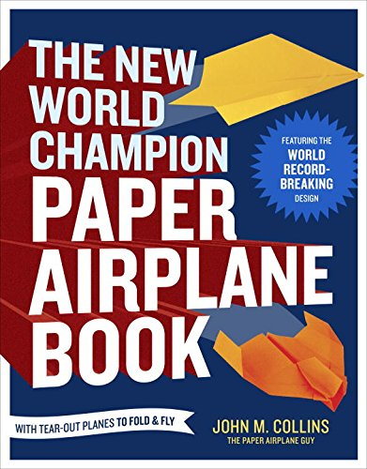
References
“The World Record Holder Paper Airplane Book” by Ken Blackburn and Jeff Lammers, 2006
“The New World Champion Paper Airplane Book: Featuring the World Record-Breaking Design, with Tear-Out Planes to Fold” by John Collins, 2013

