Slide 1
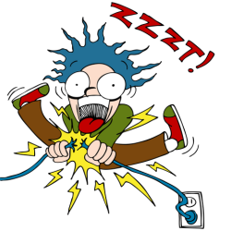
Fun with Electricity
Dr. Bill Capinski, Laser Scientist
General Atomics

Slide 2
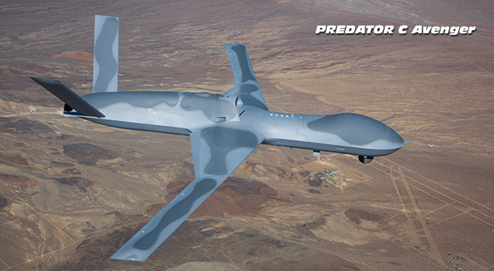

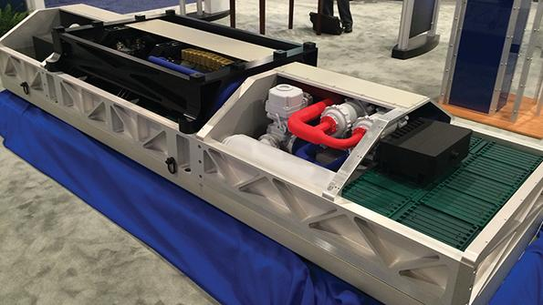
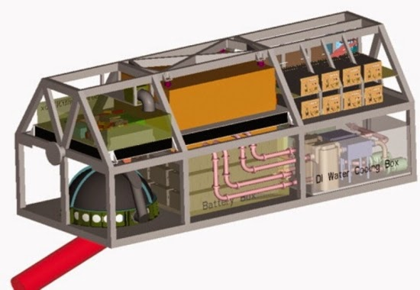

Slide 3
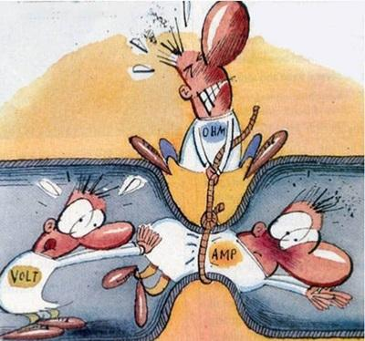

Slide 4
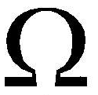
V = IR
Basic equation to understand circuits
V, Voltage (Volt): Battery, the force to push the current (electrons)
I, current (A, AMP): Current, does the work
R, resistance ( , OHM): Light bulb, fan, LED, etc. The thing that uses up the work
Note that I use the word “WORK” and not “energy” of electrons
Pay attention…. There is a quiz later…..

Slide 5
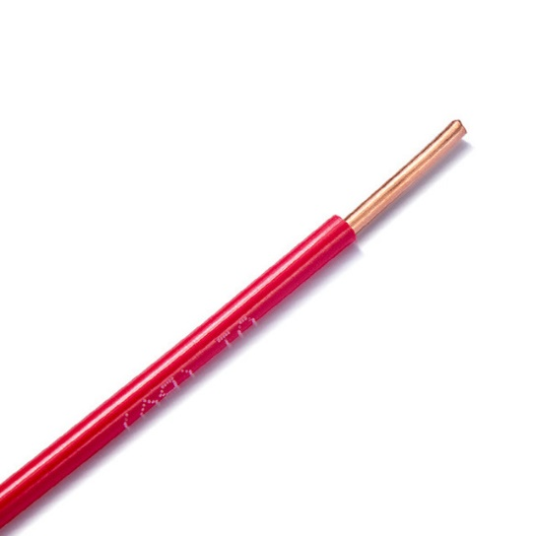
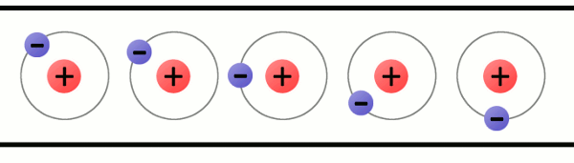
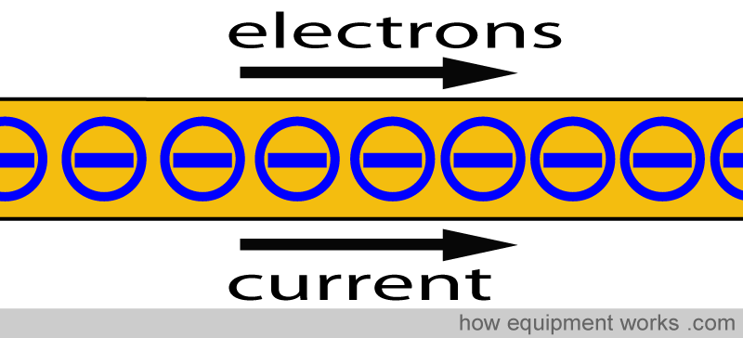
A metal wire has electrons (tiny particles) in it that move when a voltage source (battery) is used
Metal Molecule (Aluminum, Copper)
Free Electron

Slide 6
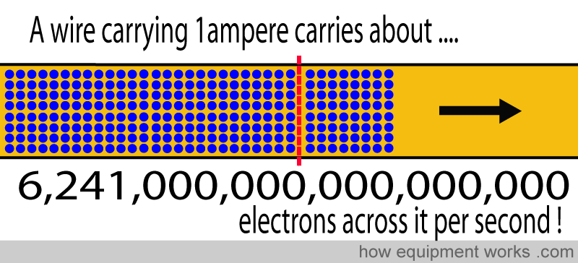
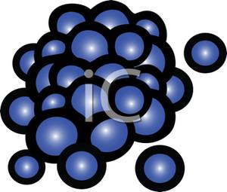
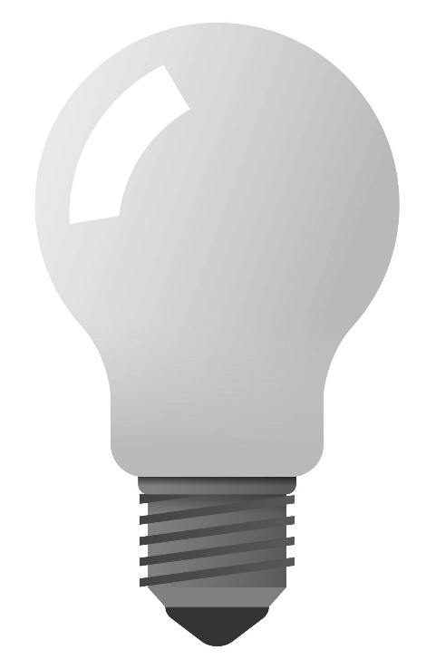
Pile of Electrons
Wire

Slide 7
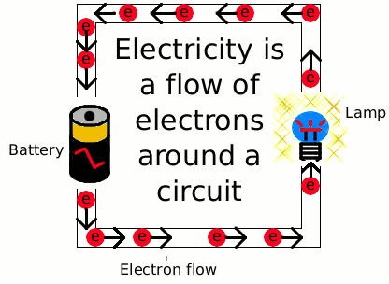
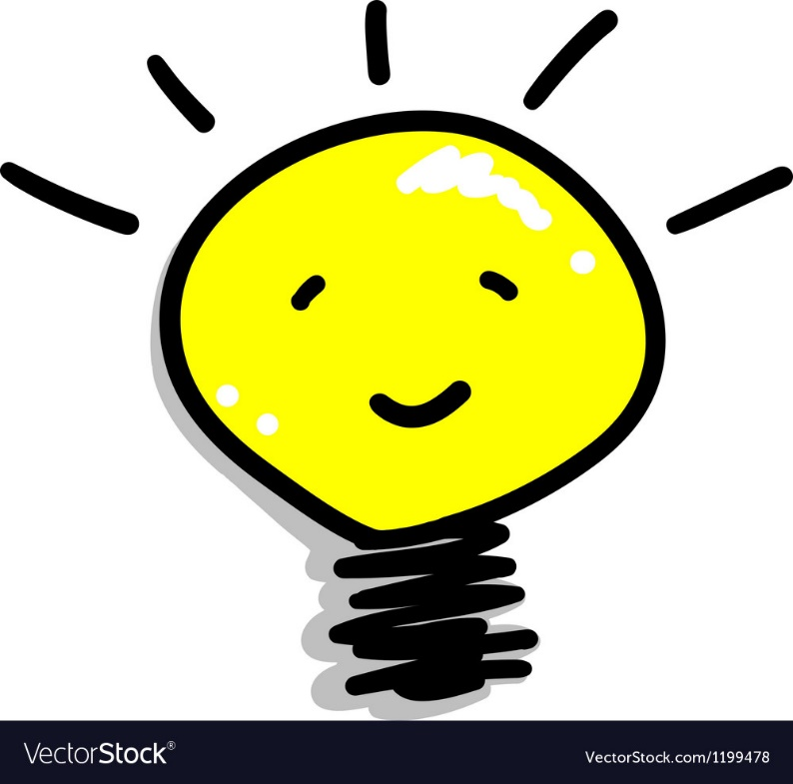
An electron does not give up any of its internal energy in a circuit. It is not the energy in the electron that lights the bulb. It is the movement, the flow, of the electrons that lights the bulb !!
Dr. Bill did not learn this until he was in college (13th grade) !

Slide 8
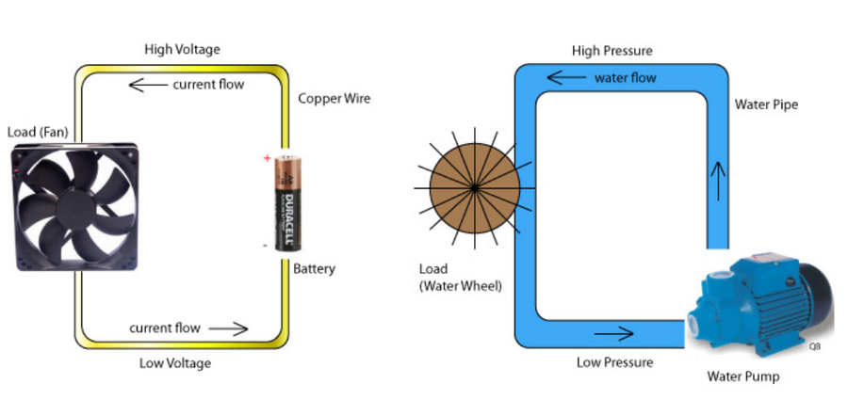
Water Flow Analogy

Slide 9
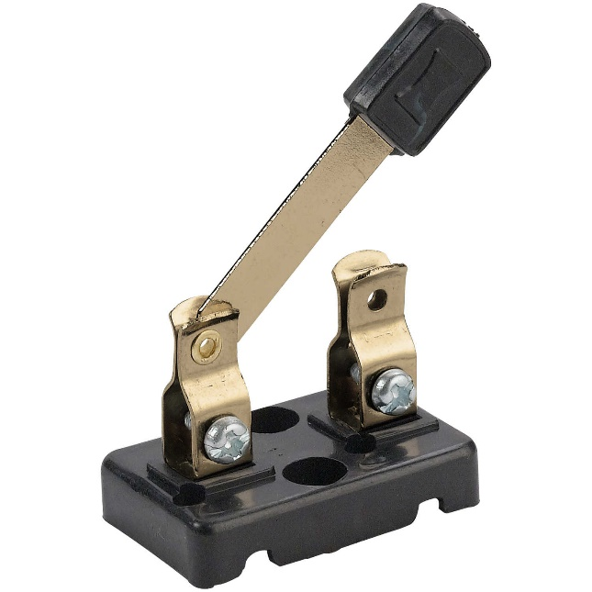
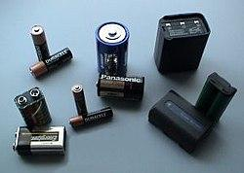
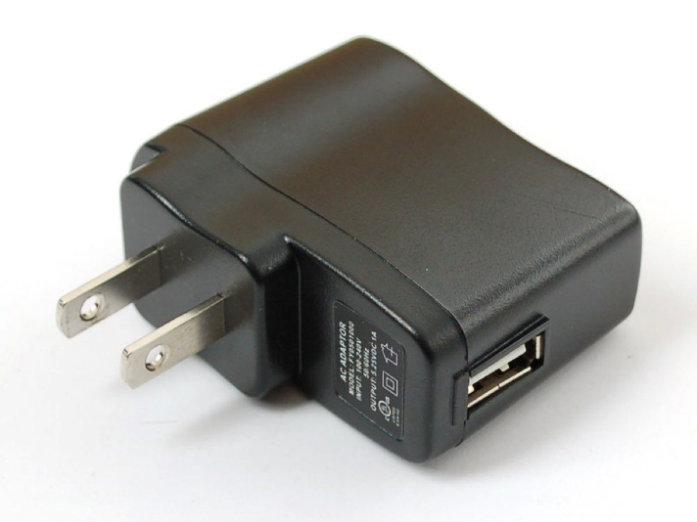
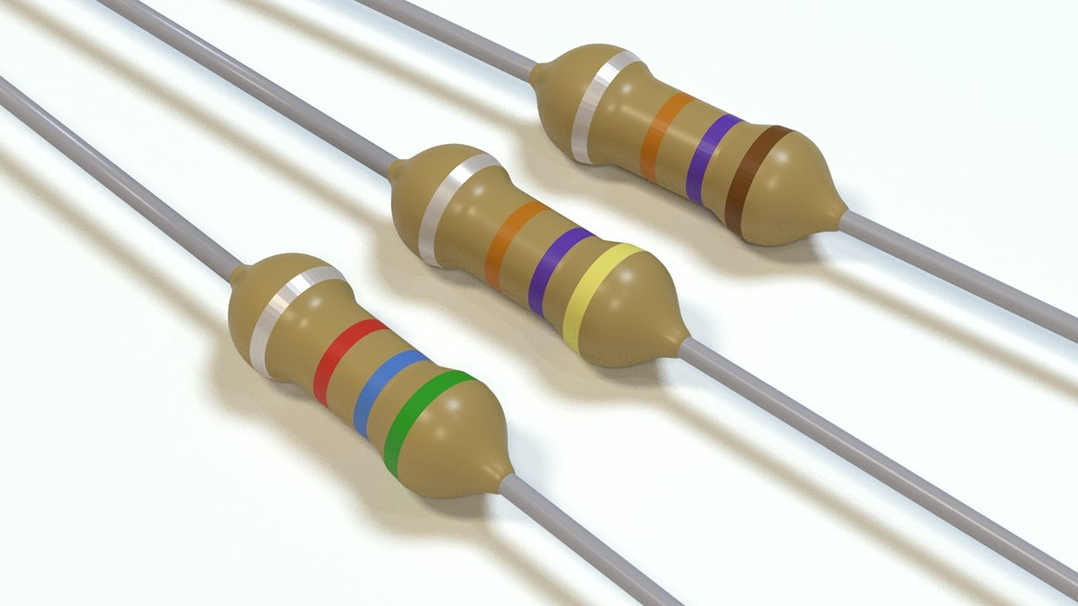
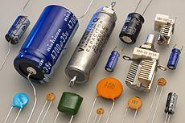
Battery
Switch
Transformers
Resistor
Capacitor

Slide 10
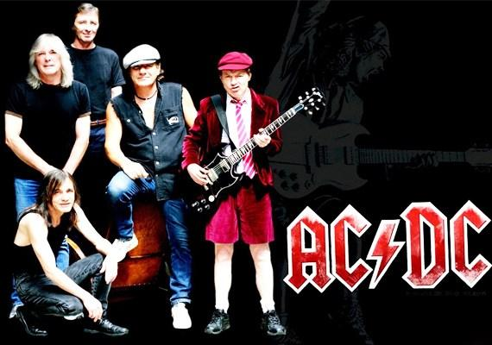
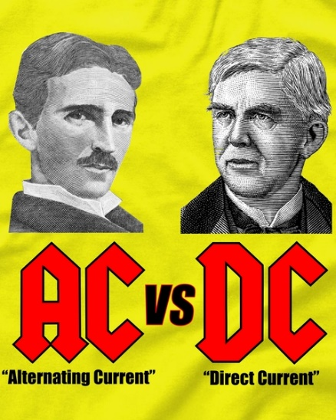
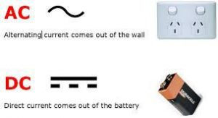
Two Types of Currents
AC: Alternating Current – Alternating flow
DC: Direct Current – Continuous flow
~ 1900: The Great AC/DC Battle
Not the rock band from 1980-2000
Nikola Tesla (AC) vs. Thomas Edison (DC)
How to power a city….. AC won!

Slide 11

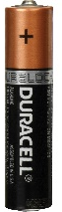
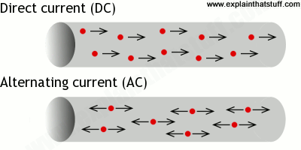
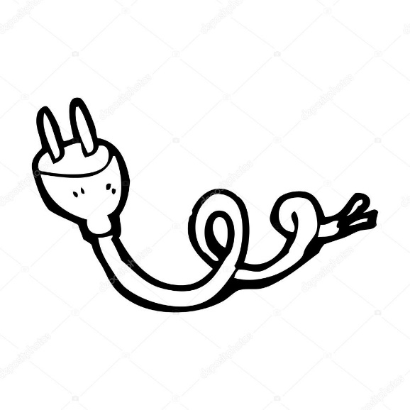
Two Types of Currents
AC: Alternating Current – Alternating flow
DC: Direct Current – Continuous flow
+
-
+/-
-/+

Slide 12
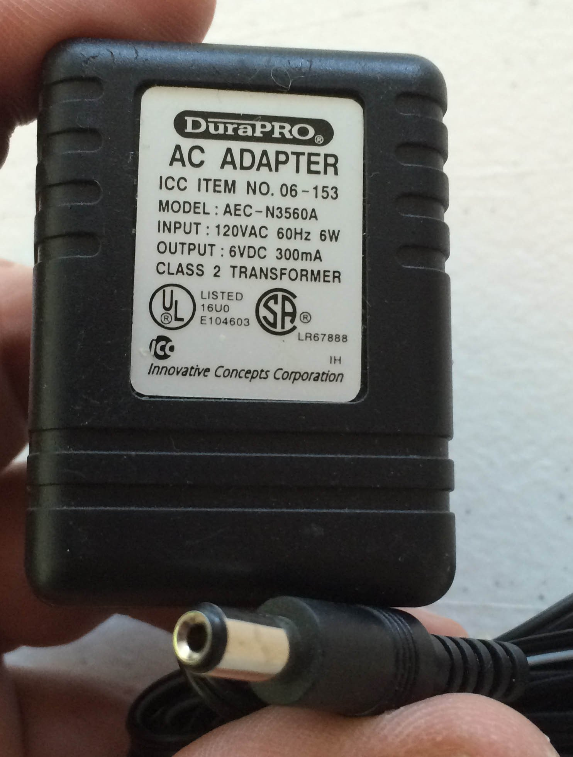
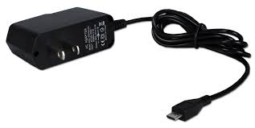
Transformers
Also called: Power Supplies or Adapters
Converts Wall plug: 110-120 V AC to low voltage (2-10 V) DC
USB Devices: 5V
Most handheld electronics: 1.5 -10 V
Power = V x I = Voltage x Current
Called Watts or VoltAmps (W or VA)

Slide 13
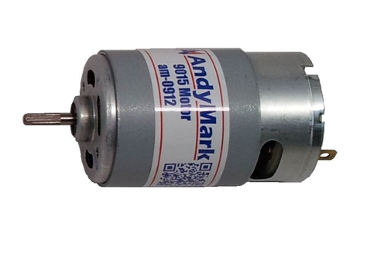
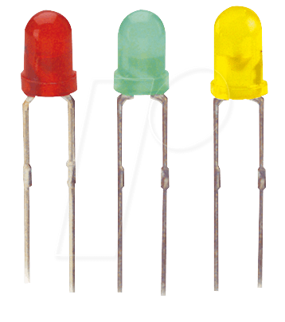
Resistors
Use up the work, drops the voltage
Standard resistors used to lower voltage
Other items that use work also lower voltage and are sometimes referred to as “resistors”
  Light Bulb, Motor (fan), Light Emitting Diode (LED)

Slide 14
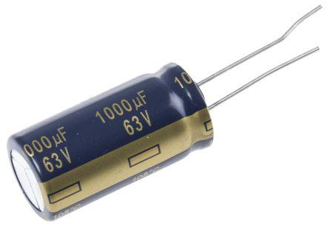
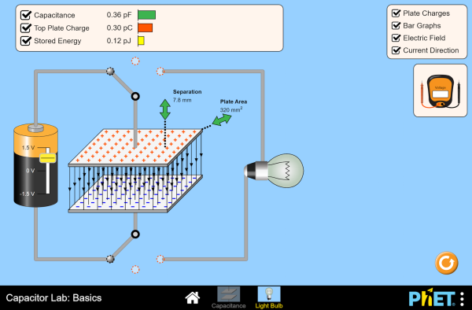
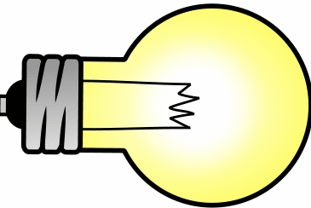
Capacitor:
Stores electrons like a battery.
Lower energy storage than a battery.
Unit is the Farad: MicroFarad (uF), NanoFarad (nF)
Can change voltage or current of circuit.

Slide 15
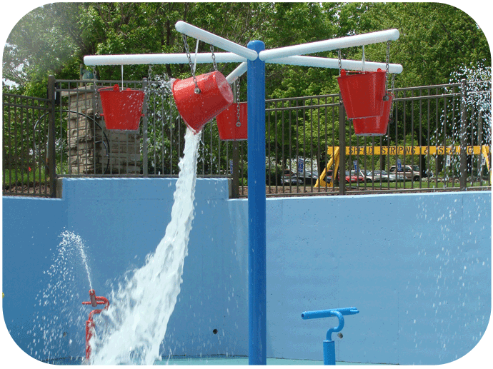
Capacitor: Stores electrons like a battery.
Smaller capacity and shorter lifetime than a battery.
Unit is the Farad: MicroFarad (uF), NanoFarad (nF)
Can change voltage or current characteristics.
Normal circuit current
Capacitor
Change voltage and/or current

Slide 16
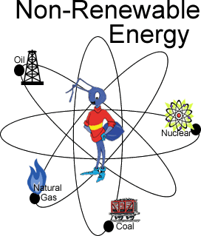
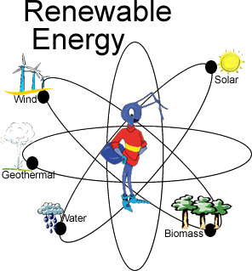
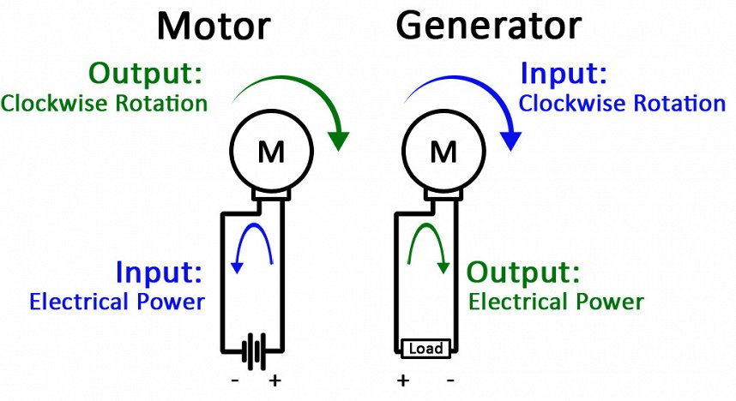
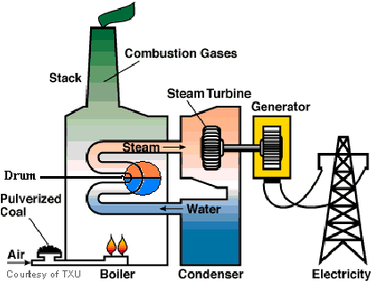
Energy Sources
Burn something, Heat and Boil Water, Turn generator….. makes energy
Wind directly turns a generator to make energy
Flowing water directly turns a generator to make energy
Solar cells directly convert sun rays to energy

Slide 17
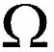
QUIZ
V:
I:
A:
R:
:
W:
VA:
DC:
AC:
Who won the great AC vs DC battle of 1900?
House Wall Plug Voltage:
USB Device Voltage:
Most handheld electronics:
What is the difference between a motor and a generator?
What is the one very important thing about electricity that Dr. Bill did not learn until he was in college?
Volt
Current
Amps
Resistance
Ohm
Watts
VoltAmps
Direct Current
Alternating Current
Tesla (AC) won. Edison (DC) lost
110-120 V
5 V
1.5-10 V
A motor uses energy to spin something. Something spins a generator to make energy.
It is not the “energy of the electron” that does the work, it is the “FLOW OF THE ELECTRONS” that does the work

Slide 18
QUIZ
V: Volt
I: Current
A: Amps
R: Resistance
: Ohm
W: Watts
VA: VoltAmps
DC: Direct Current
AC: Alternating Current
Who won the great AC vs DC battle of 1900?
Tesla (AC) won. Edison (DC) lost
House Wall Plug Voltage: 110-120 V
USB Device Voltage: 5 V
Most handheld electronics: 1.5 to 10 V
What is the difference between a motor and a generator?
A motor uses energy to spin something. Something spins a generator to make energy.
What is the one very important thing about electricity that Dr. Bill did not learn until he was in college?
It is not the “energy of the electron” that does the work, it is the “FLOW OF THE ELECTRONS” that does the work

