Slide 1
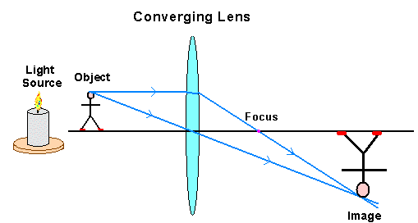
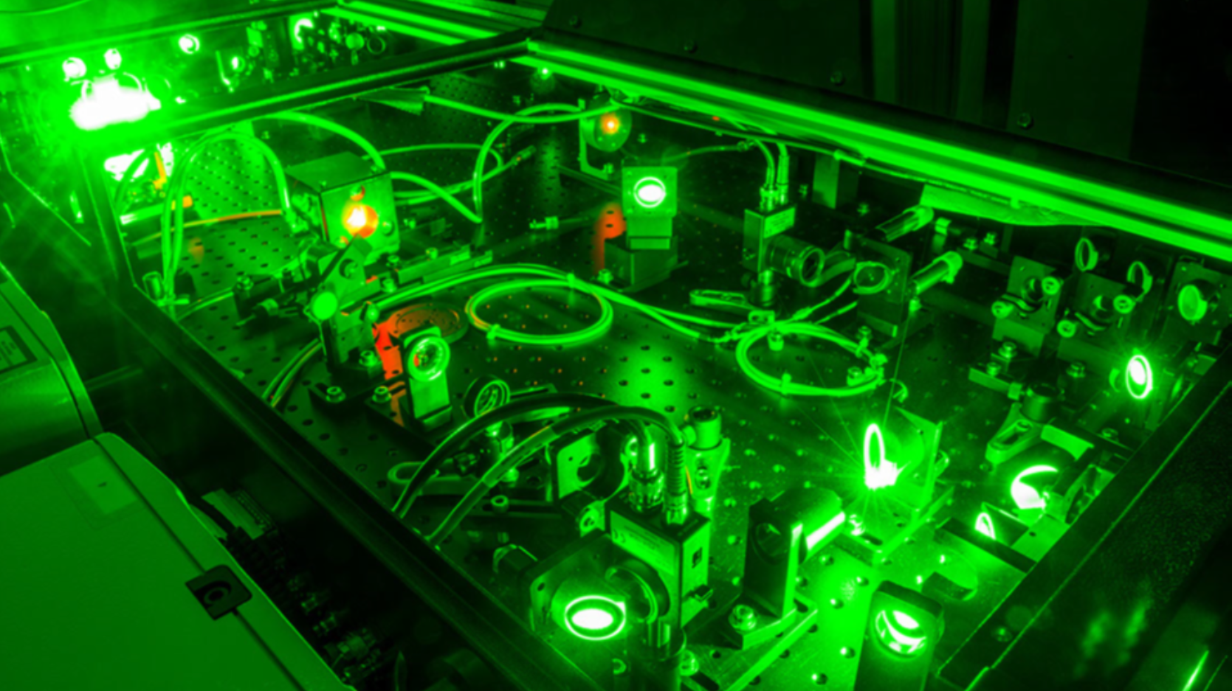
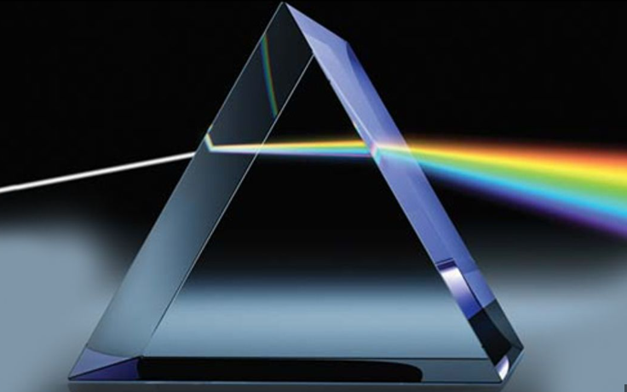
Optics and Laser Beams
Dr. Bill Capinski, Laser Scientist
General Atomics - EMS

Slide 2
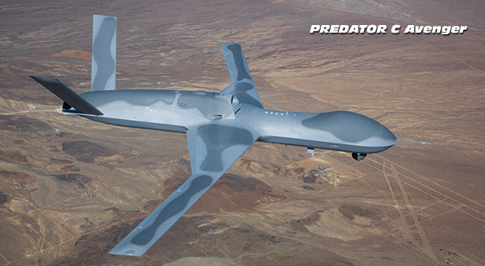
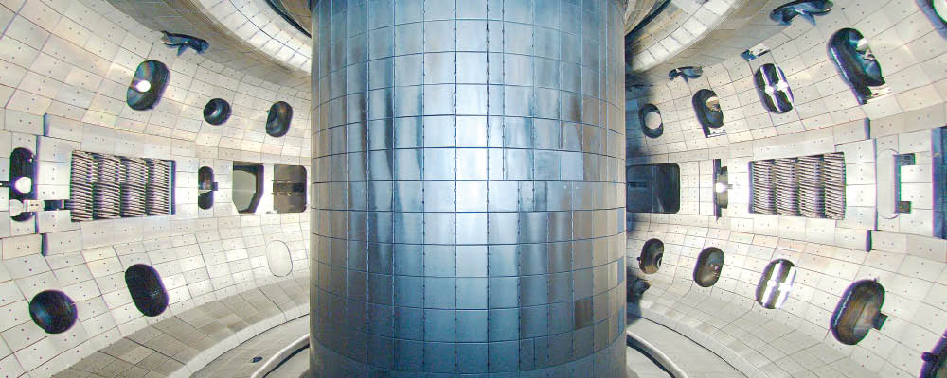
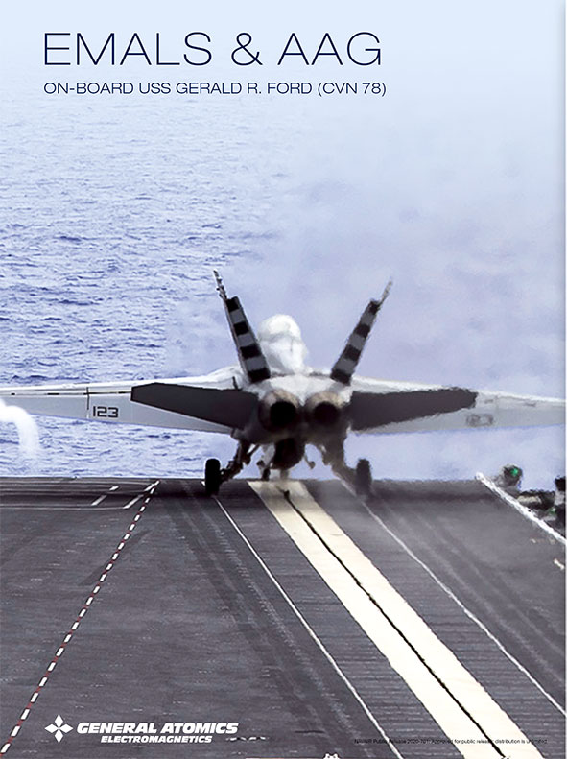
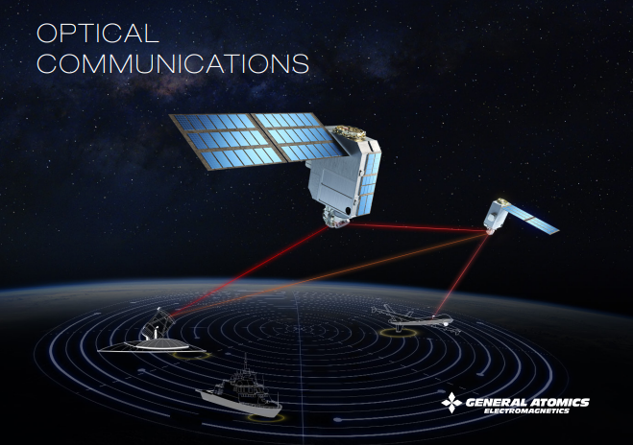
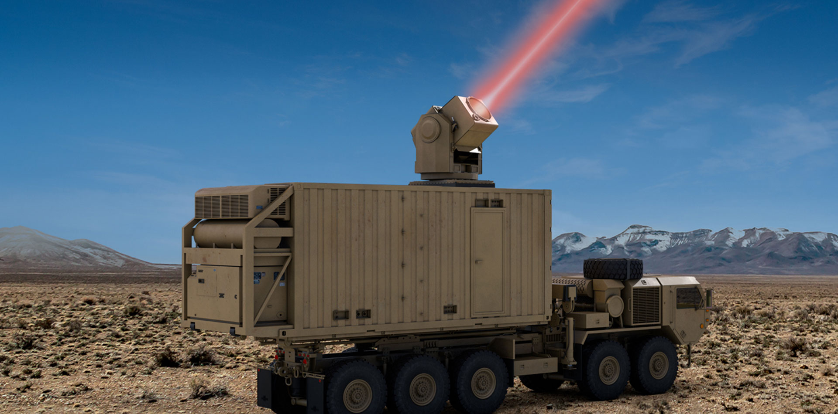
Genera Atomics
General Atomics is a defense and diversified technologies company, founded in 1955 as a Division of General Dynamics and acquired by the Blue family in 1986. GA and affiliated companies operate on five continents and include GA Aeronautical Systems, Inc. (GA-ASI).
GA-ASI produces a series of unmanned aircraft and provides electro-optical, radar, signals intelligence, and automated airborne surveillance systems. GA’s Electromagnetic Systems Division produces electro-magnetic aircraft launch and recovery systems for the US Navy, satellite surveillance, electro-magnetic rail gun, high power laser, hypervelocity projectile, and power conversion systems.
GA is the principal private sector participant in thermonuclear fusion research through its internationally recognized DIII-D and inertial confinement programs for the US Department of Energy. GA developed the UCSD Supercomputer Center and has constructed more than 60 TRIGA nuclear research reactors in 24 countries. GA is a leader in development of next-generation nuclear fission and high-temperature materials technologies.
Fusion
High Energy Lasers

Slide 3
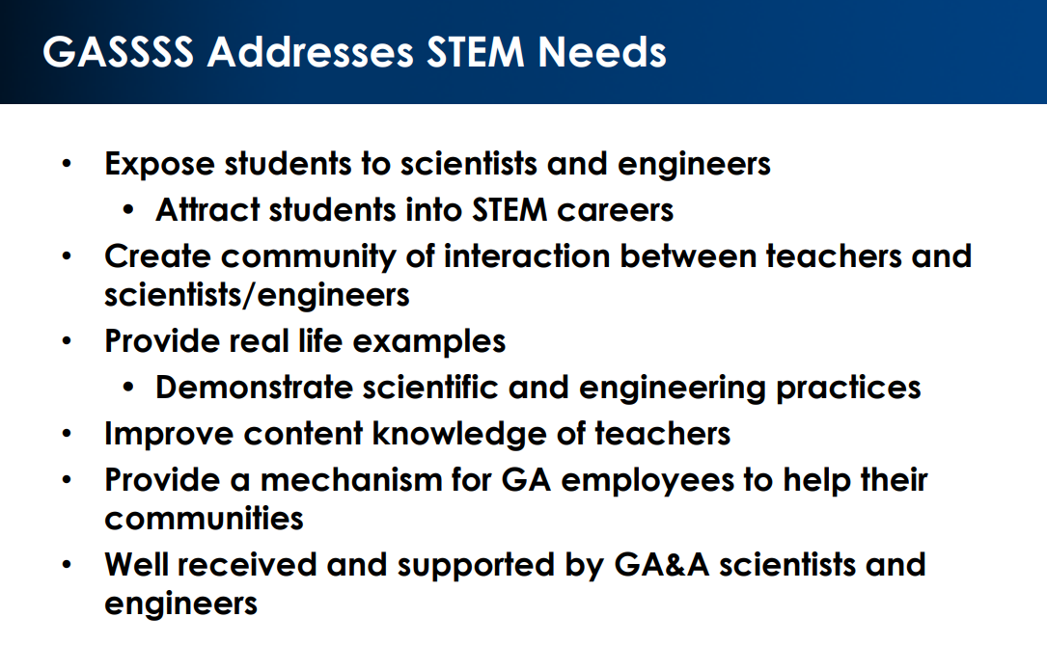
GASSSS Program: GA Scientists/Engineers Supporting Science/Engineering for Students
The General Atomics Sciences Education Foundation (GASEF) started the GASSSS program in 2010 to support all employees of the GA family of companies (GA&A) who want to improve Kindergarten through 12th grade (K-12) STEM (Science, Technology, Engineering, and Mathematics) education in their communities. The purpose of the GASSSS program is to improve K-12 STEM education via the active participation of a GA employee in an educational activity and by providing funds for associated STEM materials and hours support.

Slide 4

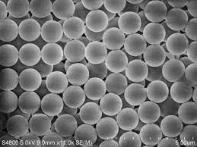

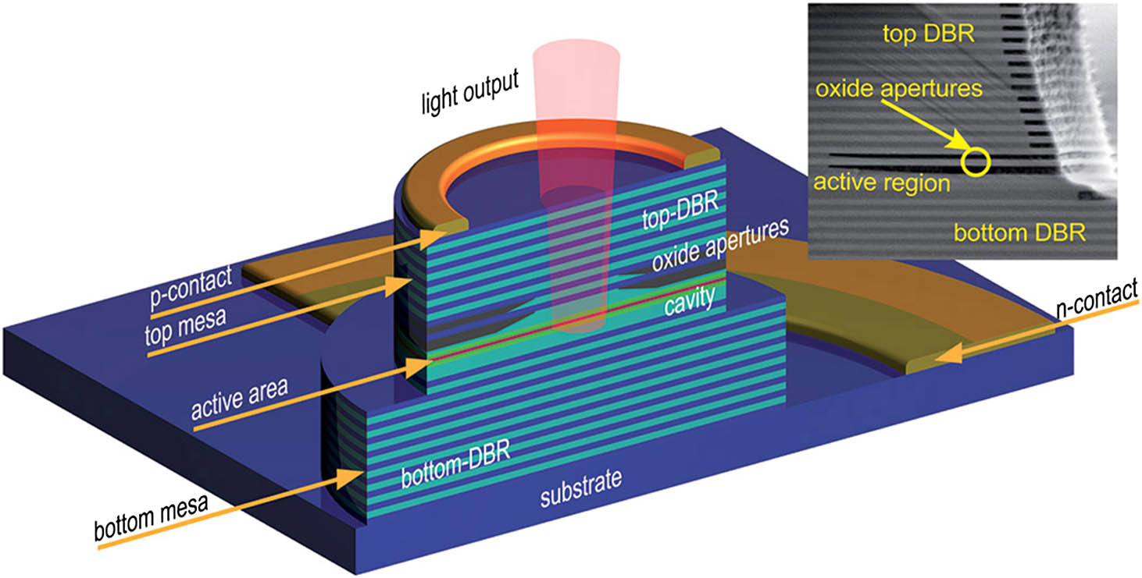
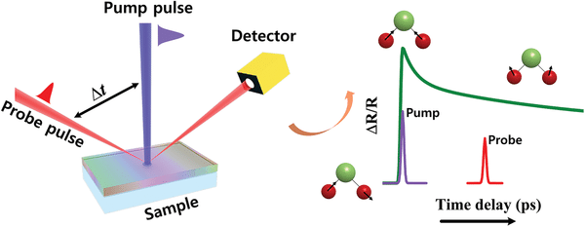
EDUCATION
High School, Pottstown, PA : 1987
B.S., Engineering Physics, Lehigh University, Bethlehem, PA : 1991
  Experimental and theoretical studies of the nonlinear optical properties of ruby and polystyrene microspheres
M.S., Physics, Brown University, Providence, RI : 1993
Ph.D., Solid State Physics, Brown University, Providence, RI : 1998
  Developed femtosecond laser-based system to measure thermal transport in semiconductor superlattices
  Thesis topic: Thermal Phonon transport in novel semiconductor structures
Lehigh University
Polystyrene Microspheres
Brown University
Semiconductor Laser
Pump/Probe of Semiconductor Structures
Polystyrene Microspheres

Slide 5
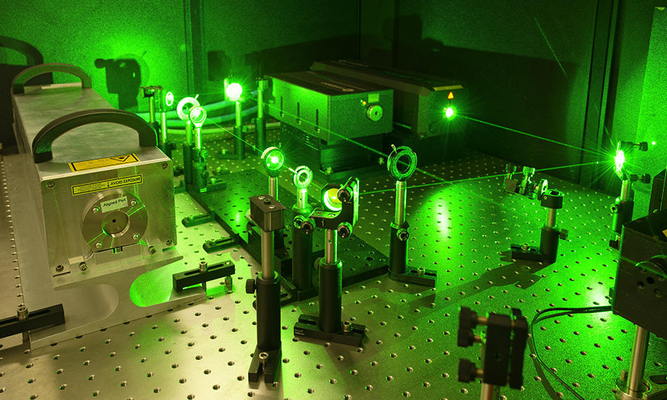
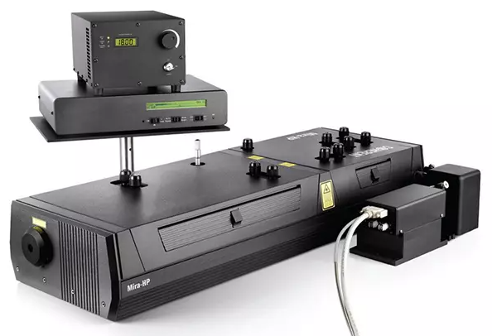

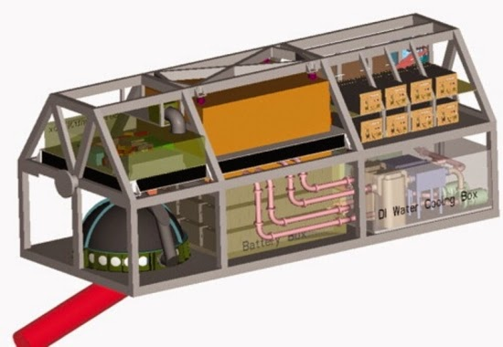
WORK EXPERIENCE
Coherent, Inc. – Scientific Lasers: 1998 - 2007
Engineer/Manager for Scientific Laser
and Telecom products
General Atomics- High Energy Lasers: 2007- 2019
Laser Scientist for DARPA* funded 150 kW HELLADS Demonstrator Laser Weapon System (DLWS) and other HEL systems
(Laser pointer ~ 1 mW: 150 kW/1mW = 150,000,000)
*DARPA: Defense Advanced Research Project Agency. “DARPA HARD” Programs.

Slide 6
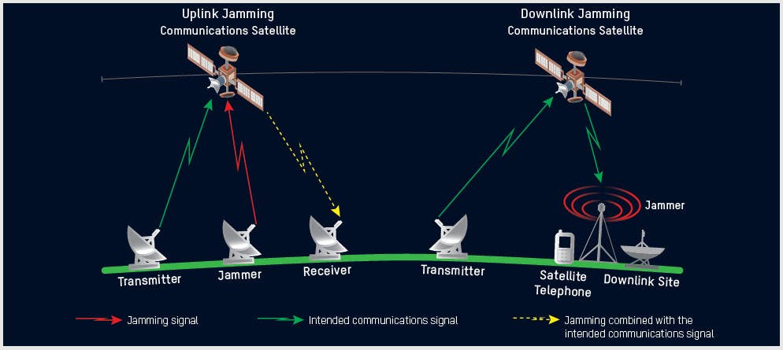
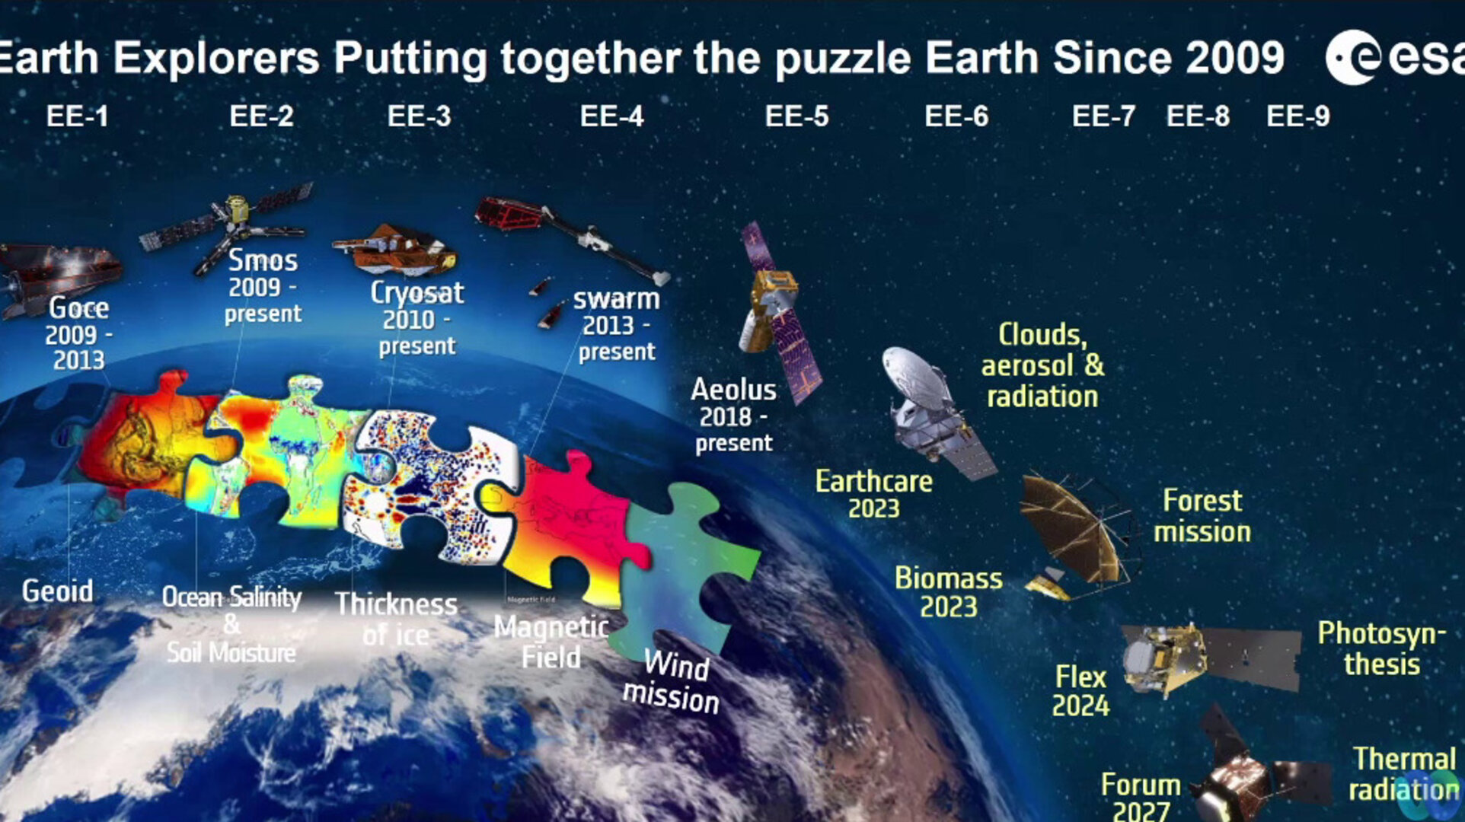
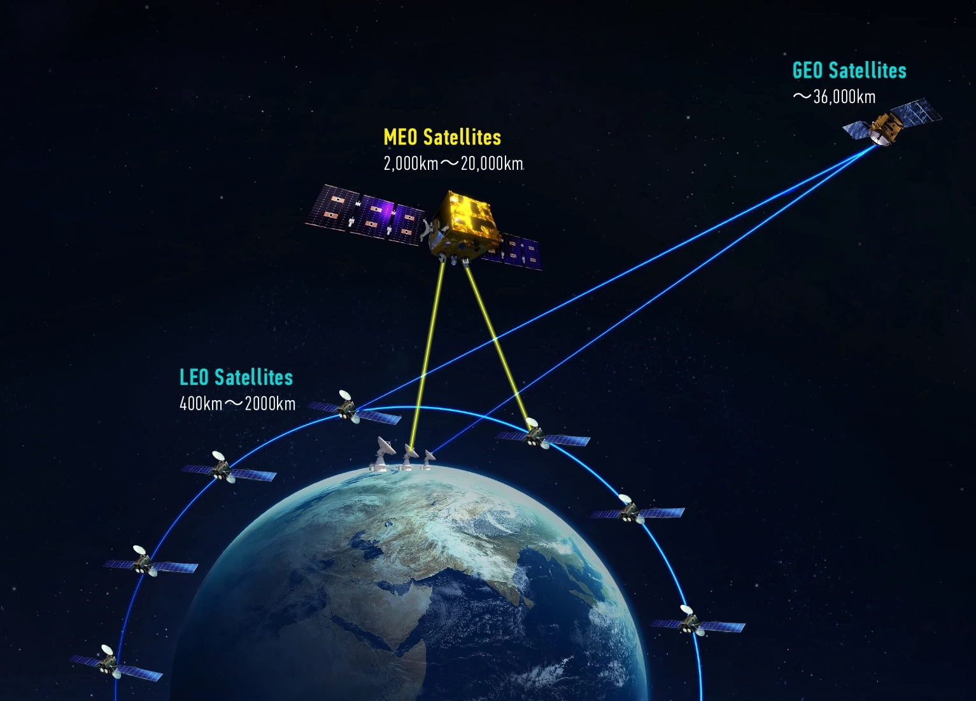
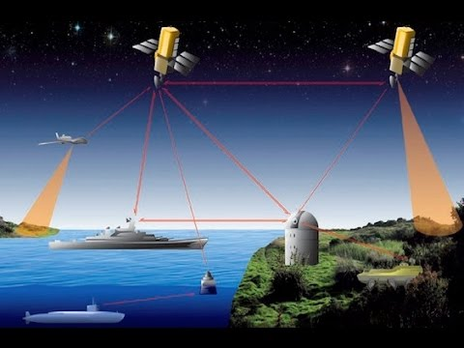
WORK EXPERIENCE
General Atomics- Optical Communication: 2019 - 2023
Chief Optical scientist for the Low Earth Orbit (LEO) Optical Communication Terminal (OCT)
Radio Frequency communication
  Low Bandwidth
  Large Field of Transmission
Laser communication
  Over 1000X greater Bandwidth
  Small Field of Transmission
  Internet in Space
RF Communication
Laser Communication

Slide 7
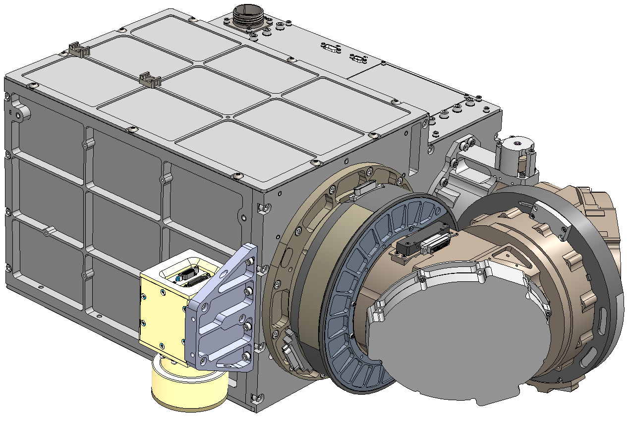
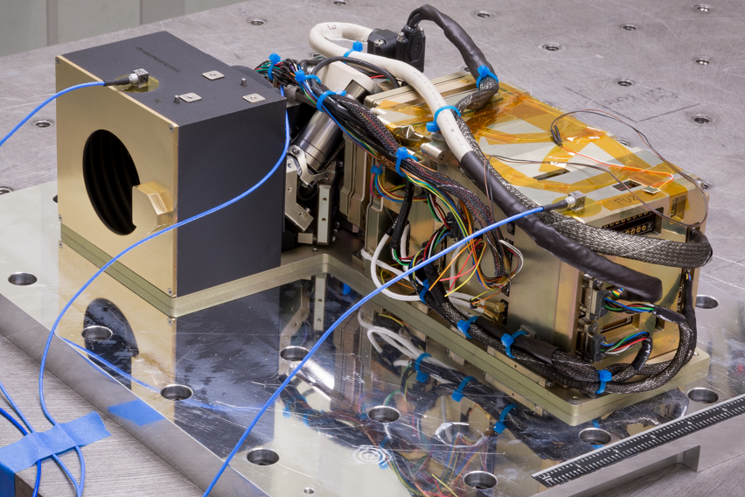
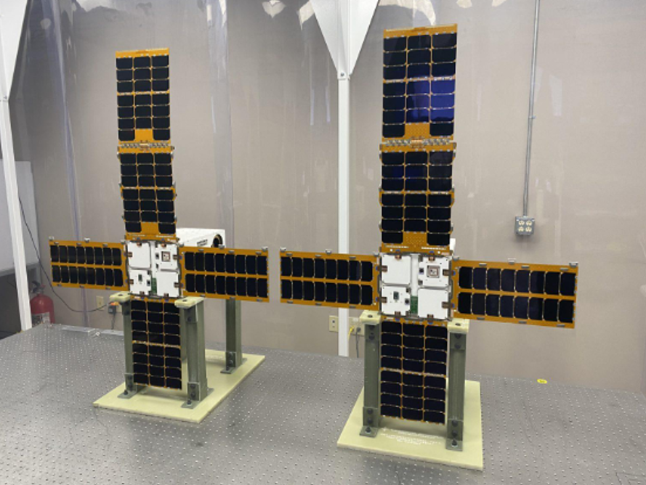
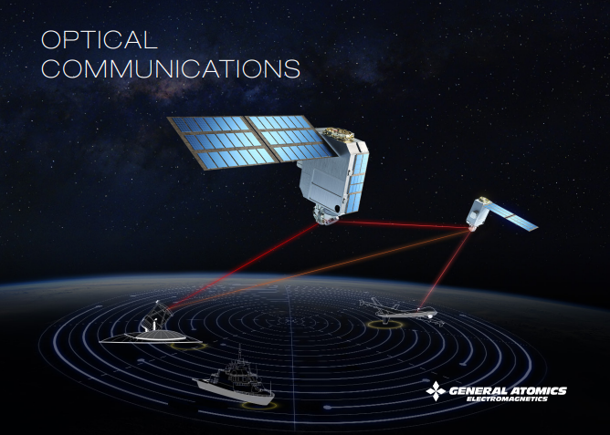
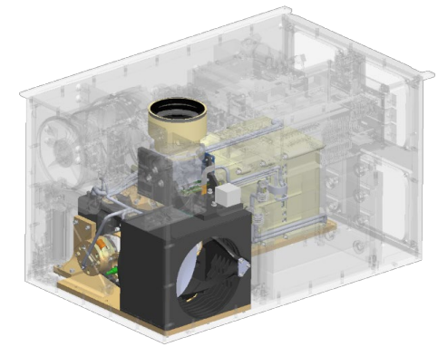
WORK EXPERIENCE
General Atomics- Optical Communication: 2019 - 2023
Chief Optical scientist for the Low Earth Orbit (LEO) Optical Communication Terminal (OCT)
MANHATTAN
LINCS
8”
11”
8”
16”

Slide 8
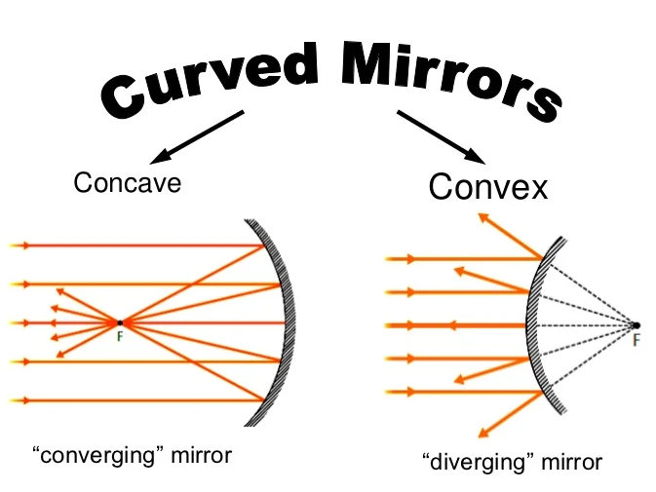

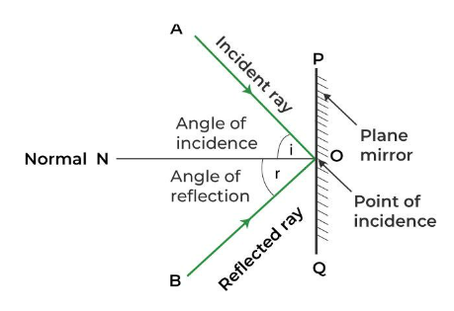
Optics:
Reflection

Slide 9
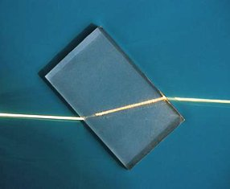
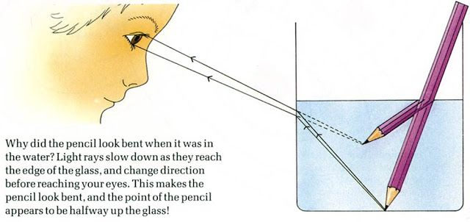
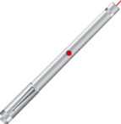

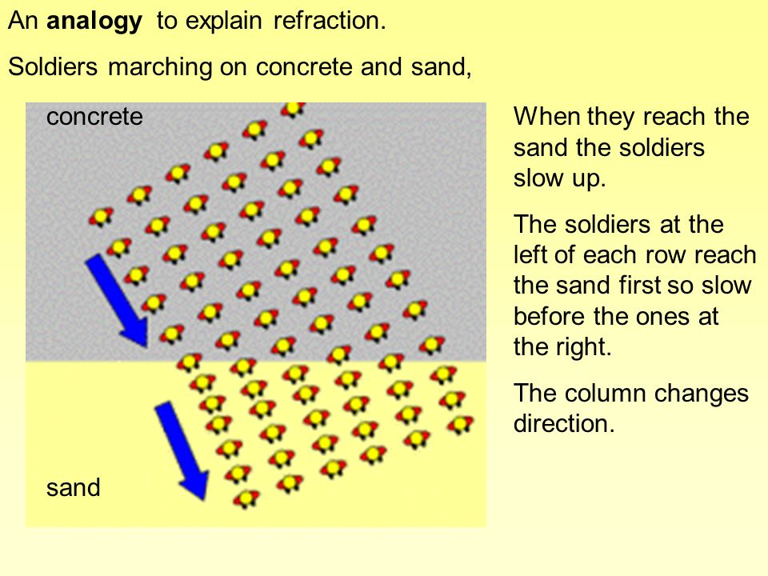
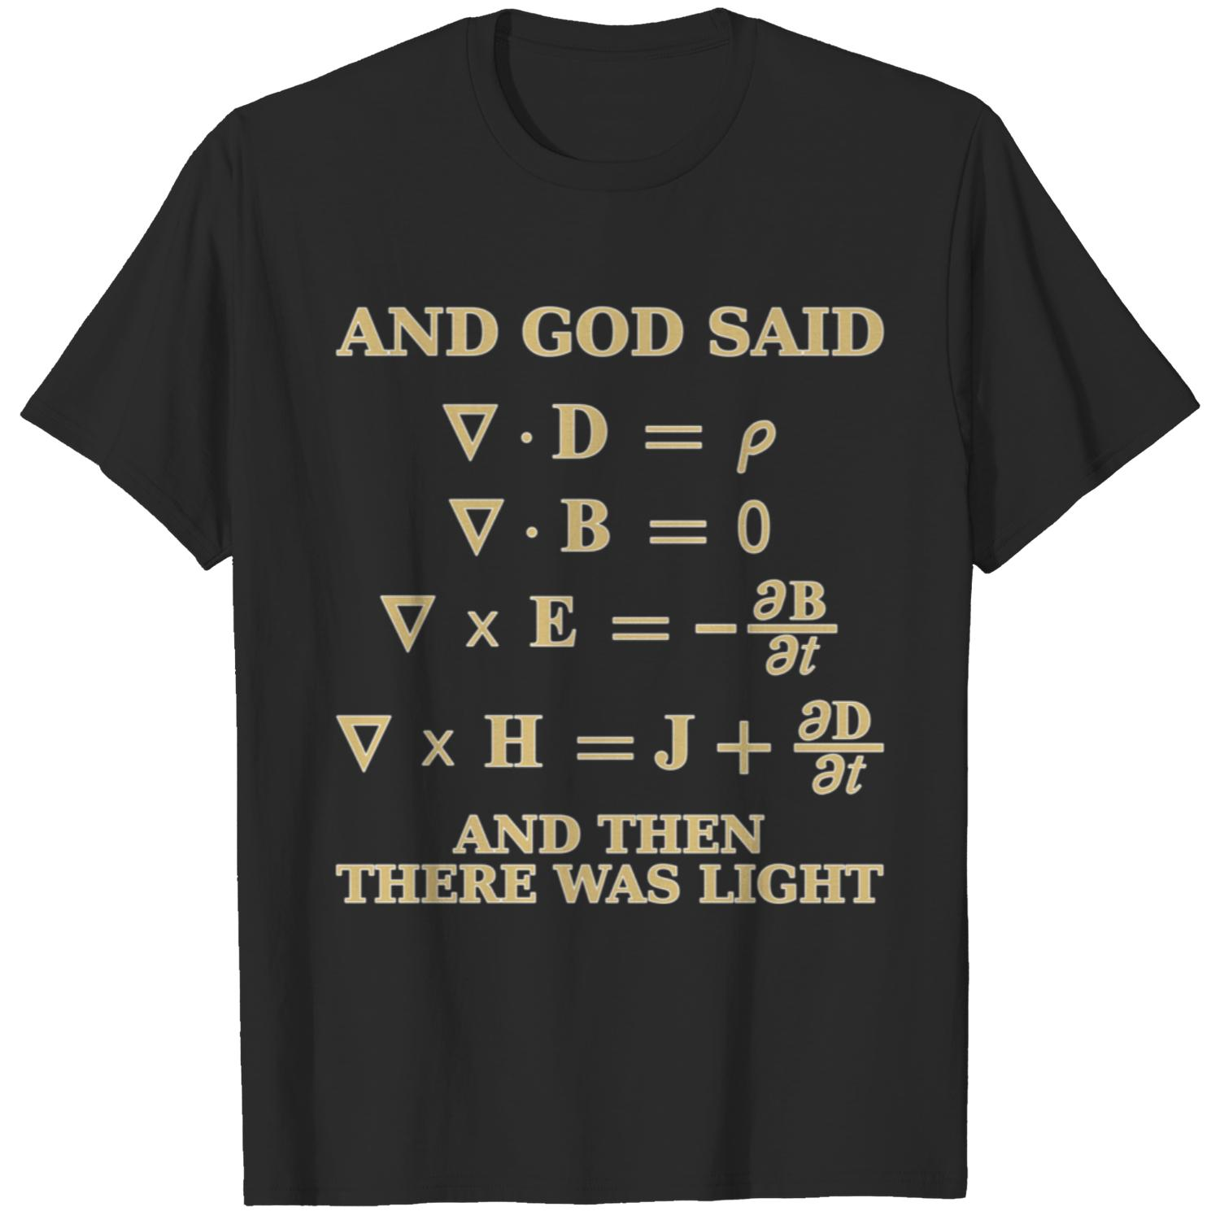
Optics:
Refraction: Redirecting laser/light rays
Maxwell’s Equations

Slide 10
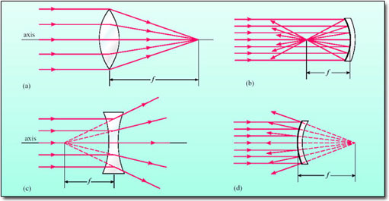
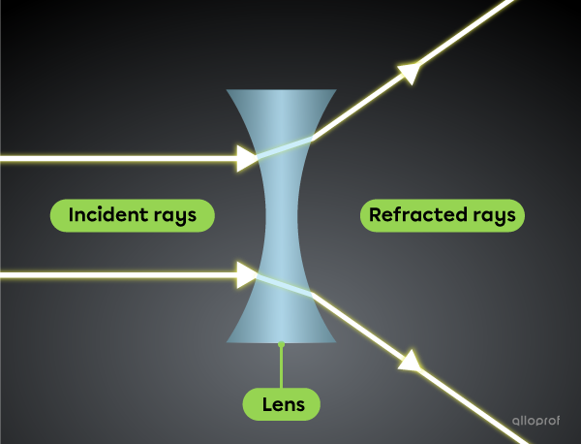
Optics:
Lens: Convex and Concave
Mirror: Convex and Concave

Slide 11
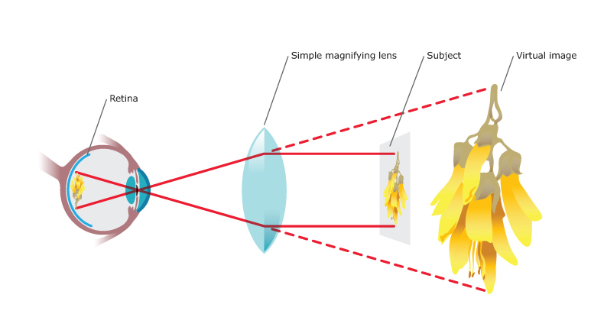
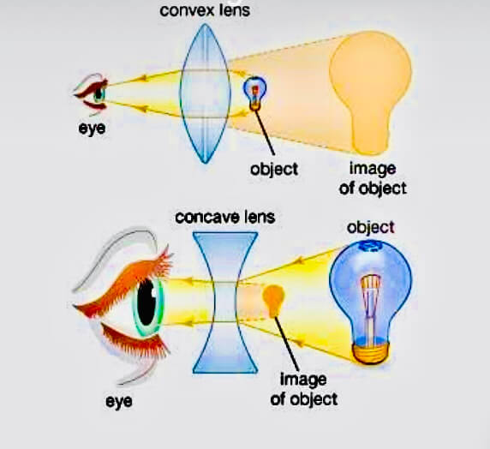
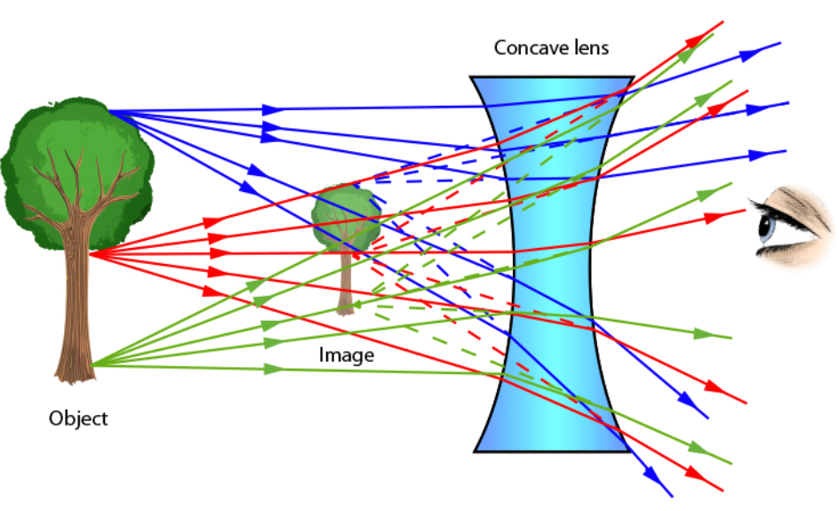
Optics:
Lens Imaging
Lens needed to create an image

Slide 12
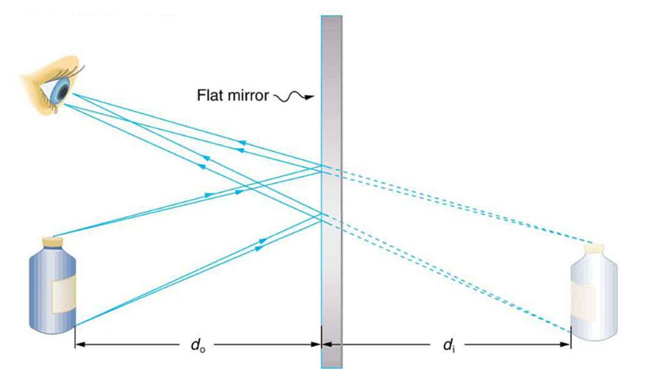
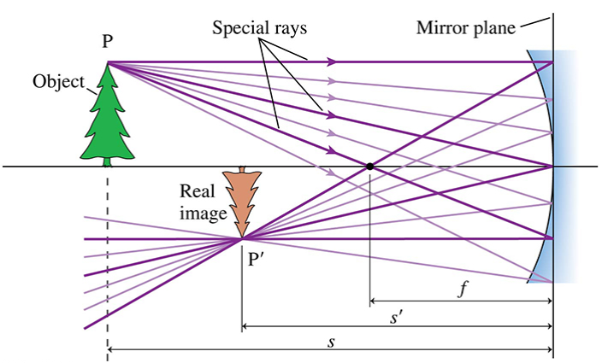
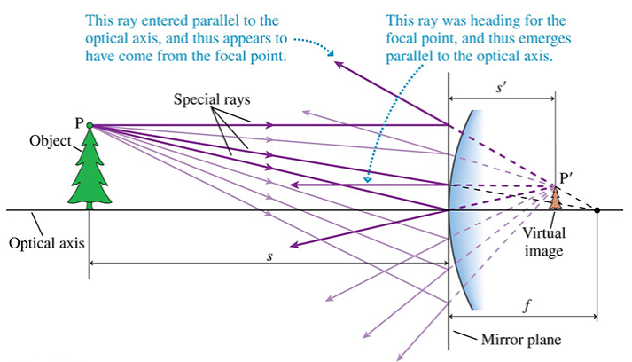
Optics:
Mirror Imaging

Slide 13
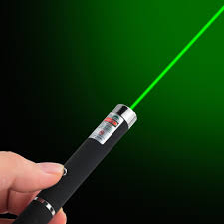
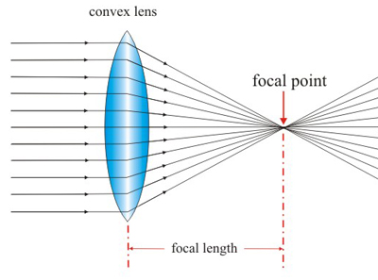
Ideal Situation:
Laser: Perfect Collimation
Lens: Focus to Point
“Geometric Optics”
NO Divergence. Perfectly Collimated.
Infinitely Small Spot

Slide 14
Ideal Situation
Laser Communication:
50 mm beam → 5000 km → 50 mm beam
#1
#2
HEL Defense:
250 mm beam → 5 km → Point Focus
HEL
Target
Lens

Slide 15
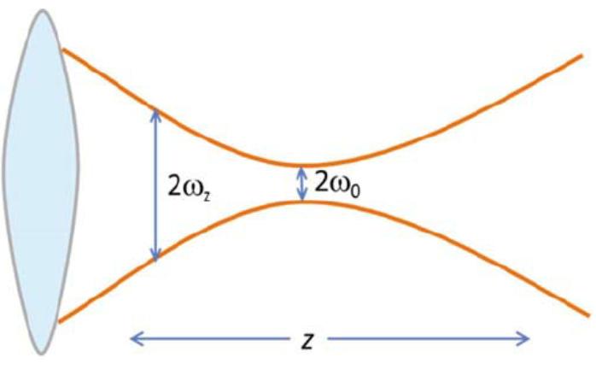
Reality:
Laser: Inherent Divergence
Lens: Finite Size Spot Focus
θ

Slide 16
Reality
Laser Communication:
50 mm beam → 5000 km → 250 m beam (5000X)
Satellite / OCT #1
Satellite / OCT #2
HEL Defense:
250 mm beam → 5 km → 25 mm beam
HEL
Target
Lens

Slide 17
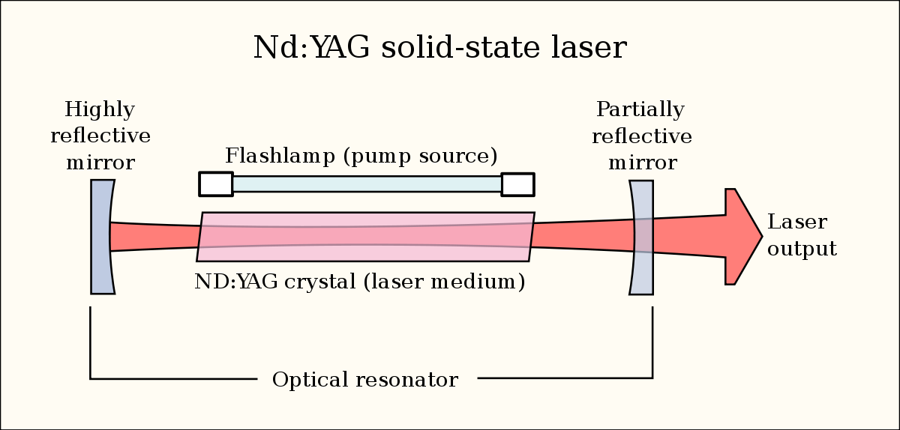
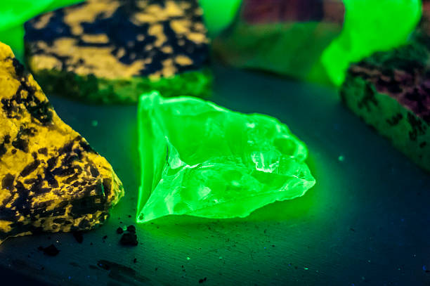
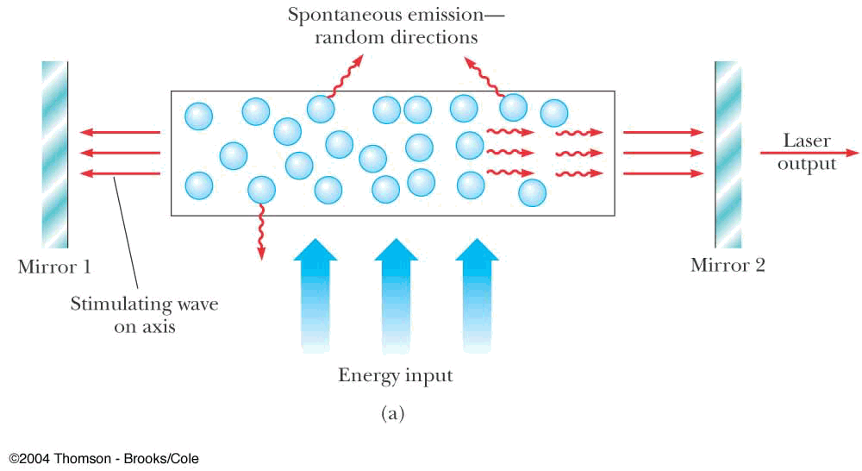
Laser: Light Amplification by Stimulated Emission of Radiation
                Gain Medium
                Energy Source
                High Reflector
                Output Coupler
Crystal Fluorescence under UV light
θ_{Lasing}

Slide 18
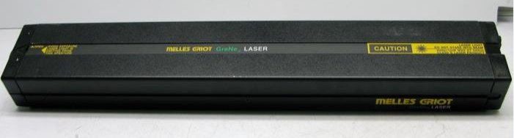
Laser: Reality
“Gaussian Optics”
Unrealistic Laser Beam
Real Laser Beam
Different incident angles blur focus spot
Beams striking lens at different angles

Slide 19
Laser: Perfect Collimation
Length ~ Infinity
Width ~ 0
Special “1-D” Gain material, No propagation in up/down or in/out axis

Slide 20
Laser: Reality
Length ~ Infinity
Width ~ 0
Special “1-D” Gain material, No propagation in up/down or in/out axis
Hard Edge, ie, Single Slit

Slide 21
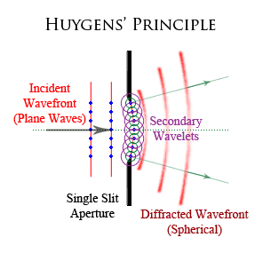
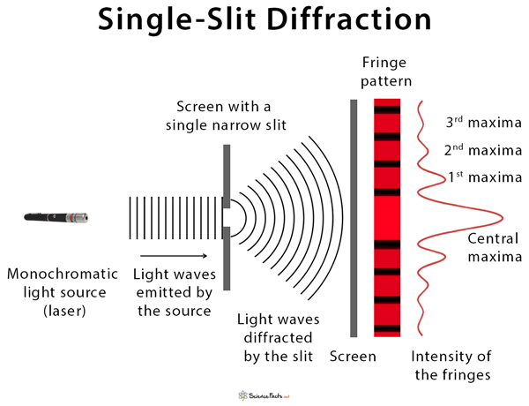
Diffraction-Limited Beam Quality
“Diffraction-Limited” Performance
Readily obtained within 10%
Obtained within 3% with high quality optics

Slide 22


Slide 23
QUIZ
Acronyms:
GA:
DARPA:
HEL:
LEO:
OCT:
Questions:
What are the 4 required laser components?
What is one of the biggest challenges for both long-range Laser Communication and for focusing a HEL beam to a small spot?
What is a significant difference between the images of a convex and concave lens?
What is diffraction limited performance?
How close can you get to DL performance, easily?, With high quality optics?
Bonus:
What is a Pump/Probe experiment?

Slide 24
QUIZ
Acronyms:
GA: General Atomics
DARPA: Defense Advanced Research Project Agency
HEL: High Energy Laser
LEO: Low Earth Orbit
OCT: Optical Communication Terminal
Questions:
What are the 4 required laser components? Gain, Energy source, High Reflector, Output Coupler
What is one of the biggest challenges for both long-range Laser Communication and for focusing a HEL beam to a small spot? Beam Divergence
What is a significant difference between the images of a convex and concave lens? Only the image of the convex lens can be displayed on a card. Your eye or another lens is needed to create a real image from a concave lens.
What is diffraction limited performance? Theoretically best collimated laser beam
How close can you get to DL performance, easily? 10%, With high quality optics? 3%
Bonus:
What is a Pump/Probe experiment? Excite a sample with a pump laser beam, probe ΔR/R with a time delayed laser beam probe

