Slide 1
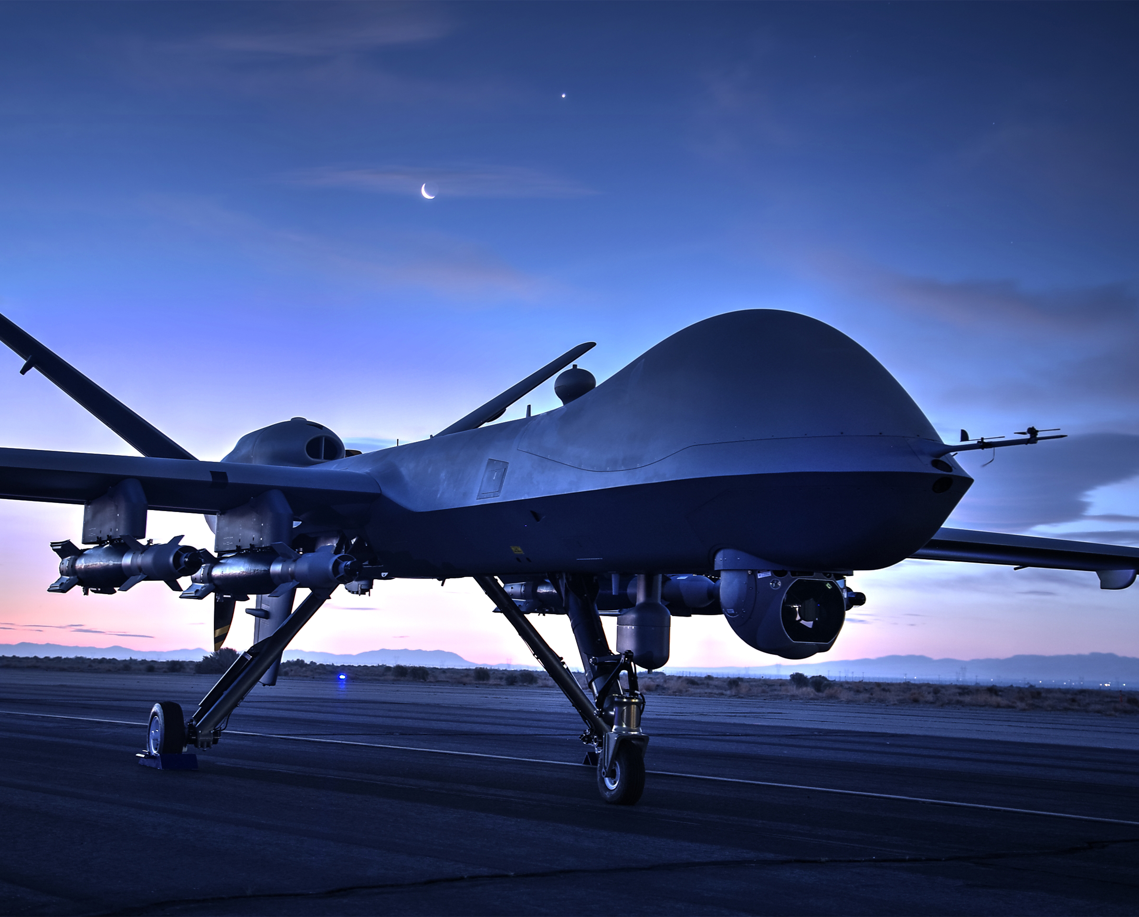
DRONE Academy
12 April 2023

Slide 2

Who are these guys?
What is engineering?
Why engineers?
What kind of Engineers?
Engineering Exercise
Take Flight!
Training

Slide 3
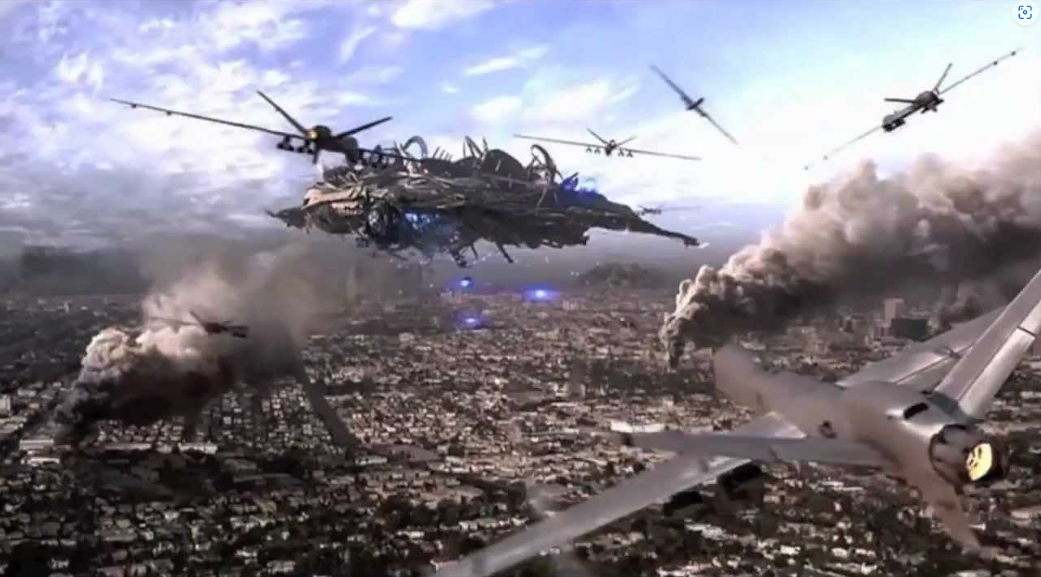


Who Are We?
Engineers from General Atomics
Develop and engineer Unmanned Aerial Vehicles (UAVs)
UAV, fancy word for Drone
Guess the movies?

Slide 4
What is engineering?
Not Science… but you need to know science
Not Technology… but good to understand technologies
Not Math… but a good idea to have a strong background
Engineering is using skills to make things work
Applying Skills
  STEM (Science, Technology, Engineering, Math)
  Communications and Reading
  Research and Learning new things
  Art, People, Business skills and many more!

Slide 5
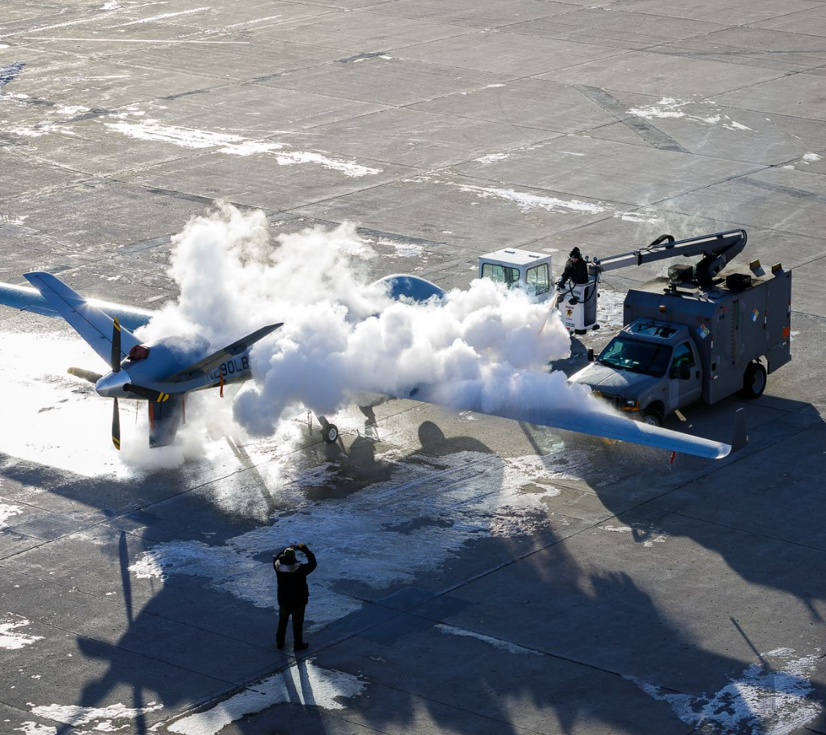
Different kinds of engineers
Computer
Software
Mechanical
Aircraft
Biological
Chemical
Project
Systems

Slide 6
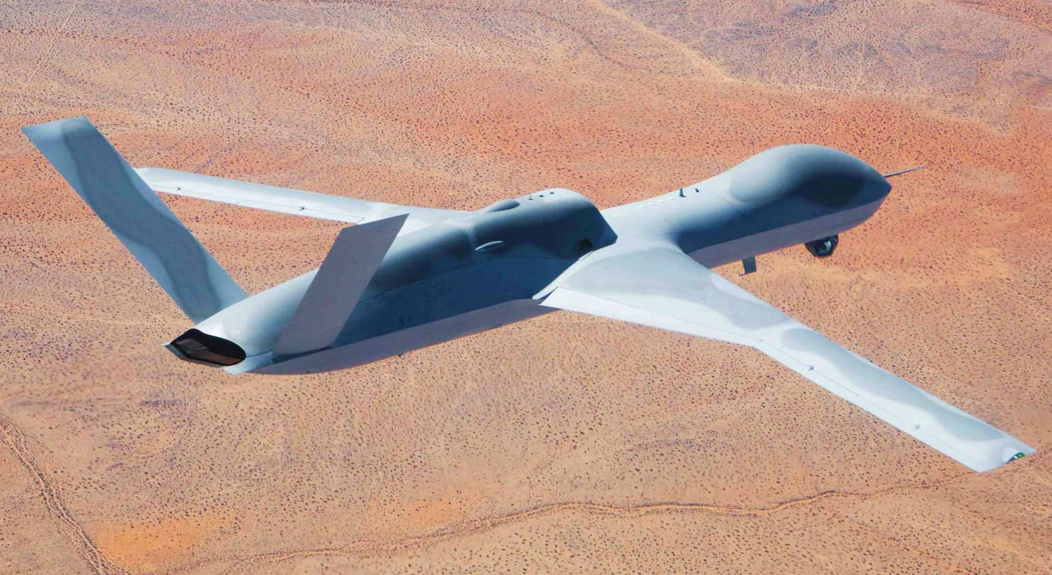

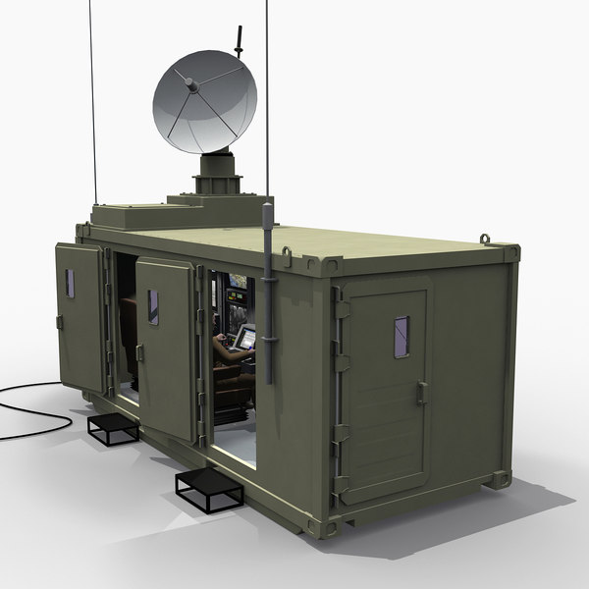
Engineering Exercise - Breakdown the problem
What are the 3 major parts of a drone?
(What’s needed to support the drone?)

Slide 7
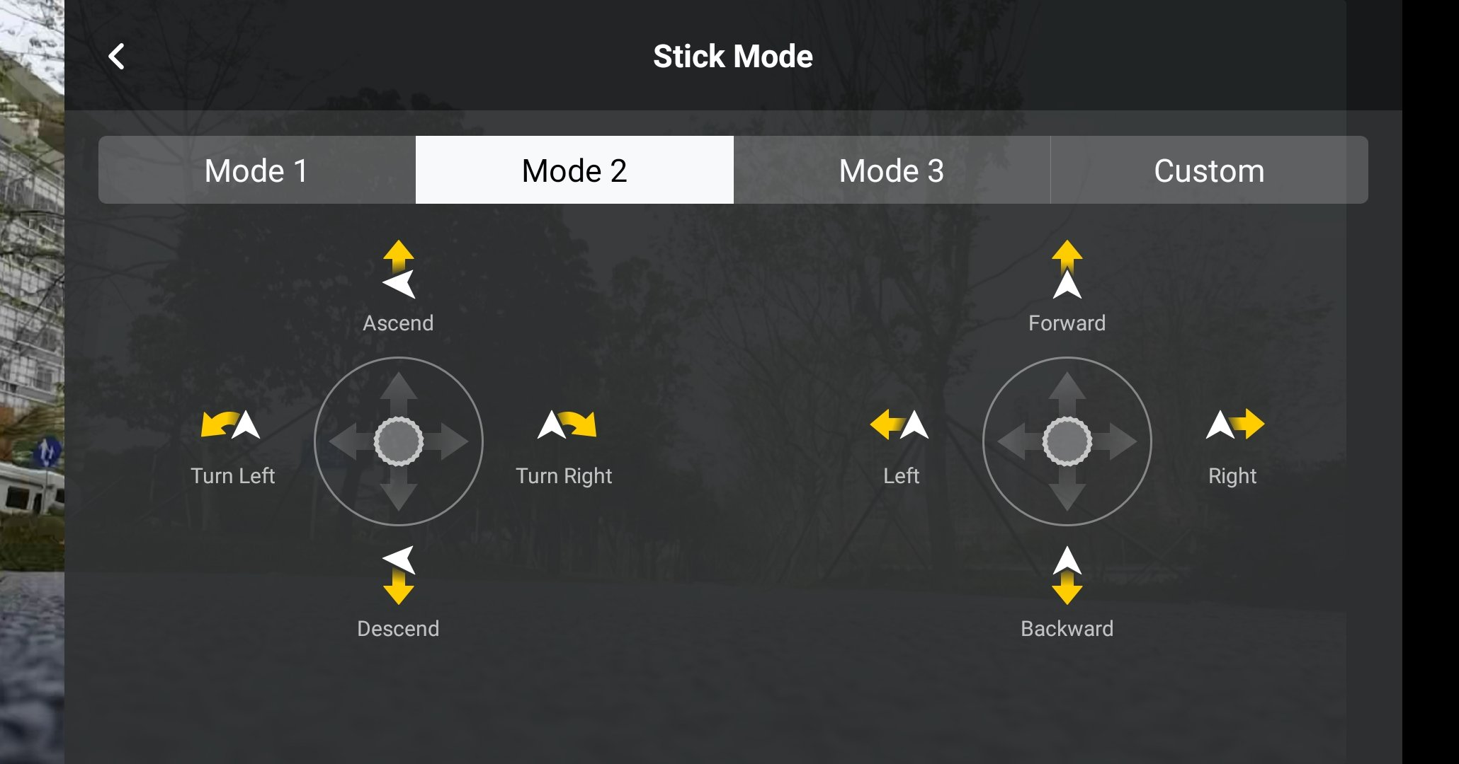
Drone Training
Control strategy and First steps
Pick your first 2 moves

Slide 8
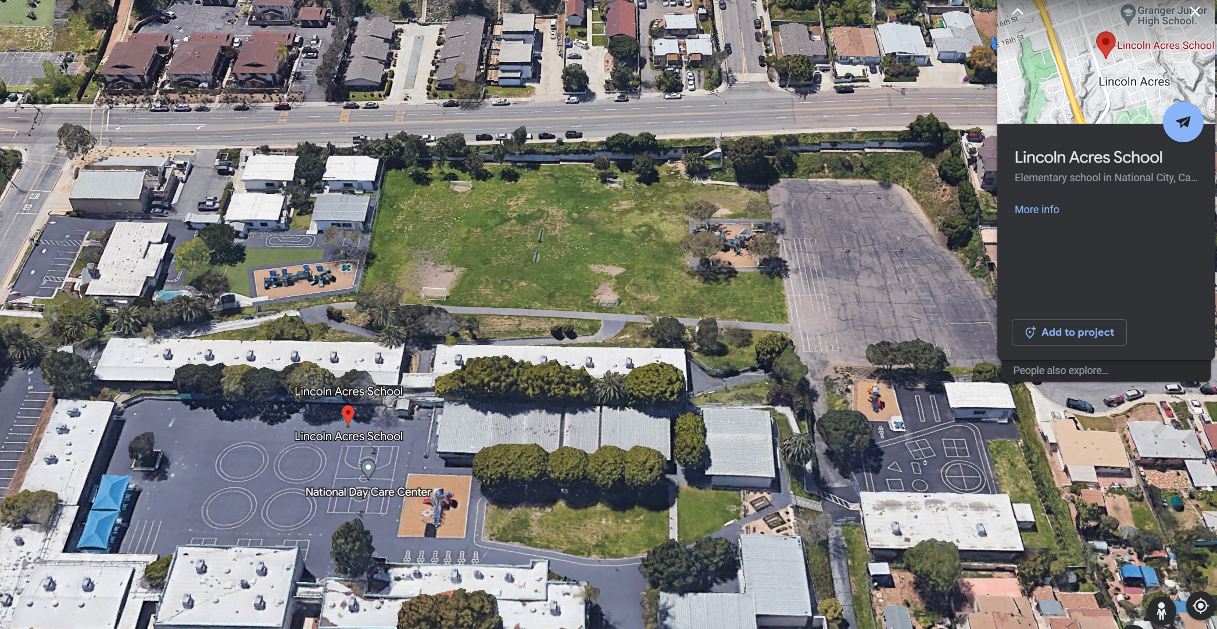



Pre-Flight Guidelines
- Instructor will takeoff
- Each student will get 1.5 minutes of flight time
- Gentle on the stick and try your first move!
- 3 flight groups, Stay in Designated areas

Slide 9
Let’s FLY!
Start your first move with a gentle push on the controller to get oriented
Questions?

