Slide 1
Engineering
15 December 2022

Slide 2

What is this guy even talking about?
Who is this guy?
What is Engineering?
Why do we want engineers?
What do engineers do?
What flavors do engineers come in?
What is it like to be an engineer?
Why are there no engineer fan clubs?
Where do engineers work?

Slide 3

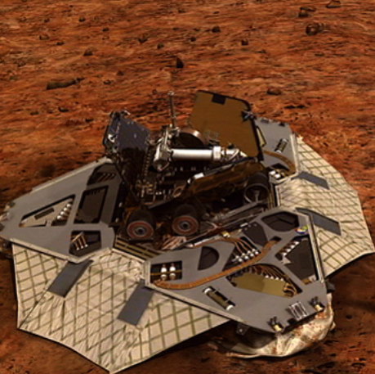
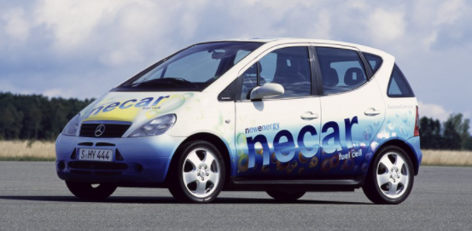
Who is this guy?
Lead Engineer for UK Protector Unmanned Air System
31 Years of experience
  Automotive design
  Aerospace design
  Fuel Cell engines
  Turbine engines

Slide 4
What is engineering?
Not Math…but you need to understand math
Not Science…but you need to know science, and how to learn about what you don’t know yet
Not Technology (exactly)…
You need to know how to figure things out and look things up
…which can be libraries, but can also be Google, Wikipedia and shopping sites
Engineering is using these skills to make things work

Slide 5

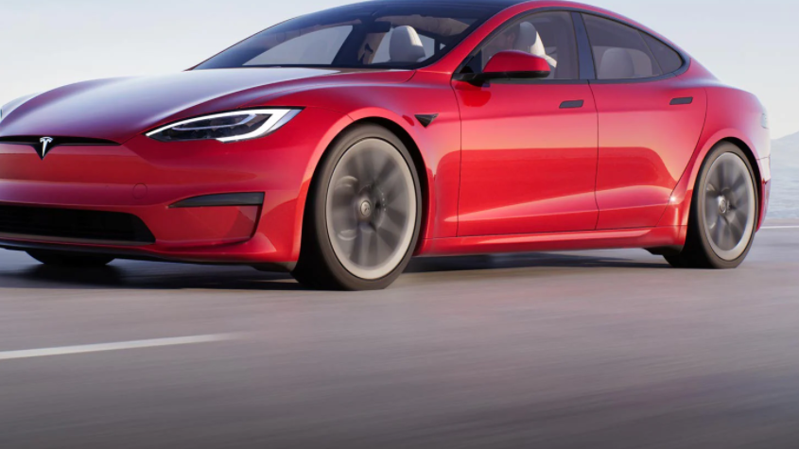
Why do we want engineers?
(because we like things to work)

Slide 6
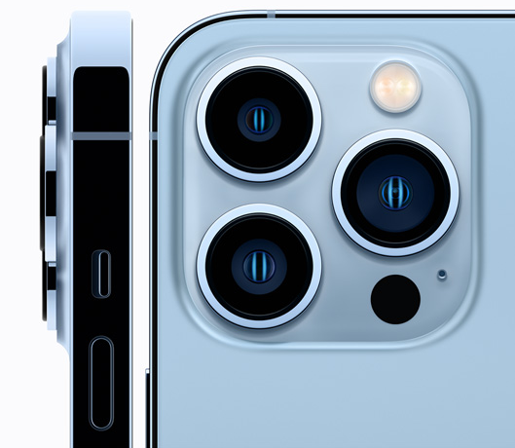
Why do we want engineers?
Radio Communications
Electro-Optical Sensors
Lenses
Semi-Conductors
Software
Advanced Materials
Manufacturing
Electromagnetism

Slide 7

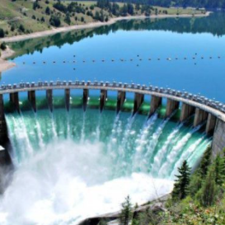

Anything Else?
Chances are that any item, system, game, computer program that you use and enjoy was invented, designed, manufactured, fixed or improved by an engineer somewhere.
Engineers work with researchers to manufacture life-saving drugs
Engineers work with architects to make sure beautiful buildings and homes are safe and will last
Engineers bring us cars, motorcycles, trains, ships and aircraft
Can anyone think of other examples?

Slide 8
What do engineers do?
The obvious answer is that they design things (like a full-time inventor), but they also:
Buy technically complicated things for companies
Test products and systems to make sure they are safe and work correctly
Figure out how to do things cheaper and/or faster
Figure out why things don’t work right
Create systems to organize people, information and/or items to achieve a goal
Create new ways of communicating with each other
Figure out how to make money by improving things that already exist

Slide 9
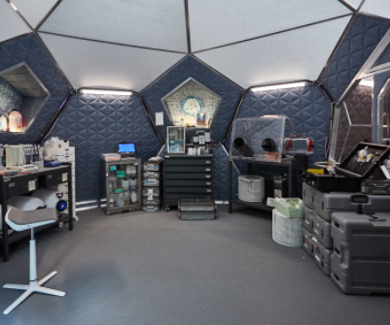

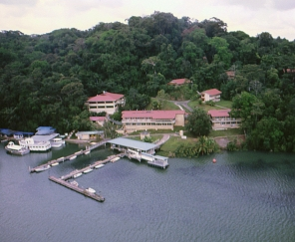
Where do Engineers WOrk?
They might work in an office
…or on a construction site
…Or in a laboratory
…Or in a jungle research facility
…and someday, Mars!

Slide 10


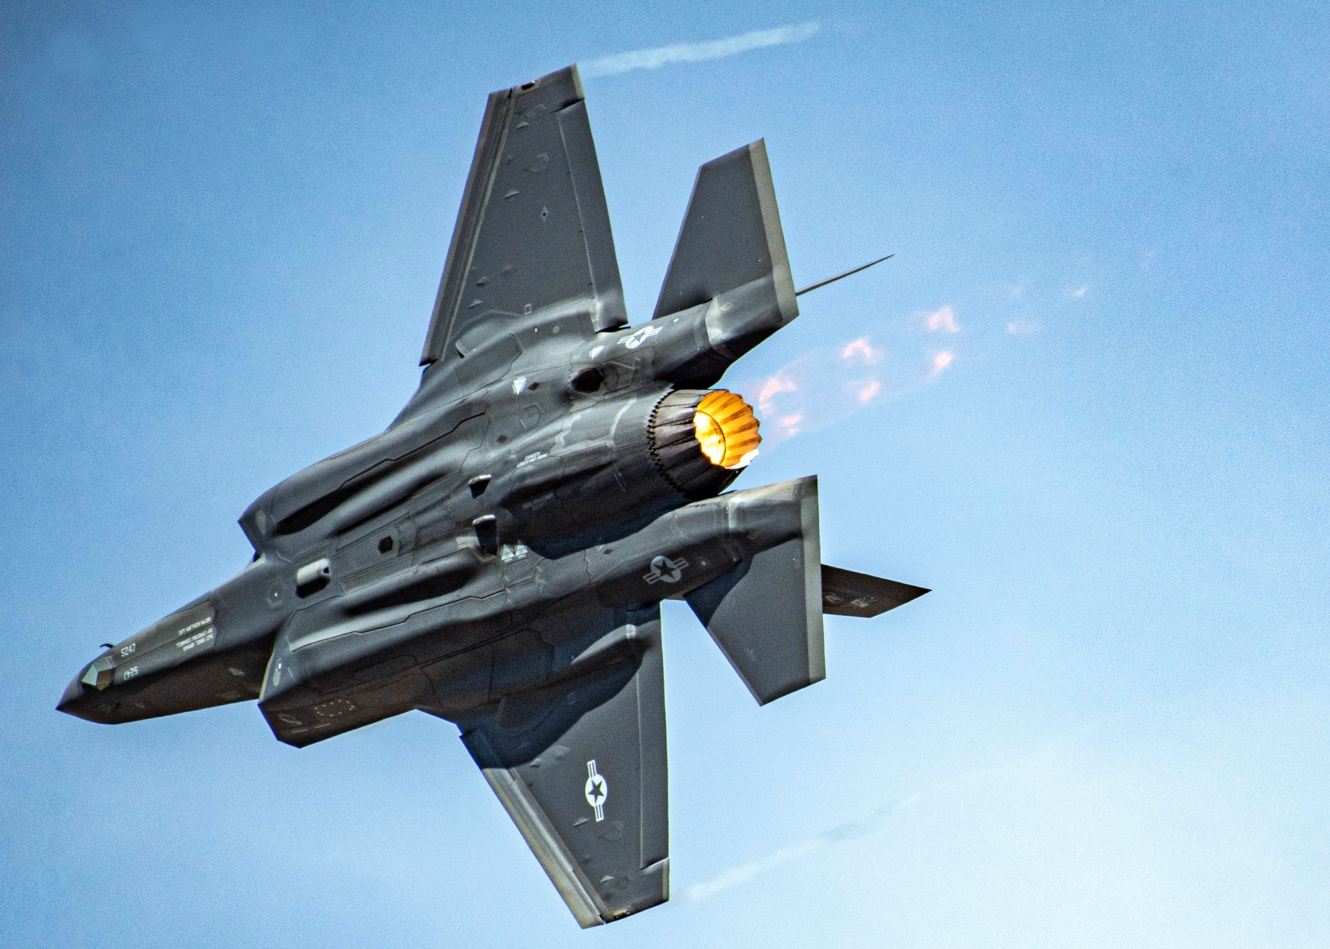
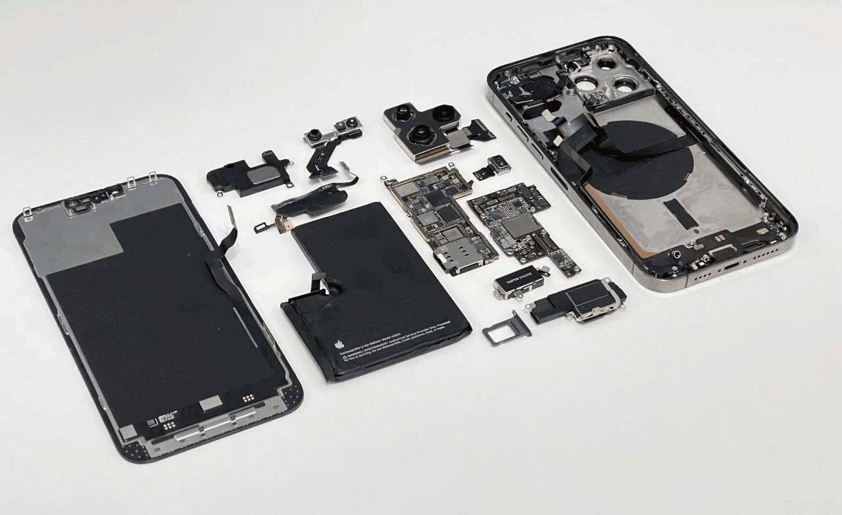
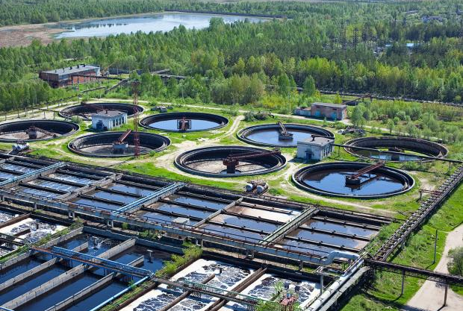
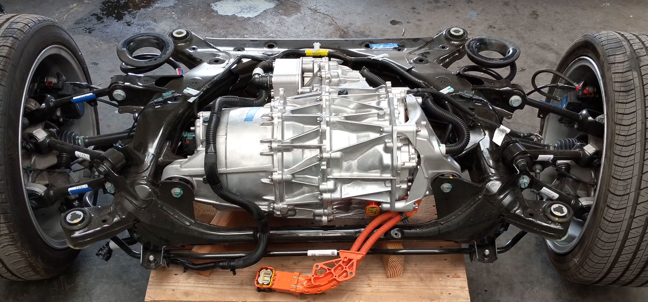
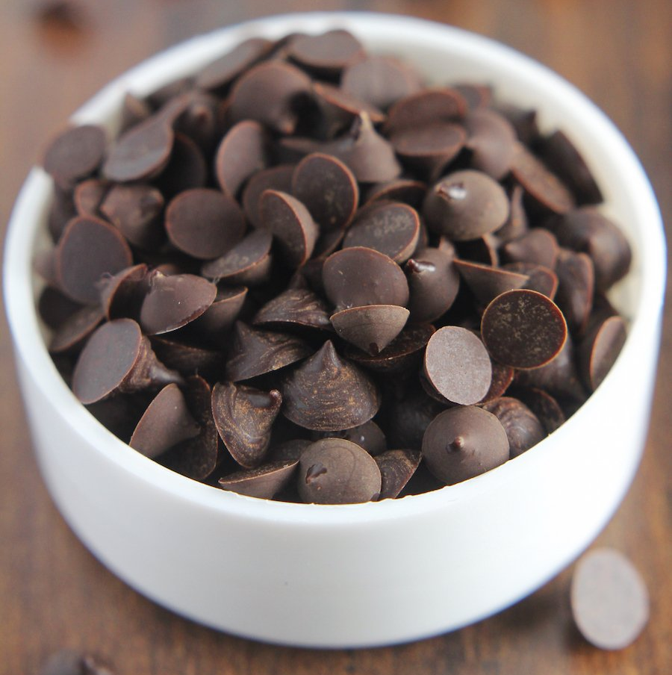
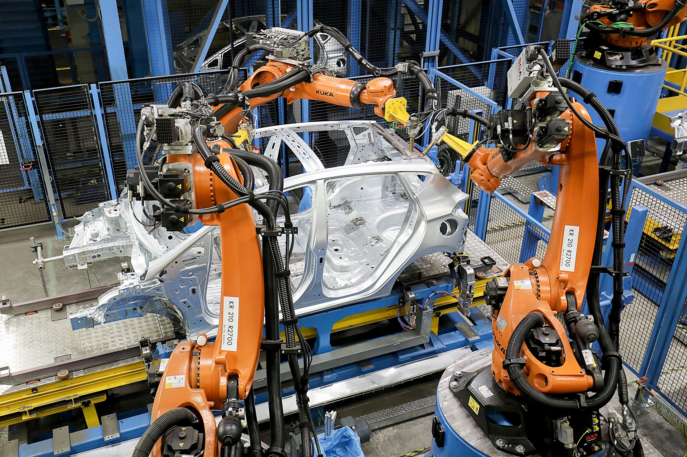


What flavors do Engineers Come in?
Mechanical
Electrical
Civil (bridges, buildings, etc.)
Software
Aeronautical
Manufacturing
Environmental
Chocolate Chip

Slide 11
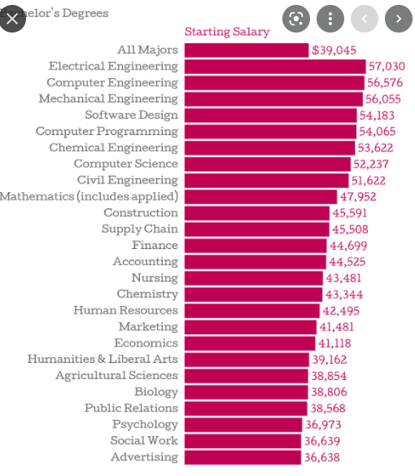
What is it like to be an engineer?
Indoor/Outdoor options
Often work alone, or in small teams
High demand in the market (somewhat easy to get a job)
Special types may be limited to certain parts of the country
+ 18%

Slide 12
Why are there no engineer fan clubs?
I don’t know
Which is one of the hardest things to say…
But you must.
Because this statement is the basis of good science and great engineering

Slide 13
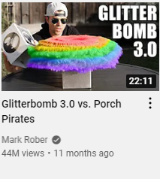
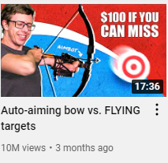
Other things to check out
Mark Rober (YouTube)
Stuff Made Here (YouTube)

