Slide 1
Principles of Flight
Escondido Adventist Academy
24 May 2013

Slide 2
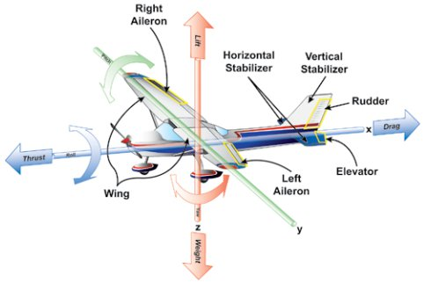
There are 4 forces involved with flight:
Lift
Weight
Thrust
Drag

Slide 3
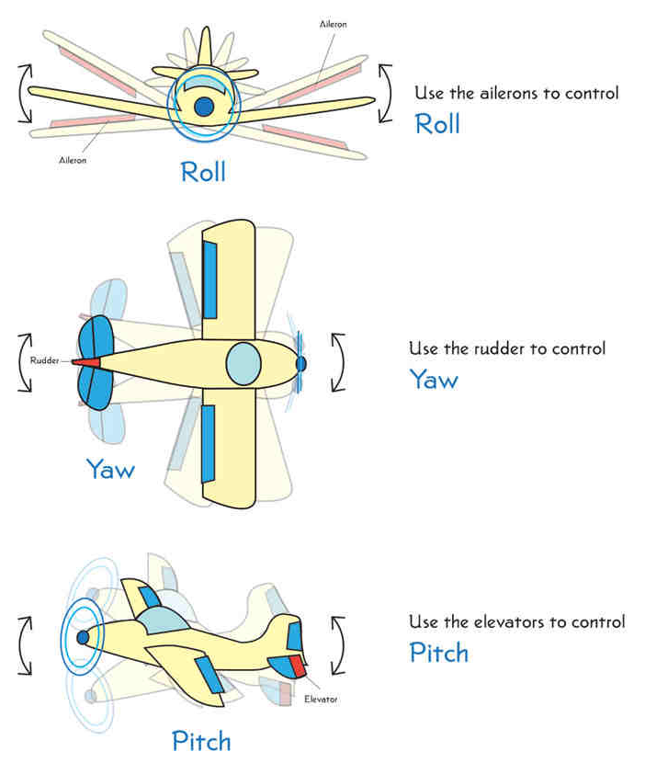
Three axis’ of flight include:
Pitch, Roll, and Yaw
Roll is controlled by the air flow across the ailerons
Yaw is controlled by the air flow across the rudder
Pitch is controlled by the air flow across the elevators.

Slide 4
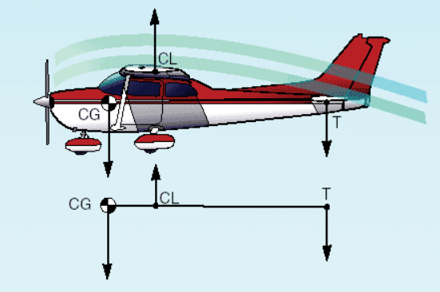

Slide 5
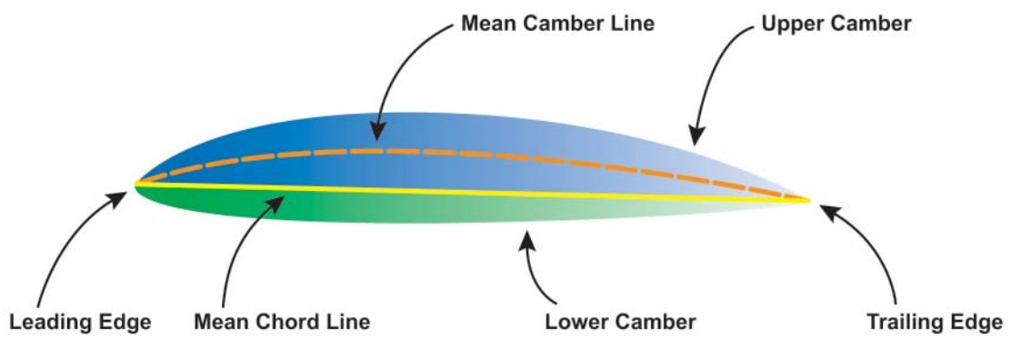
Airfoils:
  A streamlined surface that provides aerodynamic force, when interacting with a moving steam of air, is an airfoil
  A wing is shaped to take advantage of Bernoulli's principle as well as Newton's laws
  Lift created is measured with the coefficient of lift, which relates to the AoA
  Every airfoil has an angle of attack where maximum lift occurs (stall)
  The mean camber is important because it assists in determining aerodynamic qualities of an airfoil
  The measurement of the maximum camber, inclusive of both the displacement of the mean camber line and its linear measurement from the end of the chord line, provides properties useful in evaluating airfoils

Slide 6
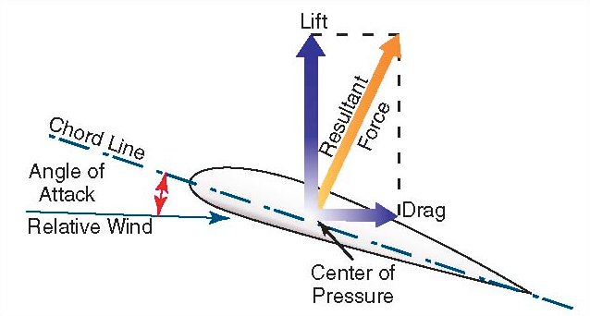

Slide 7
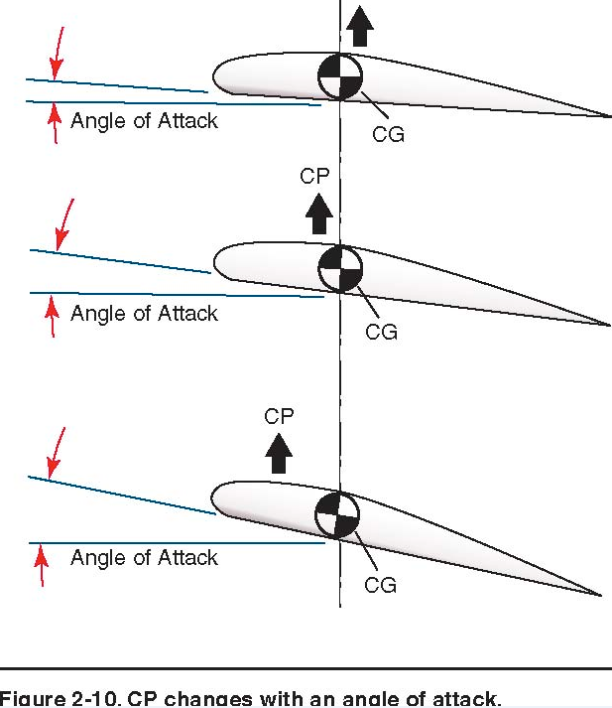

Slide 8
Airfoil Simulator / Types of airfoils
http://www.grc.nasa.gov/WWW/k-12/airplane/foil2.html
http://airfoiltools.com/airfoil/details?airfoil=naca0006-il

Slide 9
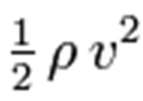




Air Density
Air Velocity
Coefficient Lift
L
L
Wing Surface Area
Total Lift
Coefficient of Lift
D
Total Drag
Coefficient of Drag

Slide 10
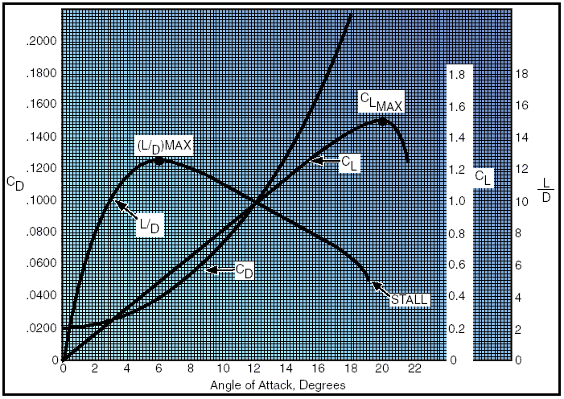

Slide 11
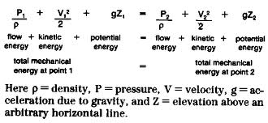
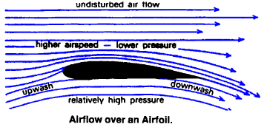
Bernoulli's principle can be derived from the principle of conservation of energy.
This states that, in a steady flow, the sum of all forms of mechanical energy in a fluid along a streamline is the same at all points on that streamline.
This requires that the sum of kinetic energy and potential energy remain constant. Thus an increase in the speed of the fluid occurs proportionately with an increase in both its dynamic pressure and kinetic energy, and a decrease in its static pressure and potential energy.

Slide 12
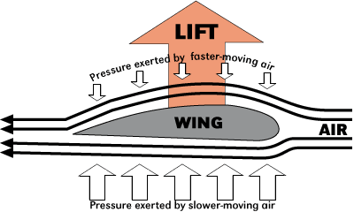

Slide 13
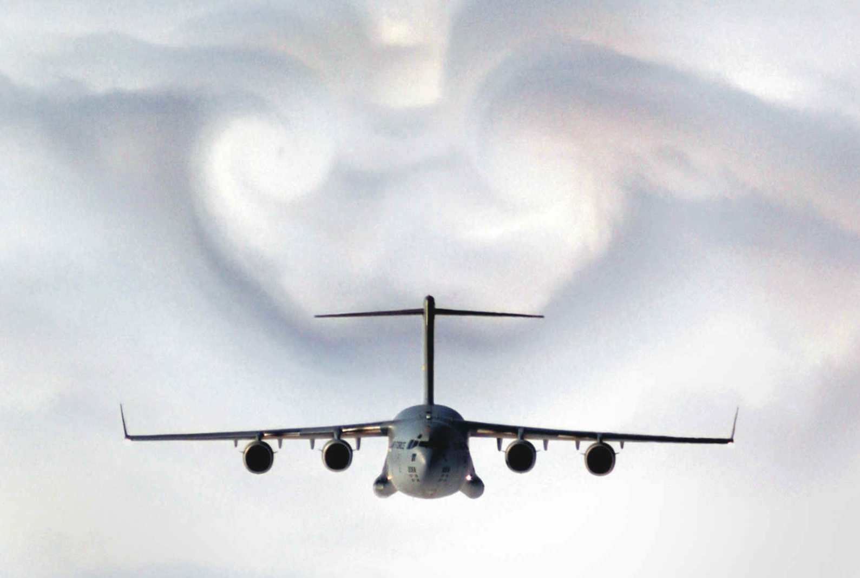
Drag is a mechanical force generated by a solid object moving through a fluid.

Slide 14
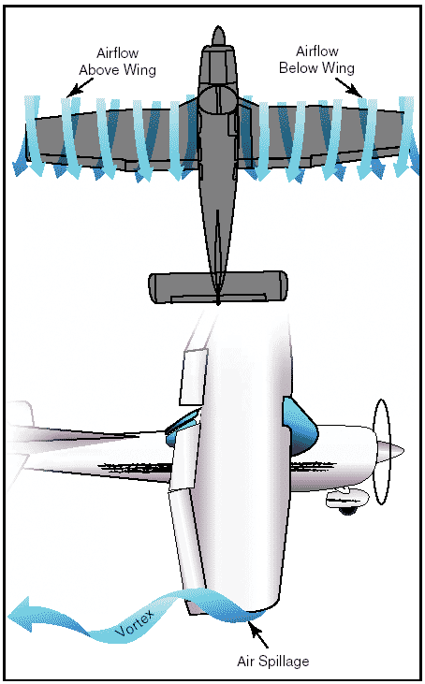
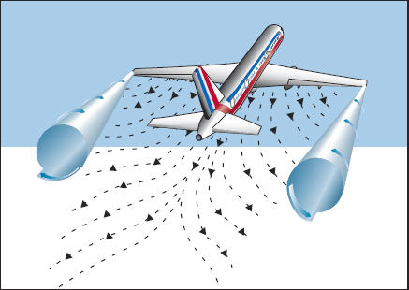

Slide 15
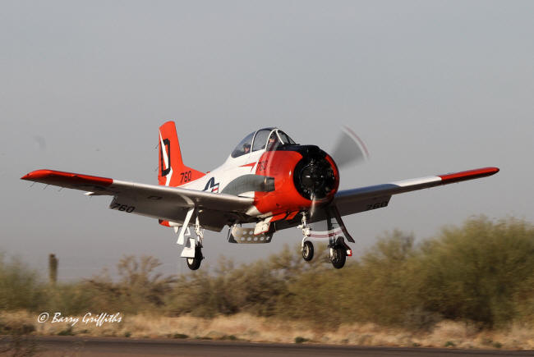
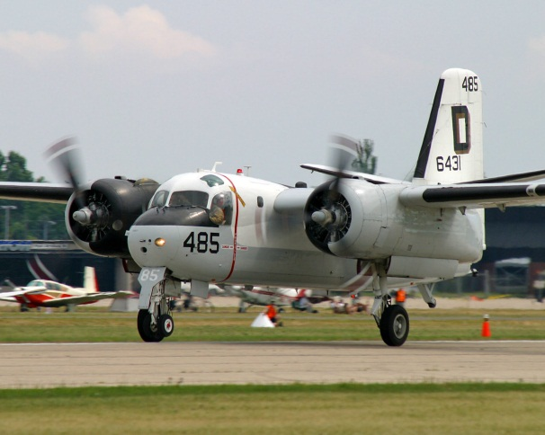
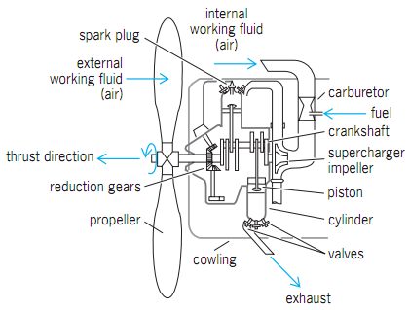
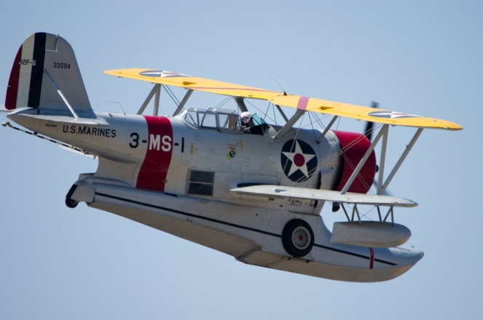
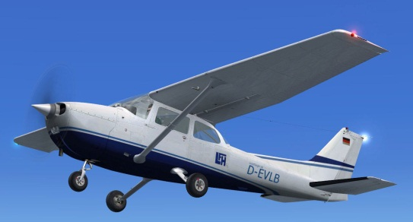
RECIPROCATING ENGINE

Slide 16
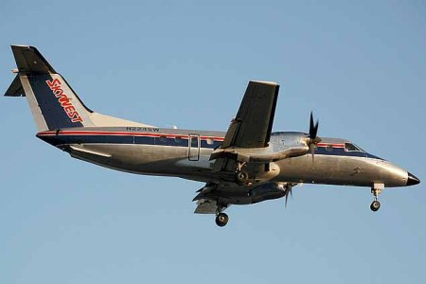
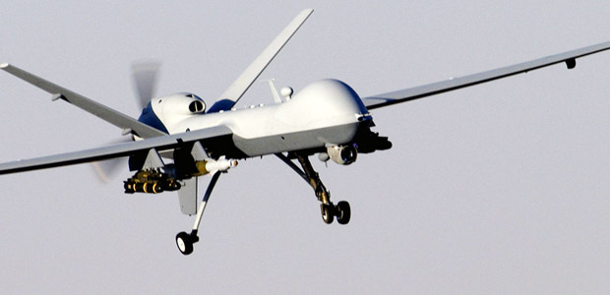
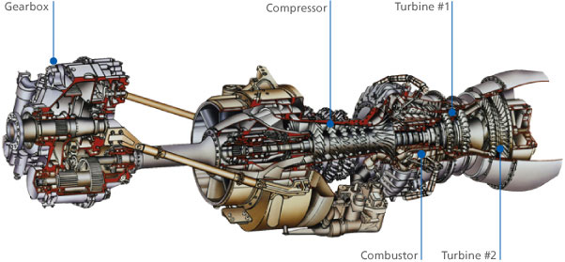
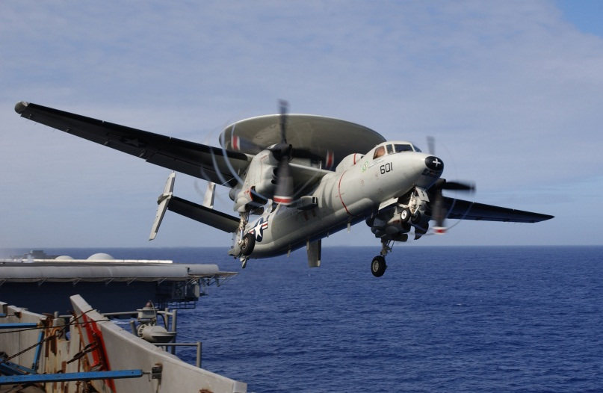
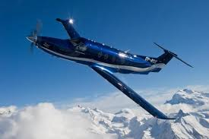
TURBOPROP

Slide 17
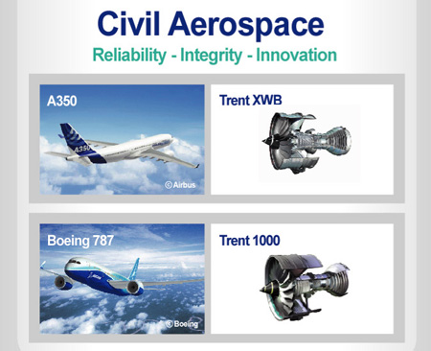
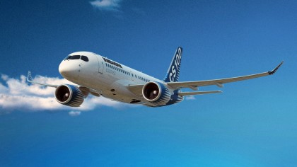
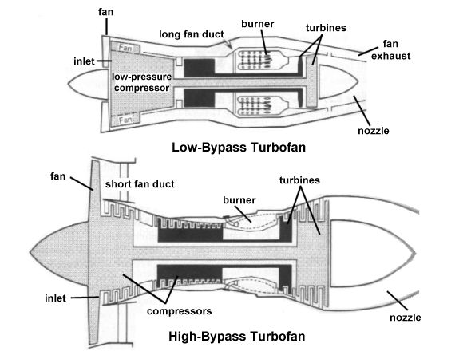
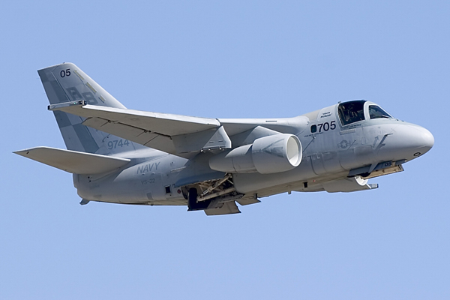
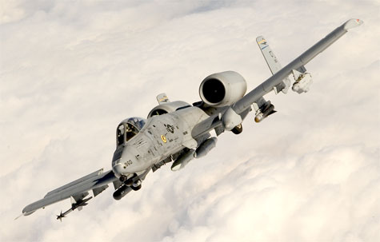
TURBOFAN ENGINE

Slide 18

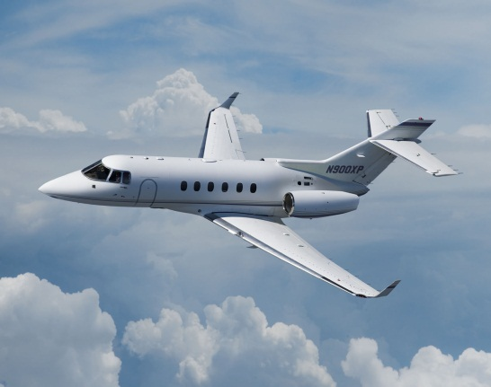
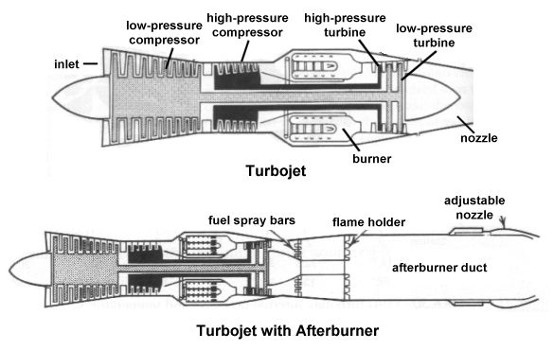
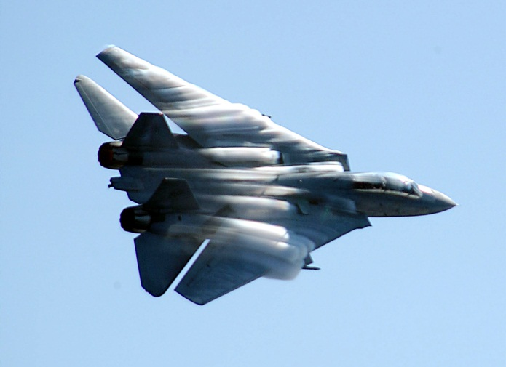
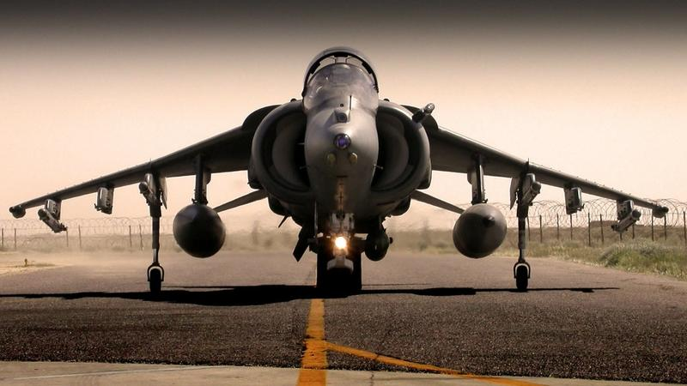
TURBOJET ENGINE

Slide 19
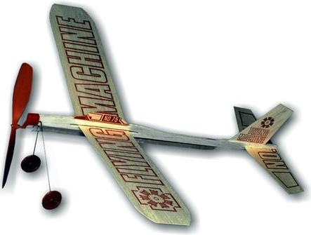
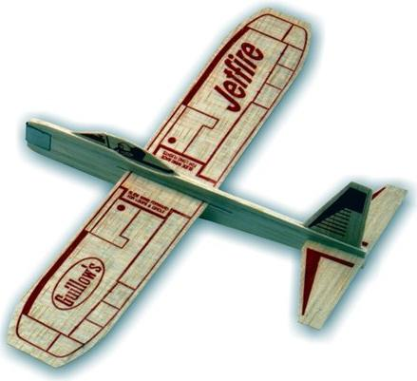
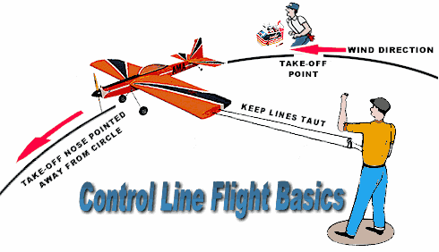

Slide 20

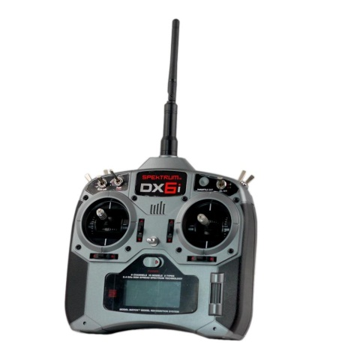
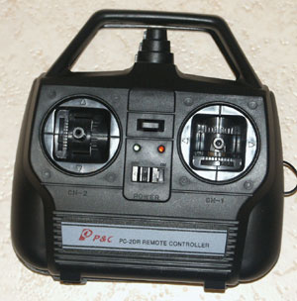
From these...

Slide 21
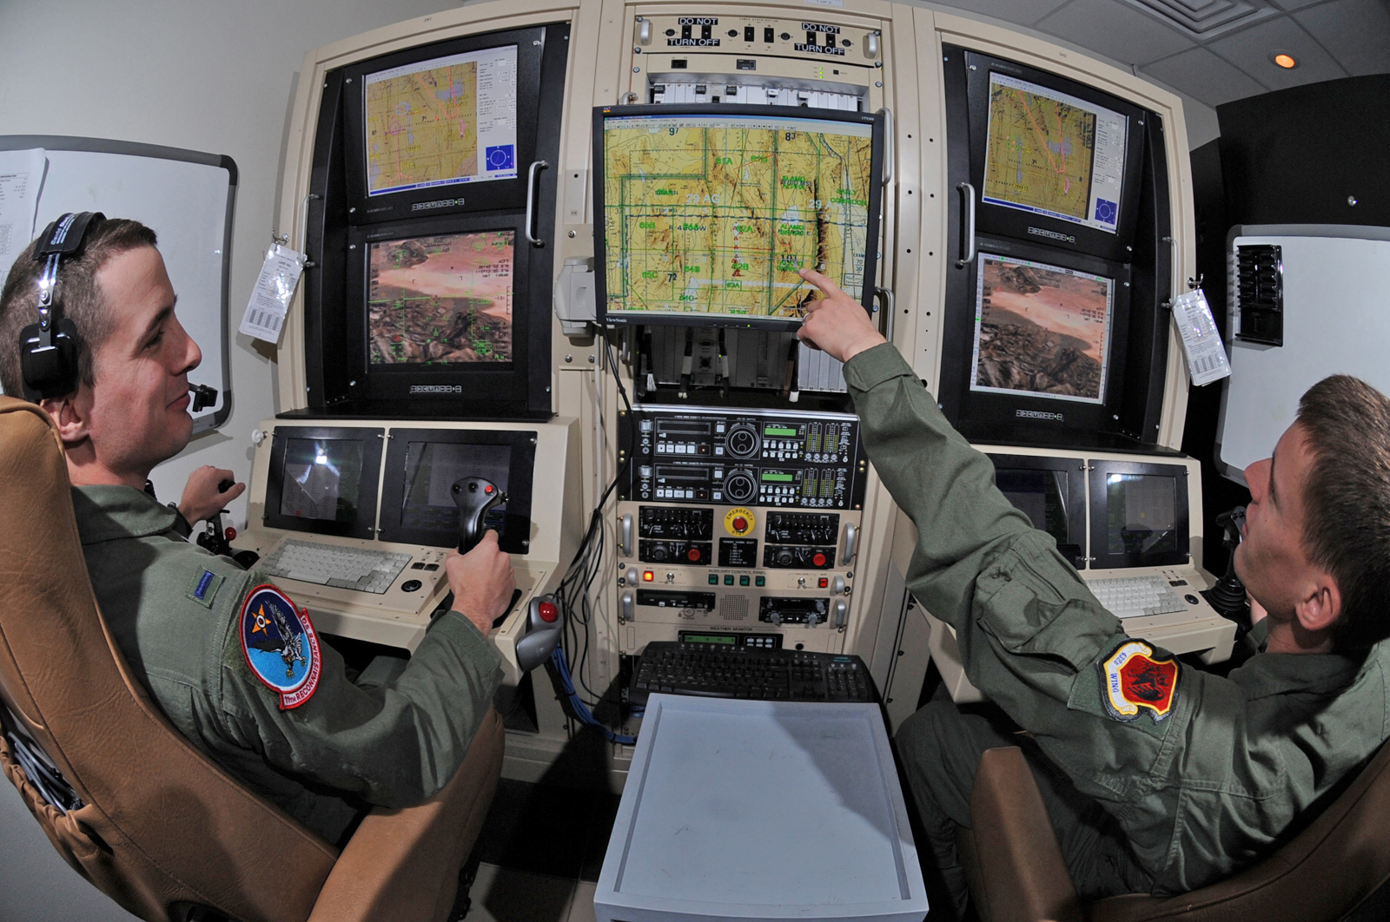
To This!!!

Slide 22
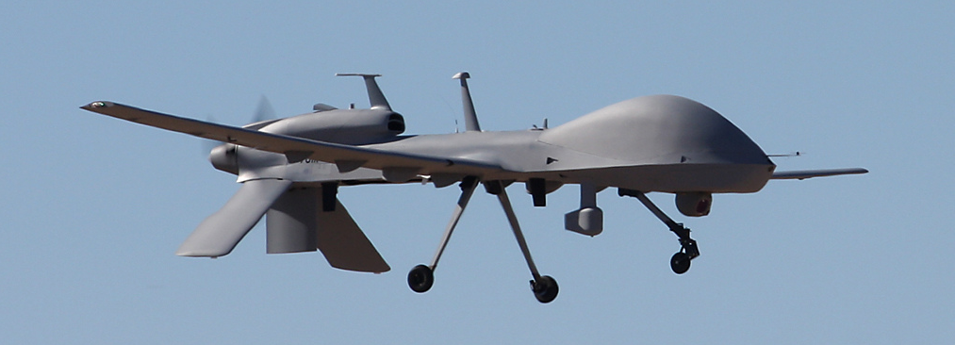
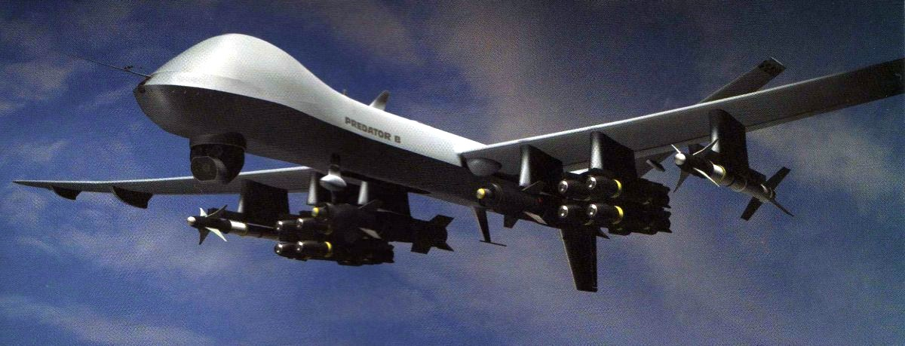

Slide 23
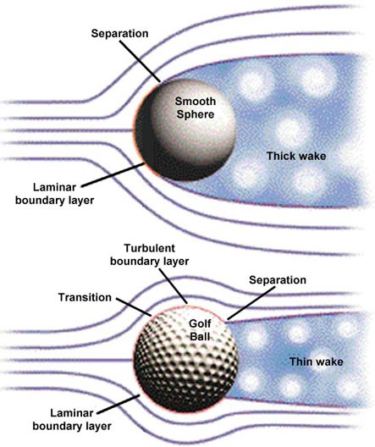
Abstract
Have you ever wondered why golf balls have a pattern of dimples on their surface? The dimples are important for determining how air flows around the ball when it is in flight. The dimple pattern, combined with the spin imparted to the ball when hit by the club, greatly influence the ball's flight path. For example, backspin generates lift, prolonging flight. When the ball is not hit squarely with the club, varying degrees of sidespin are imparted to the ball. A clockwise sidespin (viewed from the top) will cause the ball to veer right (or slice). A counterclockwise sidespin will cause the ball to veer left (or hook). This project attempts to answer the question, "Can an asymmetric dimple pattern decrease hooks and slices?"
Maybe baseball players would like baseballs dimpled!?

Slide 24
PRINCIPLES OF FLIGHT
Definitions:
Airfoil: any surface such as a wing, aileron, rotor blade, or stabilizer designed to produce lift when in motion relative to the surrounding air
Chord: Chord line longitudinal length (length as viewed from the side)
Chord Line: The chord line is the straight line intersecting the leading and trailing edges of the airfoil
Mean Camber Line: Located halfway between the upper and lower surfaces as the average
Relative Wind: The direction of the airflow with respect to an airfoil
Angle of Attack (AoA): The acute angle measured between the relative wind, or flight path and the chord of the airfoil
Angle of Incidence (AoI): formed by the chord of the airfoil and the longitudinal axis of the aircraft which is designed into the aircraft and cannot be changed by the pilot
Attitude: relationship of the aircraft's nose with the horizon
Flight Path: The course or track along which the aircraft is flying or is intended to be flown
Lift: A component of the total aerodynamic force on an airfoil and acts perpendicular to the relative wind
Center of Pressure (CP): The average (mean) of the lift force through which all lift is considered to act, same as Center of Lift
Center of Lift: The average (mean) of the lift force through which all lift is considered to act, same as Center of Pressure
Center of Gravity: The average weight across an aircraft through which gravity is considered to act

Slide 25
Introduction:
Aerodynamics deals with the motion of air and the forces acting on a body moving relative to the air
The basis for this understanding is found in the four forces acting on an aircraft and Newton's Three Laws of Motion
In un-accelerated flight, the four forces are in equilibrium which is lift equaling weight, and thrust equaling drag
Lift: Upward force created by airflow
Weight: Opposes lift via gravity
Thrust: Forward force which propels the airplane
Drag: Retarding force which limits speed
A balanced aircraft is a happy aircraft (fuel burn, efficiency, etc.)
The principle structure of an aircraft consists of:
  Fuselage: main structural unit
  Wings: airfoils to produce lift
  Flight Control Surfaces:
    Primary: ailerons, elevator, rudders
    Secondary: moveable trim tabs located on the primary flight control surfaces
    Auxiliary: wing flaps, spoilers, speed brakes and slats

Slide 26
Weight:
Force of gravity that acts vertically through the center of gravity
Weight varies based on load, passengers, and fuel
Opposing lift, as an aircraft is descending
Thrust:
Forward acting force that opposes drag and propels the airplane
Measured in pounds of thrust and/or horsepower
Acts parallel to the center of thrust to overcome drag, F=MA
Excess thrust makes an airplane climb
Provided by a propeller in most small aircraft
Thrust must overcome total drag in order to provide forward speed with which to produce lift
Increasing the power allows thrust to exceed drag, causing the airplane to accelerate
Reducing the power allows drag to exceed thrust, causing the airplane to slow

Slide 27
Lift:
Key aerodynamic force on an airfoil
Lift always acts in a direction perpendicular to the relative wind and to the lateral axis of the aircraft
  Therefore, lift is not always up or in any reference to the Earth
Lift is concentrated from the center of pressure (CP)
Drag is always a by-product of lift
Air flow over the airfoil causes lift
Lift is proportional to the square of the speed (Lift = V²)
The magnitude of the force of lift is directly proportional to the density of the air, the area of the wings, the airspeed, shape, and AoA
Total lift must overcome the total weight of the aircraft, which is comprised of the actual weight and the tail-down force used to control the aircraft's pitch attitude
Occurs proportionately with:
  Speed
  Air Density
  Shape
  Size of the airfoil
You can control lift in 2 ways:
  Increasing AoA
  Increasing Speed

Slide 28
Newton's Laws:
  Newton's first law: A body at rest tends to remain at rest, and a body in motion tends to remain moving at the same speed and in the same direction. For example, an airplane at rest on the ramp will remain at rest unless a force is applied, which is strong enough to overcome the airplanes inertia
  Newton's second law: When a body is acted upon by a constant force, its resulting acceleration is inversely proportional to the mass of the body and is directly proportional to the applied force. This law may be expressed by F=MA, for example, Speeding up, slowing down, entering climbs or descents, and turning
  Newton's third law: for every action there is an equal and opposite reaction. This principle applies whenever two things act upon each other, such as the air and the propeller, or the air and the wing of an airplane
Bernoulli's Principle:
  As the velocity of fluid (air) increases, its internal pressure decreases
  A Venturi demonstrates Bernoulli's principle, A1V1P1 = A2V2P2

