Slide 1

Sound Waves
By: Doug Seybert
Funding Courtesy of:

Slide 2
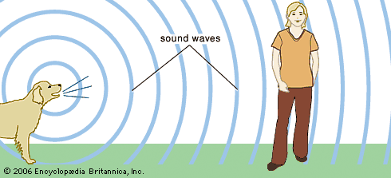
Who knows what a sound wave is?
Sound waves are a type of energy that travels through air, water, or even solid objects!

Slide 3

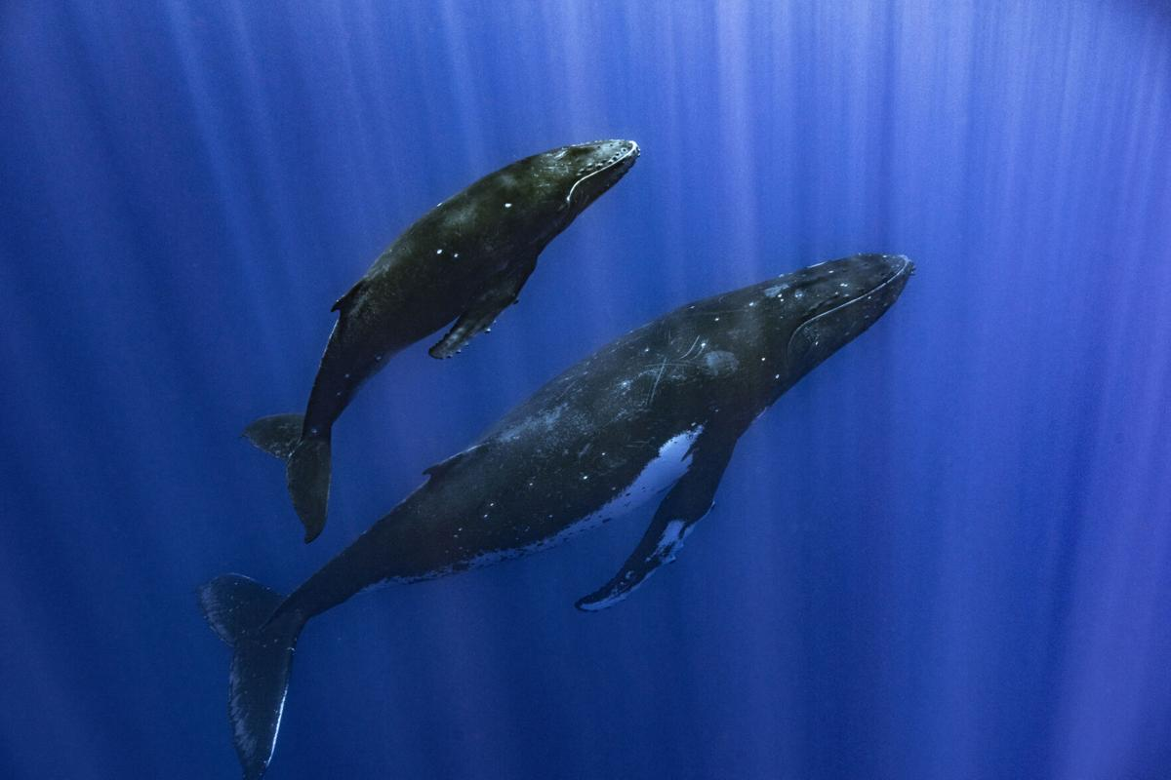
How are sound waves made?
Sounds waves are created by vibrations that excite the molecules that make up the air, water, or solid object that the sound is traveling through.
  The air, water, or solid (aka: stuff) the sound is moving through is called a medium

Slide 4

So How Do They Work?
The medium that the sound is traveling through is made of molecules
  That’s the tiny black dots shown below
The vibrations create patterns in the molecules, which reach our ears and vibrate our ear drums
  Our brains turn that into a signal that allow us to hear

Slide 5
Demonstration
Show how the tuning forks work
Use the echo box to increase the volume of the sound

Slide 6
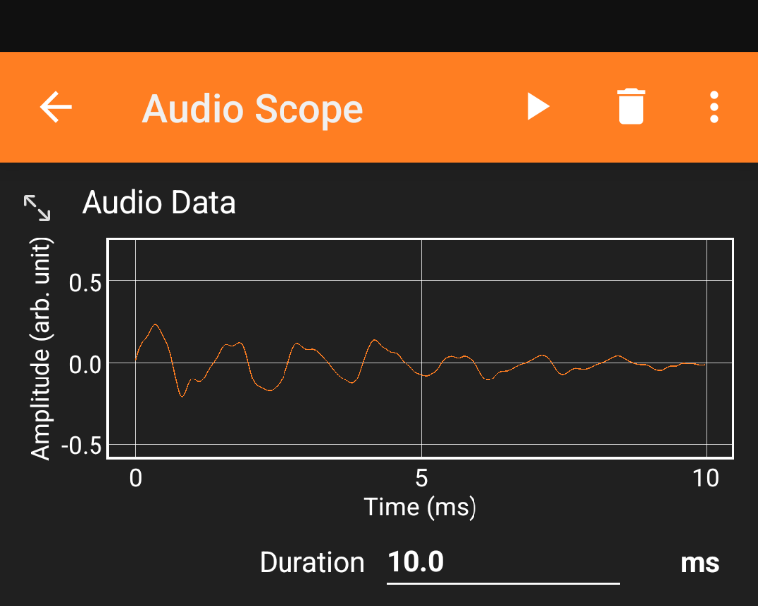
Frequency Sweep
Use the Bluetooth speaker to play frequency sweeps to demonstrate how the sound changes
  Use the Phyphox app on a smart phone to see the sound waves
    Use the Audio Scope function
Frequency Sweep Audio
Video 1
Video 2

Slide 7
Ping Pong Ball
Strike the tuning fork attached to the echo box
  With the ping pong ball on a string, touch the ball to the tuning fork while it’s vibrating
  The ball will bounce off the tuning fork
  This is energy being transferred from the tuning fork to the ball

Slide 8
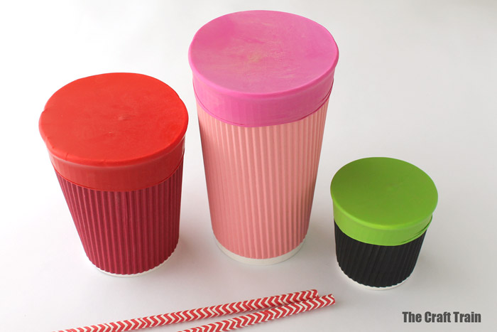
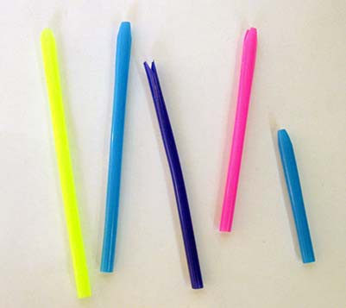
Experiment
Craft projects
  Reed Instrument using straws (how to video)
    Discuss how different length straws make different sounds because they have different frequencies
  Optional Experiment: Make Drums
    Different sized cups will make different sounds because they have different frequencies as well

Slide 9
Review
What is a sound wave?
How is sound made?
What types of things can sound travel through?
  Bonus question(s): Can sound travel through space?
    Why/Why not?

