Slide 1
Engineering, Space, Satellites
3rd Grade Manzanita Community School
Oakland, CA
Willy Logan
Aerospace/Mechanical Engineer

Slide 2
What Are We Going to Learn Today?
What is space?
What is gravity, what does it do?
What challenges do engineers overcome to access Space?

Slide 3
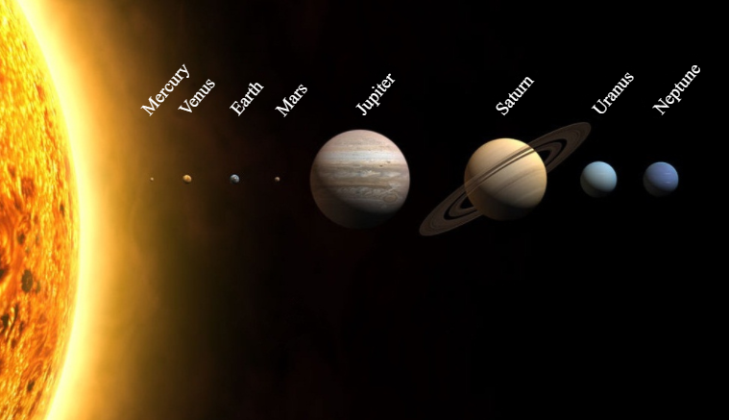
Our Solar System
This Is Us!
~4.6 Billion Years Old!
Notes:
Solar System
Solar system formed 4.6 billiion years ago
Our solar system is 1 of 200 billion in the Milky Way galaxy
Our local star is called the sun
Fusion: converting hydrogen to helium
Fit 1 mission earths in it
Produces energy for life to exist (heat, photosynthesis, nourishment for animals)
Planetary system has 8 plants & stretches 2.8 billion miles
Inner Rocky Planets
Mercury: no atmosphere & really cold, lots of cratesr, 0 moons
Venus: super hot (867 deg F), tons of volcanos/lava, 0 moons
Earth: hosts life and oceans of water, 1 moon
Mars: frozen desert, red color from iron/oxide, 2 moons
Asteroid ring 4-5 year orbit around the sun
Outer Gas Giants
Jupiter: hydrogen & helium, massive, al the other planets can fit inside it, 67 moons
Saturn: rings, so light it would float in the ocean, 62 moons
Uranus: icy planet, methane (blue), 82 year orbit
Venus: icy planet, methane (blue), 163 year orbit
8 Planets
Lots of Space
Gravitation bound system of the sun

Slide 4
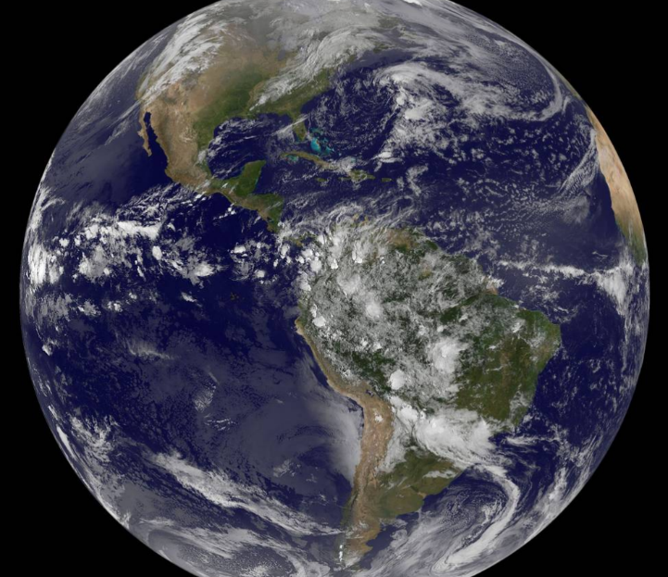
Planet Earth
Oakland, CA
Gravity!
Notes:
Earth & Gravity
Raise your hand if you live on Earth? Keep your hand raised if you left Earth? Any reason why?
Earth’s gravity pulls everything including you and me equally to the ground
Moon has gravity and pulls the ocean tides
Sun has gravity and keeps the planet in orbit
Gravity has an infinite range, though it become increasingly weaker as objects get further away

Slide 5
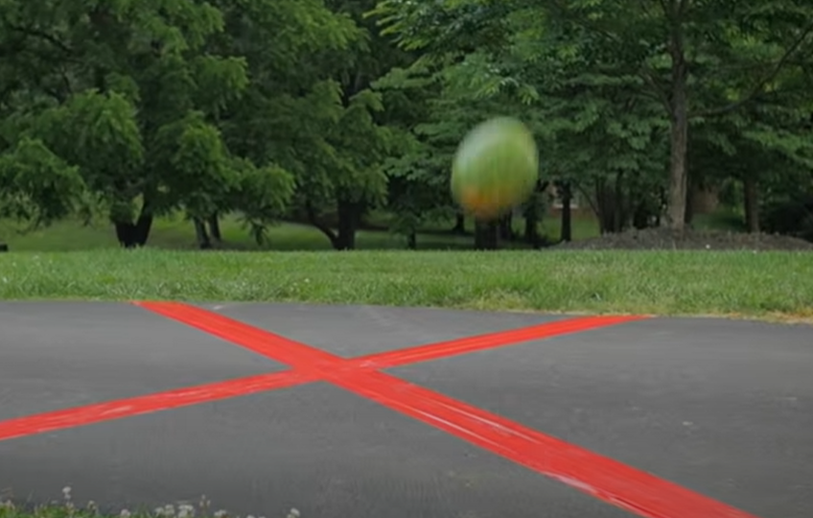
Gravity in Action!
Dropping Watermelon from 45ft
Notes:
Gravity
If you drop a penny at the same time of the watermelon which hits the ground first?

Slide 6
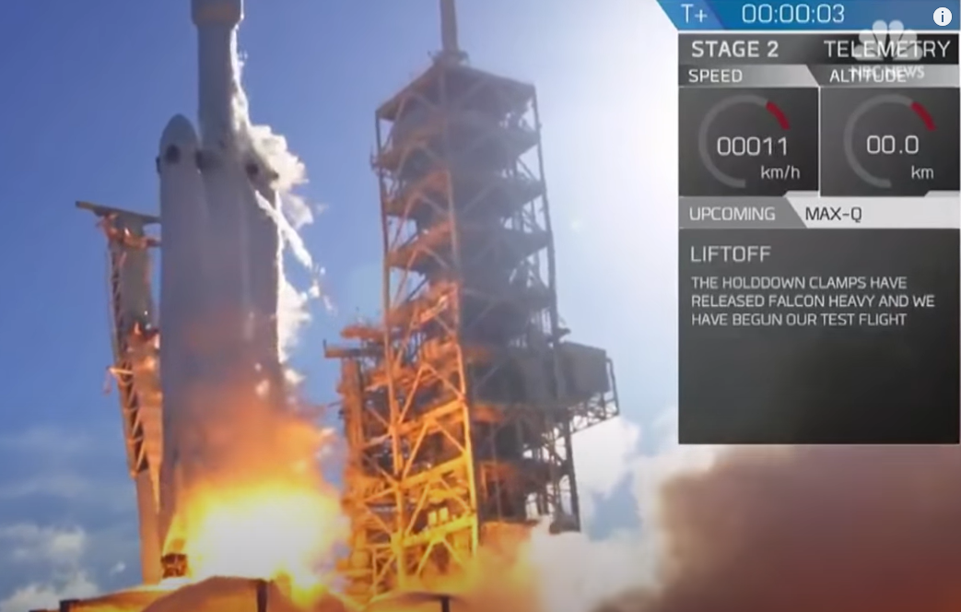
How Do We Get To Space
Falcon Heavy Launch
Notes:
How do we get to space?
As humans we want to explore space and the universe.
Started with telescopes but then we wanted to send satellites and people to space
What is stopping us from going to space?
Gravity
Engineers calculated that we need an exit velocity to enter Earth’s orbit of 25,000 mph
Escape gravity is one of the biggest challenges facing space travel. The vehicle requires an enormous amount of fuel to break through Earth's gravitational pull.
Who figures out how to solve this problem?
Rockets or a controlled explosion
Rockets need a lot of fuel. All that fuel adds significant weight to the spacecraft, and when an object is heavier, it takes more thrust to lift it. To create more thrust, you need more fuel.
Who wants to watch a rocket

Slide 7
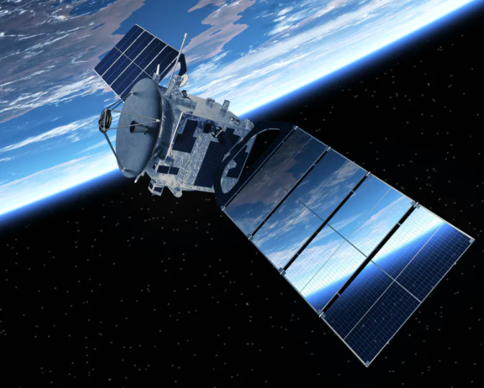
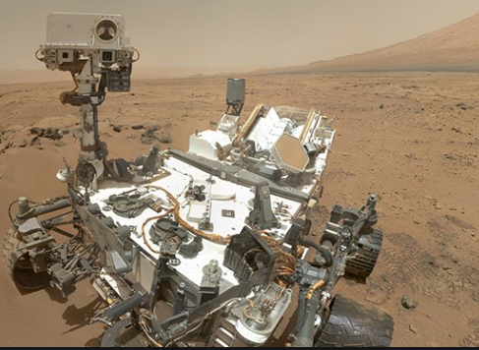
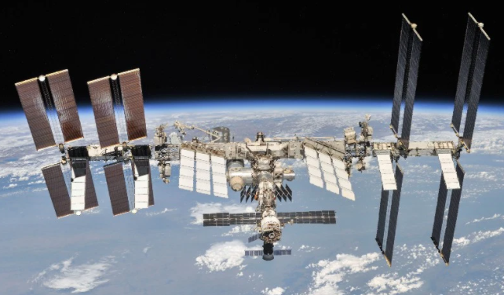
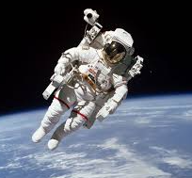
What’s In Space?
Notes:
What’s in space?
Satellites
An object in space that orbits bigger objects like Earth
Communication (cell phone, TV)
Navigation (GPS)
Pictures
Weather
Land Rovers:
Robots that travels across the surface of the planet Mars performing research
International Space Station
Modular space station in LEO built by US, Russia, Japan, Europe, Canada
Fully crewed 7
Astronauts
People like engineers go to space, they are called astronauts
Get to space with spacecraft
How man astronauts have been to the moon
12!

Slide 8
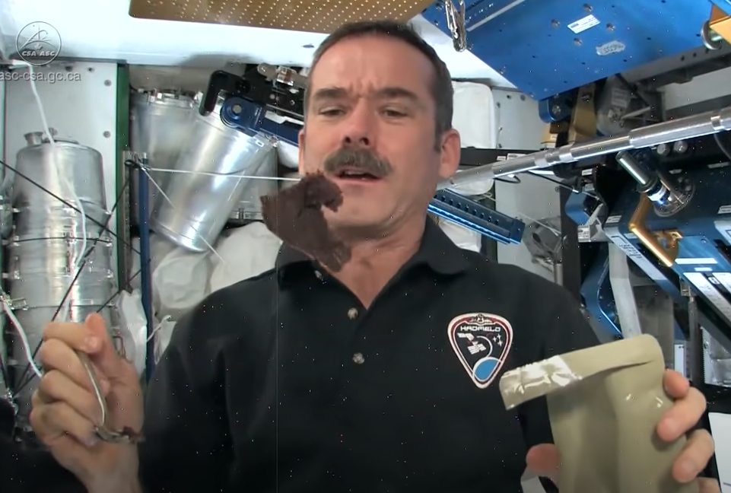
How Do You Eat In Space?
Eating In Space
Notes:
Now we are in space, but more problems…
Astronauts float in space! Is it because there is no gravity?
Nope, its because they are falling
So if astronauts are floating, how do they sleep, how do they eat?
Lets watch Chris Hadfield who will show us
Can you think of more questions?

Slide 9
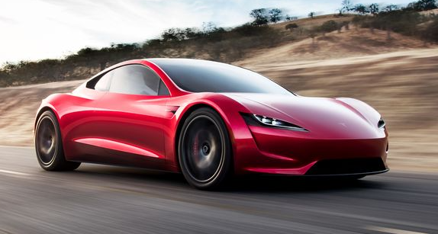

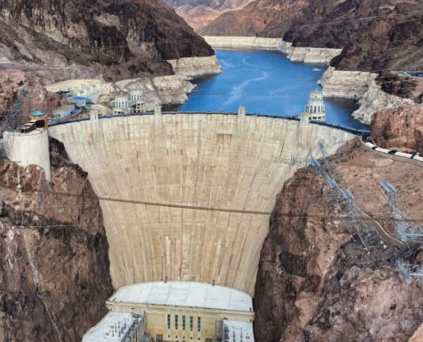
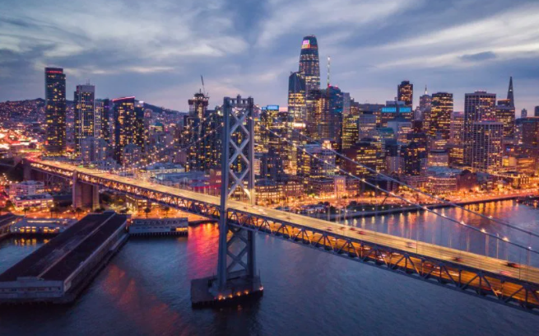
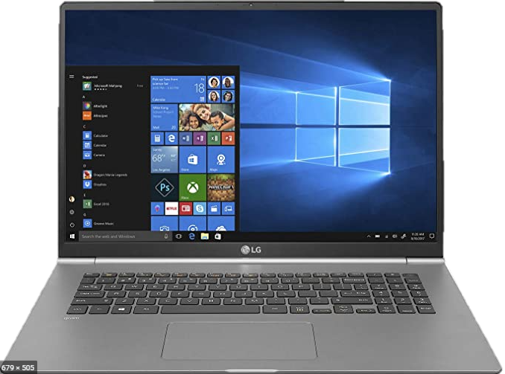
What Are Engineers?
Notes:
Engineers solve problems
Engineers study aerospace, mechanical, electrical, medicine, hardware, software, civil
Engineers design and build many types of produces for all types of environments
Engineers get to do cool stuff!
You can be an engineer
Any other problem that people can think of that engineers solve?

Slide 10
Thank You!
Links to space related activates
  https://spaceplace.nasa.gov/
Chris Hadfield YouTube Videos
  How do you brush your teeth in space?
  How do you eat in space?
  How do you play a guitar in space?
Notes:
Thank You
Never stop asking questions
Solve problems

