Slide 1
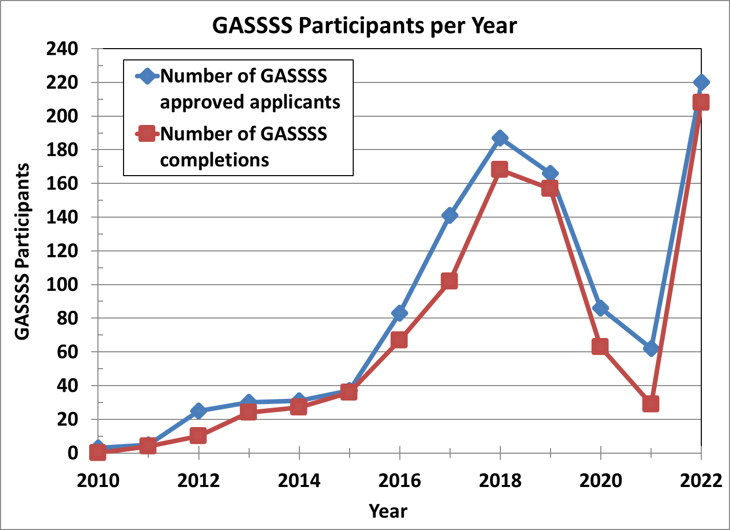
GASSSS Participation Per Year as of 12/31/2022

Slide 2
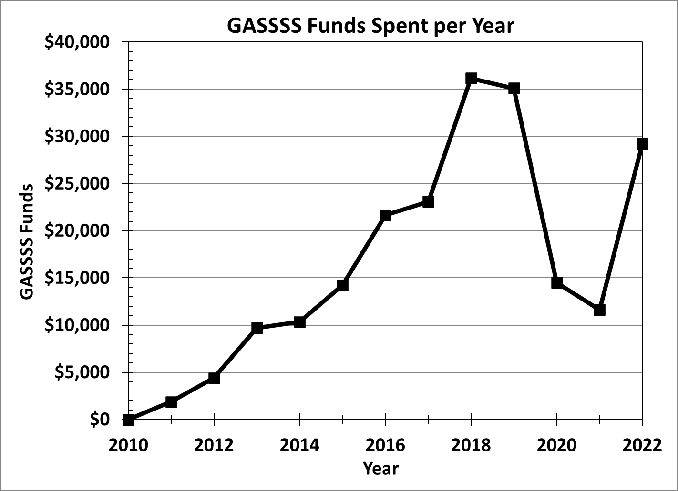
GASSSS Funds Spent Per Year as of 12/31/2022

