Slide 1
Mentoring Graduate Students for Their Likely Non-Academic Careers
American Association of Physics Teachers Meeting
San Diego, CA
January 6, 2015
Panel GB01
Dr. Lawrence Woolf
General Atomics Aeronautical Systems, Inc.
General Atomics Sciences Education Foundation
San Diego, CA 92121

Slide 2
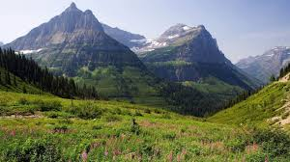

Mentoring landscape: from A to F
Advise
Act as role model
Adjust or suggest curriculum
Framing the graduate experience

Slide 3
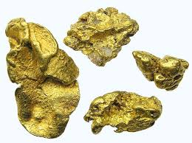
Mentoring
Broad overview of “experts”
  Common themes are color coded
  Distilled nuggets
  “Review article”
My personal perspective

Slide 4
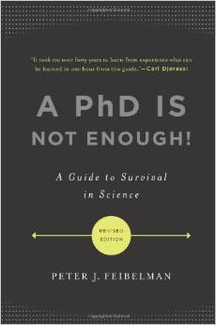

“A PhD Is Not Enough!
A Guide to Survival in Science”
Dangers of Benign Neglect – failing to teach science survival skills
Understand broad context and big picture of your research
Speak at the level and interests of your audience
Plan your thesis as short projects that can be completed and published as short papers – plan long term goal as sequence of short term projects
Be a scientific leader
“A PhD Is Not Enough” by Peter J. Feibelman, Sandia National Lab

Slide 5
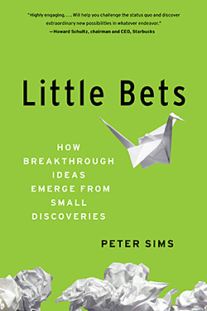
Characteristics of innovators
Fail quickly to learn fast
Smallifying
  Breaking a project down into discrete, relatively small problems to be resolved
  Small “wins” move the project towards goal
“Little Bets: How Breakthrough Ideas Emerge from Small Discoveries” by Peter Sims

Slide 6

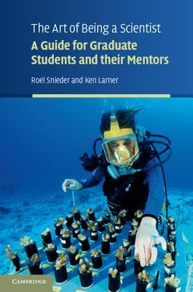
“The Art of Being a Scientist”
Simplify your problems first then bootstrap your way into complexity
Identify mistakes quickly
Time management (The 7 habits of highly effective people)
Get exercise/sleep – take care of yourself
Become proficient at proposals
  What need does it address that is important to the funder
Applying for job in industry
  Explain why you are perfect candidate – why you will help meet goals of the job and the goals of the organization
Offered as 1-credit course for one semester at Colorado School of Mines
“The Art of Being a Scientist: A Guide for Graduate Students and their Mentors” by Roel Snieder and Ken Larner

Slide 7

Second Graduate Education in Physics Conference

Slide 8
Alex Panchula (First Solar)
Gaps in physics education
  Exposure to toolsets used in industry: software, programming, statistics
  Business methods
Need to train physicists to write “the how” not “the what” in resumes, i.e. skills based resumes
  Instead of “Magnetotransport in Magnetic Nanostructures”
  Use: “Experimental design, execution, data analysis and mathematical models of complex systems”
Invite alumni in industry to speak to students
Ref: Panchula presentation at Second graduate education in physics conference (unpublished)
Also: http://www.physics.oregonstate.edu/~tate/APS2010Tutorial/PanchulaSlides.pdf

Slide 9
2nd Graduate Education in Physics
Conference Findings
Most graduate students will not have academic careers – students should be informed about employment statistics
Lack of tracking of career paths of PhDs
Lack of knowledge of skills that PhDs find valuable in their jobs
Need to set realistic educational objectives and then survey alumni to demonstrate they have been met
Stefan Zollner, New Mexico State

Slide 10

2nd Graduate Education in Physics
Conference Findings
Provide career information and guidance
  Faculty should educate both themselves and students about non-academic career paths and employment statistics
  Invite speakers/alumni from local industries
  Resumes and letters of recommendation should reflect broadly on what students can do
  Provide skills that are broadly valued in industry
  Departments should intentionally provide preparation for non-academic careers (recall danger of benign neglect!)

Slide 11
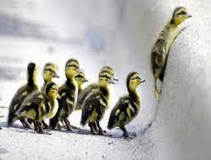
2nd Graduate Education in Physics
Conference Findings
Leadership
  Conceptualizing and planning projects
  Focus team on attaining goals
  Keep team and stakeholders informed
  Graduate students can develop leadership
    Mentor junior graduate students and undergraduates

Slide 12
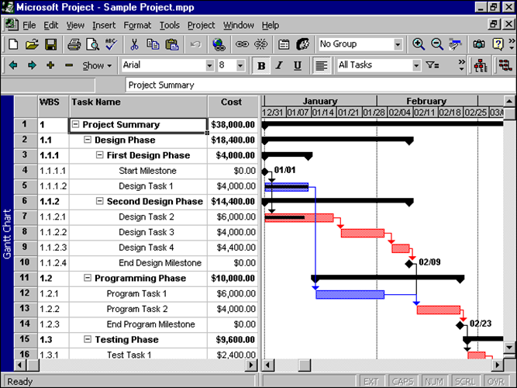
2nd Graduate Education in Physics
Conference Findings
Project Management
  Define project scope
  Develop and follow schedule
  Develop and follow budget
  Graduate students can use their thesis research as the project

Slide 13

2nd Graduate Education in Physics
Conference Findings
Communication Skills
  Verbal
    Co-workers, technicians, program managers, upper management, funding sources
  Written
    Monthly reports, proposals, white papers, test plans, test results, final reports
    Graphs and tables for technical and non-technical audiences
  Graduate students can hone these skills via thesis updates to advisors and graduate students

Slide 14
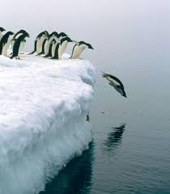
2nd Graduate Education in Physics
Conference Findings
Interpersonal skills
  Work productively with a team as leader or member
  Listening skills
  Interact with customers
Later stage graduate students can lead early stage graduate students and interact with funding sources

Slide 15

2nd Graduate Education in Physics
Conference Findings
Proposal Writing
  Proposals to internal customers
  Proposals to external customers
  Develop planning, research, and writing skills
Graduate students can:
  Assist their professors in proposal writing early in their research
  Take leadership role in proposal writing later in their research

Slide 16
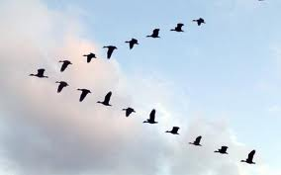
2nd Graduate Education in Physics
Conference Findings
Connections with industry: research collaborations/internships provide students with better understanding of non-academic careers
Need to value a broad range of career paths
Include modern applications/engineering aspects/connections to other areas in graduate classes
Connect with engineering or business schools for professional skills training

Slide 17

AIP-Careers-Fact-Sheet – resume writing tips
Technical skills and practical experience
Experience with Lab equipment (mention expertise level)
Fluency with Microsoft Office, Access, MatLab, LabView, or similar analytical/instrument control software
Programming languages (C++, SQL), technologies, and tools
http://www.spsnational.org/cup/careerpathways
AIP Careers Fact Sheet
Careers toolbox for undergraduate physics students, p. 51

Slide 18

APS Professional Guidebook
Introduction
Career Planning and Self-Assessment
Taking a Skills Inventory
Conducting Informational Interviews
Networking
Connecting with Opportunity
Putting Together an Effective Resume
Interviewing and Negotiation
Try, Try Again!
http://www.aps.org/careers/guidance/development/index.cfm

Slide 19
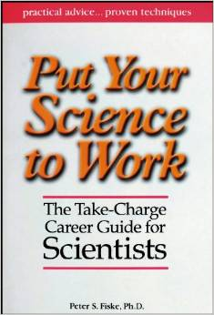
Peter Fiske – Useful skills
“Of the many skills you developed while in graduate school, which ones are the most valuable to you now?”
  Learning to seek out problems and solutions
  Ability to create
  Ability to work productively with difficult people
  The ability and courage to start something even if you don’t know how yet
http://vspa.berkeley.edu/sites/vspa_space/files/shared/doc/Put_Your_Science_to_Work.pdf
Put Your Science to Work: The Take-Charge Career Guide for Scientists - Practical Advise,,, Proven Techniques by Peter S. Fiske and Aaron Louie

Slide 20
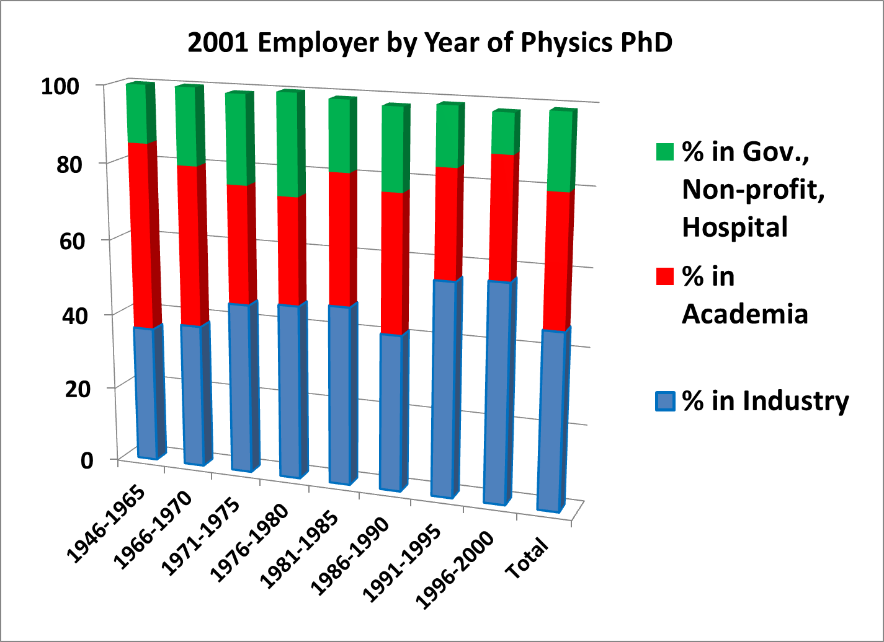
2001: Majority of Physics PhDs are in Industry
Career Outcomes for PhD Physicists – Information from the NSF’s Survey of Doctoral Recipients, by Michael Neuschatz and Mark McFarling (AIP Statistical Research Center report)

Slide 21
2006: NSF Survey of Employed Doctoral Scientists and Engineers
Physics:
  Total employed: 34,310
  Teaching as primary or secondary work activity: 8,270 (24%)
Table 15 of the 2006 NSF survey: Characteristics of Doctoral Scientists and Engineers in the United States: 2006
http://www.nsf.gov/statistics/nsf09317/content.cfm?pub_id=3920 id=2

Slide 22
2008: NSF Survey of Doctorate Recipients (SDR)
34,900 employed physicists
13,000 at educational institutions (37%)
  9,700 are post-secondary physics teachers (28%)
21,900 at non-academic institutions (63%)
  17,200 at private (49%)
  3,500 at government (10%)
  1,200 self-employed (3%)
Characteristics of Doctoral Scientists and Engineers in the United States: 2008; Tables 2, 8
http://www.nsf.gov/statistics/nsf13302/pdf/nsf13302.pdf

Slide 23
2009-2010: Physics Doctorates Initial Employment
Potentially permanent positions accepted by PhD classes of 2009 & 2010
  Academic: 23%
  Private sector: 57%
  Government: 16%
  Other: 4%
  N=365
  Table 1 at: http://www.aip.org/sites/default/files/statistics/employment/phdinitemp-p-10.pdf

Slide 24
2014: The SPS Observer – Summer 2014, p. 15
All employed physics PhDs
  Private Sector: 45-49%
  Academe: 29-33%
  Government: 14-17%
  Other: 5-7%
  Data from AIP Statistical Research Center
  Article also shows employment flow from physics undergraduate degree onward
  http://www.spsobserver.org/2014/summer.pdf

Slide 25
APS/FIAP 2014 Workshop on National Issues in Industrial Physics
Deficits identified in graduate education
  Career guidance is too narrow
  Deficits in technical training
    Tinkering limited due to complexity
    Software limited due to complexity
  Work skills
    Teamwork
    Writing – short/precise
  Cross disciplinary
    Theses across disciplines are rare
  Project management skills

Slide 26
Other resources
“Preparing Graduate Students for Careers in Industry” by Larry Woolf
  http://www.aps.org/units/fed/newsletters/spring2013/industry.cfm
Is Industry Really a "Nontraditional" Career? by Jeffrey Hunt, Boeing Corporation
  http://www.aps.org/units/fiap/newsletters/201311/
Best practices for Educating Students about Non-Academic Jobs
  http://www.aps.org/careers/guidance/advisors/bestpractices/
Second graduate education in physics conference web site and final report
  http://www.aps.org/programs/education/graduate/conf2013/index.cfm

Slide 27
Topics covered in ScienceWorks at Carthage College
Douglas N. Arion, “Things your adviser never told you: Entrepreneurship’s role in physics education,” Physics Today, August 13, 2013, p. 42-47

Slide 28
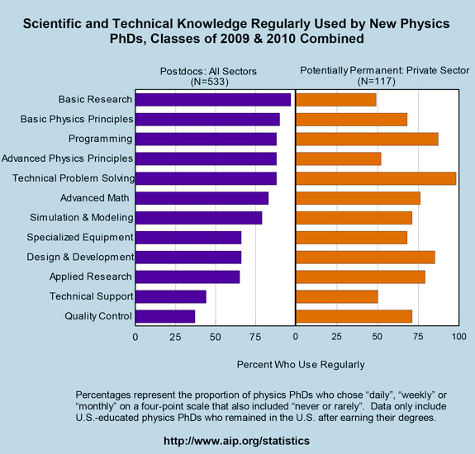
Scientific and Technical Knowledge Used
Recent Physics Doctorates: Skills Used Satisfaction with Employment
Data from the degree recipient follow-up survey for the classes of 2009 and 2010
Garrett Anderson and Patrick Mulvey
http://www.aip.org/statistics/trends/reports/physdoctorates0910.pdf

Slide 29
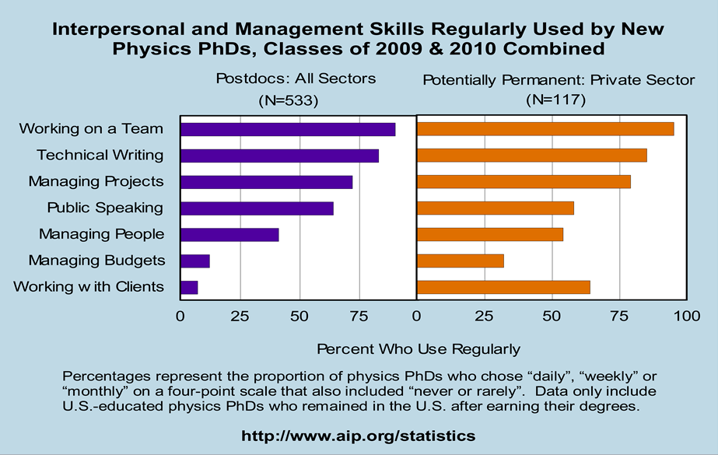
Interpersonal and Management Skills
Recent Physics Doctorates: Skills Used Satisfaction with Employment
Data from the degree recipient follow-up survey for the classes of 2009 and 2010
Garrett Anderson and Patrick Mulvey
http://www.aip.org/statistics/trends/reports/physdoctorates0910.pdf

Slide 30
PhD Physicist: View from Graduate School
Thesis
Field
Physics

Slide 31
PhD Physicist: View from Industry
Proposal writing
Plans/ Reports
Engineering
Modeling
Manufacturing
Field
Documentation
Physics
Program Mgmt
Technology Assessment/ IP
Presentations
Product development

Slide 32

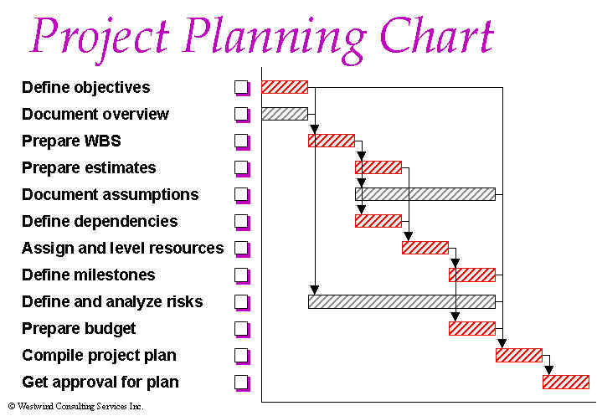
Overall skills for industry
PhD is not just about demonstrating ability to do independent research
For non-academic career, should also demonstrate ability to lead projects:
  Evaluate field
  Develop goals
  Develop plan to achieve goals
  Execute plan
  Document and communicate results
Can be incorporated into PhD plan

Slide 33
Graduate work
Current graduate program tuned for university research
What would graduate program look like if tuned for industrial research?

Slide 34
Consider a new paradigm for PhD thesis
Rapid research into multiple areas better reflects industrial projects
Students develop confidence in ability to attack new problems
Current PhD thesis
1 topic
4-7 years
Proposed PhD thesis
1 topic
0.5-1 year
1 topic
0.5-1 year
1 topic
2-3 years

Slide 35
Checklists enhance quality
Discussion of employment statistics for physics graduate students and career interests in first year
Years 0-2: Recommendations for physics and non-physics (e.g. program management, product development) courses
Schedule for PhD degree and discuss career interests – yearly
Meeting with career counseling center – years 2,4
Review of resume and cover letter: tuned for each employment opportunities, skills, ability to lead
The Checklist Manifesto: How to Get Things Right by Atul Gawande

Slide 36
Conclusions
Majority of physics PhDs will have non-academic careers
Graduate school should intentionally prepare students for varied career paths
Students need professional skills
Students should be exposed to employment data early in graduate careers
Students should discuss career options often
Resumes should be tuned for each application: both skills and ability to lead projects
Checklist for consistent mentoring

Slide 37
Back-up slides

Slide 38
My15 Point Guide to Success
1. Be responsive – return phone calls and emails promptly. When asked to do something, do it on time – be sure to ask when it should be done. Document requests and responses in writing.
2. Become the world expert in your particular area.
3. Continually expand the depth and breadth of your knowledge and skills.
4. Utilize all information resources available - books, science magazines, web sites, search engines, search services, colleagues, patents, trade magazines, catalogs, sales reps, conferences.
5. Get involved with or develop projects that have a high probability of contributing to the company’s success.

Slide 39
My 15 Point Guide to Success
6. Understand and be aware of project constraints such as your personnel and company capabilities, competitor’s strengths, and customer needs.
7. Innovate continuously. Always push your envelope as well as the science and technology envelope. Stay uncomfortable with what your skills and knowledge are.
8. Document your work in manner that can be easily understood by a co-worker a year from now. Use spreadsheets, tables and charts to convey your results in a concise, visual, and easy-to-understand manner.
9. Make sure that you learn something useful from any tests or experiments that you perform. These results should form the basis for future tests.
10. Learn from your mistakes. Don’t repeat them.

Slide 40
My 15 Point Guide to Success
11. Don’t believe everything you are told, even if it is company lore or told to you by an expert. Be skeptical.
12. Enjoy your work.
13. Treat everyone you work with (above and below you) with respect. Thank them for their work. Acknowledge their contributions whenever possible. Keep them informed as to what you are doing and why you are doing it.
14. Have a sense of humor.
Develop a unique and necessary skill and knowledge set that complements those of your co-workers and greatly increases the value of your project/team. Be indispensible.

