Slide 1
Student Career Panel
& Networking Reception
2011 April APS Meeting, Anaheim, CA
Dr. Larry Woolf
General Atomics
April 29, 2011
www.ga.com
www.sci-ed-ga.org

Slide 2
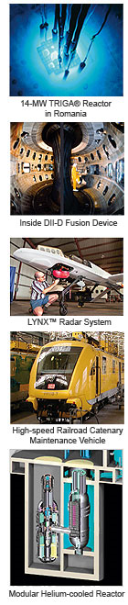
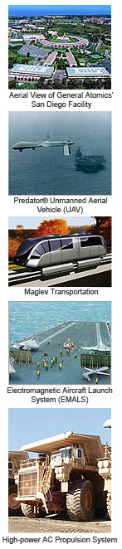
My Brief History
PhD UCSD Low temperature heat capacity of magnetic superconductors – many publications, 1980
Disappointing/unproductive post-doc at Exxon Research, 1980-1982
Hired as solid state physicist at General Atomics (GA) in 1982 to help develop non-nuclear programs. At GA for 29 years – mostly materials R&D.
Every story and perspective of life in industry is unique and changes depending on the stage of one’s career

Slide 3
Industrial careers are varied – and often unrelated to PhD thesis
Neutron doping of silicon: ’82-’83 (GA funding)
Graphite fiber physics and materials science: ‘83-’85 (GA funding)
Thermophotovoltaics: ‘86-’87 (Gov. funding)
High temperature insulators, thermionic energy conversion for space nuclear power: ‘88-91 (Gov. funding)
High temperature superconductors; ceramic processing; wire fabrication: ‘91-’98 (Japanese Venture Capital funding)
High temperature insulators for conductors for aircraft: ’98-’00 (Gov. funding)
Thin film designs and coatings: ‘01-’11 (Gov. funding)
Program management, government contracting, intellectual property/patents, budgeting, proposal writing, internal and external reports, personnel management: ‘87-’10
Punctuated Equilibrium Theory of Job Evolution

Slide 4
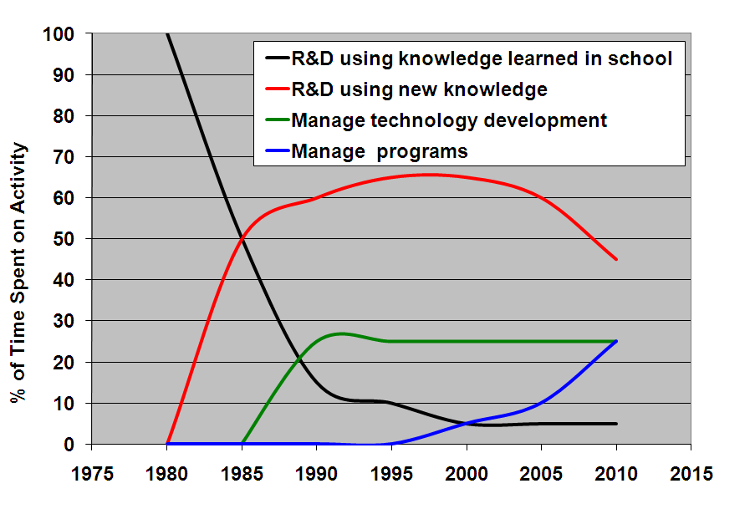
Evolution of my job over time

Slide 5
What do I do all day?
New ideas/solution to problems
  Internal R&D proposals to management
    Sell concept to management, considering technical risk, core competency, existing equipment, schedule, costs, competition
  Respond to Requests for Proposals(RFP) or Broad Agency Announcements (BAA)
    Write/manage technical and cost proposal, including schedule, milestones
Develop/optimize designs/concepts (physics)
Develop overall experimental approach (manufacturable)
Initial development
  Initiate development/analyze data
  Use analysis to design next experiment
  Iterate until initial development is complete

Slide 6
What else do I do all day?
Transition from initial development to pilot scale production
Assist transition from pilot scale production to full scale production
Write reports: technical, cost, contractual issues
  Monthly reports
  Final report
  Task/technical reports
Write and give presentations to internal management and funding agency, neither of whom may be experts in the technology (importance of explaining technology to non-experts!)
Discuss issues with technicians, engineers, scientists, managers both informally and in formal meetings
Note: Most of this does not involve solving physics problems!

Slide 7
Similarity of work in government contracting and university research
Professor receives funding from government for basic research and manages all aspects of the program
Program manager in industry receives funding from government for applied R&D and manages all aspects of the program

Slide 8
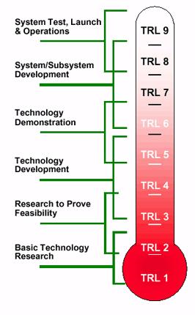
But major differences between industry and university
Technology Readiness Levels (TRL)
University Research: TRL 1
Industry: TRL 1 to 9

Slide 9
Physicists in industry should know something about process and manufacturing engineering
Process and manufacturing engineers often do not understand the basic physics enough to understand how best to process and manufacture the material/device; physicists need to understand relevant process and manufacturing techniques to efficiently transition basic technology into production
Perform R&D with final goal informing selection of design, materials, processes

Slide 10
Levels of employment in industry: Level ~$ (physics) (Aviation Week and Space Technology 2009 Workforce Study)
Level 1. Individual contributor working under direction of technical leadership, beginning to understand internal processes and tools for systems development ($66K)
Level 2. Improved knowledge of product, some self-direction, understands internal processes, and contributes to engineering estimates ($80K)
Level 3. Significant knowledge of products, decisions may have significant impact on costs, schedule, and performance. Mentor to more junior engineers ($99K)
Level 4. Serves as system architect, recommend tools and techniques for continuous improvement, lead preparation of proposals and presentations, estimates and tracks costs and schedules while managing scope ($120K)
Level 5. Develops product and technical roadmaps and competitive assessments, leads or reviews proposals, cross functional teams in a project engineering roles ($138K)
Level 6. Industry expert in knowledge of products and systems, directs sophisticated design, analysis and testing of complex systems, provides direction on strategic technology plans for company ($177K)

Slide 11
My 15 Point Guide to Success
1. Be responsive – return phone calls and emails promptly. When asked to do something, do it on time – be sure to ask when it should be done. Document requests and responses in writing.
2. Become the world expert in your particular area.
3. Continually expand the depth and breadth of your knowledge and skills.
4. Utilize all information resources available - books, science magazines, web sites, search engines, search services, colleagues, patents, trade magazines, catalogs, sales reps, conferences.
5. Get involved with or develop projects that have a high probability of contributing to the company’s success.

Slide 12
My 15 Point Guide to Success
6. Understand and be aware of project constraints such as your personnel and company capabilities, competitor’s strengths, and customer needs.
7. Innovate continuously. Always push your envelope as well as the science and technology envelope. Stay uncomfortable with what your skills and knowledge are.
8. Document your work in manner that can be easily understood by a co-worker a year from now. Use spreadsheets, tables and charts to convey your results in a concise, visual, and easy-to-understand manner.
9. Make sure that you learn something useful from any tests or experiments that you perform. These results should form the basis for future tests.
10. Learn from your mistakes. Don’t repeat them.

Slide 13
My 15 Point Guide to Success
11. Don’t believe everything you are told, even if it is company lore or told to you by an expert. Be skeptical.
12. Enjoy your work.
13. Treat everyone you work with (above and below you) with respect. Thank them for their work. Acknowledge their contributions whenever possible. Keep them informed as to what you are doing and why you are doing it.
14. Have a sense of humor.
Develop a unique and necessary skill and knowledge set that complements those of your co-workers and greatly increases the value of your project/team. Be indispensible.

Slide 14
Expanding on these points …
“… you need to be very good at whatever you are hired to do. One aspect of communication is to let your colleagues know that you are being productive.”
“Being good at what you are hired to do will help you keep your job today. Constantly learning and growing in your abilities will help you remain competent tomorrow. Taking on project management responsibilities will broaden your experience and build your reputation and network of contacts. What you learn in the process will keep you employable, not to mention being more valuable to your company.”
Milton Chang in the Business Forum feature of Laser Focus World magazine, October 2009, p.33.

Slide 15
Advantages of Careers in Industry
  Goal is development of a product
  Satisfaction of seeing your efforts make a difference to people
  Opportunities for patents, business development
  Challenge of not just doing science, but applying science to technology, then figuring out how to commercialize it. Challenges include science, technology, manufacturing, costs, schedule, competition, a dynamic marketplace.
  Challenge of learning how to perform R&D and scale-up under time, cost, equipment, personnel, facilities constraints
  Varied career opportunities: science, technology, manufacturing, program management, group management
  Many different projects; constant learning needed
  Pay, bonus pool

Slide 16
Disadvantages of Careers in Industry
  Often minimal publications or presentations due to proprietary or security issues
  Focus on a defined goal
  Limited freedom to pursue your personal interests
  Reduced likelihood of being recognized for your achievements from an academic perspective, e.g. awards, fellowships, etc
  No sabbaticals, no tenure
  Reduced interactions with peers due to proprietary or security issues
  Need to rapidly reinvent yourself as technologies and business areas change

Slide 17
Recommendations to enhance preparedness for physics related careers in industry
Have grad students participate in proposal writing and in determining the direction of future research – similar to determining the strategic direction of a business unit
  Evaluate core competencies vs. competitors
  Evaluate opportunities for major discoveries (academic) or businesses (industry)
Have grad students locate, discuss and evaluate proposal opportunities from RFPs and BAAs
Have grad students schedule and track contractual and financial progress

Slide 18
Recommendations to enhance preparedness for physics related careers in industry
Have learning goals in classes more closely mirror industry needs
  Short term memorization and rapid problem solving are not important, yet form the basis for most tests – major disconnect
  Need to be able to develop solutions to new problems based on deep conceptual and quantitative understanding across multiple fields
  Often a focus on mathematical derivations to the exclusion of deep conceptual understanding, especially in graduate classes – isn’t this a form of rote learning?

Slide 19
Recommendations to enhance preparedness for physics related careers in industry
Have grad students evaluate eventual commercialization of their research
  How could it be mass produced
  What are advantages vs. competition
  Work with grad students in process engineering and manufacturing engineering and learn about these topics
  Evaluate potential material and production costs
  Could this meet, in part, the NSF broader impacts requirement?

Slide 20
Recommendations to enhance preparedness for physics related careers in industry
Include more engineering in physics courses
  real-world problems
  Industrially relevant advanced labs
Bring in industrial physicists for colloquia to talk about their work
  Near exclusion of information for undergrads and grads to understand what life is like in industry
Survey your graduates in industry and ask them how their education could have been improved to increase their success at work – see next slide
20

Slide 21
APS Question 1 of 3
1. What drew you to physics initially?
  - Interest in astronomy in elementary school
  - The night sky/telescopes/planetariums/space program

Slide 22
APS Question 2 of 3
2. What aspects of your current career do you find surprising or difficult?
  Surprising:
  - Longevity at GA
  - Ability to innovate
  - Good at doing R&D as well as scale-up
  - Many patents
  - My extensive involvement in many aspects of science education, from K-12 to graduate
  Difficult:
  - Developing cost proposals
  - Inability to discuss work with others or publish - Need to accomplish many goals at same time

Slide 23
APS Question 3 of 3
3. What advice you would give to students who are interested in pursuing a career in your field?
- See my 15 point guide to success
- Take ownership of your projects – as a PhD, you are responsible for making it a success
- As a PhD, you will be asked to run programs so learn about program management, budgets, schedules, milestones, engineering, quality – physics is a critical part, but only a part

Slide 24
Conclusion
Physics careers in industry
  Varied
  Rewarding
  Dynamic
  Challenging
  Many aspects not included in curriculum
Education opportunities in industry
  Outreach
  May be more extensive depending on personal motivation and corporate culture

