Slide 1
An Unexpected (and Colorful) Journey
Presentation to the Teacher Enrichment Program/Center for Excellence in Education/Bite of Science
San Diego County Office of Education;
February 28, 2013
Dr. Larry Woolf
General Atomics Aeronautical Systems, Inc.
Lawrence.Woolf@ga-asi.com
This presentation will be posted at:
www.sci-ed-ga.org
then click on Presentations

Slide 2
Goals for this talk
Talk about my work
Provide useful content for teachers
Context for classroom use
My career path
Cutting edge research
Demonstration
A typical engineering problem:
  Well-defined
  Ill-defined
  Conflicting goals

Slide 3
How to solve this engineering problem?
Start with goals
Time (Started a month ago)
Focus (Home)
Review and evaluate the literature (my previous talks and presentations)
Iterate (Had no clue initially)

Slide 4
Iterative Solution
1
Start
2
3
Goal

Slide 5
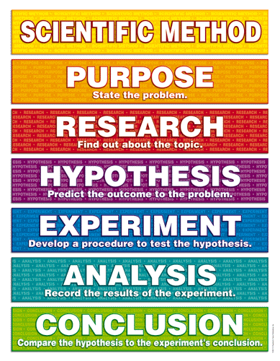
Did I (ever) follow “THE Scientific Method?”

Slide 6
My career
Early interest in astronomy and physics
HS-no science fair/competitions
Rutgers (NJ) – BA Physics
UCSD - PhD Physics
Post-Doc – Exxon Corporate Research Labs
  Not particularly successful
General Atomics – since 1982

Slide 7
Aside 1: Share with your students
Graduate students in science and engineering
  Tuition is typically waived
  Teaching assistant
  Research assistant
You get paid to get your PhD! – tell your students!

Slide 8
It started with a question from my artist wife …
Why are the primary colors of light
  red, green, and blue?
But the primary colors of paint are
  red, yellow, and blue?
Why do they just differ by one color?
I did not know, but the quest began …

Slide 9
And after about a year the journey led to …
Knowledge about color and light that later became useful for my work

Slide 10
Aside 2: Let’s do a scientific experiment: color mixing
Take “solid paint” samples
Mix “classic” primary colors
  R/Y
  B/R
  Y/B
  What colors did you obtain?
Mix “correct” primary colors
  C/M
  M/Y
  Y/C
  What colors did you obtain
Which provided a wider range of colors?
What model describes these results?

Slide 11
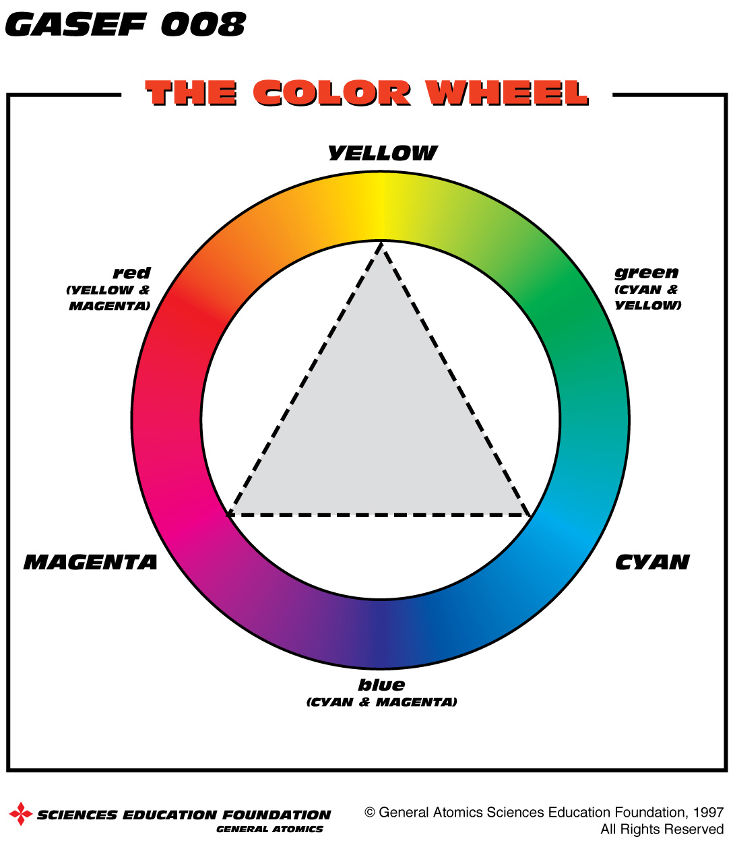
The color wheel …

Slide 12
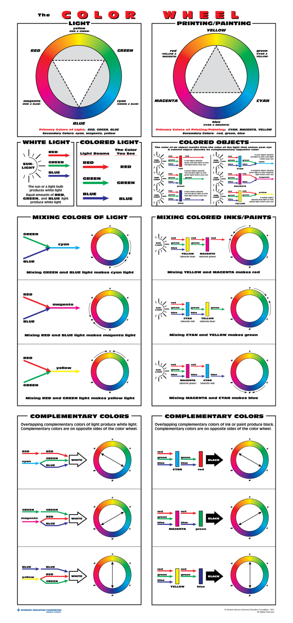
Which led to a poster
Why: confusion about primary colors and correct color wheel
Correct color wheel model
Examples of model
Side by Side Comparisons
Multiple representations

Slide 13
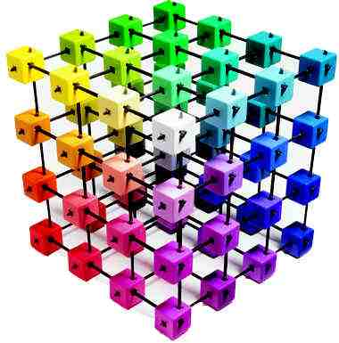
Other color models: Color Cube
Pythagorean Theorem =
Distance between 2 points in 2-D
Length = √ (X₂-X₁)² + (Y₂-Y₁) ²
Z
Distance between points in 3-D
Color difference (ΔE):
(ΔE) =√ (X₂-X₁)² + (Y₂-Y₁) ² + (Z₂-Z₁) ²
X
Y

Slide 14
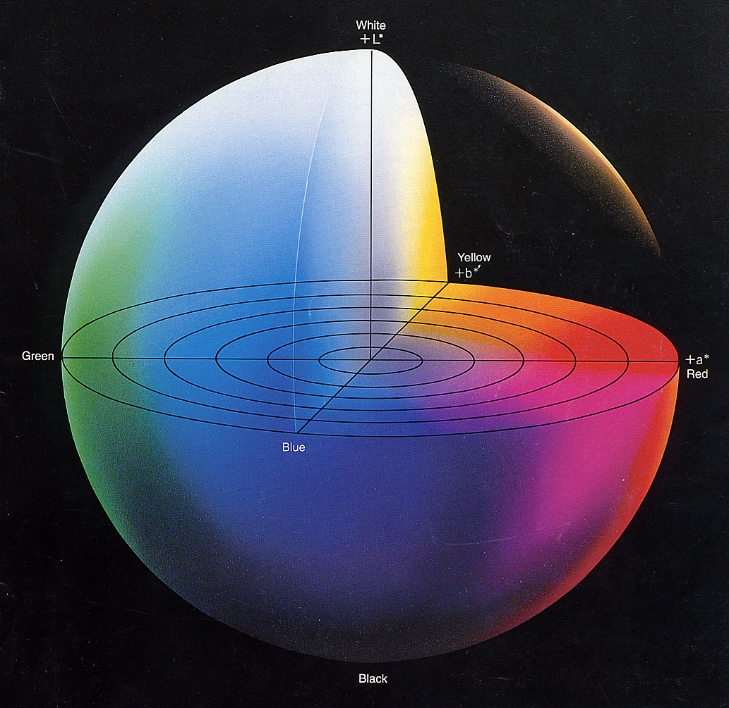
Industrial L* a* b* color model
L*
b*
a*
ΔE = √ (L₂*-L₁*)² + (a₂*-a₁*) ² + (b₂*-b₁*) ²

Slide 15
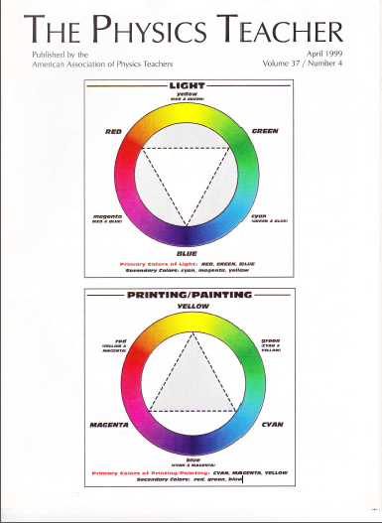
Publicity for the correct color wheels …

Slide 16
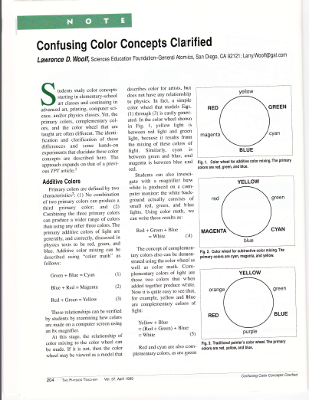
And a Physics Teacher paper

Slide 17
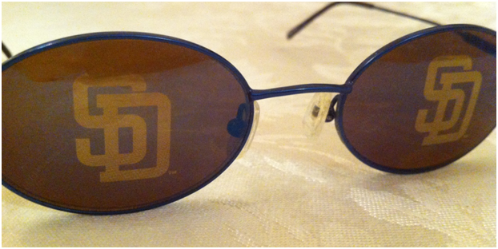
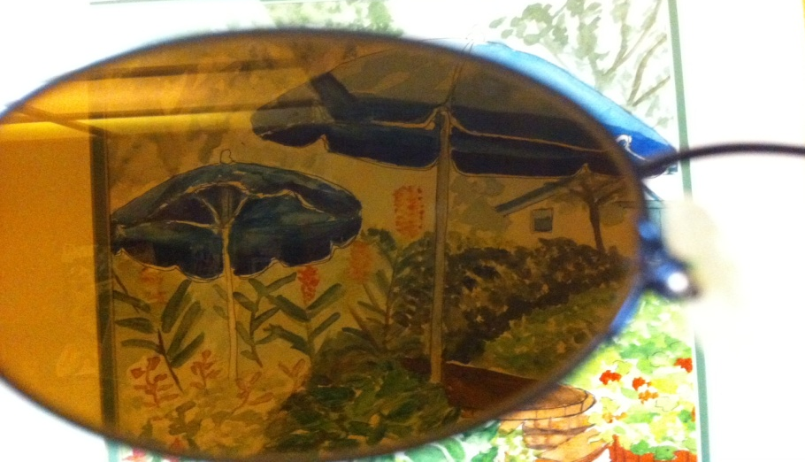
Knowledge about color helped with an engineering problem …
… the design of one-way imaging materials for windows

Slide 18
One-way imaging film – multilayer coatings
T1
R1
T2
R2
Transmittance 1 =
Transmittance 2
Reflectance 1≠ Reflectance 2
Sunglasses
Film (sample)

Slide 19
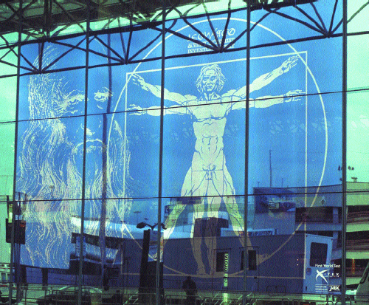
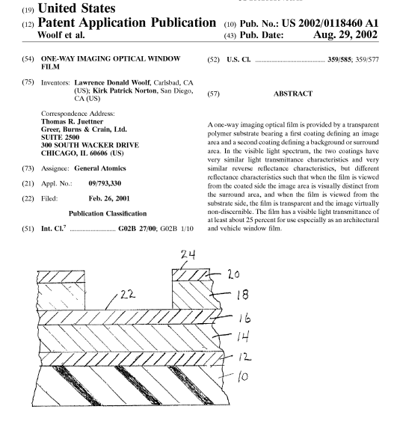
One-way imaging window film at Rome Airport
http://www.usglassmag.com/Window_Film/BackIssues/2003/March-April03/X-TEX.GIF

Slide 20
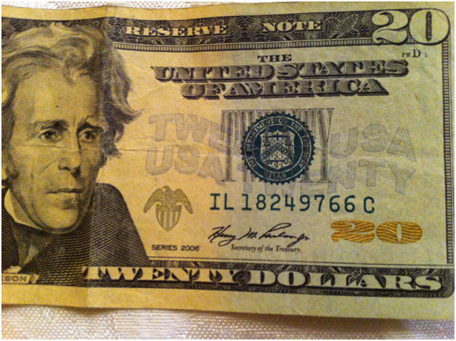
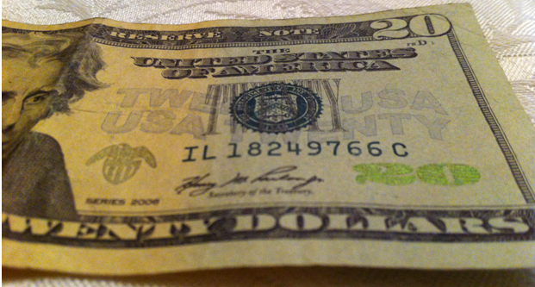
What’s in your wallet?
Multilayer coatings –
color changing pigment

Slide 21
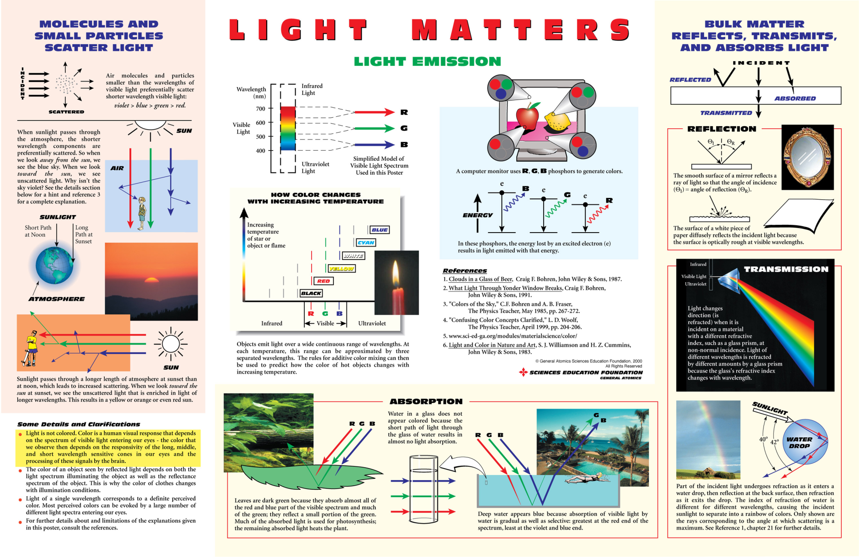
… which then inspired the Light Matters Poster

Slide 22
Light Matters Poster
Catalyst: Confusion about blue color of water
Interaction of light with matter
Interaction of light with small particles
Emission of light
… which led to an interest the interaction of sunlight with Earth: The Seasons
- Also, the subject of “A Private Universe” video and instructional materials

Slide 23
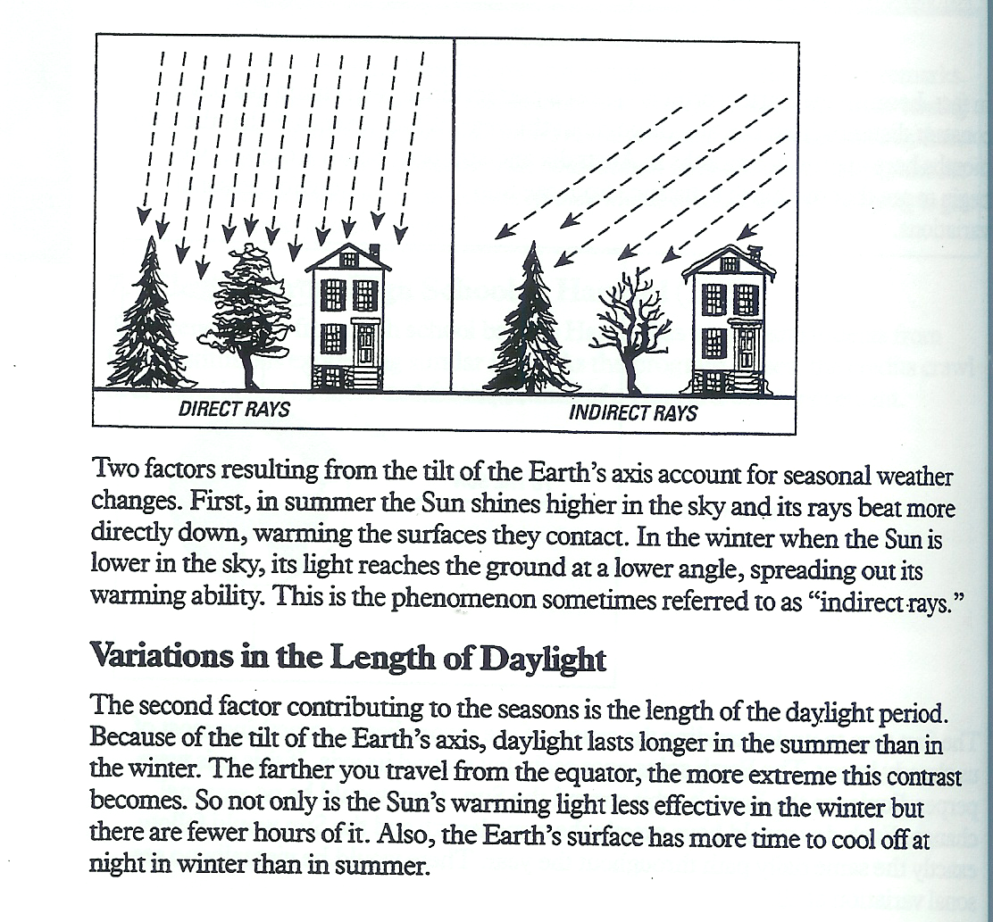
Seasons curricula commonly used misleading terms: “indirect rays” and “direct rays”
From: A Private Universe Teacher’s Guide, p. 18

Slide 24
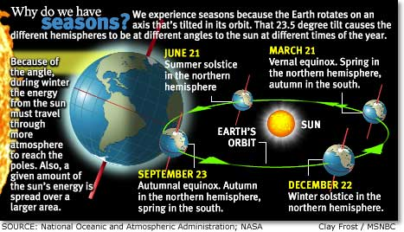
Incorrect information and misleading diagrams from leading sources
From: http://www.msnbc.com/news/251727.asp

Slide 25
Which led to The Seasons Poster
Why: Many incorrect and misleading representations of why we have seasons
Seasons due to:
  Change in intensity of sunlight during year
  Change in length of day during year
Conceptual diagrams to explain both reasons
Quantitative model to show that the seasons are due to these 2 effects (unique to this poster)

Slide 26
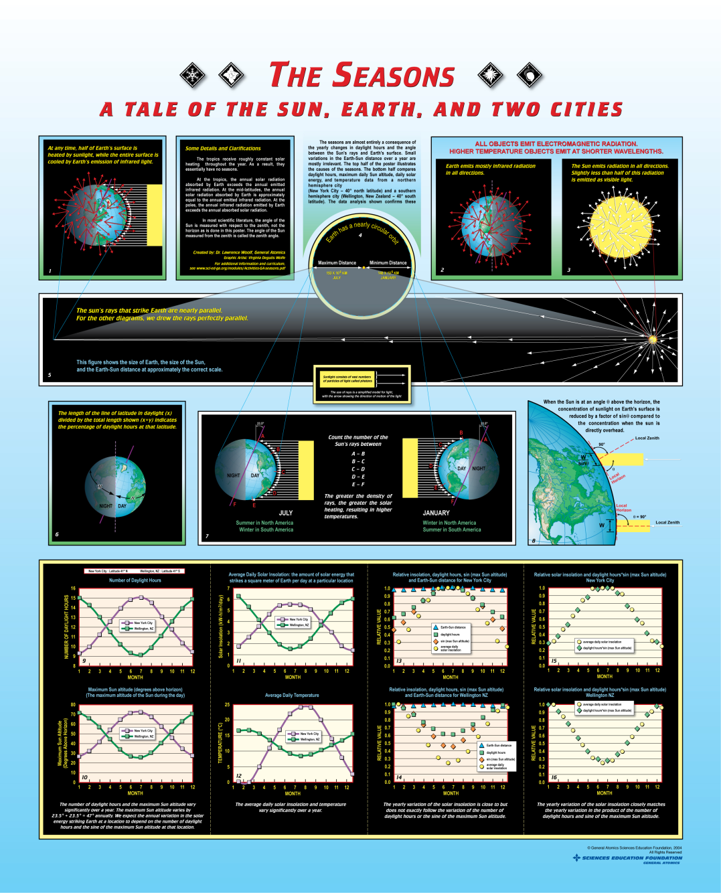
the interaction of sunlight with matter …
… intersected with …
-2008 proposed requirement of cool paint for all cars in CA by 2012 - 2016

Slide 27
95603. Automotive Coating Reflectivity Standards.
“(a) The opaque surfaces of new passenger cars, light-duty trucks, and medium duty vehicles less than or equal to 10,000 pounds must reflect at least 20 percent of the impinging direct solar energy
  (2) For 2016 and subsequent model years, the vehicle manufacturer’s entire color palette must comply with paragraph (a)”
Dark colors: Need to reflect >50% of near-infrared sunlight

Slide 28
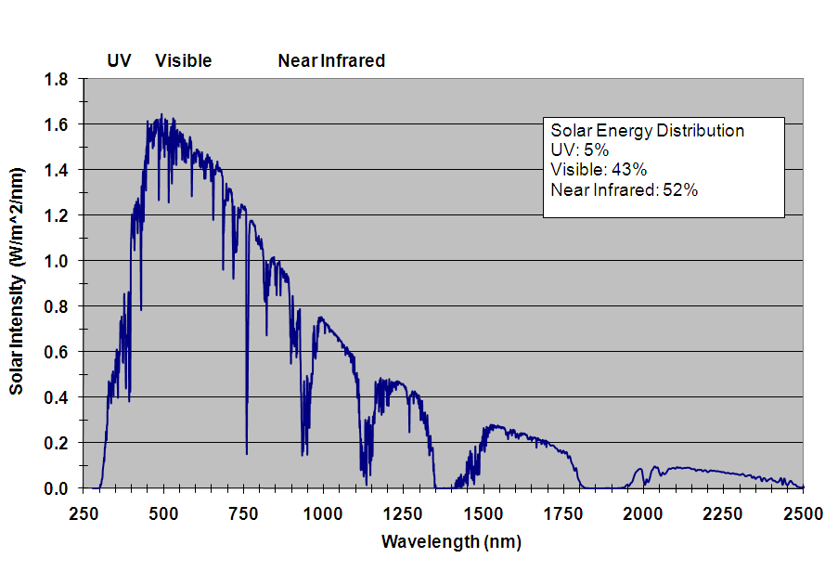
½ of solar energy is at near infrared wavelengths
B
G
R

Slide 29
Need for cool black paint from CA Air Resources Board (ARB)
http://www.newscientist.com/blogs/shortsharpscience/2009/03/california-to-ban-sale-of-blac.html
ARB staff has determined that a clear path to achieve the levels of solar reflectivity for the darker colors has not yet been identified.
Now we’re challenging inventors to create paint in all colors to reflect heat from the sun. Yes, even black paint.
Stanley Young
California Air Resources Board

Slide 30
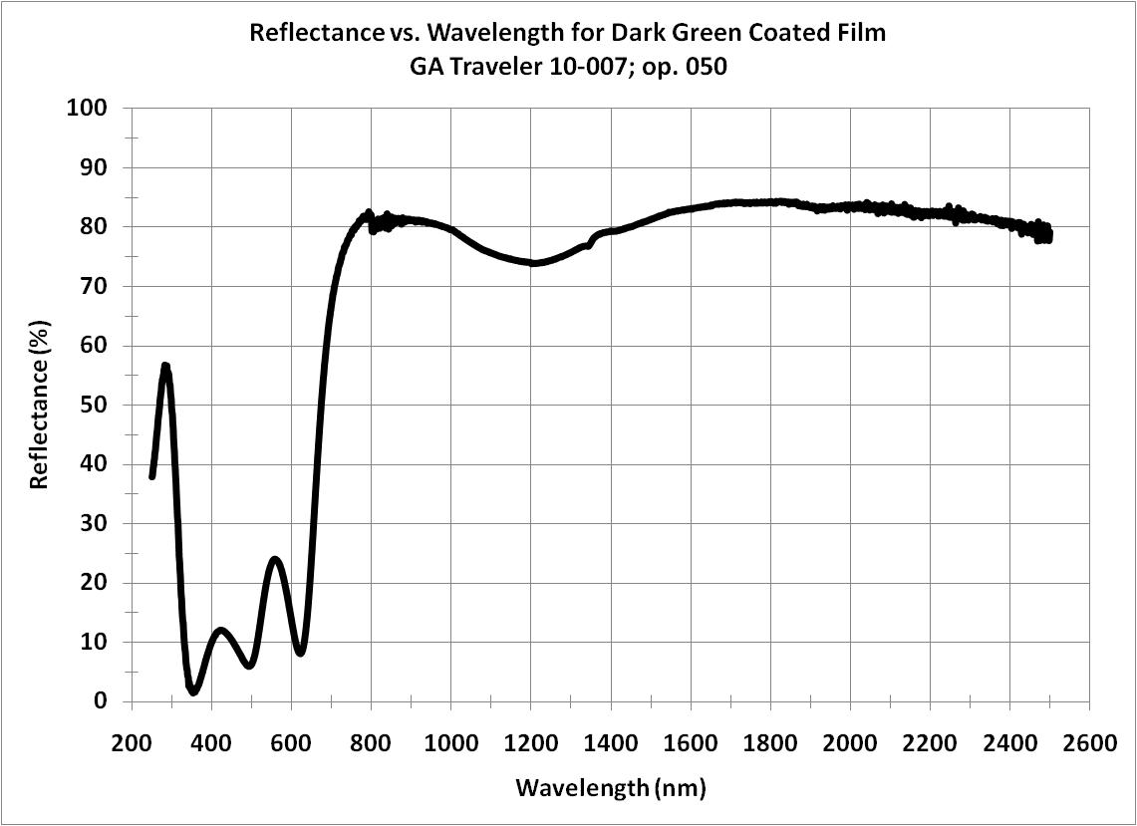
Developed dark pigment with 80% solar NIR reflectance
Near-infrared
Visible

Slide 31
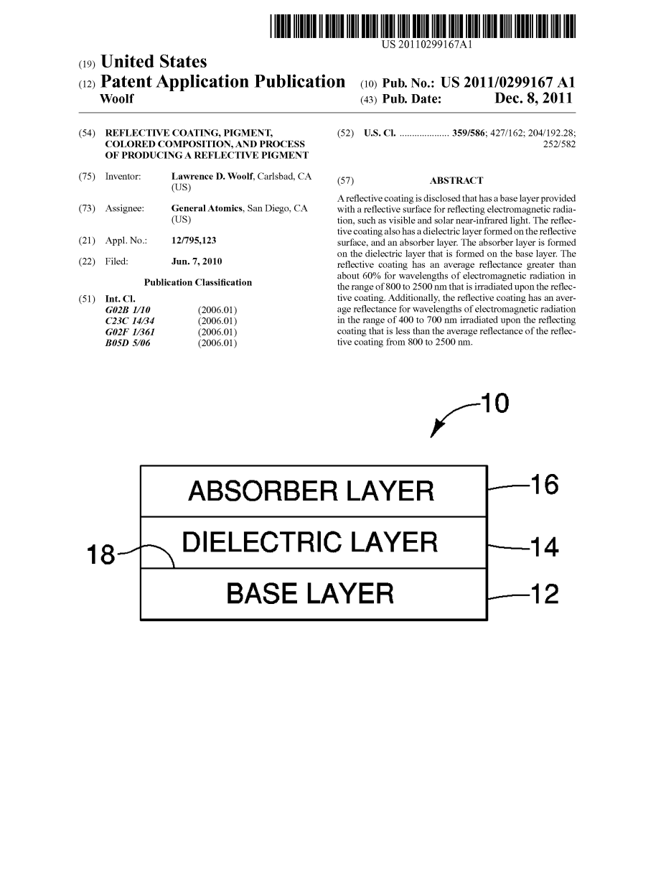
Cool paint patent application
Sadly, the CA ARB rescinded this recommendation
… but at least the Seasons Poster had brief fling with fame …

Slide 32
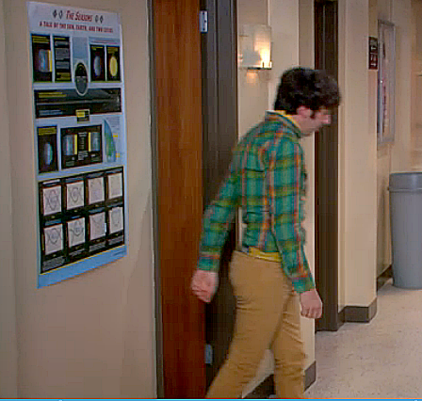
… in a guest appearance on
The Big Bang Theory …

Slide 33
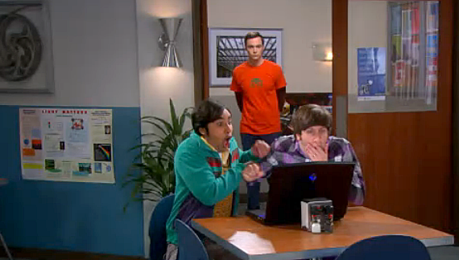
… as did the Light Matters poster …

Slide 34
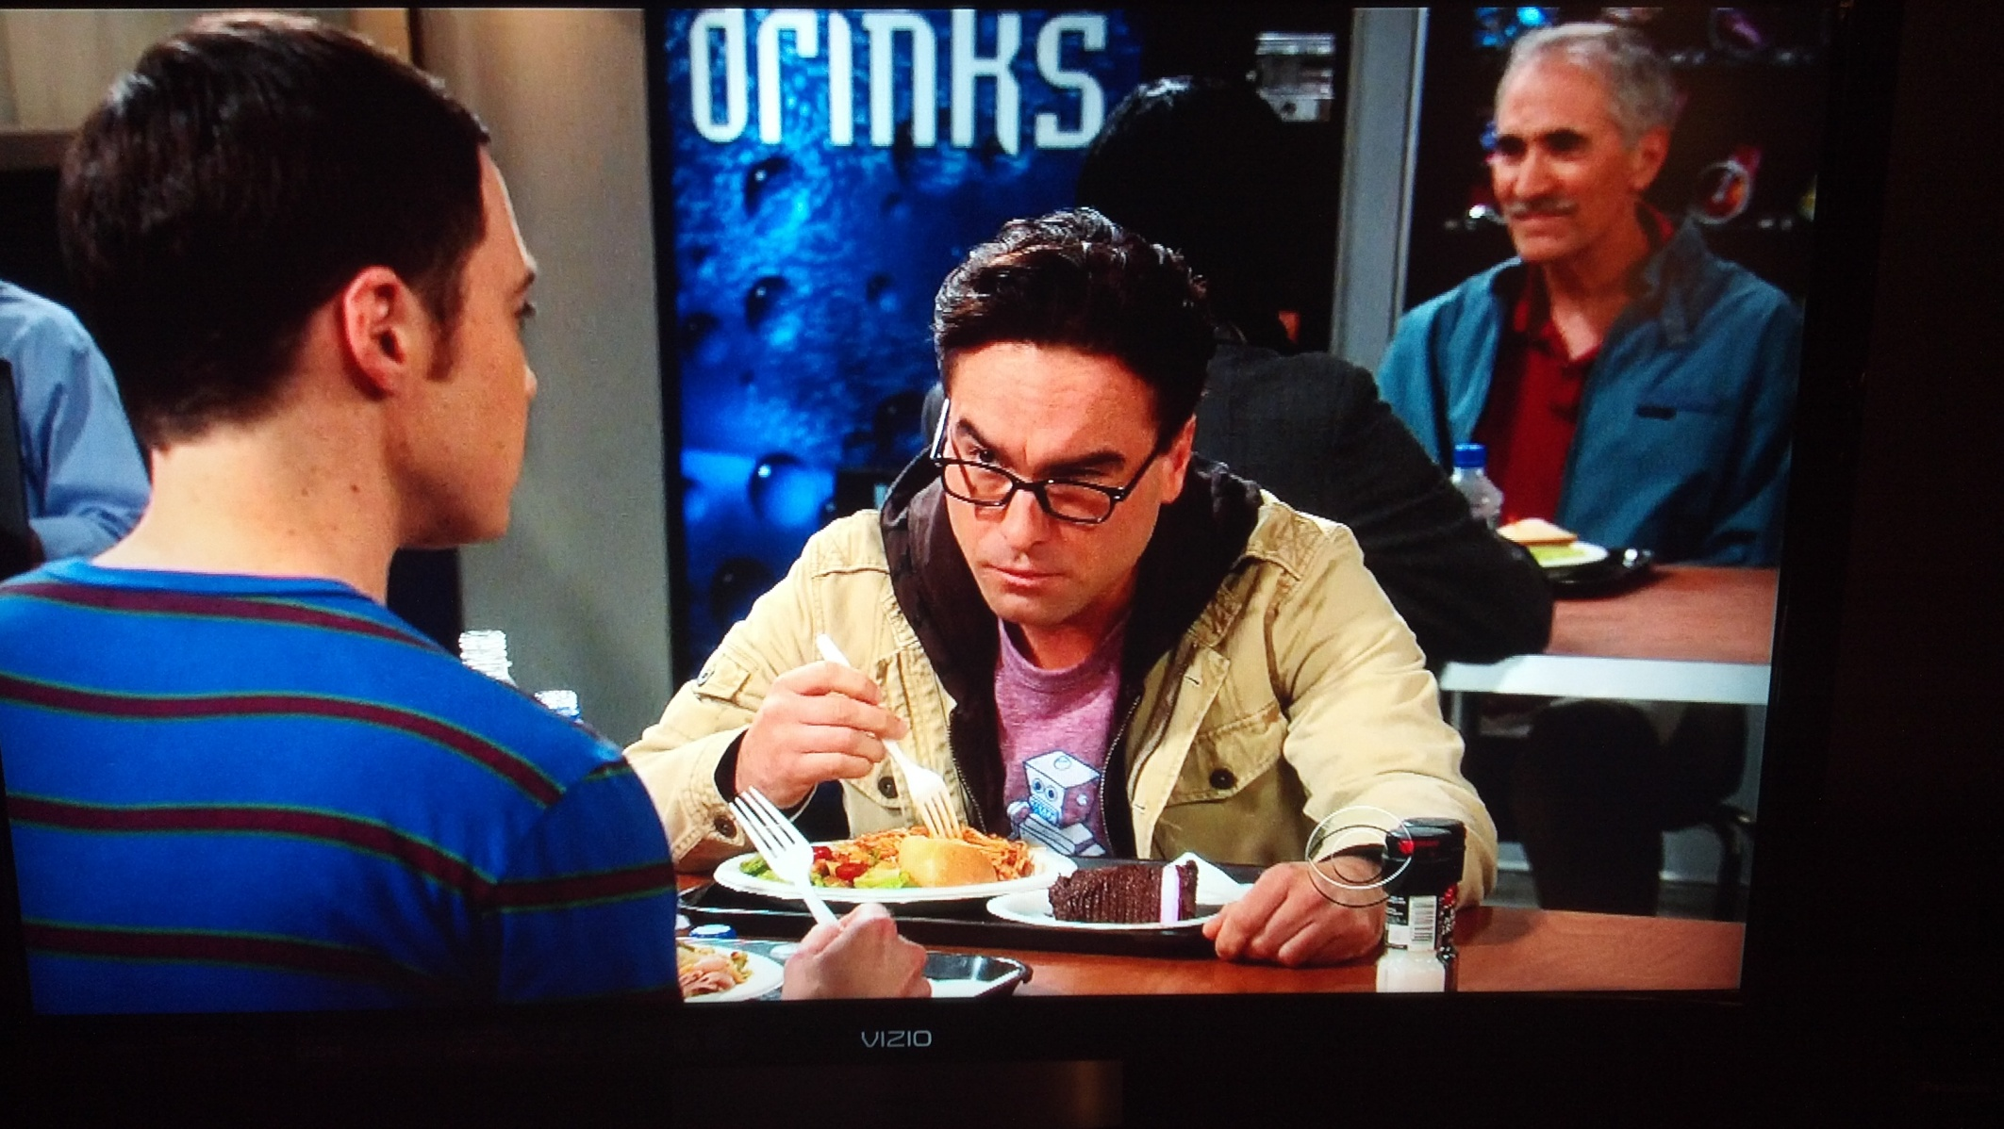
…and someone else!

Slide 35
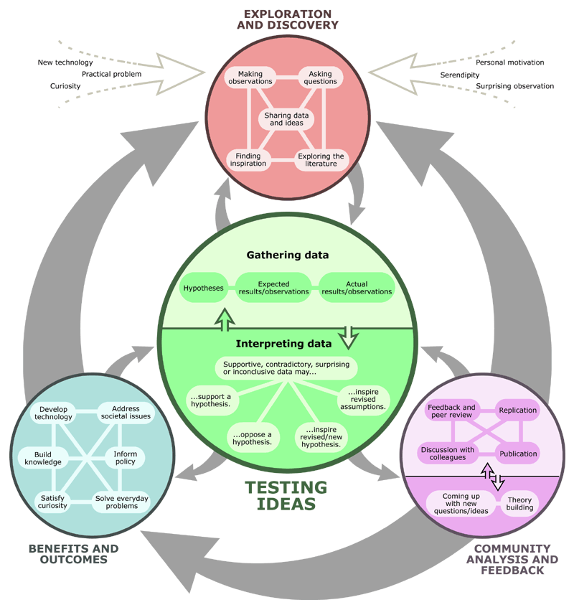
Scientific Methodologies
Was much new knowledge and technology developed?
Was THE Scientific Method used?
http://undsci.berkeley.edu/index.php

Slide 36
Other resources for science and engineering
“The Art of Being a Scientist: A Guide for Graduate Students and their Mentors,” by Roel Snider and Ken Larner
http://undsci.berkeley.edu/index.php
http://www.av8n.com/physics/scientific-methods.htm
The Pleasure of Finding Things Out by Richard Feynman
http://www.sci-ed-ga.org/pdfs/how-do-science-7-20-04.pdf

Slide 37
Concluding remarks
Scientific and engineering careers
  interesting
  unpredictable
  rewarding
  ups and downs
Need knowledge that is
  useable
  transferable to new challenges
Need to be:
  lifelong learner
  flexible
  adaptable

Slide 38
Thank you!

Slide 39
Backup Slides

Slide 40
Can also generate additive color mixing rules
What color do the following absorb (subtract):
  C,M,Y
What happens when you place CMY on a white piece of paper?
What does white light consist of?
What happens to white light with C on top?
What happens to white light with M on top?
What happens to white light with Y on top?
Shine laser light

Slide 41
Existing cool paints - black
Solar
Near-infrared light
Visible light
0% reflected
40% reflected
20% absorbed
0% transmitted
20% transmitted
Only 40% of solar NIR light is reflected

Slide 42

Improved performance with reflective undercoat
Solar NIR light
Visible light
0% reflected
60% reflected
20% absorbed
60% of solar NIR light is now reflected, but the undercoating is now a bright reflective color (white or aluminum)

Slide 43
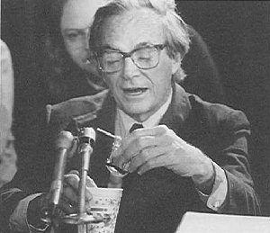
The Scientific Method
“ [the working scientist] is … not consciously following any prescribed course of action, but feels complete freedom to utilize any method or device whatever which in the particular situation before him seems likely to yield the correct answer. No one standing on the outside can predict what the individual scientist will do or what method he will follow. In short, science is what scientists do, and there are as many scientific methods as there are individual scientists.”
Percy W. Bridgman – From: On “Scientific Method” in Reflections of a Physicist, 1955
“Feynman was always the inquisitive type; he had to have the facts. To find out what happened to the shuttle, he went straight to the people who put the shuttle together.”
<http://www.fotuva.org/online/frameload.htm?/online/challenger.htm>
(He did not say: my hypothesis as to why the shuttle blew up is …)
Notes:
Is the statement in italics true? Isn’t he often biased by how things have been done?

Slide 44
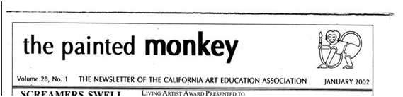
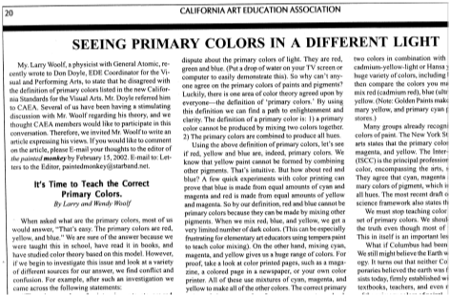

Slide 45
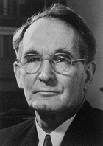
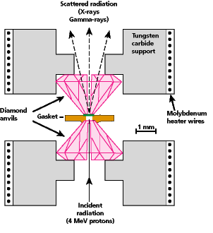
The Scientific Method
“Scientific method is what working scientists do.... No working scientist, when he plans an experiment in the laboratory, asks himself whether he is being properly scientific.”
“…[there are] various generalities applicable to most of what the scientists does, but it seems to me that these generalities are not very profound and could have been anticipated by anyone who knew enough about scientists to know what is their primary objective… that they are all trying to get the correct answer to the particular problem at hand.”
Percy W. Bridgman – From: On “Scientific Method” in Reflections of a Physicist, 1955 (winner of the 1956 Nobel Prize in Physics for high pressure physics)

Slide 46
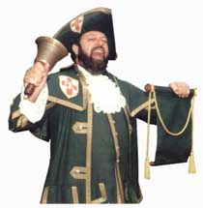
NSTA Position Statement
“Although no single universal step-by-step scientific method captures the complexity of doing science, a number of shared values and perspectives characterize a scientific approach to understanding nature. Among these are a demand for naturalistic explanations supported by empirical evidence that are, at least in principle, testable against the natural world. Other shared elements include observations, rational argument, inference, skepticism, peer review and replicability of work.”
<http://www.nsta.org/positionstatement&psid=22>

Slide 47

“Hypotheses” should be banned: they are not part of science
Scientists don’t make hypotheses (here I mean hypotheses as promoted by science fairs: a guess as to what your experiment will demonstrate)
They don’t appear in scientific papers
They are not desirable because they will tend to bias experimental design and analysis (much as the CIA’s bias that Iraq had WMD led to faulty conclusions that Iraq did have WMD)

Slide 48
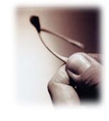
“Hypotheses” should be banned
“[The scientist] cannot permit himself any preconception as to what sort of results he will get, nor must he allow himself to be influenced by wishful thinking or any personal bias.”
Percy W. Bridgman – From: On “Scientific Method” in Reflections of a Physicist, 1955

Slide 49
Great references for correct views of methods of science
University of California Museum of Paleontology, “Understanding Science – how science really works”
http://undsci.berkeley.edu/index.php
http://undsci.berkeley.edu/teaching/teachingtools.php
http://www.av8n.com/physics/scientific-methods.htm
The Art of Being a Scientist: A Guide for Graduate Students and Their Mentors by Roel Snieder and Ken Larner

Slide 50
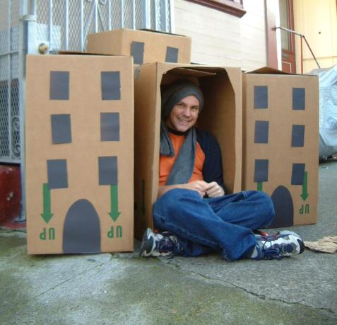
Constraints on solving problems
Funding
  Even if you have funding, you are constrained to do your proposed work
Research team
  Number, expertise, background
Equipment
Competitors
Research that is “in”
It’s hard to get funding for research that is “out”
Current modes of thinking – the “box”
If you have been in the field your entire life, you know the standard ways of solving problems but you may be less likely to use a novel approach
If you are new, you don’t know the standard ways, but may be more likely to use a novel approach
Notes:
Current modes of thinking, which greatly hindered Galileo, more recently Continental Drift

Slide 51
Time line of development of knowledge in a scientific area: The March of Science
Time
Initial discovery
Further investigations of initial discovery
A related discovery
Original understanding of initial discovery is shown to be partially false
Many related discoveries by many scientists and initial discovery is now fairly well understood
Mature field is well understood – many scientists have abandoned it
Knowledge
Notes:
This diagram is true on many scales of fields, subfields, sub-sub fields, etc

Slide 52
The March of Science:
Number/role of participating scientists
Time
Leaders/risk takers; one or a small number of people; create new fields
Good instincts; able to sense new productive fields
Could lead to Nobel Prize or completely useless/career killing
e.g. chaos, high temperature superconductors, string theory, science education research, nuclear fusion, ultracold atoms

Slide 53
The March of Science:
Number/role of participating scientists
A scientist can initially be a leader. If she continues in the field, she joins the early adopters
A few scientists who rapidly recognize importance of leader’s research and create important subfields – early adopters
Must quickly abandon their current research

Slide 54
The March of Science:
Number/role of participating scientists
A scientist can initially be an early adopter. If he continues in the field, he joins the late adopters.
Many scientists now in the field – late adopters
Determine details/mechanisms of new science
Develop well structured experiments to refute or support or refine theories
Applied research, product development
Eventually, many scientists will move to other fields
Scientists have a vital role to play at each level – all are important to the growth of scientific knowledge
Notes:
Scientists have a vital role to play at each level – all are important to the growth of scientific knowledge

Slide 55
How to approach problems: engineering
Develop multiple approaches since you aren’t sure which one will work
Start
Goal

Slide 56
How to approach problems
Develop an initial approach that gets you closer to your goal
Start
Goal
Start
Goal

Slide 57
Solving problems
If problem and solution are well defined, then just “turn the crank”
Start
Goal

Slide 58
Solving problems
Extend known methodology to a new field
Start
Goal
Old field
Start
Goal
New field

Slide 59
Solving problems
Combine two existing ideas/methods into a new idea/method
Idea 1
Start
Goal
New idea
Start
Goal
Start
Goal
Idea 2

Slide 60
Solving problems
Combine a standard method/idea with a novel method/idea
Start
Goal
Standard method
Novel idea
Start
Goal
Novel method

Slide 61
Solving “problems”
Innovators/discoverers often have no idea of what their goal is … but they have a loosely formed idea for a research area
Start
"When the Special Theory of Relativity began to germinate in me, I was visited by all sorts of nervous conflicts... I used to go away for weeks in a state of confusion."
Albert Einstein

Slide 62
Solving problems: my general approach
Define the problem: what am I trying to find do
Learn relevant background information:
  papers, patents, review articles, books, web site, vendors that make relevant equipment/materials, competitors that have done related work

Slide 63
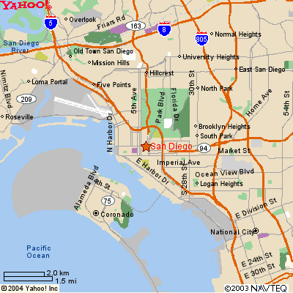
Solving problems: my general approach
Develop multiple approaches to solve the problem
Investigate the most likely approach first. If it doesn’t work, investigate alternate approaches (analogy: going from point A to point B: use freeway, but if jammed, try alternate route)

Slide 64
Solving problems: my general approach
Summarize data into tables and charts that can be understood by someone else a year from now
Analyze and summarize data and results in report
Use these results as the basis for further work (and be persistent and don’t get discouraged)

Slide 65
Look at some scientific papers to see how published scientific work is organized
Background material
Define the problem that is being addressed
Justification/rationale for the work
Experimental methods/equipment
Data and data analysis – tables, graphs
Discussion
Conclusion
Acknowledgements and References

Slide 66
Actual process vs published papers
The actual work is often not nearly as organized and logically done as the papers indicate!!
The so-called “scientific method” reflects how science is published, not necessarily how science is done.

Slide 67
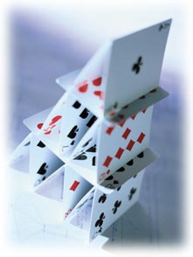
Solving problems takes time
“To do real good physics you need solid lengths of time, to… [put] ideas together which are vague and hard to remember … it’s very much like building a house of cards and each of the cards is shaky, and if you forget one of them the whole thing collapses. You don’t know how you got there and you have to build them up again, and if you’re interrupted and kind of forget half the idea of how the cards went together – your cards being different parts of the idea – it’s easy for [the idea] to slip [away]. [You] needs lots of concentration – that is, solid time to think.”
From “The Pleasure of Finding Things Out” by Richard Feynman, p. 19
"When the Special Theory of Relativity began to germinate in me, I was visited by all sorts of nervous conflicts... I used to go away for weeks in a state of confusion."
Albert Einstein

Slide 68

Importance of doubt and the fallibility of authority
“Another of the qualities of science is that it teaches the value of rational thought, as well as the importance of freedom of thought; the positive results that come from doubting that all the lessons are true… Learn from science that you must doubt the experts. As a matter of fact, I can also define science another way: Science is the belief in the ignorance of experts.”
From “The Pleasure of Finding Things Out” by Richard Feynman, p. 186-187

Slide 69
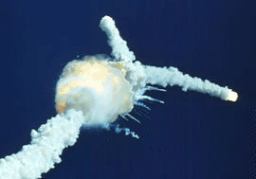
Scientific Integrity - an integral part of science
“… That is the idea that we all hope you have learned in studying science in school … It’s a kind of scientific integrity, a principle of scientific thought that corresponds to a kind of utter honesty – a kind of leaning over backwards. For example, if you’re doing an experiment, you should report everything that you think might make it invalid – not only what you think is right about it … Details that could throw doubt on your interpretation must be given if you know them.”
From “The Pleasure of Finding Things Out” by Richard Feynman, p. 209-210
“For a successful technology, reality must take precedence over public relations, for Nature cannot be fooled.”
Richard Feynman, Challenger Commission Report

